Slide 1

Customer Shopping Behavior Analysis
Transforming 3,900 transactions into strategic intelligence through data-driven insights on spending patterns, customer segmentation, and subscription dynamics.

Slide 2

PROJECT OVERVIEW
From Data to Strategic Intelligence
Our Mission
Key Objectives
Construct a comprehensive analytical framework that transforms raw transactional data into actionable business strategy.
Revenue optimization opportunities
Customer retention strategies
Targeted marketing interventions
We bridge the gap between operational data and strategic insight through disciplined engineering, rigorous analysis, and visualization-driven storytelling.
Product portfolio positioning

Slide 3

DATASET
Dataset Composition
3,900
18
37
Transactions
Variables
Missing Values
Comprehensive sample size across diverse product categories
Rich feature set spanning demographics, transactions, and behavior
Handled through systematic imputation strategy
Demographics
Transactions
Behavior
Age, Gender, Location, Subscription Status
Item, Category, Amount, Season, Size, Color
Discounts, Frequency, Reviews, Shipping

Slide 4
PYTHON
Data Engineering & Preparation
Rigorous data preparation established the foundation for reliable analysis through systematic quality assurance and feature optimization.
01
02
03
Data Assessment
Quality Management
Feature Engineering
Imported dataset and conducted structural analysis to identify data types and formatting consistency
Applied category-specific median imputation for 37 missing review ratings
Created age_group cohorts and purchase_frequency_days for behavioral insights
04
05
Redundancy Analysis
Database Integration
Removed promo_code_used feature after identifying correlation with discount_applied
Loaded cleaned DataFrame into PostgreSQL for structured SQL analysis

Slide 5
SQL ANALYTICS
Business Intelligence Queries
1
2
3
Revenue by Gender
High-Value Discounts
Product Quality
Quantified differential revenue contribution patterns across customer segments
Identified price-sensitive customers with demonstrated spending capacity
Established top five products by average review rating for competitive positioning
4
5
Shipping Economics
Subscription Analysis
Evaluated willingness-to-pay between standard and express delivery options
Calculated revenue differential between subscribers and non-subscribers

Slide 6



Advanced Customer Insights
Discount Dependency
Lifecycle Segmentation
Category Performance
Identified five products with highest percentage of discounted transactions, flagging margin-aware promotional needs.
Classified customers into New, Returning, and Loyal cohorts for targeted interventions.
Ranked top three products within each category by transaction frequency.
Age Cohorts
Calculated revenue attribution across age groups to identify high-value demographics
Repeat Purchase
Analyzed correlation between high frequency (>5 transactions) and subscription likelihood
Quality Signals
Established benchmarks for products driving conversion and reducing price sensitivity

Slide 7
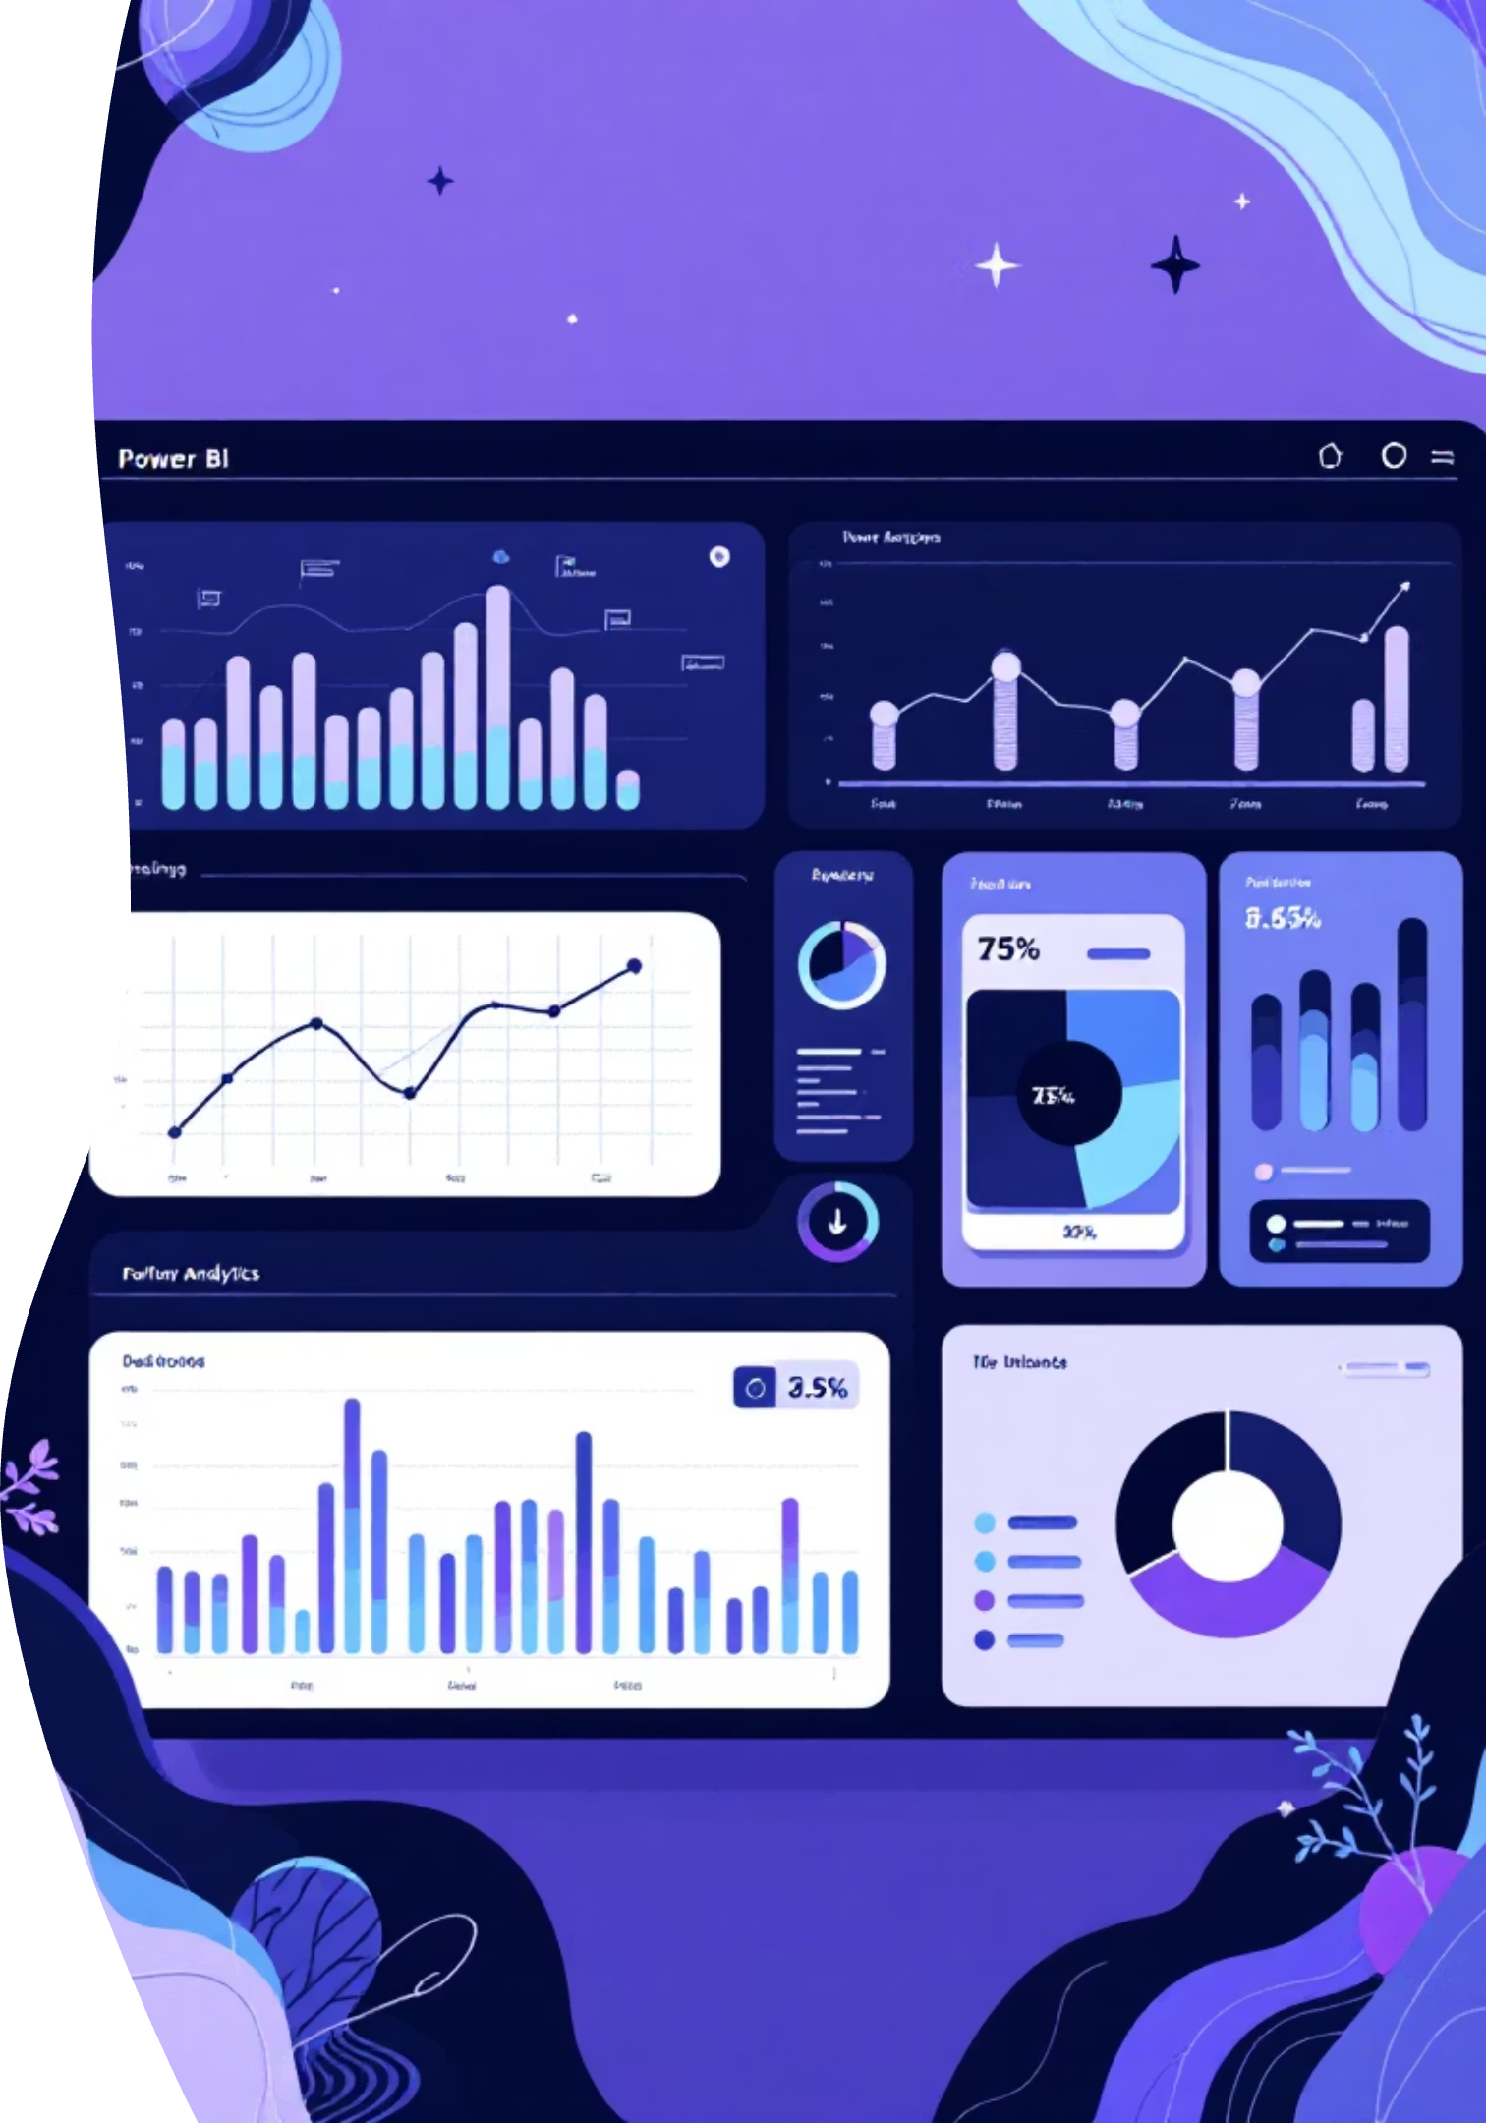
VISUALIZATION
Interactive Power BI Dashboard
Real-Time KPIs
Monitor key performance indicators with live data updates and instant insights
Multidimensional Filtering
Explore data through drill-down capabilities across customer, product, and temporal dimensions
Pattern Recognition
Identify trends and make informed decisions based on visual evidence

Slide 8
STRATEGIC RECOMMENDATIONS
Five Pathways to Growth
Subscription Growth Initiative
Develop exclusive benefits packages to migrate price-sensitive customers into higher-lifetime-value subscription models.
Customer Loyalty Architecture
Implement tiered loyalty programs to elevate returning customers into the "Loyal" segment through recognition and rewards.
Promotional Efficiency
Optimize discount policies to balance margin-growth tradeoff through strategic repricing and value-bundling.
Portfolio Positioning
Amplify marketing on high-rated, high-velocity products to drive conversion and reduce price sensitivity.
Demographic Targeting
Concentrate marketing investment on high-revenue age cohorts and express-shipping segments for improved ROI.

Slide 9

Key Findings at a Glance
Subscription Premium
Express Shipping Value
Subscribers demonstrate higher average spend, indicating strong lifetime value potential
Customers choosing express delivery show elevated transaction values and willingness-to-pay
Smart Discounting
High-value customers use discounts strategically while maintaining above-average purchase amounts
The data reveals clear opportunities: Strategic subscription incentives, optimized discount policies, and demographic-targeted marketing can drive significant revenue growth while improving customer lifetime value.

Slide 10

Transforming Data into Action
This analytical engagement demonstrates the transformative potential of disciplined data engineering, rigorous statistical analysis, and evidence-based storytelling.
By converting transactional complexity into strategic insight, organizations can move beyond intuition-driven decision making toward a data-informed operational model.
Methodology: Python Data Engineering | PostgreSQL Analysis | Power BI Visualization
Data Sample: 3,900 Transactions | 18 Features | Multi-Category Coverage
Report Prepared: January 2026

