Slide 1
H1B PETITION
AKASH SETHIYA
DATA VISUALIZATION USING R (SPRING – 2017)
COMPUTER SCIENCE GRADUATE
MISSISSIPPI STATE UNIVERSITY

Slide 2
CONTENT
Data Introduction
Tidying the data
Analysis (Graphs and Charts)
Role of h1b immigrants on US economy
Conclusion

Slide 3
DATASET INTRODUCTION
Found the dataset on Kaggle.com
It has 3 million records
Contains information about the h1b visa applications from year 2011-2016
Includes information of company_name, visa_status, job_title etc., in each application record.

Slide 4
TIDYING

Slide 5

COLUMN INFORMATION
Actual data has 3 Million records with columns:
X – Serial Number | CASE_STATUS – Visa application status
EMPLOYER_NAME – Name of the employer | SOC_NAME - Standard Occupational Classification
JOB_TITLE – Job title for which h1b is applied | FULL_TIME_POSITION – Full-time/Part-time
PREVAILING_WAGE – Salary | YEAR – Year on which h1b is applied
WORKSITE – City,State | Lon – Longitude
Lat - Latitude

Slide 6
REMOVING UNUSED AND SPLITTING COLUMNS
X,Lon and lat is not useful in this analysis, so we will remove this columns from our dataset
Worksite has value in the format (City,State) but we need both city and state, so this column will be splitted to two columns such as: CITY and STATE.
Also removing NA values from the data will help to visualize it clearly.
Columns after removing and splitting:

Slide 7
SAMPLING THE DATA
To simplify the visualization, Used sampling to use the sample of actual data.
Applied random sampling to10%.
Rows after sampling – 300K

Slide 8
ANALYSIS
GRAPHS AND CHARTS

Slide 9
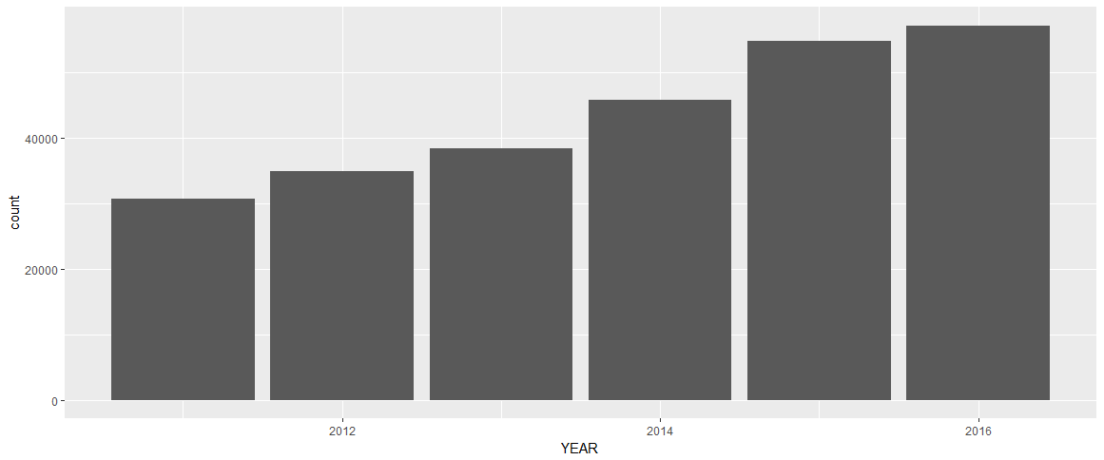
APPLICATIONS APPROVED BY YEAR

Slide 10
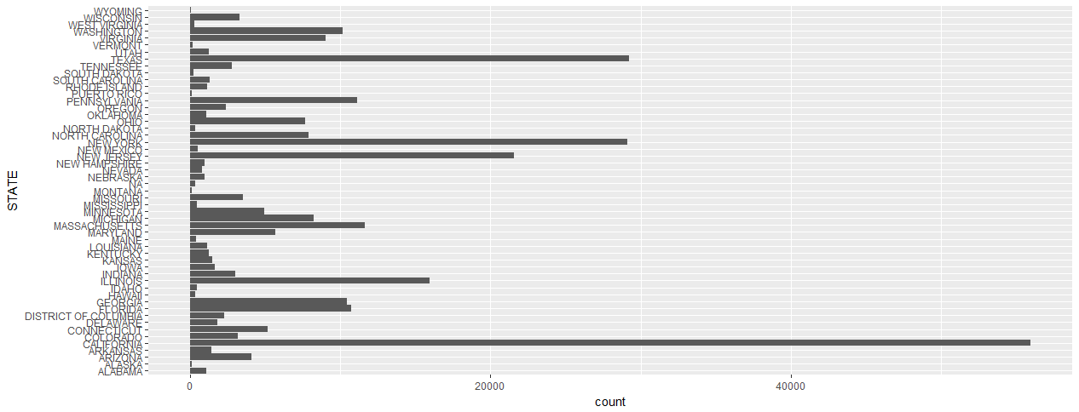
APPLICATION BY STATE

Slide 11
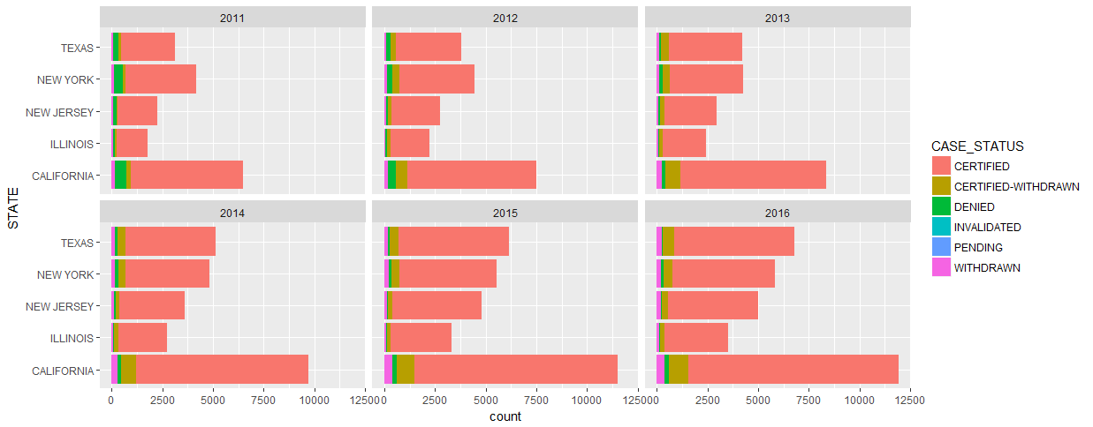
TOP 5 STATE APPLICATION BY VISA STATUS CALIFORNIA – TOP STATE TEXAS – MAJOR CHANGE FROM 2011-2016

Slide 12
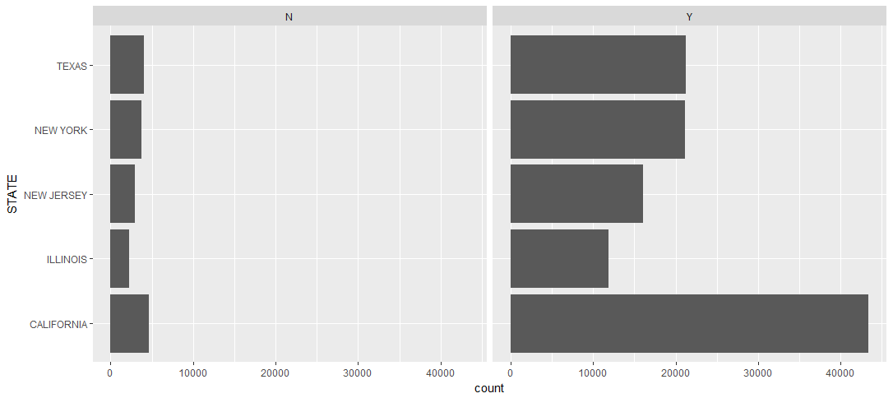
STATE VS FULL_TIME_POSITION

Slide 13
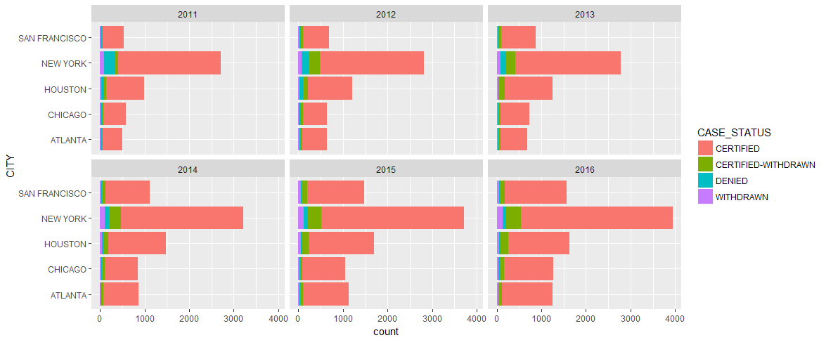
TOP 5 CITY APPLICATION BY VISA STATUS NEW YORK – TOP CITY

Slide 14
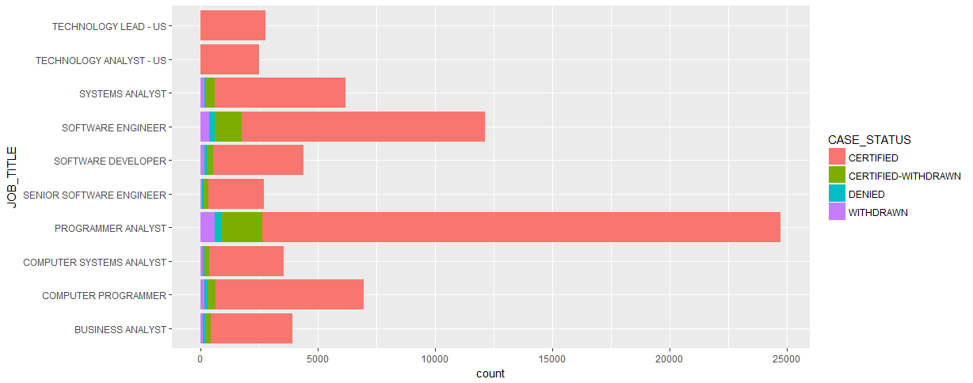
JOB TITLE VS VISA STATUS GOOD NEWS : ALL TOP 10 POSITIONS BELONGS TO COMPUTER SCIENCE

Slide 15
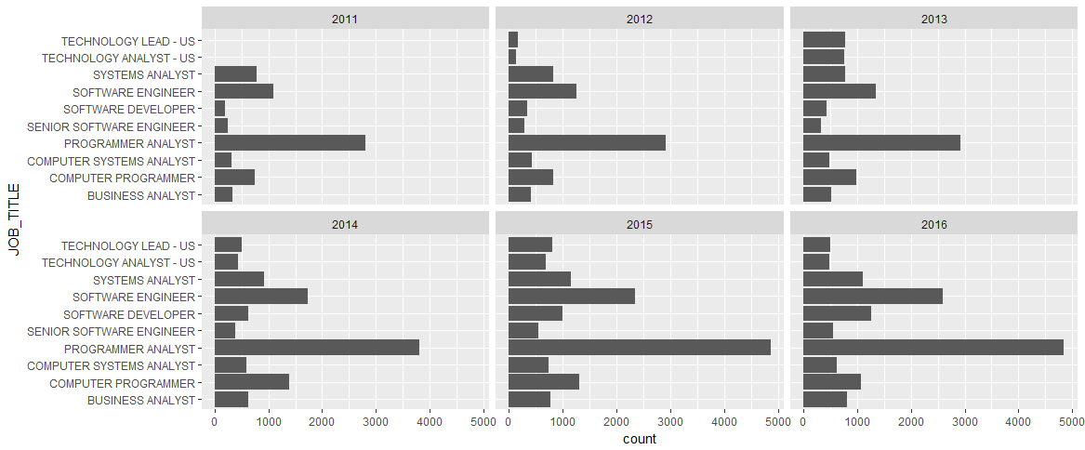
JOB TITLE VS VISA STATUS BY YEAR

Slide 16
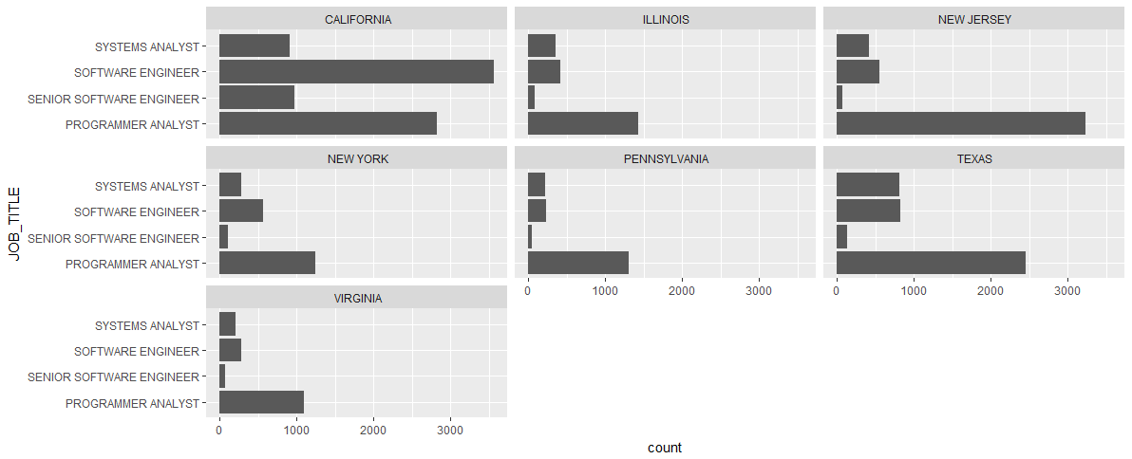
TOP 5 JOB TITLE BY TOP STATES PROGRAMMER ANALYST – ONCE AGAIN ATTENTION TO SOFTWARE ENGINEERING POSITION IN CALIFORNIA

Slide 17
EMPLOYERS
MOST IMPORTANT FACTOR FOR IMMIGRANTS
WHAT DO YOU THINK WHICH COMPANIES DO HIGHEST NUMBER OF H1B APPLICATIONS?

Slide 18
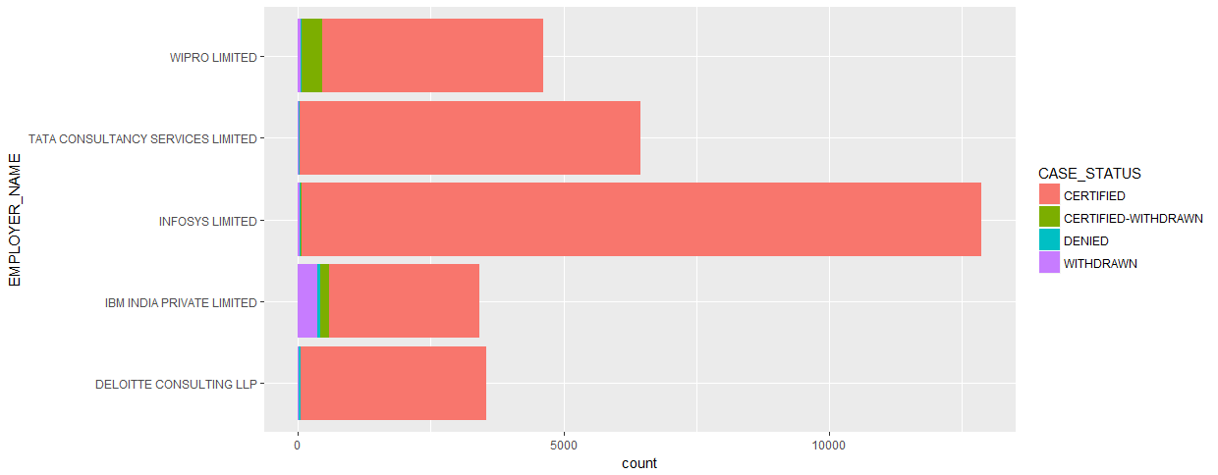

Slide 19
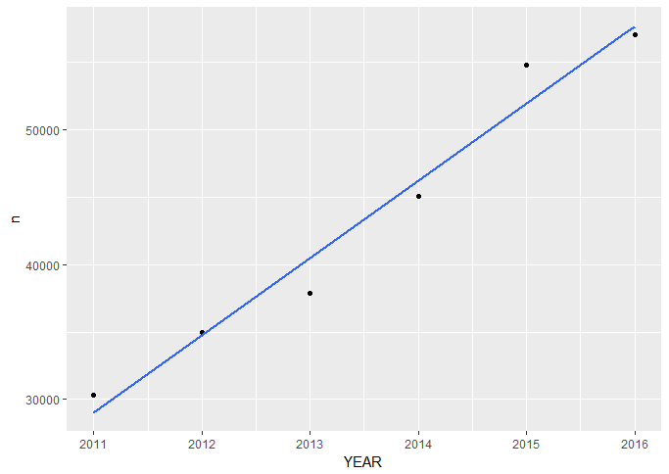
LINEAR MODEL R² = 0.969

Slide 20
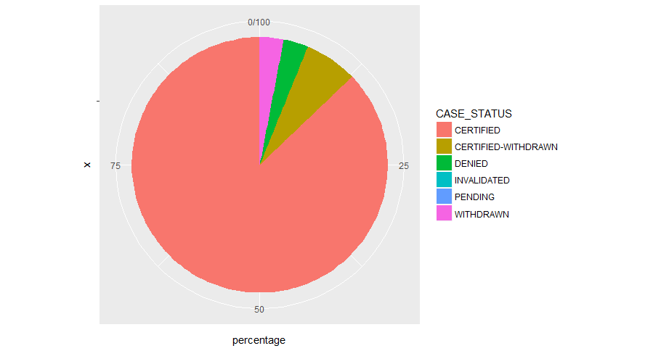
PIE CHART OF APPLICATION STATUS

Slide 21
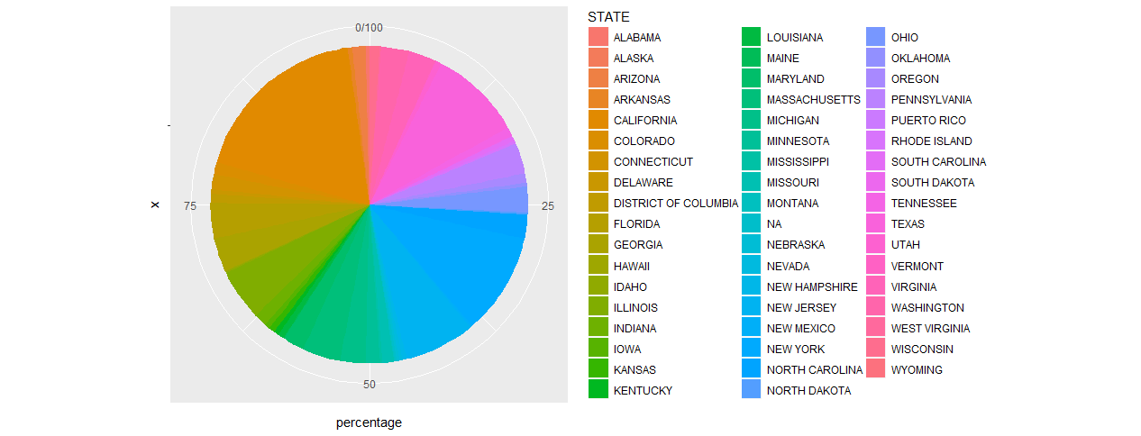
REJECTIONS BY STATE

Slide 22
ROLE OF H1B IMMIGRANTS ON USA ECONOMY

Slide 23
USA GDP in 2011 – $15.52 trillion
USA GDP in 2016 – $18.56 trillion
Total H1b approved applicants – 2615623
% Change in economy – 19.587% ▲

Slide 24
PRESIDENT TRUMP POLICY FOR H1B IMMIGRANTS
Recently, in news we have watched that President Mr. Trump has proposed a policy for the application of h1b that companies can apply to h1b of only those employees who has yearly income of >= 130k.
According to the previous data – only 87095 applicants out of 3 million applicants who has yearly salary more than 120k. Only 2.903% will be eligible for H1B.

Slide 25
CONCLUSION
SUMMARY

Slide 26
Top state – California
Top city – New York
Top employer – Infosys limited
Best job title – Programmer Analyst (USA) and Software Engineer (California)
87% applications gets approved.

Slide 27
REFERENCES
R for data science - http://r4ds.had.co.nz/
http://www.stackoverflow.com
https://stats.stackexchange.com/
https://www.google.com/publicdata/explore?ds=d5bncppjof8f9_&met_y=ny_gdp_pcap_cd&idim=country:USA:RUS:GBR&hl=en&dl=en
http://www.livemint.com/Politics/711rl4SV1bhUssgqz9CUcI/H1B-visa-reform-bill-introduced-in-US-minimum-pay-doubled-t.html

Slide 28
QUESTIONS????

Slide 29
THANK YOU
BEST OF LUCK FOR YOUR H1B APPLICATION IN FUTURE

