Slide 1
EASY WORKFLOWS & WORK TRACKING PLATFORM
Office Workflow Tracking App
A simple, friendly way to organize office tasks, assign work, and get instant updates.
🎁 Try the Beta Version: Test with Your Team for 1 Week Free!

Slide 2
PART 01: THE BIG PICTURE
How the App Works (Simply Explained)
No More Messy Emails: Keep all tasks, details, and schedules inside a single, clean workspace.
Two Separate Panels: A Manager dashboard to oversee everything, and an Employee dashboard to view assigned tasks.
Fast & Modern Page: The app responds instantly on both mobiles and computers with no slow loading times.
Safe and Secure: Encrypted database ensures only your registered team members can see your company files.

Slide 3
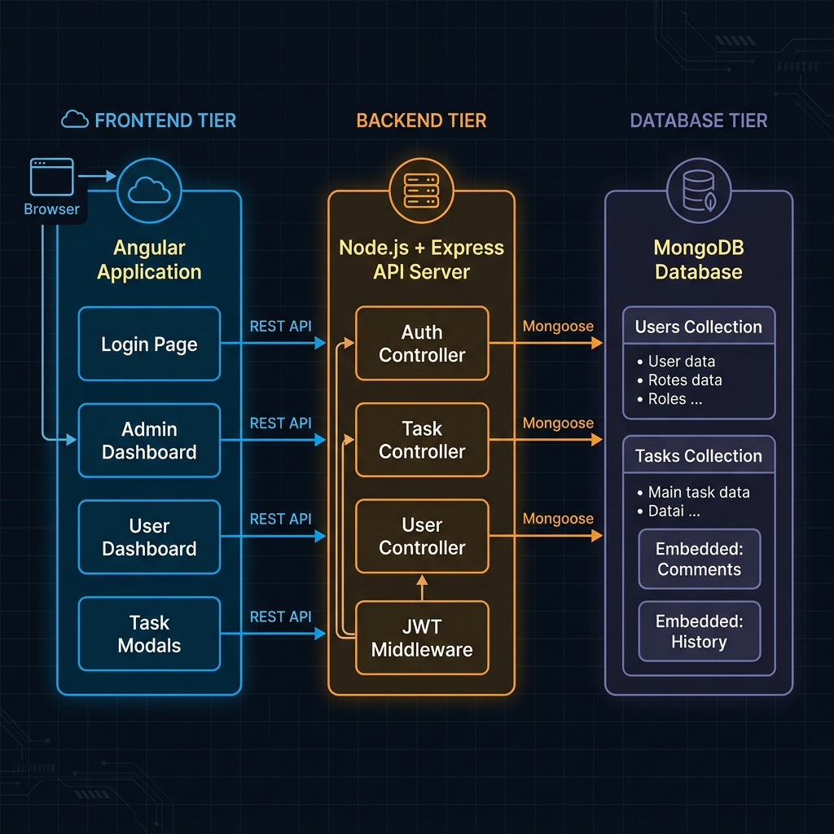
PART 01: THE BIG PICTURE - LIVE PREVIEW
How the App Works (Simply Explained)
🔍 System Architecture: Visualizing the secure, modular design connecting managers, employees, and the secure cloud database.

Slide 4
PART 02: SIMPLE WORKFLOWS
Easy Step-by-Step Task States
Pending (To-Do): The manager assigns a task. It appears in the worker's checklist.
In Progress: The employee starts working and marks the task as active.
Waiting for Approval: The worker finishes the task and sends it to the manager to check.
Done (Approved): The manager checks the work, clicks approve, and closes the task.
Reverted (Need Info): If details are missing, the worker sends it back to the manager to clarify.

Slide 5
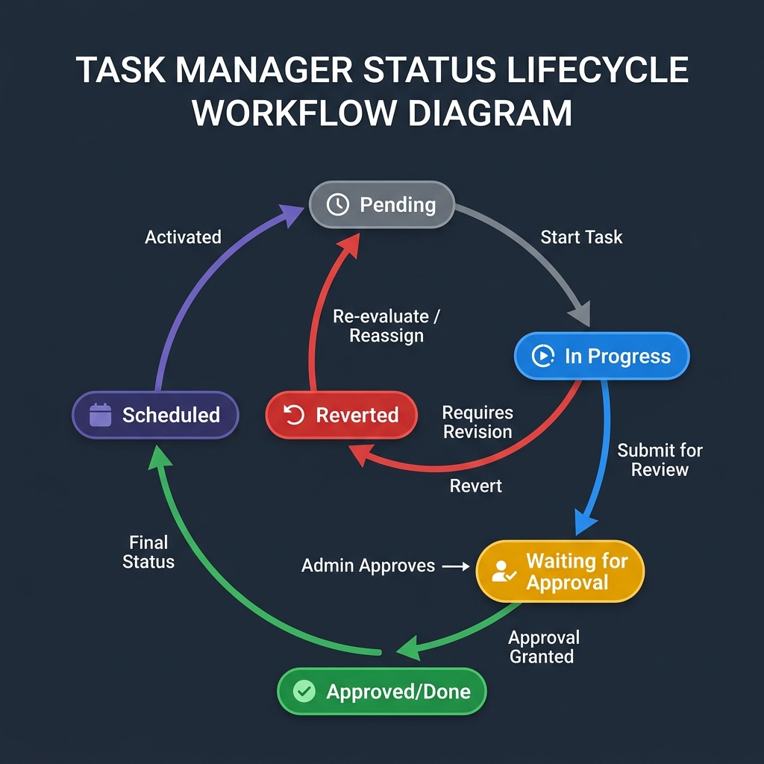
PART 02: SIMPLE WORKFLOWS - LIVE PREVIEW
Easy Step-by-Step Task States
🔄 Workflow Tracker: Seamless progression states from initial setup to employee start, manager review, and final approval.

Slide 6
PART 03: SCREENS TOUR
Welcome & Secure Login Screen
Private Entrance: Restricts entry so only your authorized employees can access the task list.
Modern Visuals: Elegant, dark blue background with clear input fields that look very professional.
Immediate Signup: New team members can easily request an account directly from the main page.

Slide 7
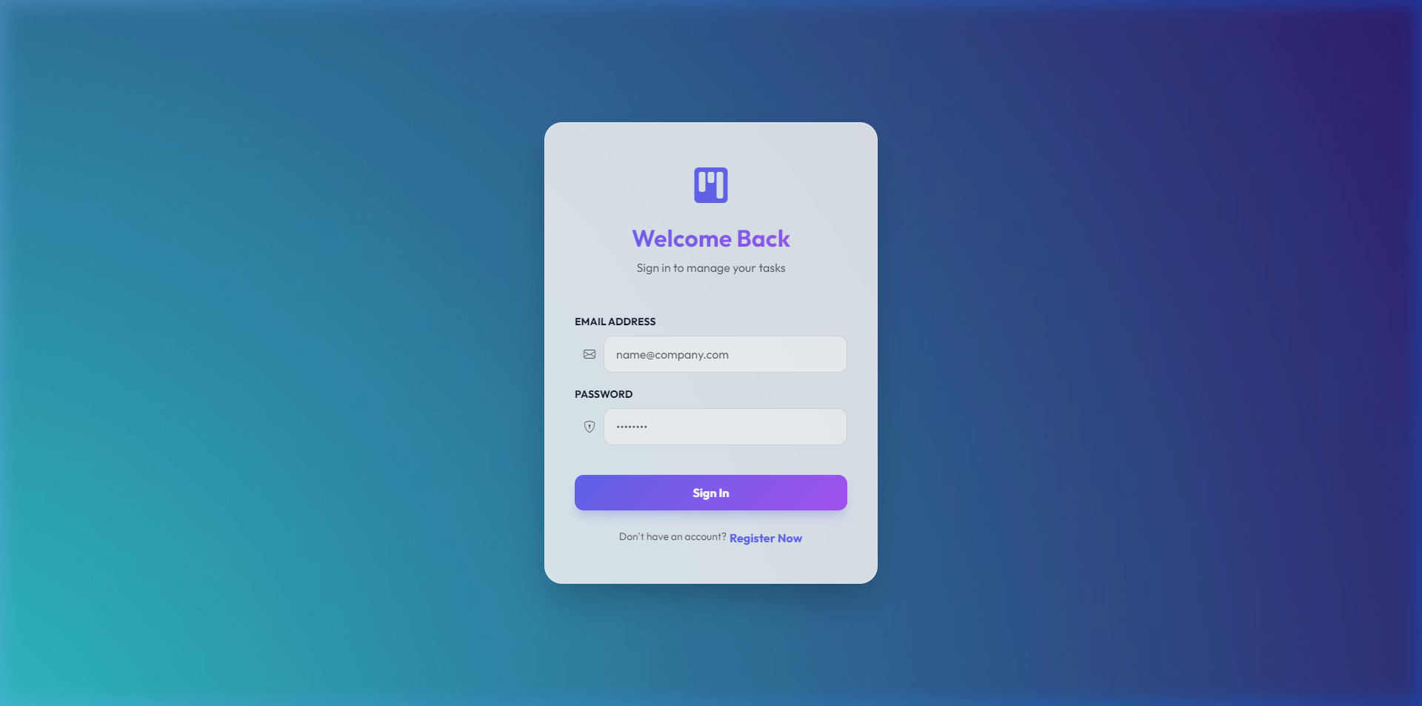
PART 03: SCREENS TOUR - LIVE PREVIEW
Welcome & Secure Login Screen
🔒 Security Gate: Elegant dark-mode portal validating employee and admin login requests instantly.

Slide 8
PART 03: SCREENS TOUR
Manager's Control Panel (Admin View)
Quick Stats Block: Instantly see total tasks, pending approvals, completed tasks, and overdue items at a glance.
Team Registry List: Easily register new team members, edit profiles, or clear out old accounts in seconds.
Instant Filtering: Search the entire list by writing a word, or clicking easy tabs (Pending, Completed, Reverted).

Slide 9
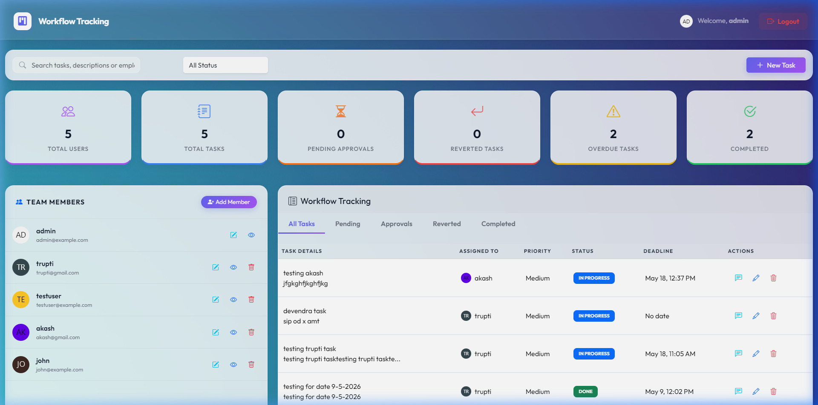
PART 03: SCREENS TOUR - LIVE PREVIEW
Manager's Control Panel (Admin View)
📊 Manager Command Center: Real-time high-level statistics, comprehensive team lists, and active task overview panel.

Slide 10
PART 03: SCREENS TOUR
Employee Task Board (Worker View)
No Distractions: Workers see only the active tasks assigned specifically to them, keeping them highly focused.
Visual Priorities: Clear color dots show what is High Priority (Red) so they know what to do first.
Deadline Alerts: Built-in calendar alarms show warning pop-ups so nobody forgets approaching target times.

Slide 11
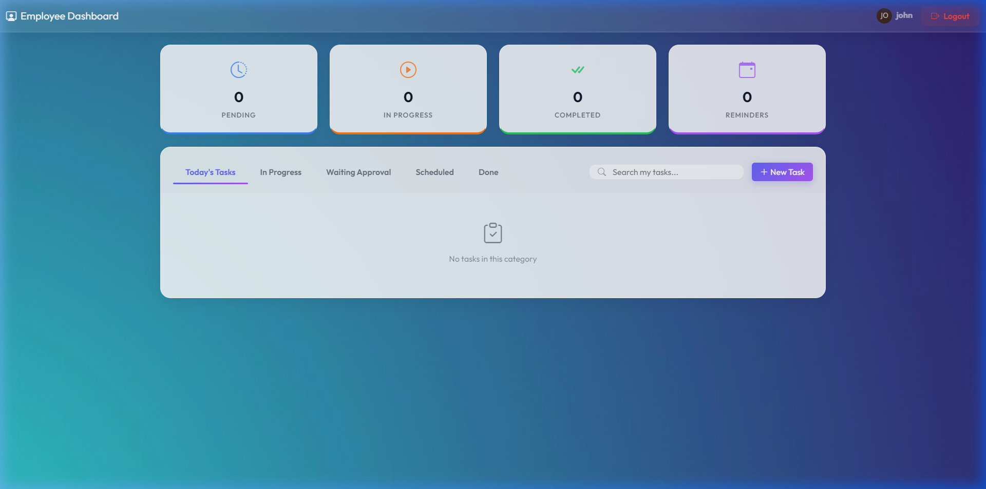
PART 03: SCREENS TOUR - LIVE PREVIEW
Employee Task Board (Worker View)
💼 Employee Dashboard: Highly structured list focusing purely on tasks assigned to the logged-in team member.

Slide 12
PART 03: SCREENS TOUR
Creating and Assigning a Task
Simple Dropdowns: Choose which employee to assign from a friendly, dropdown list of active team members.
Detailed Scopes: Write descriptive notes, set priority dots (Low, Medium, High), and schedule targets.
Alarms Setup: Pick a final Due Date and set a separate Reminder Alarm to notify the worker automatically.

Slide 13
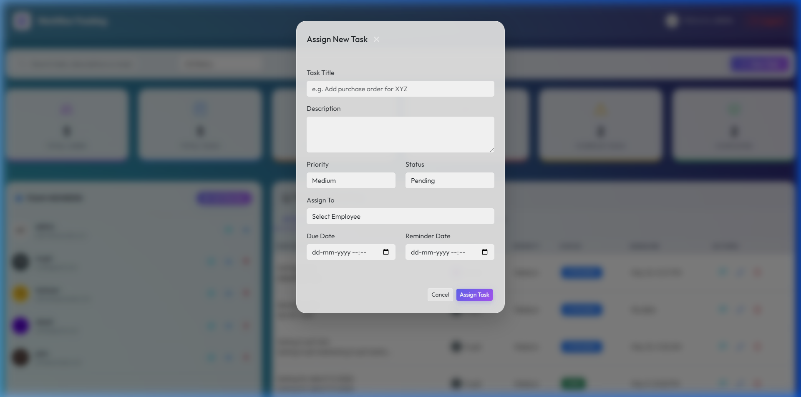
PART 03: SCREENS TOUR - LIVE PREVIEW
Creating and Assigning a Task
➕ Task Creation Form: Interactive dialog setting names, priority scales, target dates, and explicit team assignment.

Slide 14
PART 03: SCREENS TOUR
Direct Chat & Task History Log
Chat Under the Task: Employees and managers can write messages and ask questions right inside the task page.
Full Timeline Log: The system automatically records a diary of when the task was started, submitted, or edited.
Clear Communication: Ensures everybody is on the same page and avoids confusing back-and-forth emails.

Slide 15
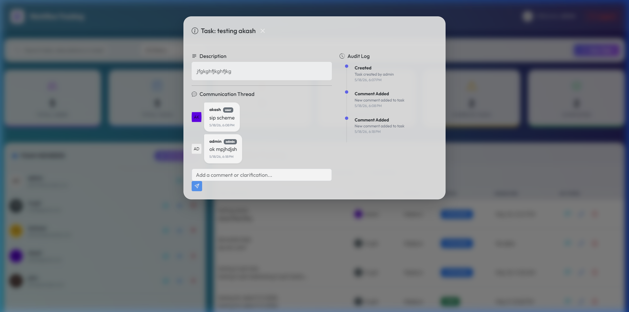
PART 03: SCREENS TOUR - LIVE PREVIEW
Direct Chat & Task History Log
💬 Collaboration Panel: Full history of task changes along with a real-time messaging thread to discuss work items.

Slide 16
NEXT STEPS & ROADMAP
Try the Beta Version for 1 Week
How the 1-Week Trial Works
Upload Beta App: We will put the app online on a private testing website.
Get Free Accounts: We will give your managers and employees custom usernames and passwords.
Real-World Test: Your team uses it for 7 days to assign work, write comments, and track progress.
Collect Your Feedback: We note down what you liked and what you want changed or improved.
Easy Timeline of Launch
Day 1: We send your team the testing website link and login details.
Day 1 to 5: Your team uses the system for everyday task management.
Day 6: We call you to collect suggestions and desired updates.
Day 7 to 8: We make the quick revisions to perfect the app for you.
Day 9: The final official version is launched for your permanent use!

