Slide 1
SHAH INVESTMENT
TASK MANAGEMENT APPLICATION

Slide 2
PART 01: CORE ARCHITECTURE
Upgraded Enterprise Workflow Dashboard
Ultra-Contrast White Mode: Transitioned the entire app to a beautiful slate-white glassmorphic background for maximum outdoor/indoor readability.
Two Isolated Panels: Provides an Admin dashboard for managers to orchestrate assignments, and a streamlined Employee dashboard focusing strictly on assigned tasks.
Subsecond Interaction: Built using Angular and Node.js for subsecond, instant view updates on tablets, laptops, and smartphones.
Military-Grade Security: Passwords hashed with bcrypt and sessions validated via secure JSON Web Tokens (JWT) inside the browser.

Slide 3
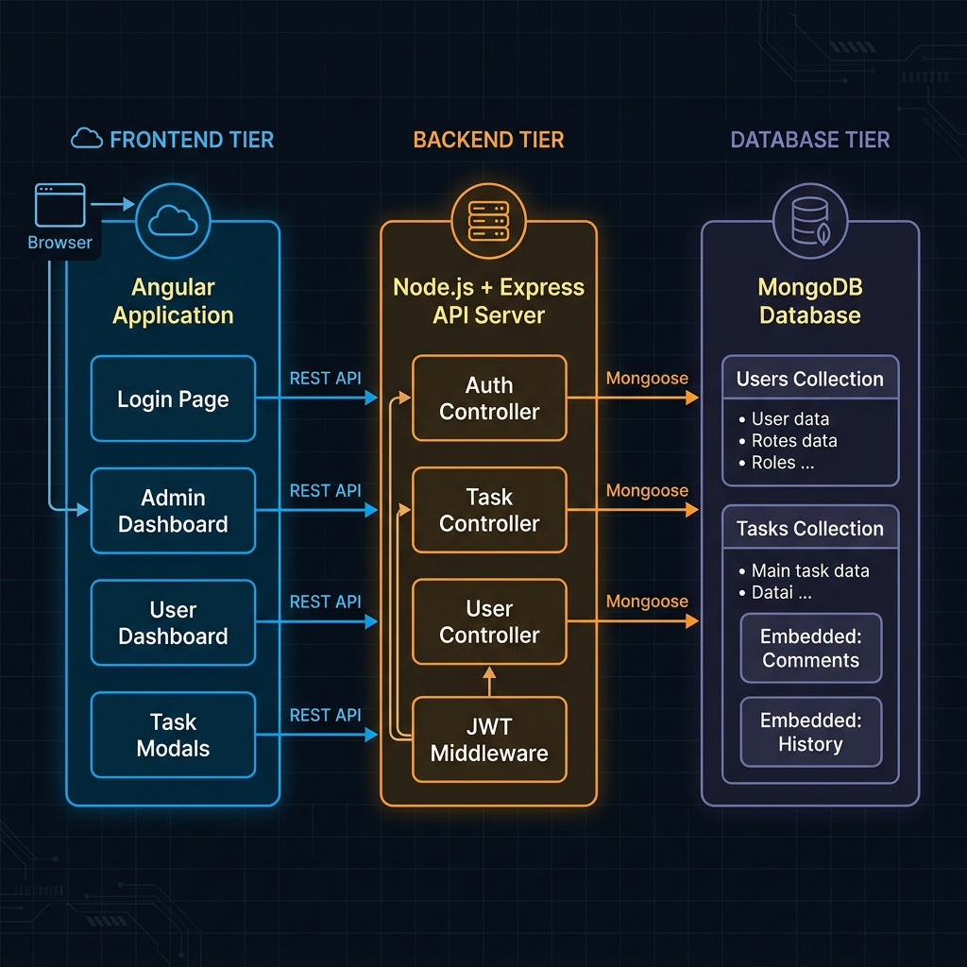
PART 01: CORE ARCHITECTURE - LIVE INTERFACE SCREENSHOT
Upgraded Enterprise Workflow Dashboard
🔍 Platform Architecture: Modular node connection connecting managers, employees, and the cloud database.

Slide 4
PART 02: WORKFLOWS
Easy Step-by-Step Task States
Pending State: Initial status when the Manager creates and assigns a task. Appears inside the employee's pending tab.
In Progress State: Active worker status. Indicated on the card by an Indigo color boundary.
Waiting for Approval State: Employee marks a task finished. Flags the item inside the manager's approval queue.
Done (Approved) State: Closed status. The manager reviews the completed work, clicks 'Approve', and closes the item.
Reverted (Clarification) State: If instructions are missing, the worker clicks 'Need Clarification', instantly re-routing it back to the Admin.

Slide 5
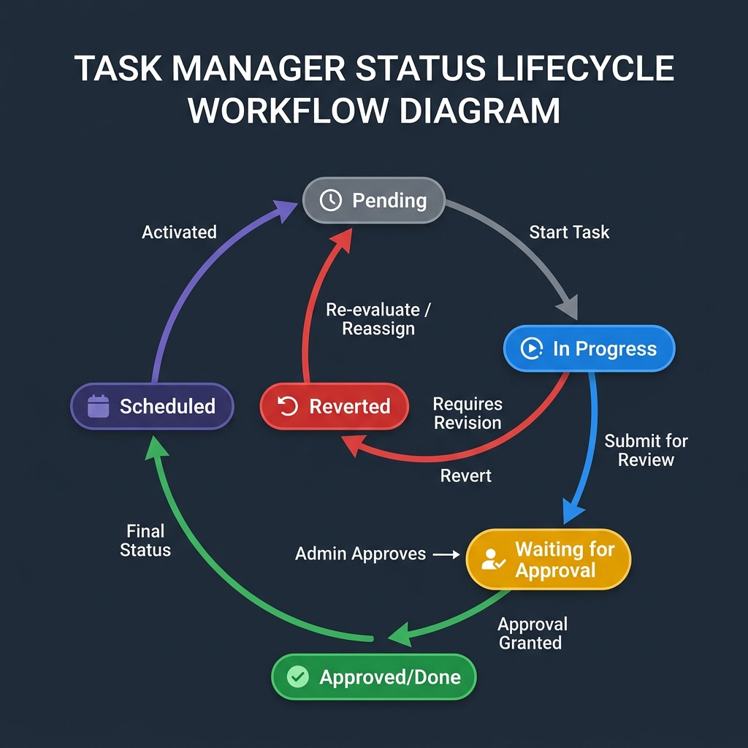
PART 02: WORKFLOWS - LIVE INTERFACE SCREENSHOT
Easy Step-by-Step Task States
🔄 Workflow Stages: Dynamic states showing progression from task initiation to active progress, review, and final sign-off.

Slide 6
PART 03: SCREENS & BUTTONS TOUR
Secure Entrance Gate & Form Validation
Sign In Button: Validates form syntax, calls the Node API, saves JWT session token, and automatically routes the user to their dashboard.
Register Now / Sign In Link: Switches the entry form instantly between Login and Registration modes.
Register Button: Instantiates a new user registry in the database after validating fields in real time.
Interactive Error Outlines: Missing or invalid input bars instantly highlight with sharp red borders and warning icons.
Username Warning (Signup): Alerts if empty or under 3 characters.
Email & Password Alerts: Prevents submission of invalid email addresses or passwords under 6 characters.
Confirm Password Matcher: Prevents registration if confirmation password doesn't match the original entry.

Slide 7
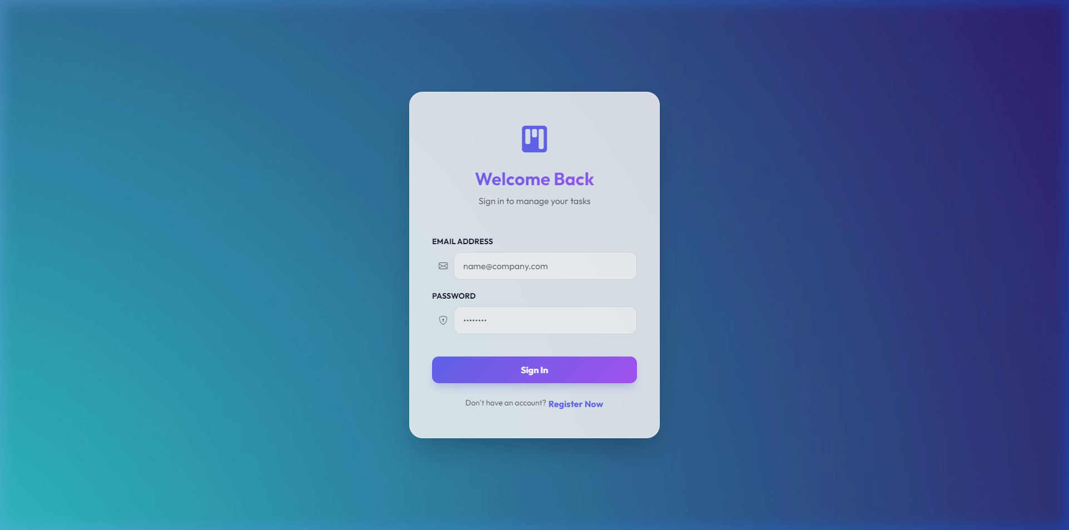
PART 03: SCREENS & BUTTONS TOUR - LIVE INTERFACE SCREENSHOT
Secure Entrance Gate & Form Validation
🔒 Portal Gate: Sleek white-glass login panel with real-time validation error alerts.

Slide 8
PART 03: SCREENS & BUTTONS TOUR
Manager Control Panel (Admin View)
Total / Pending / Scheduled / Done Tabs: Click any status button to instantly filter the primary registry.
Search Bar: Fast responsive filter. Type titles or descriptions to screen tasks instantly.
New Task Button: Opens a popup form to create and delegate a new task item.
Add Member Button (Registry Panel): Opens a registry modal to add employees or manage active worker profiles.
Logout Button: Safely clears the session token from browser cache and returns securely to the login portal.
Audit Trail Timeline: Displays a real-time log of state transitions (who did what and when).

Slide 9
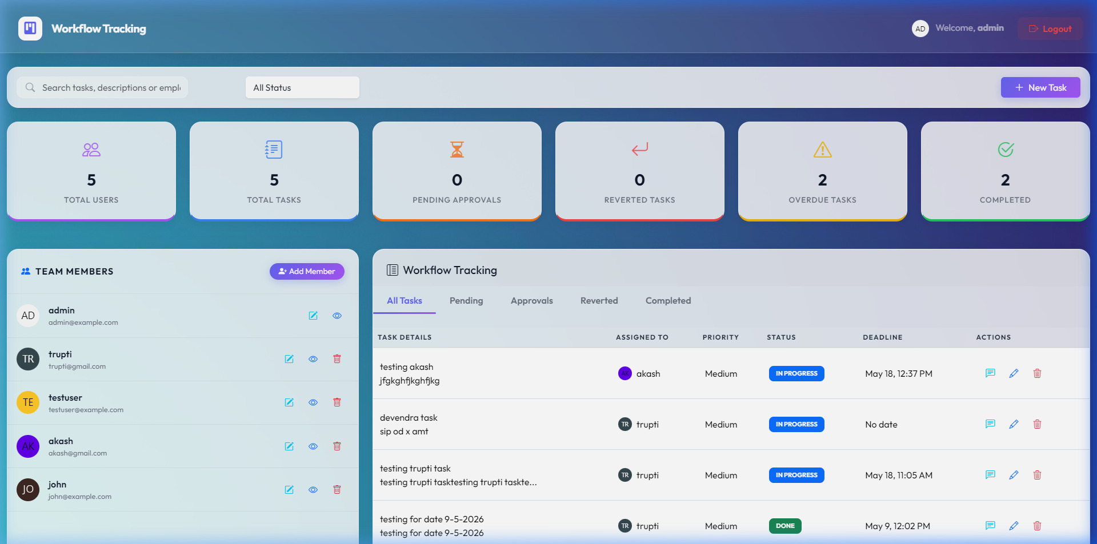
PART 03: SCREENS & BUTTONS TOUR - LIVE INTERFACE SCREENSHOT
Manager Control Panel (Admin View)
📊 Admin Dashboard: Manager overview dashboard displaying active workflow statistics, search utilities, and team directory.

Slide 10
PART 03: SCREENS & BUTTONS TOUR
Employee Task Board (Worker View)
Today's Tasks / In Progress / Waiting / Done Tabs: Allows the employee to navigate only their specific assigned tasks.
Task Card Click: Opens a high-fidelity details dialog displaying comments, deadlines, and logs.
Priority Indicator Badges: Displays Low (Green), Medium (Yellow), or High (Red) urgency dots so workers prioritize effectively.
Dynamic Deadlines: Shows the exact calendar date limit for completion.

Slide 11
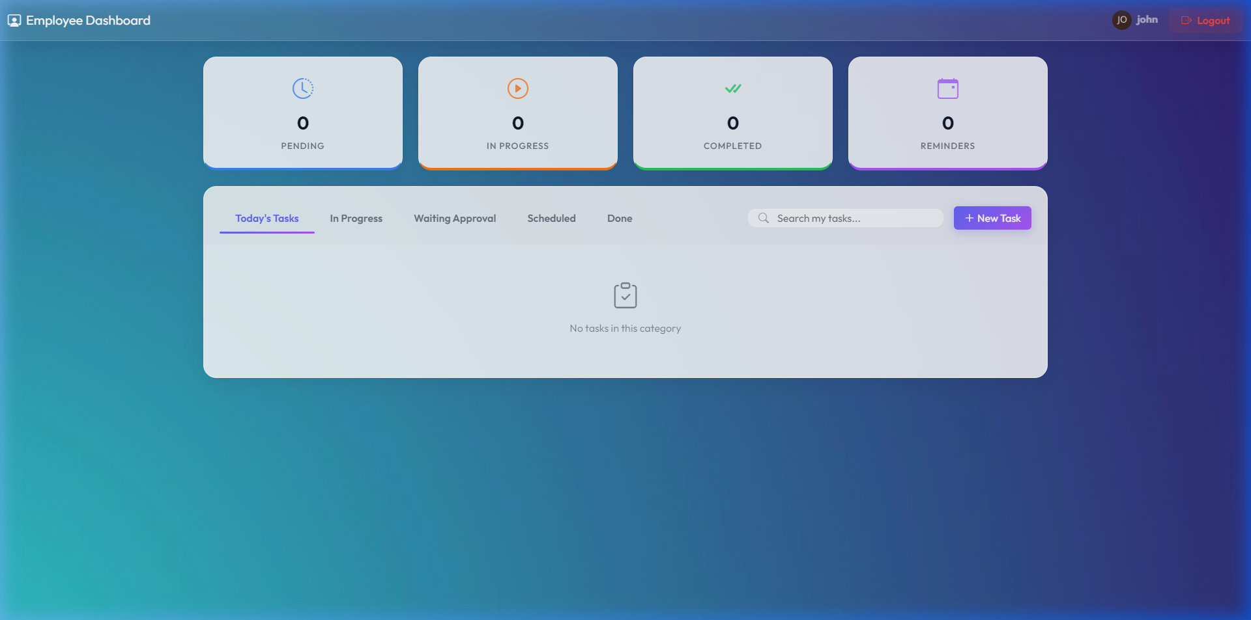
PART 03: SCREENS & BUTTONS TOUR - LIVE INTERFACE SCREENSHOT
Employee Task Board (Worker View)
💼 Employee Task Grid: Streamlined, clean White Mode grid displaying only the active items assigned to the worker.

Slide 12
PART 03: SCREENS & BUTTONS TOUR
Task Details & Real-Time Discussion Panel
Start Task Button: Changes status to 'In Progress', turns card boundary to active Indigo, and updates manager.
Submit for Approval Button: Swaps status to 'Waiting for Approval', highlighting it inside the Admin panel.
Need Clarification Button: Swaps status to 'Reverted' and redirects the item back to the manager with a alert.
Real-Time Chat Field & Send Icon: Type text and click send to post persistent discussion messages under the task.
History Log Panel: Lists full date and action markers tracking every progress edit since creation.

Slide 13
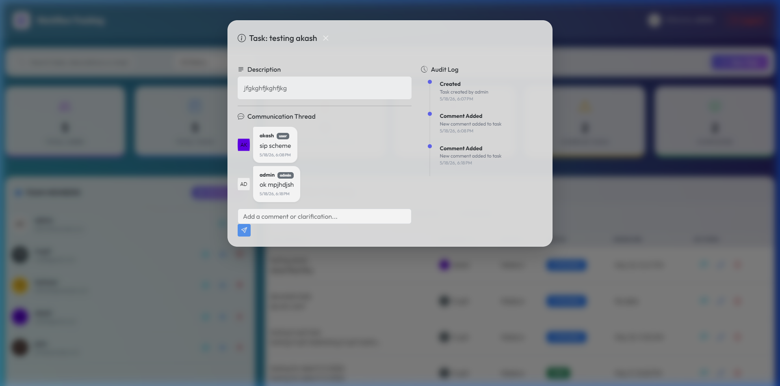
PART 03: SCREENS & BUTTONS TOUR - LIVE INTERFACE SCREENSHOT
Task Details & Real-Time Discussion Panel
💬 Task Detail Dialog: Detailed instructions, comments discussion column, and full progress tracking diary.

Slide 14
PART 03: SCREENS & BUTTONS TOUR
Creating and Scheduling a Task
Task Title & Description Fields: Set clear instructions and scope notes.
Priority Dropdown (Low / Medium / High): Configures visual urgency boundaries.
Assign To Employee Dropdown: Pulls active workers automatically from database registry to assign.
Due Date Picker: Configures standard deadline limit.
Reminder Date Picker: Configures an automatic calendar alarm that triggers a notification for the employee.
Schedule Task Button: Commits task record to MongoDB and updates the worker's board.
Cancel Button: Discards changes and closes the assignment modal.

Slide 15
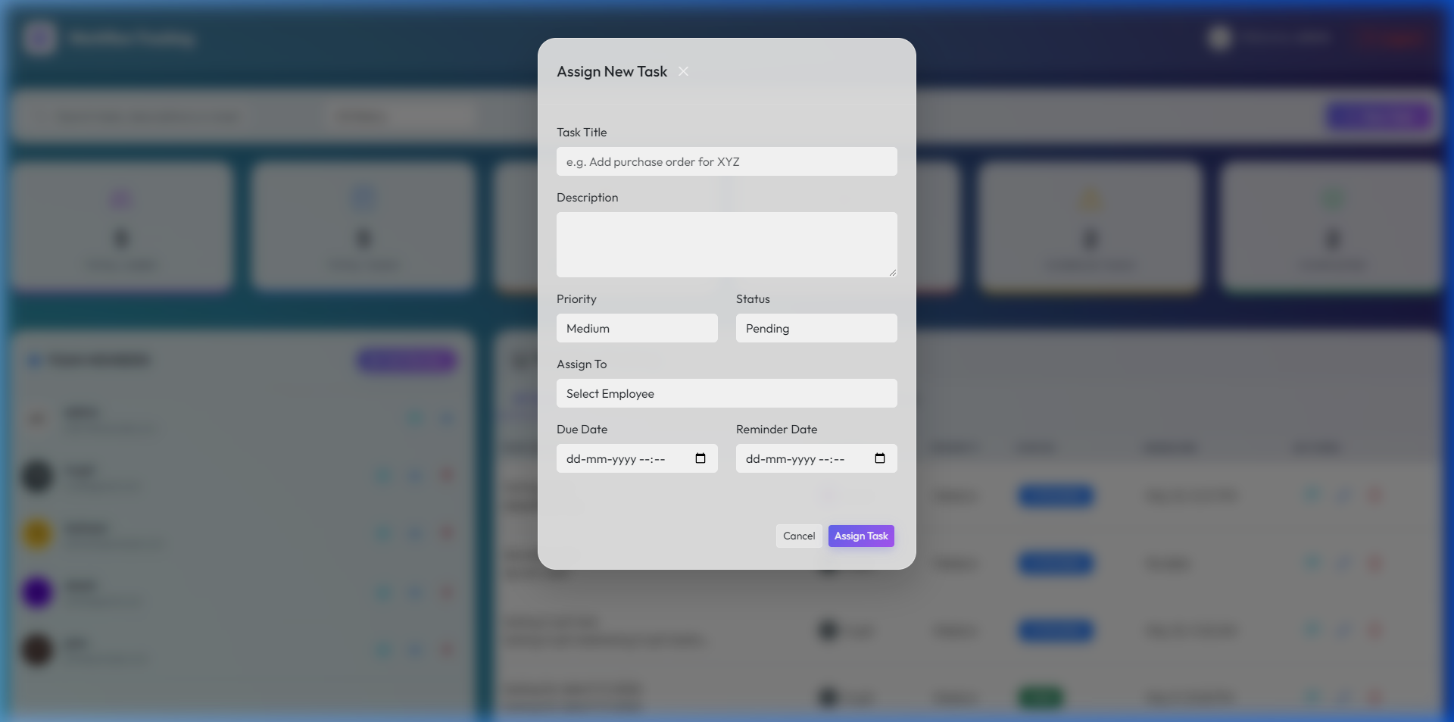
PART 03: SCREENS & BUTTONS TOUR - LIVE INTERFACE SCREENSHOT
Creating and Scheduling a Task
➕ Task Delegation Dialog: Interactive assignment form setting titles, priorities, assignees, deadlines, and alerts.

Slide 16
PART 03: SCREENS & BUTTONS TOUR
Team Member Registry & Profiles Dialog
Full-Width Medium Modal Frame: Upgraded width to 'modal-md' to guarantee form buttons fit side-by-side perfectly.
Registry Fields (Username, Email, Role): Quick forms to input employee profiles and choose role (Admin vs Employee).
Password Input Field: Enforces secure credentials for the employee.
Save Member Button: Performs secure validation and creates the database user account.
Cancel/Close Button: Safely closes the modal without committing edits.

Slide 17
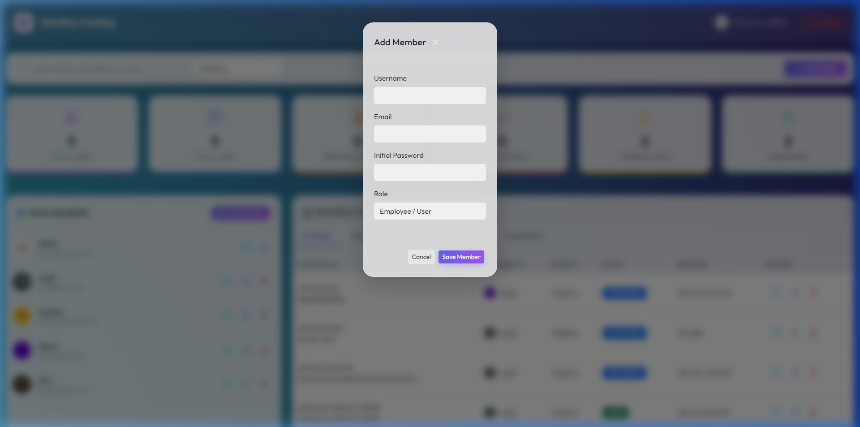
PART 03: SCREENS & BUTTONS TOUR - LIVE INTERFACE SCREENSHOT
Team Member Registry & Profiles Dialog
👥 Add Member Dialog: Beautiful full-width registry form to onboard team members and assign roles.

Slide 18
PART 03: SCREENS & BUTTONS TOUR
Isolated Private Personal To-Do Tab
My Personal To-Do Tab Button: Activates the private checklist workspace, hiding search and collaborative buttons.
Full-Width Single Row Tabs: Header layout places search bar on a secondary line so all tabs fit cleanly on a single row.
Add To-Do Item Button: Instantly saves a low/medium/high priority task to browser cache and updates checklist.
Interactive Checkbox: Checking items strikes through the text and blends the background to clean, completed gray.
Trash/Delete Button: Safely wipes the checklist item from browser cache in real-time.
100% Privacy Guarantee: Items are saved directly in browser's local storage under 'personal_todos_${userId}'. Since they never touch the server database, the Admin has absolutely zero right, access, or visibility!

Slide 19
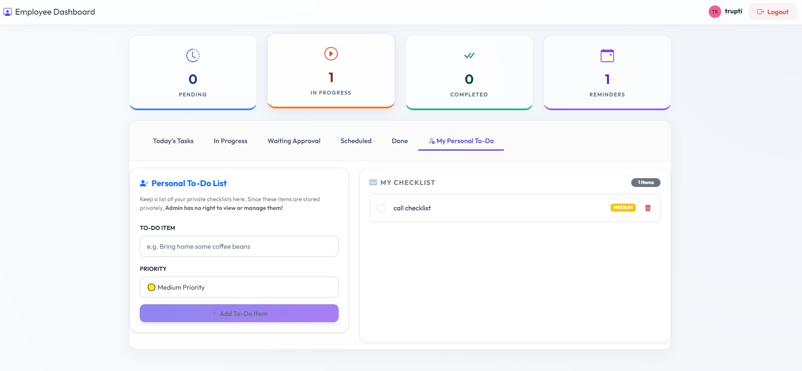
PART 03: SCREENS & BUTTONS TOUR - LIVE INTERFACE SCREENSHOT
Isolated Private Personal To-Do Tab
🔒 Private Checklist Tab: Employee private to-do list storing checklists strictly locally for absolute privacy.

Slide 20
NEXT STEPS & ROADMAP
Try the Redesigned App for 1 Week
How the 1-Week Trial Works
Upload Beta App: The Light Theme production app is deployed online on a secure testing URL.
Get Team Accounts: Managers receive administrator keys, and workers get standard employee accounts.
7-Day Active Trial: Assign actual daily office tasks, write reviews, and run private checklists.
Collect Feedback: We compile notes on feature performance, speed, and any adjustments you request.

Slide 21


THANK YOU

