Slide 1
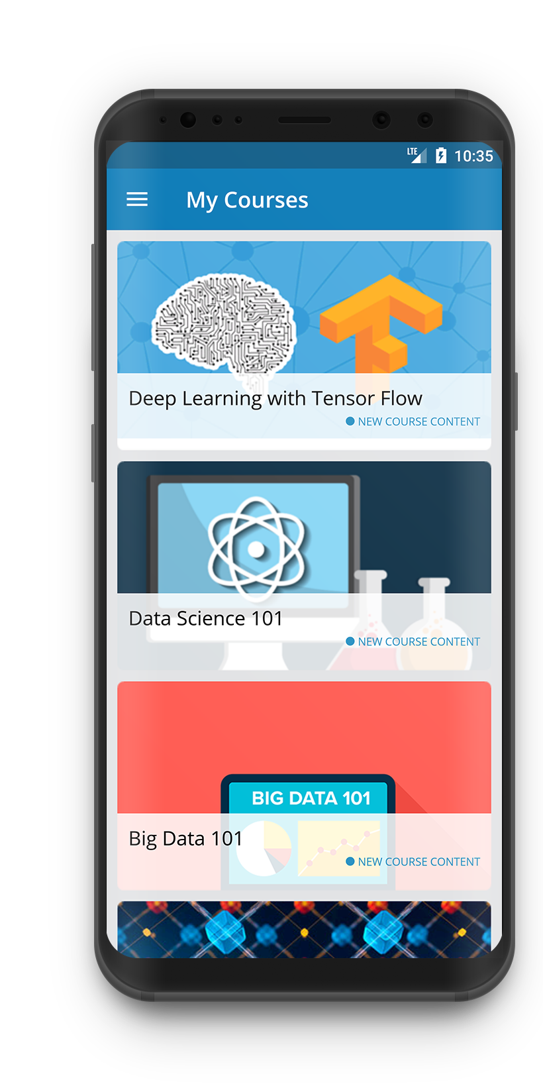
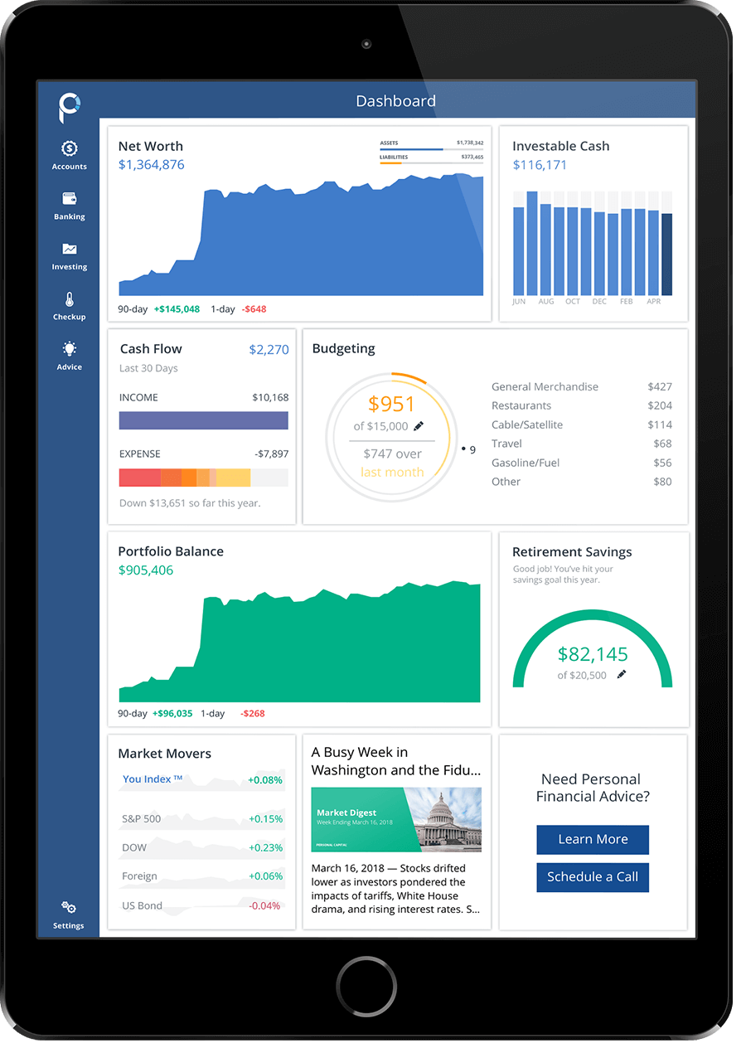
Account
SOAP
Service
JSON/HTTP
WS SOAP Proxy
APIGEE
Security Gateway
Salesforce
User
Service
Payment
Service

