Slide 1
Introduction

Slide 2
Why Kivy?
Kivy is platform independent!
Supports multi-touch.
Platform Independent.
Code in python and design in kivy’s own python like language.
And ofcourse its free!!

Slide 3
What can I do with it?
Everything, literally!
Kivy is the GUI for a python powered app.
It is like web development. Backend in python and front-end with kivy.
Not happy with kivy? Move your backend to some other framework.
Tons of features available in kivy.
Widgets and animations will make your life easy.

Slide 4
Fundamentals
Before any great thing happens, foundation needs to be laid.

Slide 5
Kivy App
Before we start talking about anything, let us first see how easy it is to code a kivy running app.

Slide 6
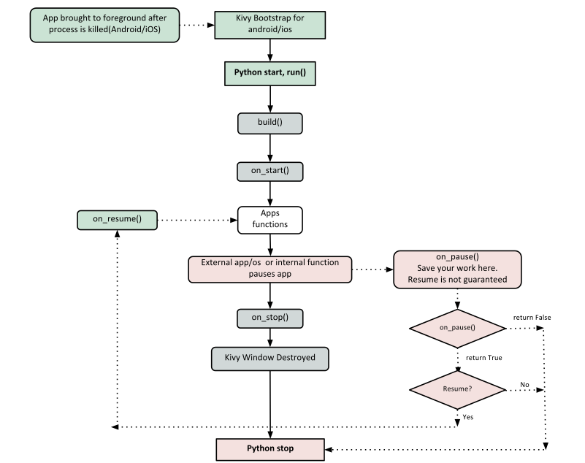
Lifecycle of App

Slide 7
Events in Kivy
EventDispatcher class (Widget, Animation, Clock)
Clock events
Callbacks
Using Properties

Slide 8
Input in Kivy
Kivy can handle mouse, touchscreen, accelerometer, gyroscope, etc.
Global Architecture
Input providers -> Motion event -> Post processing -> Dispatch to Window
Touch events - Lets see the code.

Slide 9
Widgets
A widget is the base building block of GUI interfaces in Kivy.
Provides Canvas, receives events and reacts.
Widgets are organised in a tree structure.
root widget and children
add_widget()
remove_widget()
clear_widgets()

Slide 10
Layouts
layout is a special kind of widget that controls the size and position of its children.
size_hint and pos_hint for size and pos.
BoxLayout
GridLayout
StackLayout
AnchorLayout
FloatLayout
Available units are pt, mm, cm, inch, dp and sp.

Slide 11
UIX widgets
Button
Label
Progress Bar
Text
File Chooser
Canvas

Slide 12
Debugging
Use dotted lines.
Open kivy app in debug mode.

Slide 13
KV language

Slide 14
How to load KV
Name convention:
Kivy looks for a Kv file with the same name as your App class in lowercase, minus “App” if it ends with ‘App’
e.g: MyApp -> my.kv
Builder:
You can tell Kivy to directly load a string or a file.
Builder.load_file('path/to/file.kv')

Slide 15
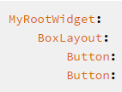
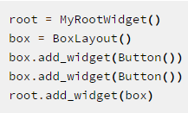
Understanding <>
Widget
<MyWidget>
App, root, self
Code in kv language:
Equivalent code in python:

Slide 16
THANK YOU!
-Akash Singh Tomar, Full Stack Developer.
Contact – fb : akash.tomar107
Linkedin- Akash Singh Tomar
Twitter-@tomar217

