Slide 1

Final Year Project (ECS 852) Topic: Improving Performance of Device to Device Communication Using Underlay Cognitive Radio Principle
Done by: Akash Pandey (17EC8050)
Guguloth Sunayana (17EC8065)
Kishalaya Mandal (17EC8080)
Manisha Mandal (17EC8011)

Slide 2
Contents:
Introduction
Objective
System Model and Problem Formulation
Simulation Results
Conclusion

Slide 3
Introduction
The exponential growth in the number of mobile devices and need for spectrum realizes a tough constraint on the spectrum as a resource.
The idea of cognitive radio (CR) network increases the spectrum utilization efficiencies.
In CR to mobile networks, the primary users and the secondary users can coexist in the same licensed band In such an underlay approach

Slide 4
The interference temperature limit (ITL) is the maximum interference that can be allowed by the secondary users to the primary network
The interference should be below a certain level i.e. ITL. So that the primary transmitted signal can’t be affected by the secondary interference
Cognitive radio network should always check the estimated interference at primary network
This paper is basically about using this underlay cognitive radio principle for improving the performance in device to device communication

Slide 5
Objective
The main objectives of this project are
To present the expression for multiple numbers of D2D pairs and to propose a scheme where the interference level is naturally maintained.
To determine the throughput for simultaneous transmissions by up to two D2D nodes in the same frequency band.
To show that sum throughput improves with the increasing number of D2D pairs in a secondary network by user selection method among multiple numbers of D2D pairs.

Slide 6
System Model and Problem Formulation
Considering one D2D pair from given N D2D pairs which are transmitting in same frequency band.
Assumptions-
1)All the channel experience with independent Rayleigh fading.
2) The primary transmitter is located far away from the secondary receivers and hence the primary interference at the secondary node can be neglected.
3) We assume that the secondary network is located relatively far apart so that the same frequency can be reused by two transmitters concurrently.

Slide 7
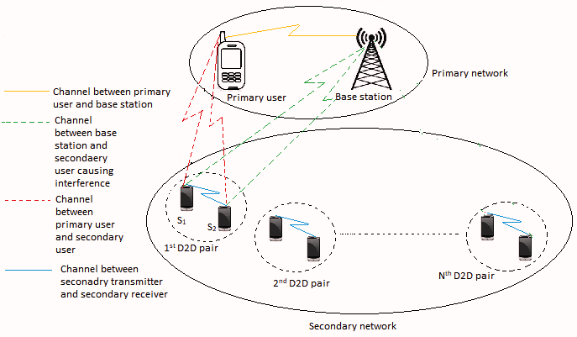
System model of co-existing underlay CR network

Slide 8
𝑆₁ transmits with power 𝑃_{𝑆1} and 𝑆₂ transmits with power 𝑃_{𝑆2}.
P_{s1} ≤ I_{P} / |h_{1c}|²
and
P_{s2} ≤ I_{P} / |h_{2c}|² should be maintained
Where, h_{1c} and h_{2c} : Channel gain from secondary network to primary network
I_{P} : Interference Temperature Limit
The outage probability of D2D link:
= P_{r} (( I_{p} |hc|²)/σ_{n}² min⁡(P_{Out} |h1c|²,|h2c|²) ≤ γ_{th} ),
where γ_{th} =(2^{R} −1);
R: transmission rate of secondary network
( I_{p} |hc|²)/σ_{n}² min⁡(|h1c|²,|h2c|² : Instantaneous SINRs

Slide 9
For N number of D2D pairs are considered then the outage probability corresponding to the best D2d pair is being chosen out of N such pairs is:
P_{Out} = P_{r} (maxi ϵ_{{1,n}}( xi ≤ γth )
X_{i} : Maximum SNIR among each D2D pair
We use minimum peak power(P) as If the channel is very weak, then the power may shoot up very large.
∴ P_{s} = min(P , I_{p}/|h_{sp}|²)

Slide 10
SNR at the receiver will be:
γ _{D1} = (min(P, I_{p}/|h_{D2C}|²) |h_{D}|²)/((P_{C}/|h_{CD1}|²)+σ_{n}²) ;
when S₂ is transmitting.
γ _{D2} = (min(P, I_{p}/|h_{D1C}|²) |h_{D}|²)/((P_{C}/|h_{CD2}|²)+( σ_{n})²) ;
when S₁ is transmitting.
Then the non-outage probability will be:
P_{NO}^{S} = Pr[{γ _{D1} > γ _{th}} ∩ {γ _{D1} > γ _{D2}}] + Pr[{γ _{D2} > γ _{th}} ∩ {γ _{D2} > γ _{D1}}]

Slide 11
Simulation Results
We have used Monte-Carlo simulation method in MATLAB for simulating this problem.
The number of iterations =10^6
The path loss exponent (ple) = 3
Ip = 20 dB :Interference Temperature Limit
d = 2 units :Normalized distance between device 1 to 2
bd1=bd2=5 units :Normalized distances between the base station and two secondary users
pd1=pd2 = 4 units :Normalized values of distances between the primary user and the devices in a device pair
All these values have been used for simulation purpose.

Slide 12
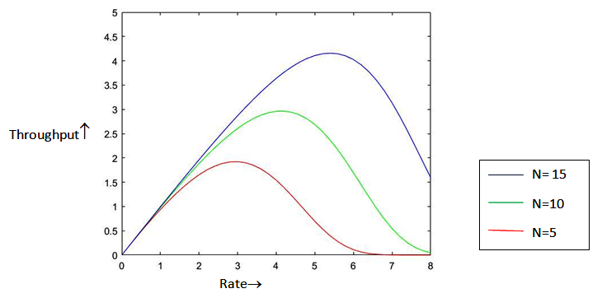
Matlab Plot
Throughput achieved for three different values of N

Slide 13
The throughput at first increases upto a certain value and then decreases to minimum with the change of rate. Overall we have observed a bell shaped curve in throughput vs rate graph.
Three different N values are taken which are respectively 5, 10 and 15 and it is observed that throughput increases with increasing number of D2D pair in the secondary network. Overall we can conclude that the performance increases with increase in the number of d2d pairs in the network.

Slide 14
Conclusion
In this project, we addressed the spectrum reuse and power assignment issue within D2D communications underlay D2D network where the simulation scenario was chosen according to a realistic underlay cognitive network. The effectiveness of our proposed solution was proved through simulation results. So, the D2D communication enables the devices to communicate directly with each other without the drawbacks regarding interference and power control.

