Slide 1

Youtube Dataset Analysis
A Course project on
Big Data and Analytics Titled
Team A8: Abhishek Patil 01fe17bcs008 Amit Kumar Jha 01fe17bcs029 Akash Yadagoud 01fe17bcs018 Anirudh.P 01fe17bcs032
School of Computer Science and Engineering

Slide 2
Domain:
Social media analysis.

Slide 3
Introduction:
YouTube allows billions of people to connect, inform, and inspire others across the globe using originally created videos.
There is an exponential growth in social media industry and with that there is a big burden of data storage & analysis.
In our Project we analyze the data to identify the top 5 categories in which the most number of videos are uploaded.
The dataset will be gathered and stored in Hadoop Distributed File System(HDFS).
MapReduce algorithm will be applied to process the dataset and identify the video categories.

Slide 4
Problem Statement:
Analyze the youtube data to infer valuable information and plot the results using big data tools and technologies .

Slide 5
Dataset Description:
Attribute | Description
video ID | an 11-digit string, which is unique
uploader | a string of the video uploader's username
age | an integer number of days between the date when the video was uploaded and Feb.15, 2007 (YouTube's establishment)
category | a string of the video category chosen by the uploader
length | an integer number of the video length
views | an integer number of the views
rate | a float number of the video rate
ratings | an integer number of the ratings
comments | an integer number of the comments
related IDs | up to 20 strings of the related video IDs

Slide 6
Tools and Technologies:
Technologies
Hadoop HDFS
Hive
Cloudera QuickStart VM
Unix shell

Slide 7
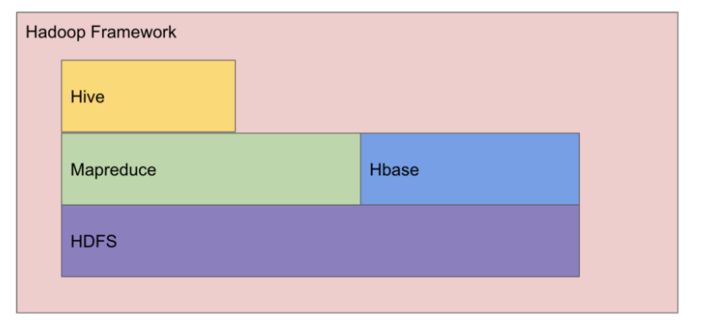
Proposed methodology:
Fig 1: Proposed system

Slide 8
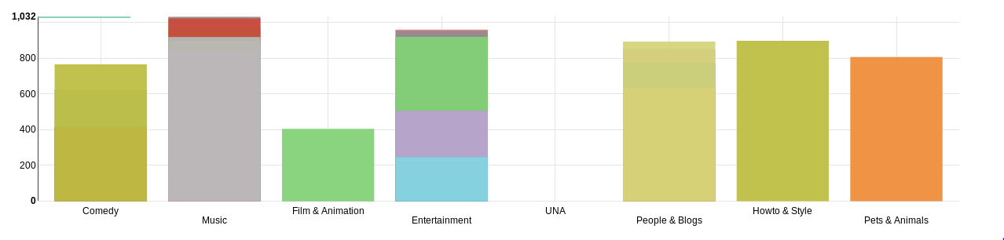
Results:
X = categories Y= age
Figure 2: Graph of Categories vs Age

Slide 9
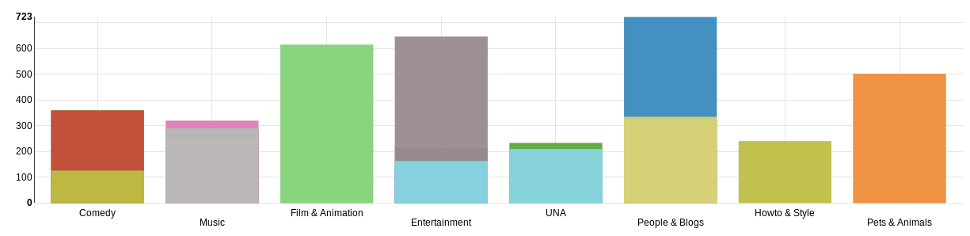
x
X = categories Y = video lengths
Figure 3: Graph of Categories vs video lengths

Slide 10
X = categories Y = number of rate
Figure 4: Graph of Categories vs number of rate

Slide 11
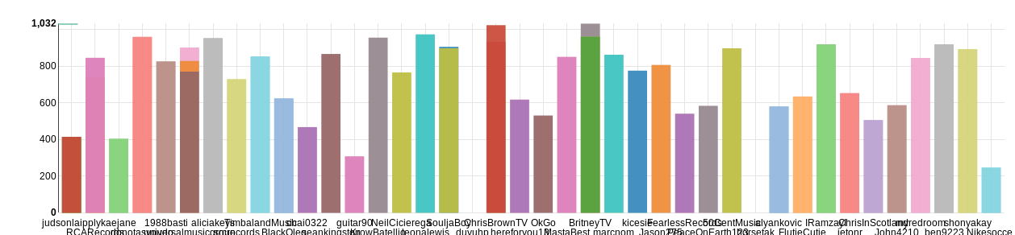
X = Uploader Y = Age
Figure 5: Graph of Uploader vs Age

Slide 12
THANK YOU

