Slide 1

Exploring enterprise java
…a lighter approach
David Morgantini
Akash Bhalla
(Picture: “air” by fiddleoak, CC image from flickr )

Slide 2



Who are we?
David Morgantini
Akash Bhalla
Software developer @ ThoughtWorks
dmorgant@thoughtworks.com
http://davidmorgantini.blogspot.co.uk/
Software developer @ ThoughtWorks
akash@thoughtworks.com
http://www.akashb.com/blog
@akashb
@dmorgantini

Slide 3
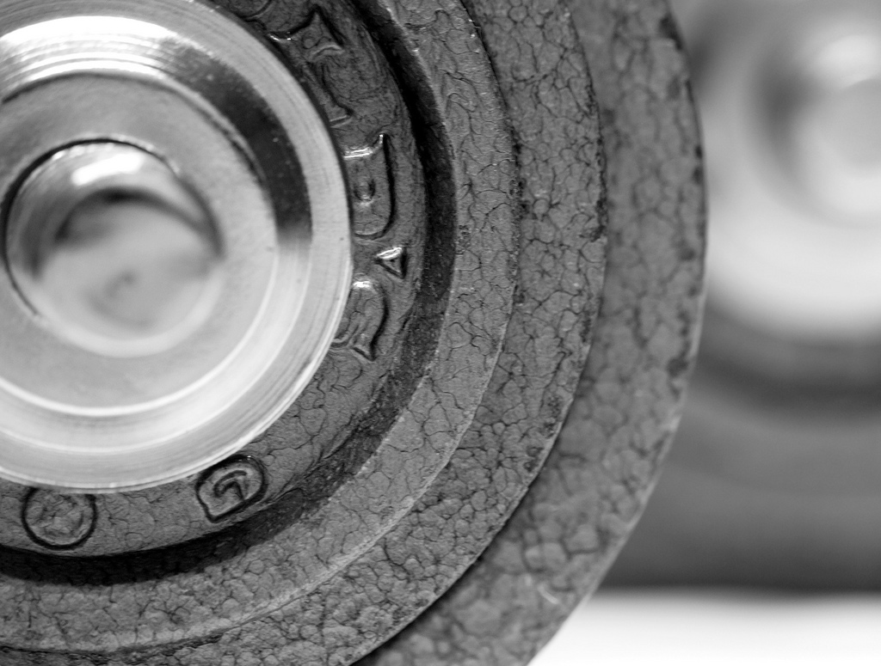
(Picture: “hammertone time” by DryRot, CC image from flickr )
Notes:
In our time working as professional developers we’ve seen and felt the pain of having to work with the heavyweight tools and processes that are typically associated with enterprise java applications. At the same time we’ve been exposed to a number of other languages and frameworks which have become popular for proving a much lighter approach, technologies that take minutes not days to get you up and running. This session will explore an alternate java stack which can be used to provide similar benefits. To get you up and running as fast as possible, and avoid getting bogged down and boiler plate code and mountains of set up.

Slide 4
Isn’t there
another way?

Slide 5
Drop
wizard
MongoDB
jQuery
http://dropwizard.codahale.com/
http://www.mongodb.org/
http://jquery.com/
Notes:
This is the stack we’ll be using for this tutorial

Slide 6
Dropwizard
FreeMarker
Jetty
Jersey
Jackson
Metrics
Logback/slf4j
Guava
Notes:
This is the stack we’ll be using for this tutorial

Slide 7

Why dropwizard?
Developed by Yammer
“Historically not sucked”
Production ready from the start
Lightweight, quick to setup
Great documentation
Easier to setup than SimpleFramework

Slide 8
Why MongoDB?
NoSQL Database
Flexible Schemas
Lightening fast reads
Simple Queries
Free
Quick to setup and get going
Easy to shard
Production ready out of the box

Slide 9
Why jQuery?
Focuses on DOM interaction
Powerful CSS selector
Testable with jasmine
Write less, do more
jQuery UI tools

Slide 10

P
The
LAN
(We love it when a plan comes together)
Introduction
Set up machines (we’ll be pairing)
Introduce the problem (stories we’ll work on)
- Introduce the technology required to complete story
- Pair programming
- Come together and share results
- Repeat for the next story
Recap
Feedback

Slide 11
Setup
Work in pairs (1 laptop between 2 people)
Github: git@github.com:akash/story-wall.git
Notes:
Link to blog post to see the instructions for everything you need to set up.

Slide 12
Maven
Git
MongoDB

Slide 13
http://maven.apache.org/download.html#Installation
Maven
Git
MongoDB

Slide 14
https://github.com/signup/free
http://help.github.com/mac-set-up-git/
http://help.github.com/win-set-up-git/
Maven
Git
MongoDB

Slide 15
Send your github username to be added as a collaborator
> git clone git@github.com:akash/story-wall.git
Maven
Git
MongoDB

Slide 16
http://www.mongodb.org/display/DOCS/Quickstart+OS+X
(or Unix/Windows)
Maven
Git
MongoDB

Slide 17

Story #2
Story #3
Story #1
Story #3
Create Story
Delete Story
View Swimlanes
Progress Story
New story page
Create story in DB
Show story in swimlanes
Notes:
Story 1
Introduction to Dropwizard/Freemarker/Jersey
Codebase should already include the basic skeleton of all of these
Index page should have the basic HTML already in place for swimlanes (Backlog/In Progress/Complete)

Slide 18
Story wall
Backlog
In Progress
Done
Notes:
Needs to be updated once we have the basic page up and running, and will just add a screengrap of the actual page….

Slide 19

Dropwizard

Slide 20
<FreeMarker>

Slide 22
Story #2
Story #3
Story #1
Story #3
Create Story
Delete Story
View Swimlanes
Progress Story
New story page
Create story in DB
Show story in swimlanes
Notes:
add a link to the wall page which goes to a new create story page
add create story page controller and view
view should be a html form which posts, but no consumer for the post should be created yet

Slide 23
Story #2
Story #3
Story #1
Story #3
Create Story
Delete Story
View Swimlanes
Progress Story
New story page
Create story in DB
Show story in swimlanes

Slide 24
New Story
Title
Estimate
Create

Slide 25
Story #2
Story #3
Story #1
Story #3
Create Story
Delete Story
View Swimlanes
Progress Story
New story page
Create story in DB
Show story in swimlanes
Notes:
Consume the post data and create story in DB
use Post-Redirect-Get to redirect user back to wall page after create

Slide 26


Slide 27
Story #2
Story #3
Story #1
Story #3
Create Story
Delete Story
View Swimlanes
Progress Story
New story page
Create story in DB
Show story in swimlanes
Notes:
- load stories from mongo and show in correct swimlane

Slide 28
Story wall
Backlog
In Progress
Done
#1
Story title
(estimate)
Notes:
Needs to be updated once we have the basic page up and running, and will just add a screengrap of the actual page….

Slide 29
Story #2
Story #3
Story #1
Story #3
Create Story
Delete Story
View Swimlanes
Progress Story
New story page
Create story in DB
Show story in swimlanes
Notes:
Story #3: Progress story / Story #4: Delete Story –
Group is free for the remaining 45 mins to go ahead and implement the last two stories as they see fit.

Slide 30
Story #2
Story #4
Story #1
Story #3
Create Story
Delete Story
View Swimlanes
Progress Story
New story page
Create story in DB
Show story in swimlanes
Notes:
Story #3: Progress story / Story #4: Delete Story –
Group is free for the remaining 45 mins to go ahead and implement the last two stories as they see fit.

Slide 31


Slide 33
How this looks
in the real world

Slide 34
Client
jQuery
RESTful Service
Simple, Jersey
Oracle
Web Layer
RESTful Service
Apache, Simple, Freemarker, Jersey
Simple, Jersey
Mongo
Acceptance Tests
RESTful Service
Selenium/WebDriver, HtmlUnit
Simple, Jersey
MySQL

Slide 35
thanks

Slide 36
/
/
Liked
Lacked
Longed for

