Slide 1

AKASH SINGH
Employee Code- 1874

Slide 2
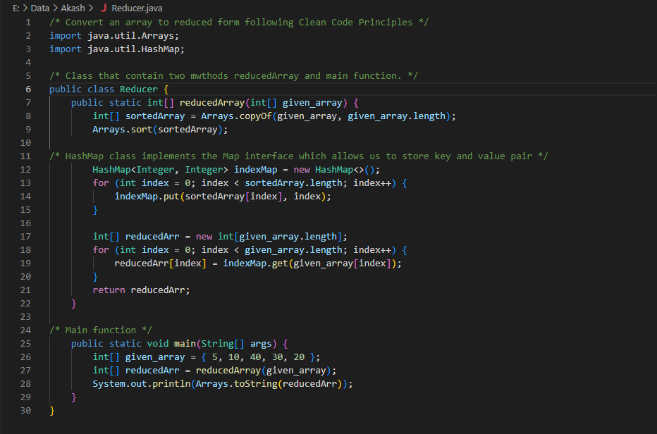

Slide 3
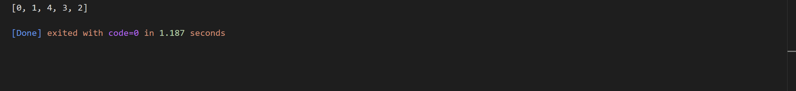

Slide 4
LINK:
https://github.com/akash01847/1874_Clean_Code_Assignment.git

Slide 5
Thank You

