Slide 1


Practical Uses of Deep Learning
Explainable AI & Federated Learning
AKASH S ,
2303921310421012,
III-CSE-A

Slide 2
Introduction to AI
Understanding Explainable AI and Federated Learning
Explainable AI (XAI)
Federated Learning (FL)
Importance of Technologies
Explainable AI focuses on making AI decisions transparent and understandable, ensuring users trust AI systems by providing insights into how decisions are reached and what factors influence them.
Federated Learning is a decentralized approach to AI training that preserves data privacy by allowing model updates from local devices without sharing sensitive data, enhancing security and compliance.
Both XAI and FL are crucial for building trustworthy AI systems, supporting ethical practices and adherence to regulations while optimizing user experience and data protection in applications across various industries.
2

Slide 3
Fundamentals of Explainable AI
Understanding core concepts and methodologies
Motivation
Types of Explainability
Common Techniques
Explainability in AI is crucial for trust and accountability, ensuring that users can comprehend decisions made by AI systems, which is essential for regulatory compliance and ethical standards.
Explainability can be classified as global or local, where global explanations provide an overview of the entire model behavior, while local explanations focus on individual decisions for specific inputs.
Key methods for achieving explainability include model-agnostic techniques like LIME and SHAP, along with interpretable models such as decision trees and linear models, providing insights into AI behavior.
3

Slide 4
Understanding Federated Learning
Decentralized AI Model Training Explained
Motivation
Basic Architecture
Training Process
Federated Learning addresses the critical need for data privacy in AI, allowing models to learn from decentralized data without compromising user confidentiality or violating regulations.
The architecture consists of local clients that maintain their data while communicating with a central server, enabling efficient model updates while preserving data security and privacy.
In the training process, local models are updated based on local data, with results aggregated via methods like FedAvg to ensure global model improvement without direct data sharing.
4

Slide 5
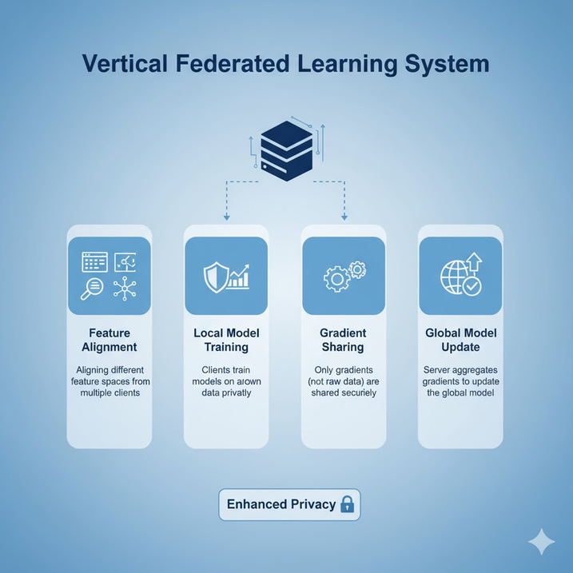
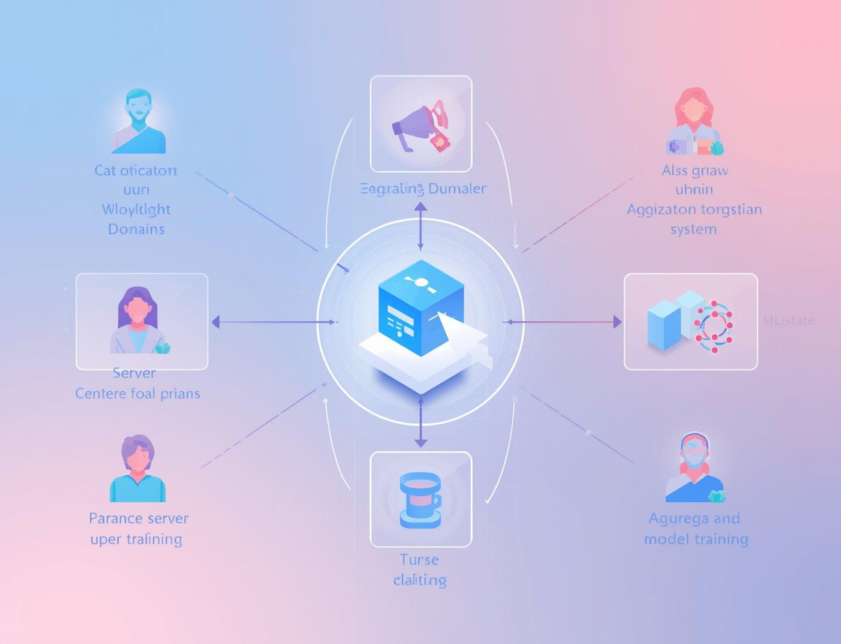
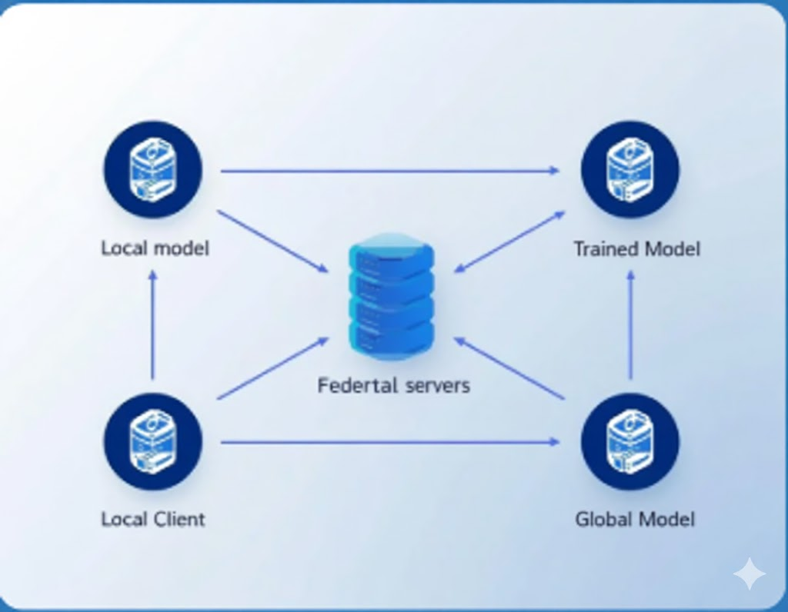
Types of Federated Learning
Federated Transfer Learning
Horizontal FL
Vertical FL
Horizontal federated learning involves clients with similar feature spaces training a shared model collaboratively.
Vertical federated learning allows clients to collaborate while retaining ownership of their unique feature sets.
Federated transfer learning enables clients with different datasets to leverage shared knowledge for improved models.

Slide 6



Use Cases of FL
Mobile Devices
Healthcare Data Sharing
Financial Institutions
Federated learning enables secure data processing on mobile devices without compromising user privacy.
Healthcare institutions can collaborate on patient data analysis while maintaining strict data privacy standards.
Federated learning supports collaborative fraud detection across financial institutions without sharing sensitive data.

Slide 7
Challenges in Federated Learning
Understanding key obstacles in FL implementation
Communication Costs
Data Heterogeneity
Device Diversity
High communication costs can hinder the efficiency of Federated Learning, as frequent updates between local clients and the central server can lead to increased network strain and latency.
The variability in data across different clients affects model performance and interpretability, as inconsistent data distributions can lead to biased outcomes and challenges in model generalization.
The heterogeneity of devices participating in Federated Learning poses challenges, as variations in computational power and capabilities can impact learning efficiency and the overall quality of the trained model.
7

Slide 8
Challenges in Explainability
Navigating complexities in federated learning
FL Context Challenges
Data Heterogeneity
Privacy vs Transparency
Explainability is often limited in federated learning due to decentralized training, making it difficult to understand model decisions based on distributed data sources and local updates.
Variability in data types and distributions across clients can hinder the model interpretability, as differing data characteristics complicate the extraction of consistent, understandable explanations.
Striking a balance between providing meaningful explanations and protecting sensitive data is challenging, as revealing too much can compromise privacy, creating conflict in regulatory contexts.
8

Slide 9
Integrating XAI and FL
The importance of combining these technologies
Trustworthiness
Research Trends
Best Practices
Combining Explainable AI and Federated Learning is essential for developing trustworthy AI systems that prioritize user understanding and data privacy, fostering confidence among users and stakeholders alike.
Ongoing research focuses on frameworks that merge XAI with FL, exploring innovative approaches to enhance explainability while maintaining the security and privacy of decentralized data.
Implementing best practices involves designing models that prioritize interpretability, utilizing effective explanation methods, and establishing clear communication protocols to convey insights generated by AI systems.
10

Slide 10

Case Studies in Healthcare
Integrating XAI and FL for Diagnostics
Demonstrating successful case studies, this integration enhances patient outcomes through explainable AI, ensuring decisions are transparent and data privacy is maintained across federated learning systems.

Slide 11
Conclusion
Federated Learning (FL) fundamentally redefines how machine learning models are trained by enabling collaborative learning across decentralized data sources without the direct exchange of raw data, thereby offering significant advantages in data privacy and security.
This distributed approach allows for the development of robust global models from diverse local datasets, addressing critical concerns around data sovereignty and regulatory compliance.
Moreover, as FL models become increasingly integrated into sensitive applications, the importance of Federated Model Interpretation emerges.
This crucial component ensures transparency and builds trust by providing insights into model behavior and predictions, both locally at the client level and globally after secure aggregation, ultimately leading to more accountable, understandable, and widely adoptable AI solutions.

Slide 12
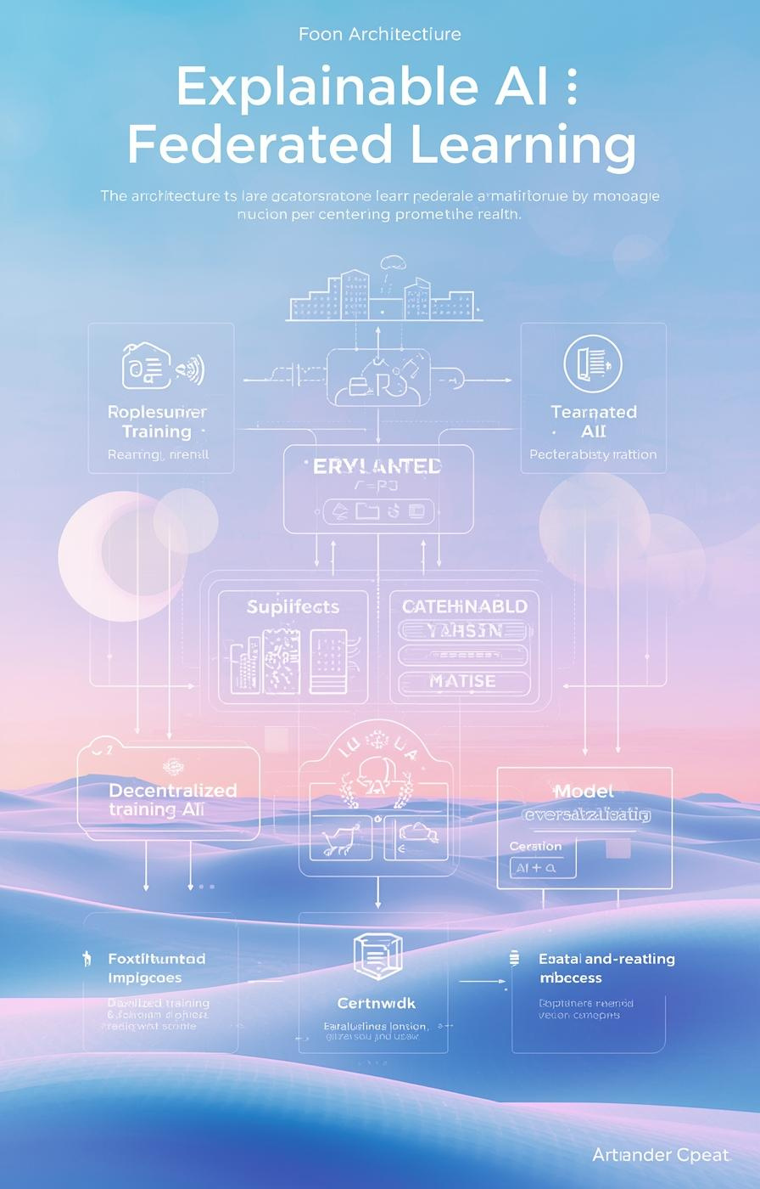
Thank You
ANY QUERIES !!?

