Slide 1
AI
RASET 2026 - BANNARI AMMAN INSTITUTE OF TECHNOLOGY - SATHYAMANGALAM
AI-Based
Skill Gap Analyzer
Intelligent career guidance powered by NLP, semantic matching, and personalised learning paths
NLP + ML
Match Score
Learning Path
NLP
82
LP
Understands skill evidence
0-100 readiness signal
Targeted next steps

Slide 2
02
Research Team
RASET 2026 - BIT
Student Contributors
PROJECT GUIDE
Aadhitya S
AM
Aaron Marshall A
AS
Akash S
Student - CSE
Student - CSE
Assistant Professor
Department of CSE
PSNA College of Engineering and Technology
aaronmarshall2009@gmail.com
s.akash02062005@gmail.com
AS
Akash S M
CP
Chandru P
Student - CSE
Student - CSE
aadhityasivagnanam@psnacet.edu.in
akashkaviya2005@gmail.com
chandru90925@gmail.com
Department of Computer Science and Engineering - Dindigul, Tamil Nadu, India
Submitted to
RASET 2026
Bannari Amman Institute of Technology

Slide 3
03
Presentation Roadmap
RASET 2026 - BIT
01
02
03
04
Introduction
Problem
Existing Systems
Proposed System
The modern career landscape
Why current tools fall short
Three categories analysed
The intelligent platform
05
06
07
08
Architecture
Methodology
Results
Future Scope
Modular system design
Workflow and semantic engine
Dashboard and evaluation
Limitations and roadmap
20 slides - one project story - problem to validated prototype

Slide 4
04
Introduction - The Career Landscape Today
RASET 2026 - BIT
A world of knowledge.
Still one hard question:
The Gap
Generic advice vs.
personalised direction
What should I learn next?
Rapid change
Technology roles reshape every year; learning plans age quickly.
70%+
1x1
Different targets
learners feel directionless about what to learn next
personalised analysis is rare in common guidance tools
Two learners with similar resumes may need very different paths.
Generic guidance
Most tools give the same advice because they only read keywords.

Slide 5
05
Problem Statement
RASET 2026 - BIT
Why personalised guidance is missing
Current platforms often understand job titles, course popularity, or raw keywords. They rarely understand the learner's actual depth, target role, and progress over time.
Pain points observed
No deep profile analysis
Existing portals do not examine true competencies.
Surface-level matching
01
Brief mention vs deep usage
A one-line mention can look equal to hands-on project experience.
Keyword scorers cannot tell them apart.
Generic recommendations
Same advice for everyone
02
Popular courses appear even when they do not close the learner's gap.
Trending-skill lists ignore target role.
No long-term progress view
No continuous tracking
Learners cannot see the gap closing.
03
A single snapshot cannot show whether study effort is improving readiness.

Slide 6
06
Motivation - Why AI Helps Now
RASET 2026 - BIT
Modern language models can read a resume closer to how a human reviewer reads it: context first, keywords second.
NLP
ML
TAX
Contextual NLP
ML Classifiers
Skill Taxonomies
Sentence-level embeddings interpret meaning beyond literal words. ML maps to Machine Learning automatically.
Rich profile signals align with structured role-specific requirements drawn from hiring data.
Curated industry standards provide a living catalogue of what each role demands.
The opportunity: move from keyword overlap to explainable, profile-aware guidance.

Slide 7
07
Existing Systems - Three Categories
RASET 2026 - BIT
01
02
03
Large Job Portals
Course Marketplaces
Early AI Prototypes
WHAT THEY DO
WHAT THEY DO
WHAT THEY DO
Maintain massive resume databases and let employers filter by keywords.
Promote trending courses based on enrolment numbers or broad demographics.
Use one similarity scorer trained on limited data, often without progress tracking.
LIMITATION
LIMITATION
LIMITATION
Wide reach, but recommendations are popularity-driven and rarely explain why a job was suggested.
Strong content variety, but no check whether a course closes a personal gap.
Limited context, no sentiment integration, and weak use of live job descriptions.

Slide 8
08
Consequences for the Learner
RASET 2026 - BIT
What exists breaks
How we respond
VS
Aggregate suggestions
Profile-aware analysis
Top-10 lists ignore individual targets.
Catalogue meets the learner's actual skills.
Unreliable scoring
Semantic embeddings
Brief mentions look identical to deep mastery.
Cosine similarity replaces literal overlap.
Frustrating recommendations
Targeted course paths
Poor job suggestions reduce learner trust.
Each recommendation closes a verified gap.
One-time snapshots
Continuous re-analysis
No way to plan long-term growth.
Score updates every time a skill is added.

Slide 9
09
Proposed System - An Intelligent Career Companion
RASET 2026 - BIT
A web-based platform that merges NLP, Machine Learning, and learner-friendly UX into one cohesive guidance tool.
Helping every learner know where they stand - and what to do next.
Profile Intake
Semantic Parsing
Gap Categorisation
1
2
3
Manual, paste, or upload PDF/DOCX resume.
spaCy + embeddings extract real skills.
Matched, partial, and missing classes.
Match Score 0-100
Learning Roadmap
Progress Tracking
4
5
6
Weighted, transparent readiness signal.
Personalised courses and certifications.
Live re-scoring as skills are added.
Personalised career guidance from resume evidence to measurable progress

Slide 10
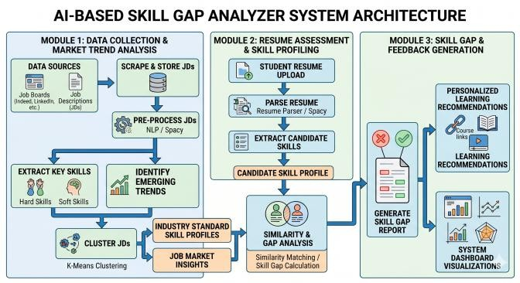
10
System Architecture
RASET 2026 - BIT
Fig. 1 - AI-Based Skill Gap Analyzer system architecture
Three-module pipeline
Module 1
1
Data Collection
Scrape and store JDs; pre-process with NLP/spaCy; cluster via K-Means.
Module 2
2
Resume Assessment
Parse resume; extract candidate skills; build the personal profile.
Module 3
3
Gap & Feedback
Generate skill gap report, learning recommendations, and dashboard.
Input data -> resume profile -> gap report -> learning dashboard

Slide 11
11
Skill Data Acquisition & Processing
RASET 2026 - BIT
The learner provides
NLP parser pipeline
Manual skill entry
Tokenisation & cleaning
Custom resume rules
1
1
2
Type known skills, certifications, and target role.
spaCy tokenises text, removes noise, and normalises casing.
Section-aware extraction for skills, certifications, projects, and experience.
Pasted resume text
2
Paste plain text from a resume or profile.
Synonym normalisation
Structured profile output
3
4
ML equals Machine Learning; JS equals JavaScript; Postgres equals PostgreSQL.
Each skill stores confidence, source span, and evidence reference.
Uploaded document
3
Upload PDF or DOCX; the parser handles both.

Slide 12
12
Skill Comparison & Gap Identification
RASET 2026 - BIT
After a target role is selected, the engine compares the extracted profile against a curated catalogue using sentence-level embeddings rather than literal text matching.
MATCHED
PARTIALLY MATCHED
MISSING
Full overlap
Adjacent expertise
Genuine gap
Example
Example
Example
Profile: Python, Pandas, SQL
Role: Python, Pandas, SQL
Profile: Python
Role: Python, Pandas, NumPy
Profile: none
Role: Machine Learning, Statistics
Contributes 100%
Contributes about 50%
Contributes 0%

Slide 13
13
Match Score - Weighted, Transparent, 0-100
RASET 2026 - BIT
Formula
score = sum(wi x contributioni) / sum(wi)
How it is computed
Each skill carries a weight
Weights mirror how often the skill appears in role-specific job descriptions.
Matched skills contribute fully
82
Their full weight is added to the numerator.
Partial skills contribute proportionally
Only a fraction is credited to reflect partial coverage.
Missing skills reduce the score
Their weight stays in the denominator but adds nothing to the numerator.
MATCH SCORE
Sample - Data Scientist Role
Readable baseline for tracking improvement over time

Slide 14
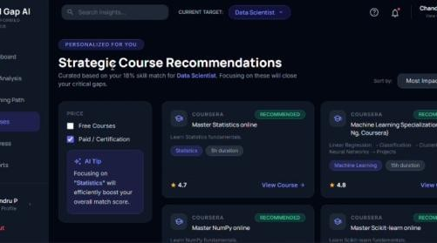
14
Recommendation Engine - Personalised Learning Path
RASET 2026 - BIT
For every gap, the engine assembles a justified, prioritised plan - not a generic course list.
Skill Importance
1
Higher role weights get earlier slots in the path.
Learning Effort
2
Estimated study time keeps the plan realistic.
Learner Preference
3
Free vs paid, video vs reading, self-paced or cohort-based.
What the learner receives
Curated courses
Certification tracks
Structured learning path
Live re-ranking

Slide 15
15
Methodology - End-to-End Workflow
RASET 2026 - BIT
From profile to progress
Profile creation
AI extraction
Industry comparison
1
2
3
User registers, enters skills, uploads or pastes resume.
Backend extracts structured information and cleans it.
Profile is matched against role catalogue with transformer embeddings.
Gap identification
Personalised suggestions
Continuous tracking
4
5
6
Cosine thresholds classify each skill as match, partial, or missing.
Recommendation engine builds the learning path with priorities.
Score, dashboard, and timeline update as the learner studies.
The loop matters: each completed skill can trigger re-analysis and updated recommendations.

Slide 16
16
Implementation Stack
RASET 2026 - BIT
A modular, containerised architecture lets each layer evolve independently.
Frontend
Backend - AI
Data - Infra
Layer 1/3
Layer 2/3
Layer 3/3
React
Python - Flask/FastAPI
PostgreSQL / MongoDB
Component-driven SPA dashboard
REST APIs for parsing and scoring
Profile and catalogue storage
TailwindCSS
spaCy + custom rules
Live JD scraper
Responsive utility styling
Resume parsing and skill extraction
Role weight signals
Chart libraries
Transformers - Sentence-BERT
Docker containers
Donut, bar, and roadmap visuals
Semantic embedding and cosine similarity
Horizontal scaling and deployment

Slide 17
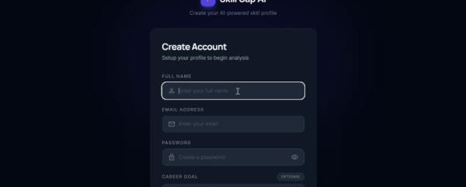
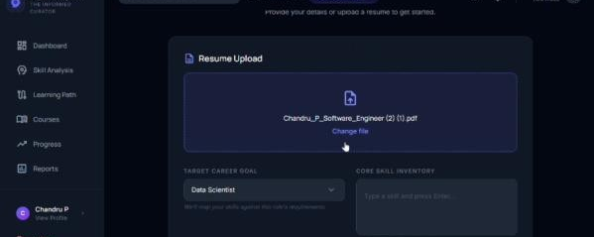
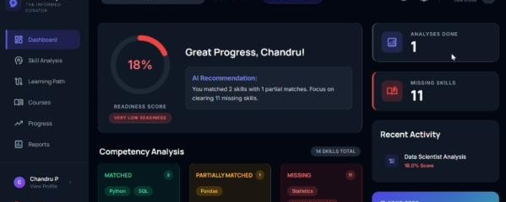
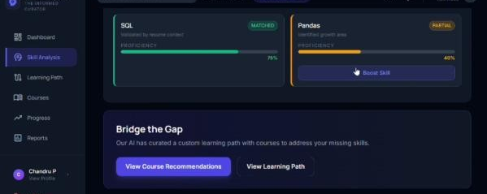
17
Results - Learner Dashboard in Action
RASET 2026 - BIT
Evaluation
Tested across
4 domains
Account creation
Resume upload + target
Software Engineering
Data Analytics
Cybersecurity
UI / UX Design
Match score dashboard
Skill analysis - bridge
Key finding
Match scores correlated strongly with independent expert assessments, including tricky equivalence cases such as Django vs Flask and Power BI vs data visualisation.

Slide 18
18
Advantages of the Proposed System
RASET 2026 - BIT
What makes it different
Semantic over keyword
Transparent scoring
Personalised plans
1
2
3
Embedding-driven matching captures meaning, not just literal text.
A 0-100 score is intuitive and easy to interpret.
Each course targets a real identified gap.
Continuous tracking
Browser-only access
Horizontal scalability
4
5
6
Progress timeline visualises improvement over weeks.
No installation friction; works on any device.
Containerised microservices grow with demand.
Informal feedback: users appreciated the clarity of the match score and the way the roadmap broke long-term goals into manageable steps.

Slide 19
19
Limitations & Future Work
RASET 2026 - BIT
Limitations
Future roadmap
01
Live job-portal integration
Static role catalogue
Real-time role catalogues for up-to-minute weights.
Catalogue refresh is periodic, so short-lived role trends may lag.
02
Mobile companion app
Offline planning, push notifications, on-the-go progress.
Browser-only experience
03
Cohort-based learning
No offline study planner or push reminders yet.
Peer comparison, study groups, and team challenges.
04
Employer collaboration
Single-learner focus
Dashboards for upskilling programmes.
Cohort comparison and peer motivation are outside v1 scope.
Explainability layer
05
Why this course? justifications for every recommendation.

Slide 20
Conclusion
A long-term partner for every learner.
NLP-driven understanding
Quantifiable match
1
2
Reads resumes the way a human reviewer would.
A transparent score the learner can act upon.
Actionable guidance
Living progress
3
4
Each recommendation closes a verified gap.
Improvement is visible and continuous.
Thank you
Questions, ideas, and collaboration are warmly welcomed.
RASET 2026 - Bannari Amman Institute of Technology, Sathyamangalam

