Slide 1

Video To Slide Automation System -PresentationAI
Capstone Project Phase – 1
Akash Kumar
Dr. Thenmozhi S
SRN: PES1PG23CA009
Professor
Department Of CA

Slide 2
Video To Slides Automation System
Abstract
Video-to-slide automation is gaining attention for transforming lengthy video content into concise, structured, and visually engaging presentations
Video-to-Slide Automation System is a React-based application that automates the generation of PowerPoint slides from video content, enhancing efficiency in content creation for education, business, and other domains.
The extracted and summarized video content is used as input to create slides with key points, enabling users to quickly produce professional presentations.
The objective of this project is to analyse video transcripts and automatically generate visually structured slides, summarizing key topics for streamlined presentation creation.
This system supports processing YouTube videos and other sources for both static and real-time slide generation, offering a scalable, user-friendly solution to reduce manual effort and enhance productivity in content summarization and visualization.
Akash Kumar(SRN: PES1PG23CA009)
Department of Computer Applications

Slide 3
Video To Slides Automation System
Introduction
Problem Statement
Manually creating presentation slides from video content is a time-consuming and labour-intensive task, particularly for educators, content creators, and business professionals.
Summarizing long-form videos into concise points and formatting them into visually engaging slides requires significant effort, often slowing down content delivery and knowledge sharing.
Proposed Solution
The Video-to-Slide Automation System converts video content into structured presentation slides. Using Python for backend processing and React for the interface, it extracts, summarizes, and organizes key points to generate polished PowerPoint presentations from a YouTube video link.
Akash Kumar(SRN: PES1PG23CA009)
Department of Computer Applications

Slide 4
Video To Slides Automation System
Introduction
Purpose
The purpose of this project is to streamline the process of creating presentation slides by automating content extraction and summarization. This helps reduce manual work, improves productivity, and enhances accessibility to educational and informational content.
Scope
Static and dynamic video content, allowing users to input video links for automated processing.
Customizable slide generation, providing flexibility in slide design and layout.
Real-time content summarization and visualization, making it suitable for various applications, including education, business presentations, and content marketing.
Akash Kumar(SRN: PES1PG23CA009)
Department of Computer Applications

Slide 5
Video To Slides Automation System
Domain Survey
1. Introduction To The Domain
The project falls within the domain of Artificial Intelligence (AI) and Content Generation, specifically focusing on automated presentation creation. The web application aims to transform various content sources (videos, text, documents) into professionally structured presentations using AI-driven techniques and ML modules.
2. Key Aspect
2.1 Content Processing:
Video content extraction and analysis
Text summarization and structuring
Document parsing and organization
Multi-format input handling (YouTube, PDF, DOCX, TXT)
2.2 Artificial Intelligence (AI):
Natural Language Processing (NLP) for text understanding
Content summarization algorithms
Semantic analysis for topic extraction
Structure recognition and organization
Akash Kumar(SRN: PES1PG23CA009)
Department of Computer Applications

Slide 6
Video To Slides Automation System
Literature Survey
Title: VidSum - Video Summarization using Deep Learning
Author: Nishit Anand; Rupesh Kumar Koshariya; Varsha Garg
Publication Detail:
Publisher: IEEE
Published In: 2023 Second International Conference on Informatics (ICI)
Summary: The paper introduces VidSum, a video summarization framework leveraging Convolutional Neural Networks (CNNs) and Long Short-Term Memory (LSTM) networks to create short, coherent summaries of videos by identifying and selecting important frames. The approach addresses the challenges posed by the massive growth of video data, with applications in areas like surveillance, automated movie trailers, and event highlight reels.
Akash Kumar(SRN: PES1PG23CA009)
Department of Computer Applications

Slide 7
Video To Slides Automation System
Literature Survey
Title: Lecture2Note: Automatic Generation of Lecture Notes from Slide-Based Educational Videos
Author: Chengpei Xu; Ruomei Wang; Shujin Lin; Xiaonan Luo; Baoquan Zhao; Lijie Shao
Publication Details:
Publisher: IEEE
Published in: 2019 IEEE International Conference on Multimedia and Expo (ICME)
Summary: The paper presents Lecture2Note, a method for generating lecture notes by aligning visual entities from slides with corresponding speech texts using semantic similarity. These are arranged in a compact, note-like layout to enhance navigation and review. While effective, the method's quality depends on OCR and subtitle accuracy, with limitations in unordered cases. Future work aims to improve accuracy using image captioning.
Akash Kumar(SRN: PES1PG23CA009)
Department of Computer Applications

Slide 8
Video To Slides Automation System
Literature Survey
Title: Presentation slides generation from scientific papers using support vector regression
Author: S. Syamili; Anish Abraham
Publication Details:
Publisher: IEEE
Published in: 2017 International Conference on Inventive Communication and Computational Technologies (ICICCT)
Summary: The paper proposes an automated system for generating presentation slides from scientific papers. Using Support Vector Regression (SVR), it ranks sentence importance based on features like headings, sentence position, and numerical data. Integer Linear Programming (ILP) creates slides by selecting key sentences, phrases, and visual elements. The system saves time by producing editable draft slides and aims to support multiple documents. Future improvements include expanding to diverse document types and enhancing slide quality.
Akash Kumar(SRN: PES1PG23CA009)
Department of Computer Applications

Slide 9
Video To Slides Automation System
Literature Survey
Title: Video Summarization Leveraging Multimodal Information for Presentations
Author: Hanchao Liu, Dapeng Chen, Rongjun Li, Wenyuan Xue, Wei Peng
Publication Details:
Source: Google Scholar, Interspeech 2023
Summary: The paper introduces a video summarization system for presentation videos, leveraging multimodal data (speech, text, visuals). It uses ASR and OCR to extract text, a query-focused summarizer to identify key content, and assembles video clips accordingly. Tested on ICCV 2017 videos, it reduces video length by 80% while preserving critical content, outperforming existing methods. Future improvements include enhancing OCR queries and adding a discourse parser.
Akash Kumar(SRN: PES1PG23CA009)
Department of Computer Applications

Slide 10
Video To Slides Automation System
Literature Survey
Title: Automatic Presentation Slide Generation Using LLMs
Author: T Gupta
Publication Details:
Source: Google Scholar
Summary: Automatic Presentation Slide Generation Using LLMs," addresses the challenge of manually creating presentation slides from scientific research papers, a process that is often time-consuming. The study explores automated slide generation by fine-tuning large language models (LLMs) such as Longformer-Encoder-Decoder and BIGBIRD-Pegasus, which can handle longer sequences of text. Two approaches are examined: abstractive summarization and hybrid summarization. The research utilizes the PS5K dataset and finds that models supporting longer sequence lengths, especially when trained on section-slide pairs, produce more coherent and effective slides, as indicated by higher R2 and RL scores.
Akash Kumar(SRN: PES1PG23CA009)
Department of Computer Applications

Slide 11
Video To Slides Automation System
Tools And Technologies
Operating System: Windows 10/11, macOS Monterey or later, Ubuntu 20.04 LTS or later
Language: JavaScript (frontend), Python(backend), Node.js(server-side)
IDE: Visual Studio Code
Framework: React (version 17.x or later), Axios, Express.js (version 4.x or later for Node.js),
Akash Kumar(SRN: PES1PG23CA009)
Department of Computer Applications

Slide 12
Video To Slides Automation System
Functional Requirements
Video Input Processing:
Users can upload a video file or provide a YouTube video link.
Video Transcription:
Deep Learning Technique is applied to extract text from audio data
Optical Character Recognition (OCR) is used to extract the text from video frames
Content Summarization:
Summarize the video transcript to extract key points using LLM algorithms.
Slide Generation:
Automatically generate PowerPoint slides with summarized content using Python-pptx.
Customization Options:
Allow users to select slide themes, layouts, or presentation styles (optional).
Real-time Slide Preview:
Display a preview of slides before final download.
Download Output:
Provide a downloadable .pptx file of the generated slides.
Akash Kumar(SRN: PES1PG23CA009)
Department of Computer Applications

Slide 13
Video To Slides Automation System
Non- Functional Requirement
Performance:
Ensure minimal latency during video-to-slide conversion with efficient processing, especially for larger files, and quick React frontend rendering (under 2 seconds).
Scalability & Availability:
Handle large video files and concurrent users, with high availability and redundancy to minimize downtime.
Security & Data Integrity:
Encrypt user data and video content, implement access controls, and ensure no data loss during video processing and slide generation.
Usability & Maintainability:
Provide a user-friendly interface with clear instructions, error feedback, and modular code
that’s easy to maintain and update.
Compatibility & Compliance:
Ensure compatibility across browsers and presentation tools, while adhering to data protection regulations and accessibility standards.
Akash Kumar(SRN: PES1PG23CA009)
Department of Computer Applications

Slide 14
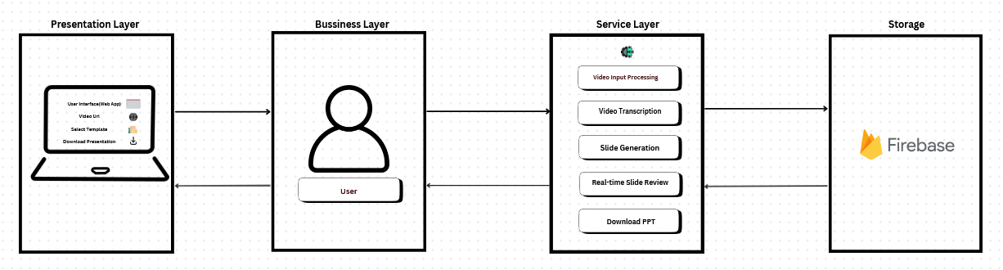
Video To Slides Automation System
Architecture Diagram
Akash Kumar(SRN: PES1PG23CA009)
Department of Computer Applications

Slide 15
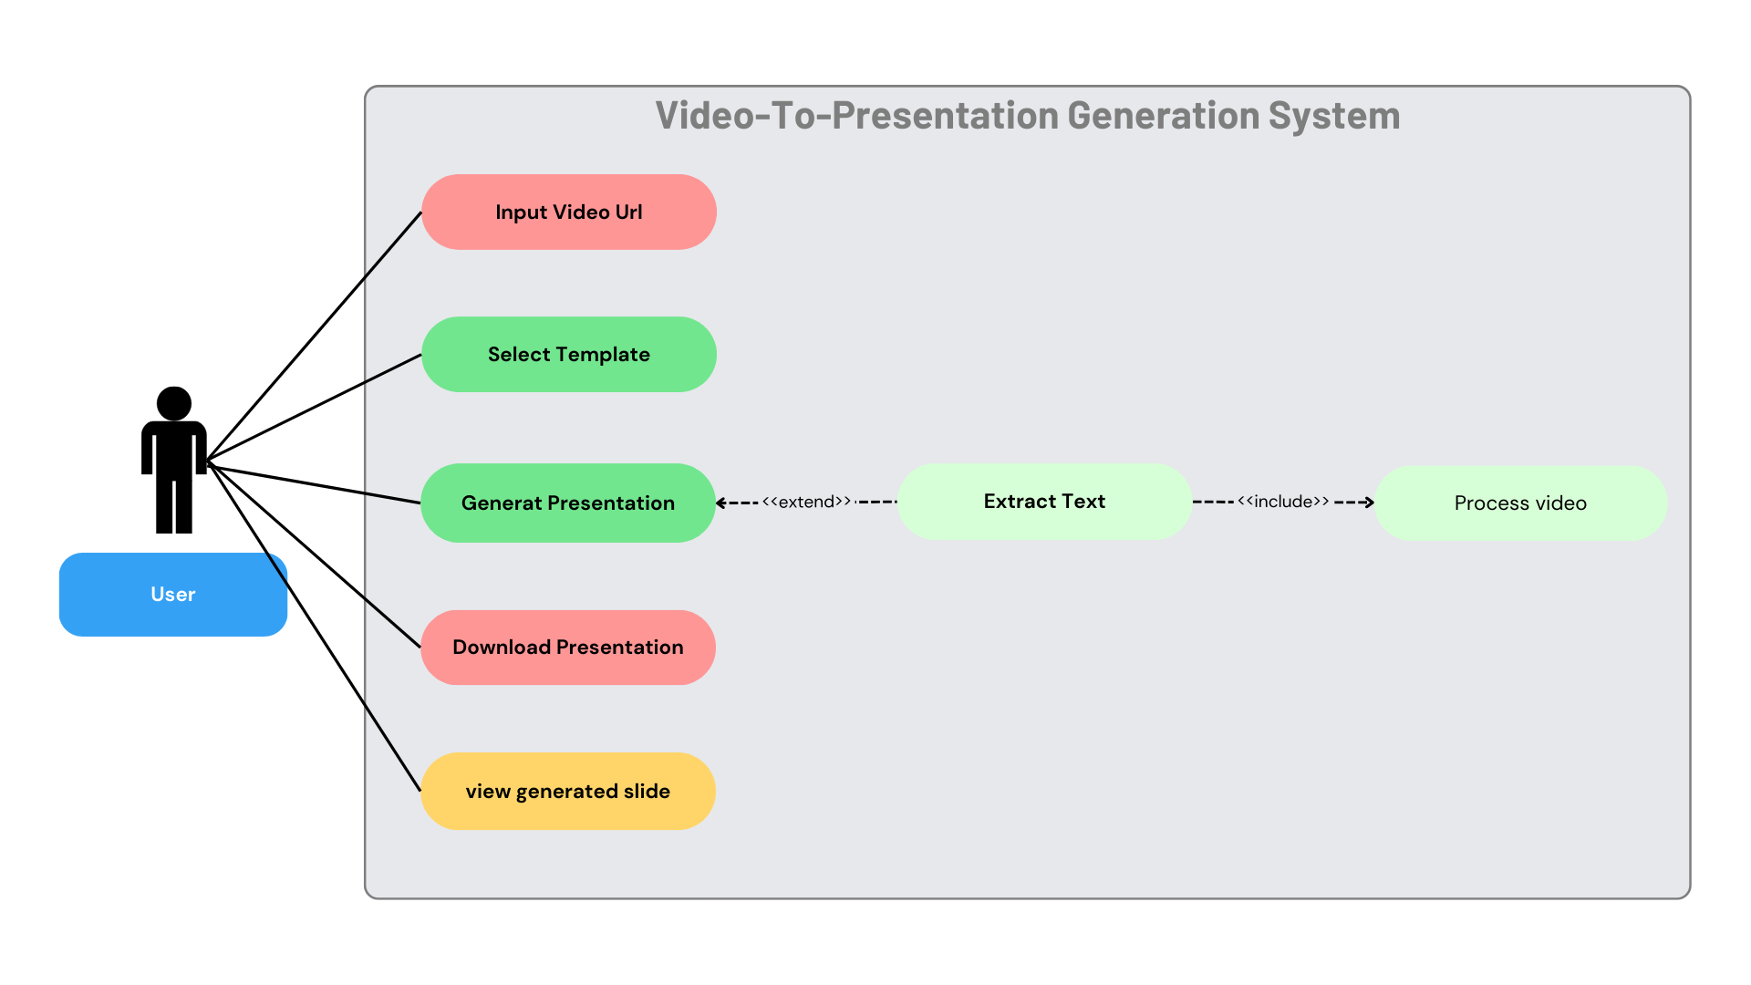
Video To Slides Automation System
Use Case Diagram
Akash Kumar(SRN: PES1PG23CA009)
Department of Computer Applications

Slide 16
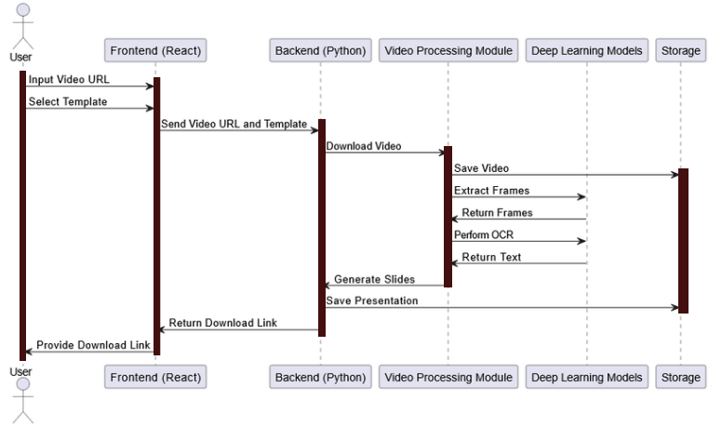
Video To Slides Automation System
Sequence Diagram
Akash Kumar(SRN: PES1PG23CA009)
Department of Computer Applications

Slide 17
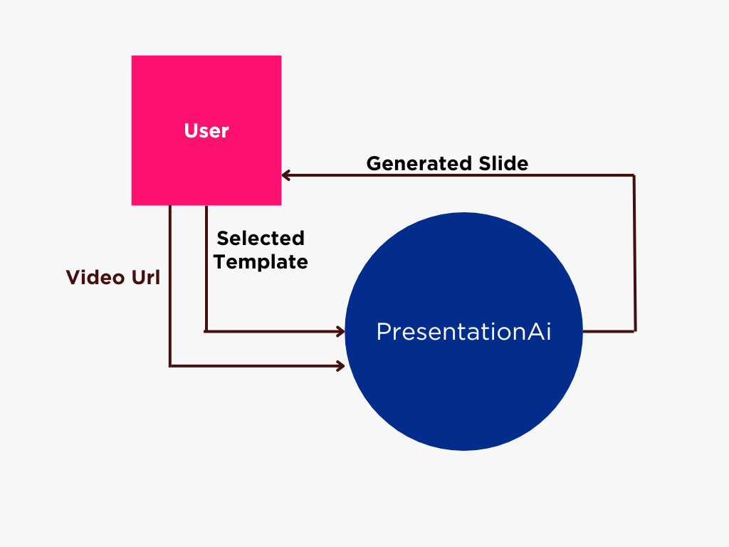
Video To Slides Automation System
Context Diagram
Akash Kumar(SRN: PES1PG23CA009)
Department of Computer Applications

Slide 18
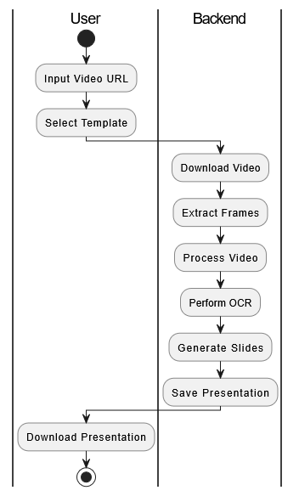
Video To Slides Automation System
Activity Diagram
Akash Kumar(SRN: PES1PG23CA009)
Department of Computer Applications

Slide 19
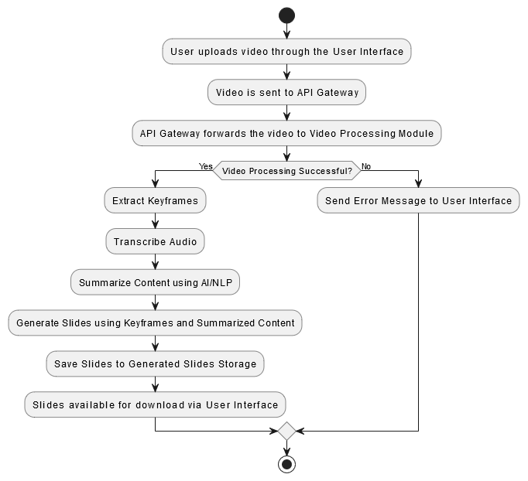
Video To Slides Automation System
Flow Diagram
Akash Kumar(SRN: PES1PG23CA009)
Department of Computer Applications

Slide 20
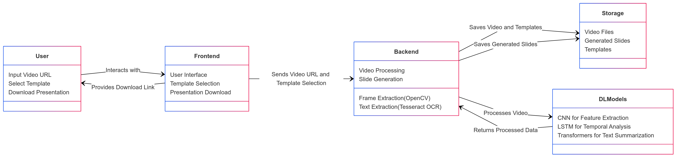
Video To Slides Automation System
Block Diagram
Akash Kumar(SRN: PES1PG23CA009)
Department of Computer Applications

Slide 21
Video To Slides Automation System
Methodology
User Interface Development: Using React to build the frontend application.
Video Downloading: Using library like youtube-dl or pytube (for Python) to download videos from platforms like YouTube.
Audio and Frame Extraction: Use ffmpeg to extract the audio track from the video file.
Speech Recognition: Using the SpeechRecognition library in Python for accurate transcription.
Text Processing: Utilizing libraries like Hugging Face Transformers.
Presentation Generation: Using pptxgenjs for the frontend or python-pptx for the backend to generate PowerPoint files.
Akash Kumar(SRN: PES1PG23CA009)
Department of Computer Applications

Slide 22
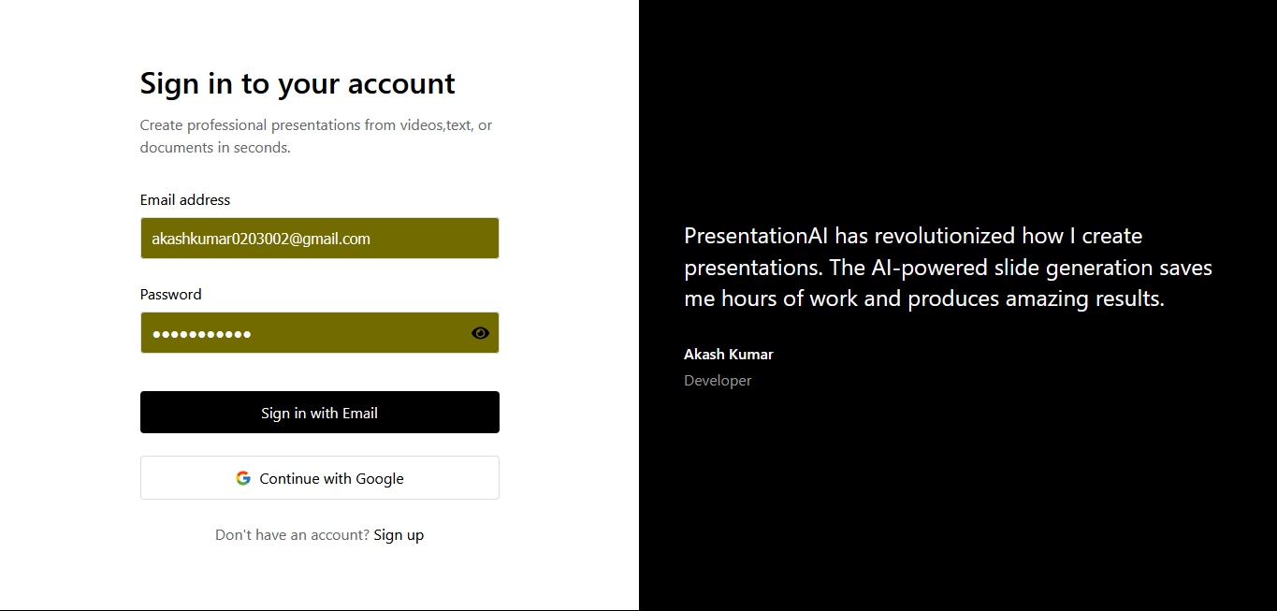
Video To Slides Automation System
Implementation
Akash Kumar(SRN: PES1PG23CA009)
Department of Computer Applications

Slide 23
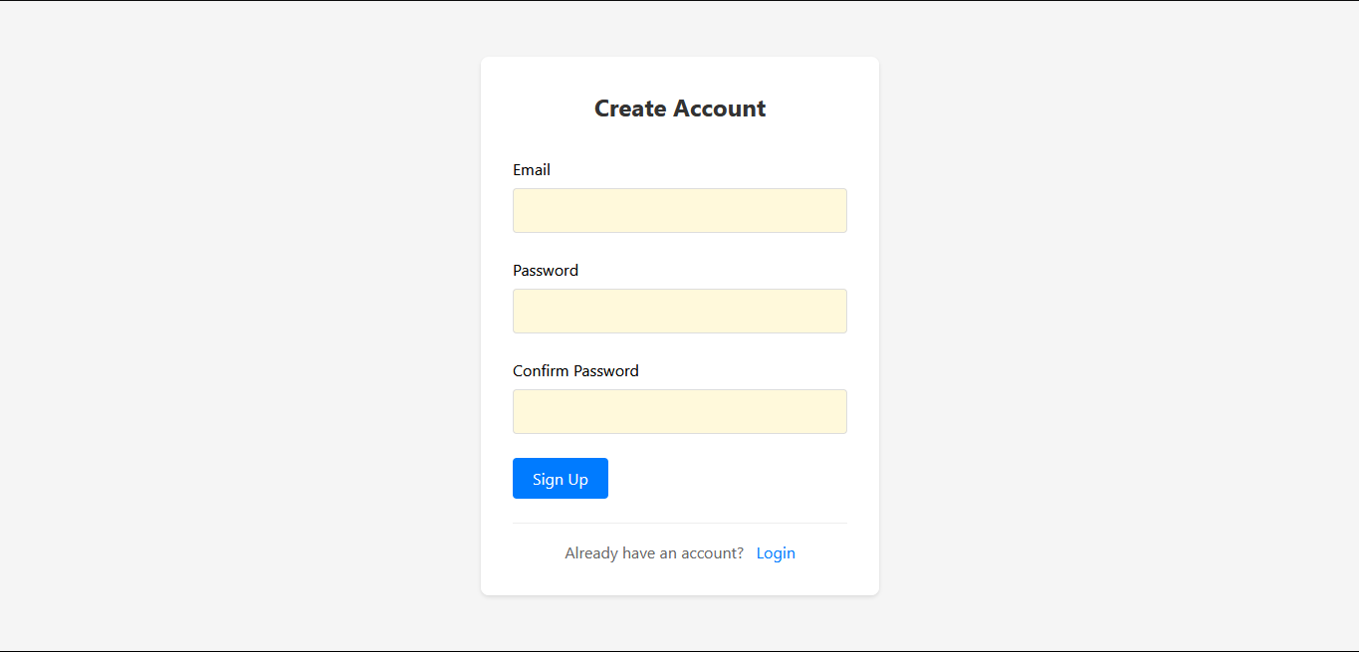
Video To Slides Automation System
Implementation
Akash Kumar(SRN: PES1PG23CA009)
Department of Computer Applications

Slide 24
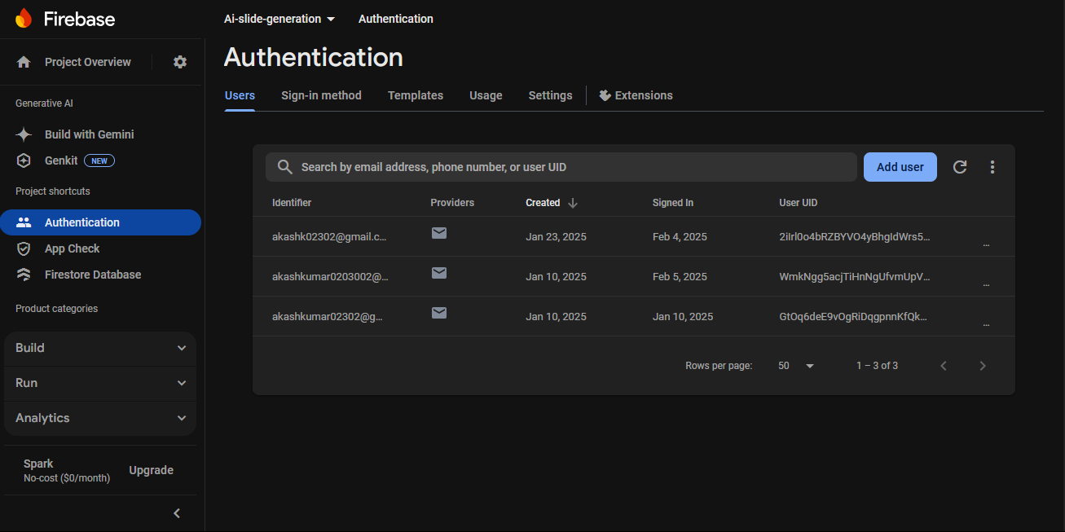
Video To Slides Automation System
Implementation
Akash Kumar(SRN: PES1PG23CA009)
Department of Computer Applications

Slide 25
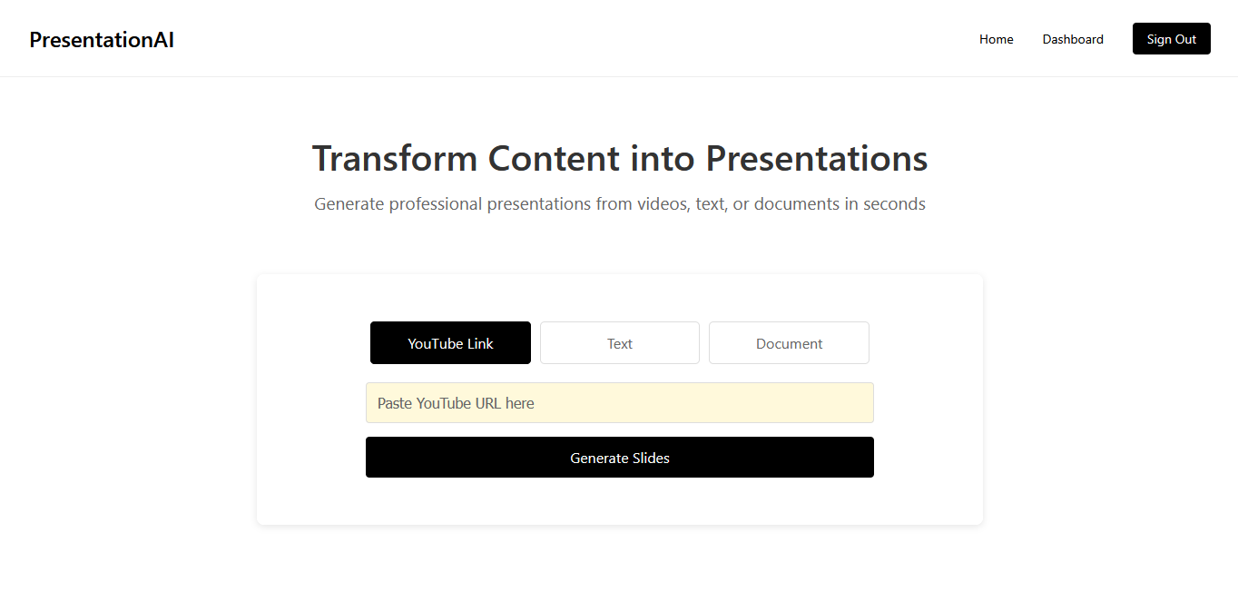
Video To Slides Automation System
Implementation
Akash Kumar(SRN: PES1PG23CA009)
Department of Computer Applications

Slide 26
Video To Slides Automation System
Application In Real World
Education & E-Learning
Corporate Training
Content Creation for Social Media
Healthcare & Medical Training
Conference & Webinar Summaries
Research & Academia
Media & Journalism
Akash Kumar(SRN: PES1PG23CA009)
Department of Computer Applications

Slide 27
Video To Slides Automation System
Progress
Video Input Processing - completed
Uers can upload a video file or provide a YouTube video link.
Video Transcription:
Deep Learning Technique is applied to extract text from audio data
Optical Character Recognition (OCR) is used to extract the text from video frames
Content Summarization:
Summarize the video transcript to extract key points using LLM algorithms.
Slide Generation:
Automatically generate PowerPoint slides with summarized content using Python-pptx.
Customization Options:
Allow users to select slide themes, layouts, or presentation styles (optional).
Real-time Slide Preview:
Display a preview of slides before final download.
Download Output:
Provide a downloadable .pptx file of the generated slides.
Akash Kumar(SRN: PES1PG23CA009)
Department of Computer Applications

Slide 28
Thank You
Akash Kumar
SRN: PES1PG23CA009
Department Of Computer Application

