Slide 1

DETACH : Distributed Data Aware Scheduling For Hadoop
Akash Rafaliya
Chintan Patel
Arpit Sheth
CS554 : Data Intensive Computing
April 29th 2015

Slide 2
Outline
Introduction
Problem Statement
Proposed Work and System Design
Benchmarking
Conclusion

Slide 3
Outline
Introduction
Problem Statement
Proposed Work and System Design
Benchmarking
Conclusion

Slide 4
Diff. Between Hadoop 1.0 and Hadoop 2.0(YARN)
HADOOP 1.0
HADOOP 2.0
MapReduce
(data processing)
Others
MapReduce
(cluster resource management
& data processing)
YARN
(cluster resource management)
HDFS
(redundant, reliable storage)
HDFS2
(redundant, highly-available & reliable storage)

Slide 5
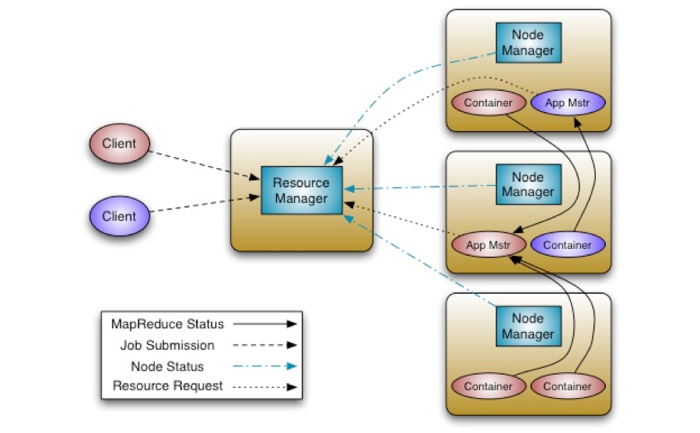
Hadoop-Yarn
ResourceManager (RM)
Central agent - Manages and allocates cluster resources
NodeManager (NM)
Per-Node agent - Manages and enforces node resource allocations
ApplicationMaster (AM)
Per-Application –
Manages application
lifecycle and task
scheduling

Slide 6
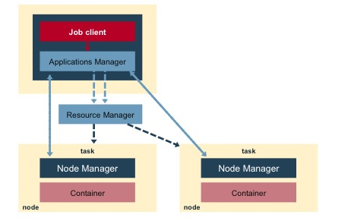
MapReduce Job Lifecycle in YARN
App request by passing config for Application Manager to Resource Manager.
RM allocates a container as per AM requirements.
AM talks directly to the NM on those nodes to launch the containers for tasks.
AM monitors the progress of the tasks.

Slide 7
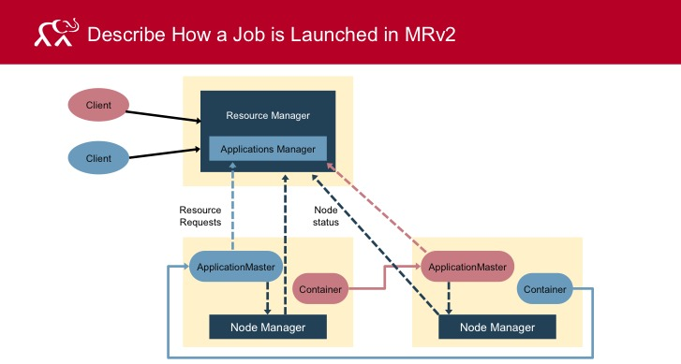
Non-MapReduce Job Lifecycle in YARN

Slide 8
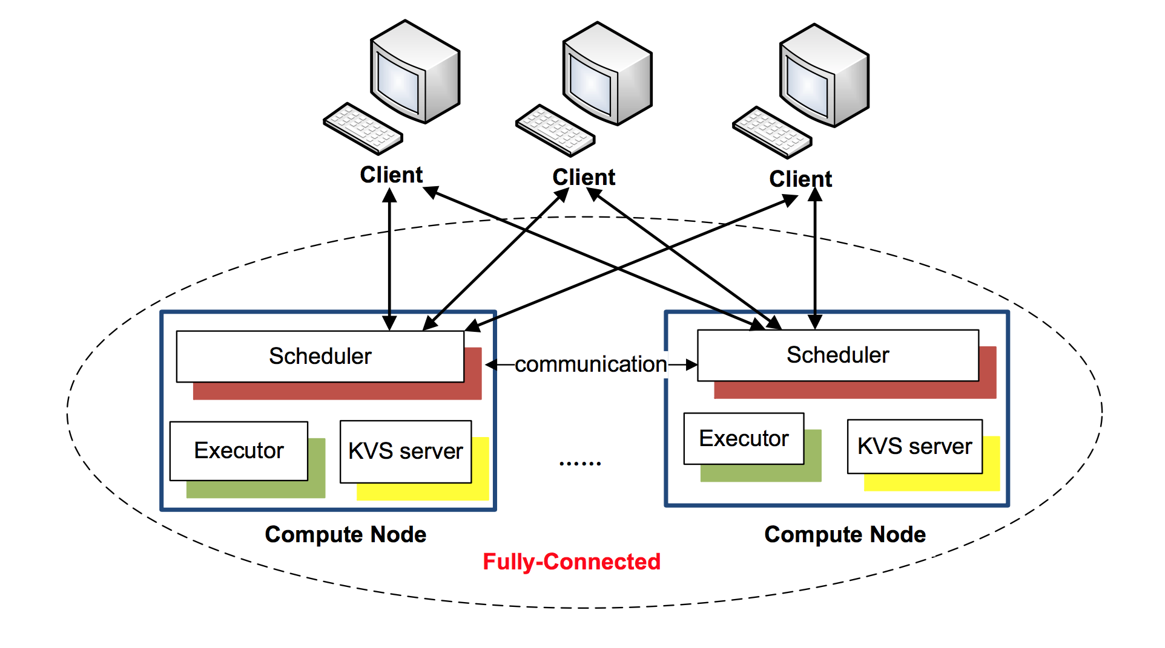
MATRIX

Slide 9
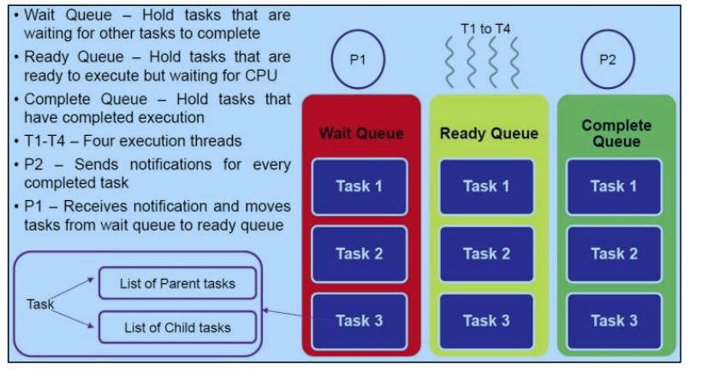
MATRIX Execution Unit

Slide 10
Outline
Introduction
Problem Statement
Proposed Work and System Design
Benchmarking
Conclusion

Slide 11
Problem Statement
Design Issues
Centralize design of Resource Manager and task scheduler.
Metadata management of HDFS file system.
Scalability
System scale is increasing to extreme-scale
Increment in workload size
Efficiency
Distributed load balancing to achieve high system utilization

Slide 12
Outline
Introduction
Problem Statement
Proposed Work and System Design
Benchmarking
Conclusion

Slide 13

DETACH : System Architecture
Client
Resource Manager
Client
Application Manager
Resource
Requests
Node Status
ApplicationMaster
MATRIX
MATRIX
MATRIX
Container
Container
Container
Node Manager
Node Manager
Node Manager

Slide 14
Outline
Introduction
Problem Statement
Proposed Work and System Design
Benchmarking
Conclusion

Slide 15
Benchmarking
Benchmarking of some of the distributed TEFs (Task Execution Framework)- Hadoop-YARN, MATRIX
We will use below metrics for evaluation of above systems : Throughput, Latency.

Slide 16
Hadoop - YARN
Apache Hadoop is a framework that allows for the distributed processing of large data sets crossclusters of commodity computers using a simple programming model.
It is designed to scale up from single server to thousands of machines, each providing computation and storage.

Slide 17
Hadoop-YARN Benchmarking
Experiment environment : Amazon EC2 , c3.large

Slide 18
Hadoop-YARN Benchmarking
Experiment environment : Amazon EC2 , c3.large

Slide 19
MATRIX
MATRIX is distributed Many Task Computing execution fabric.
MATRIX uses adaptive work stealing technique to achieve distributed load balancing.
It also uses ZHT, distributed key-value store to keep task metadata.

Slide 20
MATRIX - Benchmarking
Experiment environment : Amazon EC2 , c3.large

Slide 21
MATRIX - Benchmarking
Experiment environment : Amazon EC2 , c3.large

Slide 27


