Slide 1
CUSTOMER CHURN PREDICTION AND BEHAVIOUR ANALYSIS: A MACHINE LEARNING APPROACH
Group 10:
Akash Anand T Arjun Sreekumar
Ayantika Chatterjee Taranjeet Kamboj

Slide 2
TABLE OF CONTENTS
INTRODUCTION
OUR BUSINESS PROBLEM
01
03
DATA EXPLORATION
05
MACHINE LEARNING APPROACH
07
CHALLENGES
02
04
06
BUSINESS SOLUTION
08
CONCLUSION
FEATURE SELECTION

Slide 3
01
INTRODUCTION
01

Slide 4
Introduction
Customer churn is a critical challenge impacting profitability and growth.
Our project leverages data-driven insights to:
Identify key drivers of churn.
Predict at-risk customers with high accuracy.
Support targeted retention strategies.
By addressing churn, businesses can enhance customer loyalty and reduce acquisition costs.

Slide 5
Our Business Problem
02

Slide 6
Business Problem
Impact of Customer Churn:
High churn rates increase customer acquisition costs.
Retaining customers is more cost-effective than acquiring new ones.
Key Questions to Solve:
Can we predict which customers are most likely to churn?
What key factors influence customer churn behavior?
Goal:
Build a predictive model using customer data to identify at-risk customers and support targeted retention efforts.

Slide 7
DATA EXPLORATION
03

Slide 8
Data Overview
5,000 customer records with 12 features.
Features include demographics (Age, Gender, Region), spending patterns (Monthly Spend), satisfaction metrics, and churn status.
Data Quality:
Missing values in critical fields like Age (500) and Satisfaction Score (500).
Features required preprocessing for consistency and usability.
Key Variables:
Target: Churned (1 = Yes, 0 = No).
Predictors: Monthly Spend, Satisfaction Score, Discount Offered, etc.
Purpose of Exploration:
Identify patterns and trends to inform model building and business insights

Slide 9
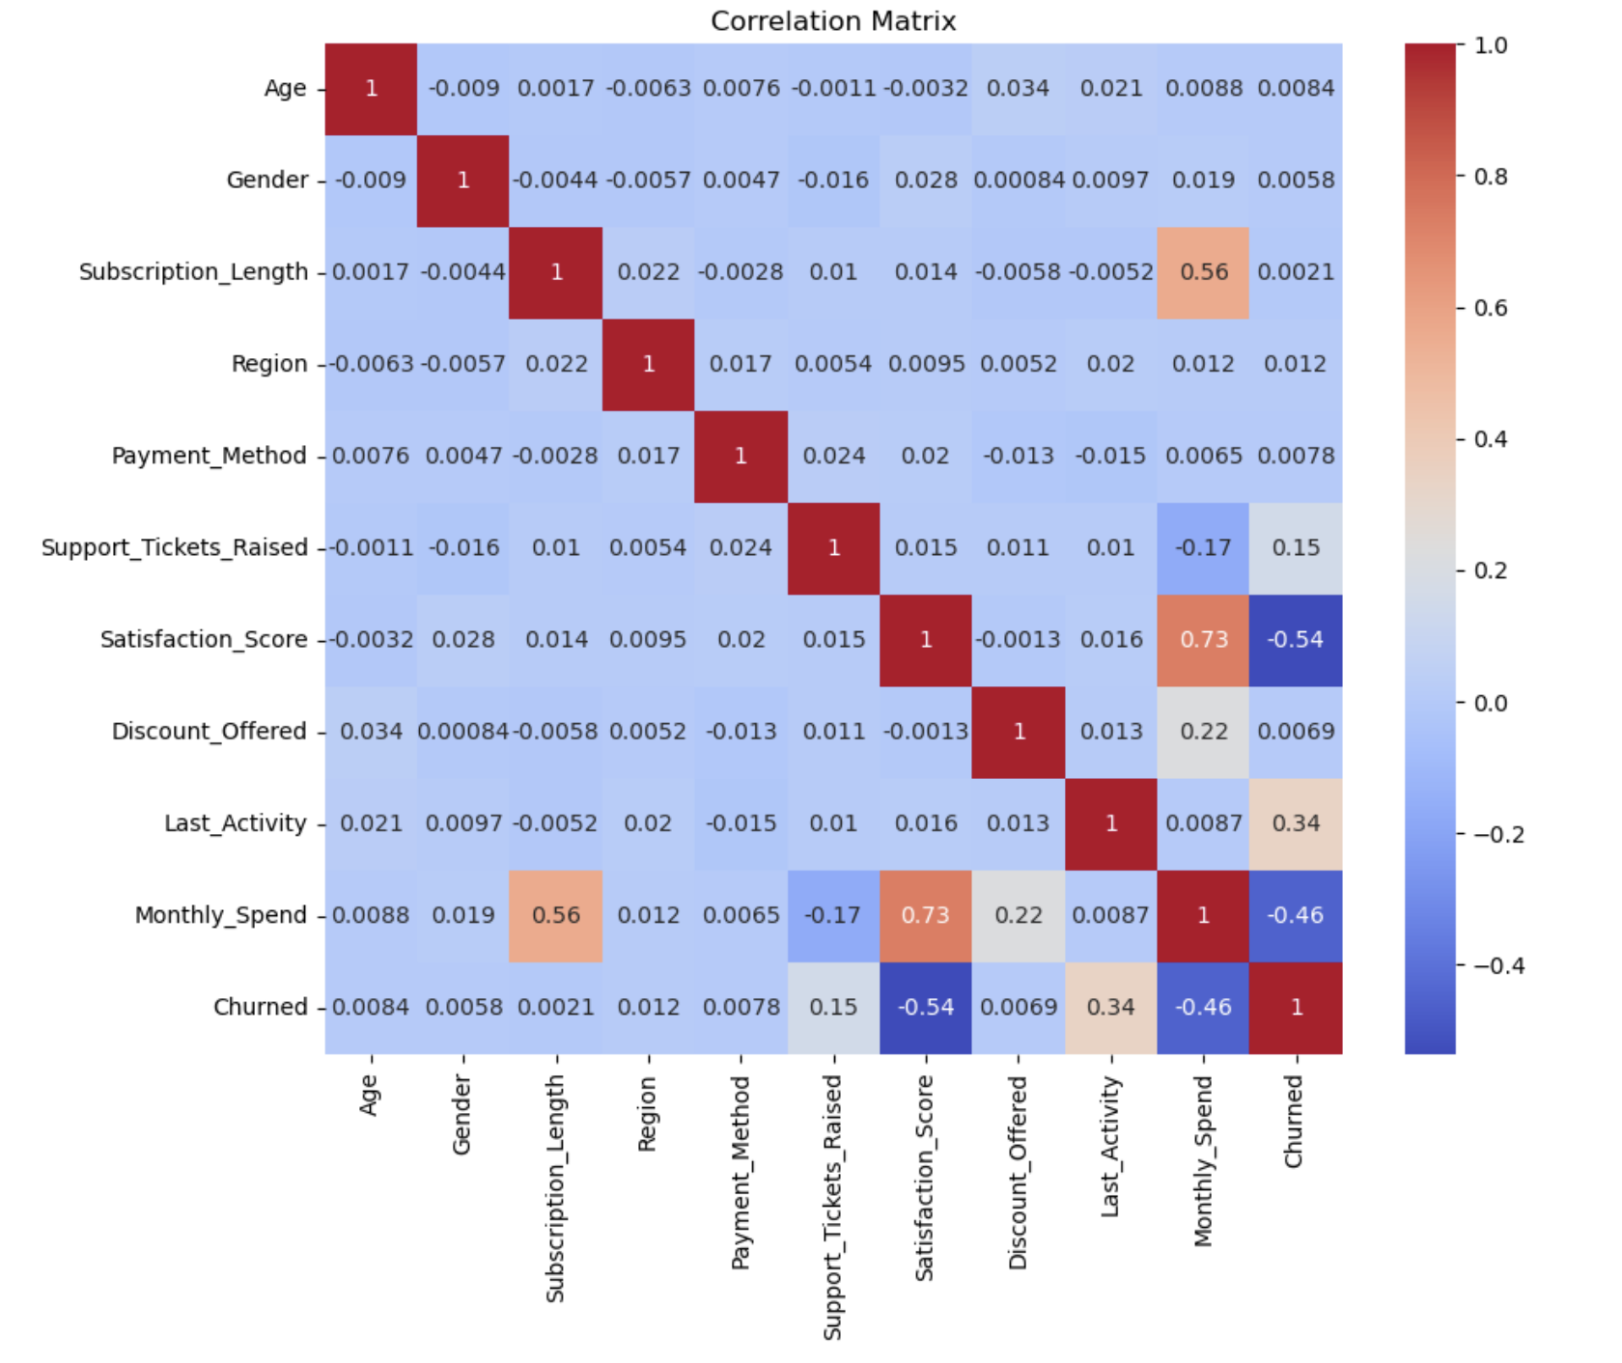
Exploratory Data Analysis
Key Findings:
Higher discounts correlate with higher churn rates, indicating potential inefficiencies in discount strategies.
Customers with low satisfaction scores are more likely to churn.
Spending patterns vary significantly between churned and retained customers.
Churn Distribution:
Approximately 30% of customers in the dataset have churned.
Purpose of Analysis:
Identify significant trends and relationships between features.
Guide feature selection for the predictive model.

Slide 10
FEATURE SELECTION
04

Slide 11
Features Selected for Regression Model (Monthly Spend)
Selected Features:
Subscription Length (Subscription_Length): Reflects customer tenure
Support Tickets Raised (Support_Tickets_Raised): Indicates customer service needs.
Satisfaction Score (Satisfaction_Score): Links customer happiness to spending.
Discount Offered (Discount_Offered): Impacts spending behavior.
Purpose:
Focus on customer behavior and satisfaction to predict spending patterns.

Slide 12
Features Selected for Classification Model (Churn)
Selected Features:
Gender (Gender): Demographic insight.
Payment Method (Payment_Method): Automated or manual payments.
Support Tickets Raised (Support_Tickets_Raised): Impacts churn likelihood.
Satisfaction Score (Satisfaction_Score): Key factor in retention.
Last Activity (Last_Activity): Frequency of customer engagement.
Purpose:
Identify at-risk customers using behavior and demographic patterns.

Slide 13
Machine Learning Approach
05

Slide 14
Prediction Models for Regression
Linear Regression
Random Forest Regressor
Actionable Outcomes:
- Straightforward insights into key drivers of churn or spending, aiding in data-driven decision-making.
Actionable Outcomes:
- Provides insights into feature importance (e.g., which behaviors contribute most to churn).
- Helps predict metrics like monthly spend or viewing hours with high accuracy, which supports customer segmentation.

Slide 15
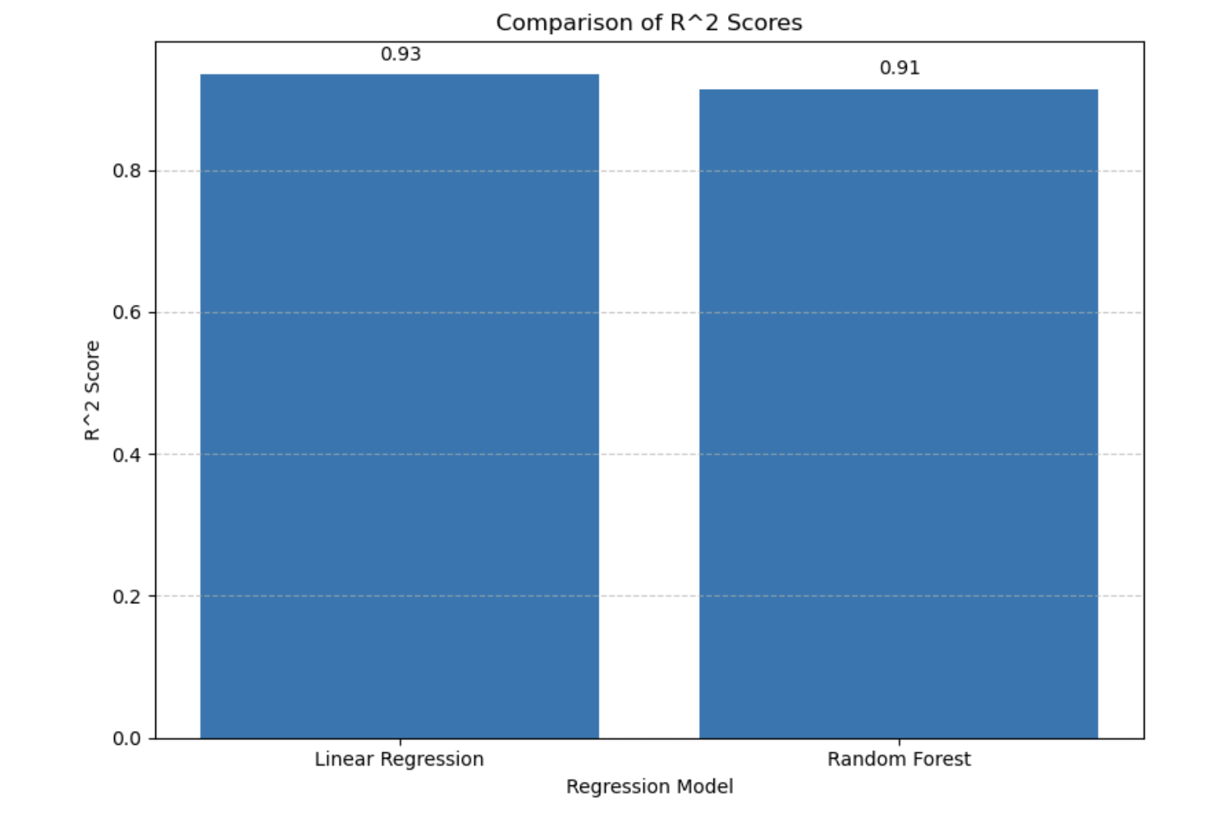
Comparing Regression Models
Linear Regression slightly outperformed Random Forest with a R square value of .934, accurately predicting monthly spending
Both models provide reliable spending predictions for customer segmentation.
This suggests that customers with longer subscriptions, who raise fewer support tickets, have higher satisfaction scores, and are offered discounts tend to spend more.

Slide 16
Prediction Models for Regression
Logistic Regression
KNN
Random Forest Classifier
Actionable Outcomes:
Helps prioritize actionable features (e.g., “Low satisfaction increases churn risk by 20%”), enabling focused interventions.
Actionable Outcomes:
Highlights similarities between customer groups, enabling targeted retention strategies (e.g., “Customers with similar profiles are at risk of churn”).
Actionable Outcomes:
- Offers clear, data-driven insights into what drives churn (e.g., “Discounts are the strongest predictor of retention”).
- Supports decisions on customer retention strategies and personalization.

Slide 17
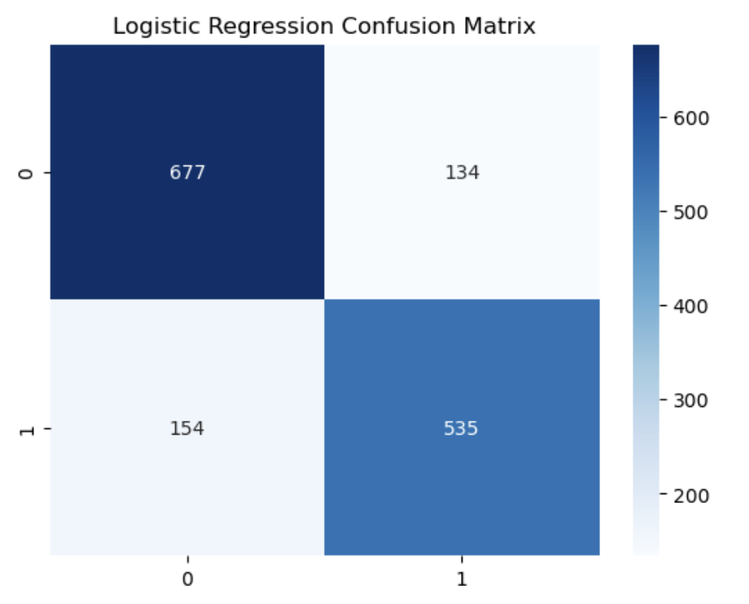
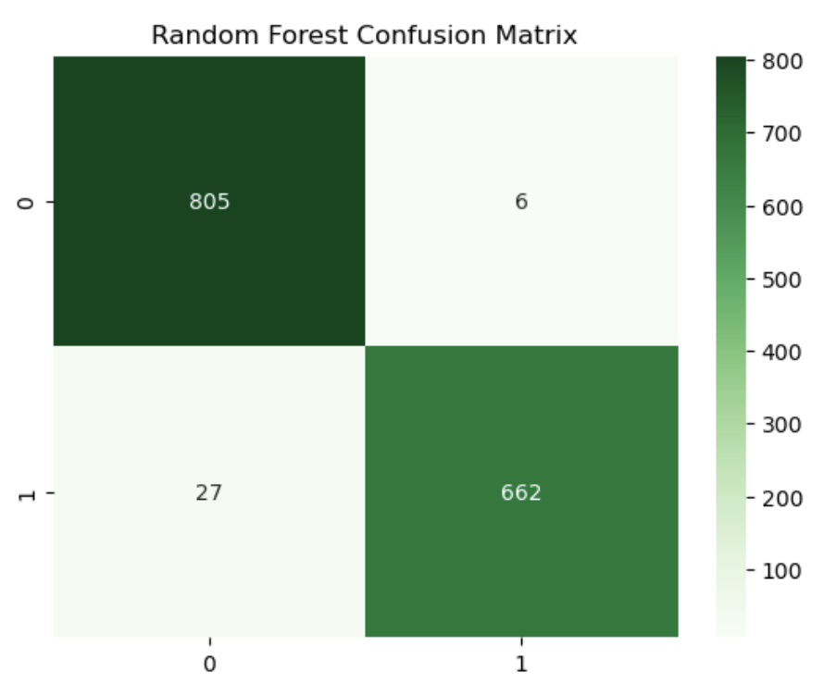
Prediction Models for Classification
Logistic Regression
Random Forest Classifier
Performs adequately, but its false negatives (154) suggest challenges in identifying churned customers.
Consistently outperforms others with minimal false positives (6) and false negatives (27), achieving the best balance between precision and recall.

Slide 18
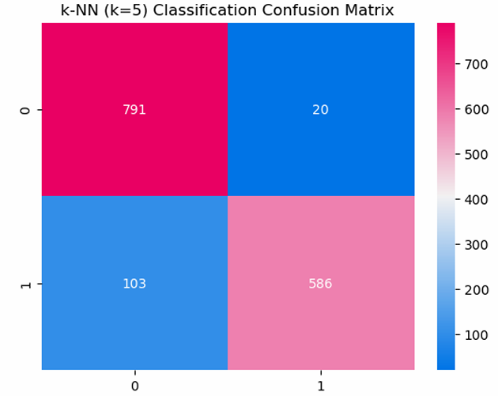
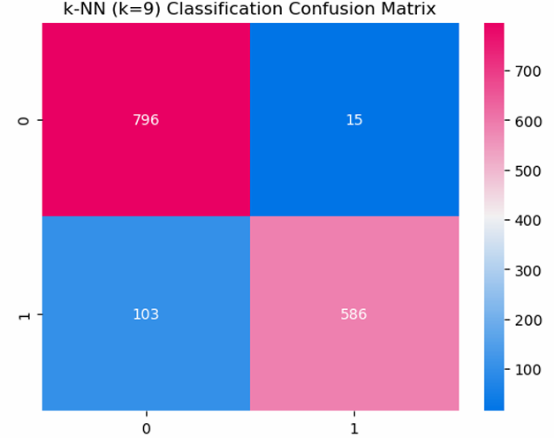
Prediction Models for Classification
k-NN (k=5)
k-NN (k=9)
High accuracy but shows higher false negatives (103) compared to Random Forest.
Lower false positives (15) compared to k=5, suggesting better precision.

Slide 19
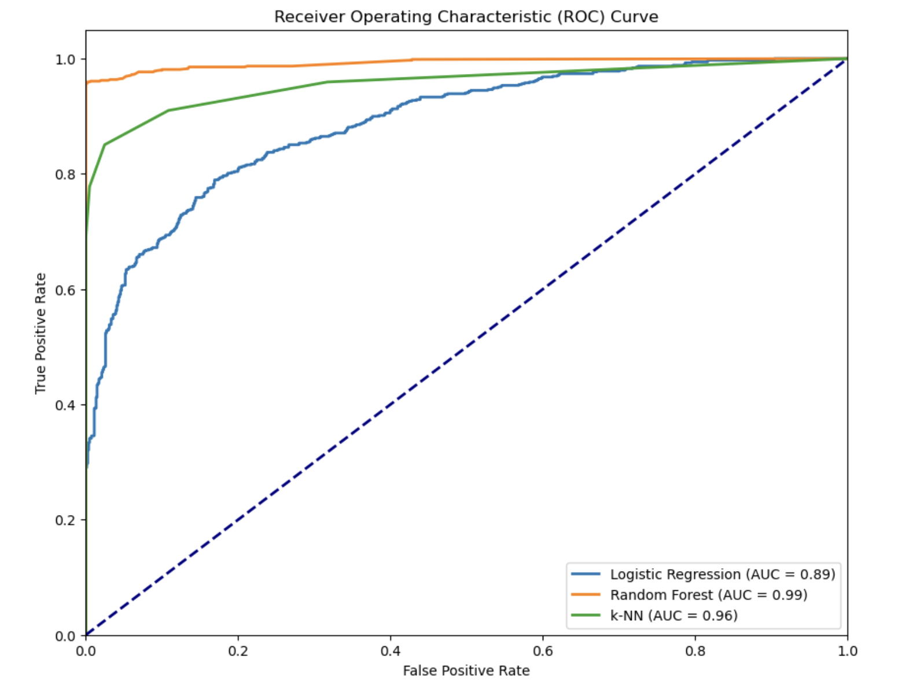
Comparing Classification Models
Random Forest achieved the highest Accuracy (83%) and AUC (0.88), outperforming Logistic Regression and k-NN.
Decreased product usage or engagement can signal a decline in customer interest.
Customers with low satisfaction scores are more likely to churn

Slide 20
BUSINESS SOLUTION
06

Slide 21
WHAT TO DO (Business Solution)
For Optimizing Spending
Customer Segmentation: The models can be used to segment customers based on their predicted spending levels. This can help the business target specific customer segments with tailored marketing campaigns and offers.
Product Development: Understanding the factors that influence spending can help the business develop products and services that appeal to high-spending customers.
Customer Support: Analyzing the impact of support tickets on spending can help the business optimize their support processes and improve customer satisfaction.
Pricing and Promotions: The models can be used to evaluate the effectiveness of pricing strategies and promotions on customer spending.

Slide 22
WHAT TO DO (Business Solution)
For Reducing churn
Customer Segmentation: The models can be used to segment customers based on their predicted spending levels. This can help businesses target specific customer segments with tailored marketing campaigns and offers.
Product Development: Understanding the factors that influence spending can help businesses develop products and services that appeal to high-spending customers.
Customer Support: Analyzing the impact of support tickets on spending can help businesses optimize their support processes and improve customer satisfaction.
Pricing and Promotions: The models can be used to evaluate the effectiveness of pricing strategies and promotions on customer spending.

Slide 23
WHAT TO DO (Business Solution)
Retention Strategies
Proactive Customer Engagement:
Identify at-risk customers: Use predictive models to identify customers likely to churn.
Personalized communication: Tailor outreach to specific customer needs and preferences.
Enhanced support: Provide timely and efficient customer support.
Product and Service Optimization:
Continuous improvement: Regularly update and enhance products and services.
Customer feedback: Actively seek and incorporate customer feedback.
Streamlined processes: Simplify processes to improve customer experience.
Data-Driven Decision Making:
Regular model updates: Keep models current to accurately predict churn.
A/B testing: Experiment with different strategies to optimize results.
Data-driven insights: Use data to identify trends and make informed decisions.
By implementing these strategies, businesses can significantly reduce churn and foster long-term customer relationships.

Slide 24
CHALLENGES
07

Slide 25
Missing Values
Challenge:
Opportunity:
Key variables such as Age and Satisfaction Score had missing data, impacting analysis reliability.
Enhance data collection processes to ensure completeness and reduce reliance on imputation.

Slide 26
Imbalanced Churn Distribution
Challenge:
Opportunity:
Churned customers were significantly fewer than retained ones, leading to potential bias in predictive models.
Implement techniques like resampling or class weighting to address imbalance for fairer insights.

Slide 27
CONCLUSION
08

Slide 28
Conclusion
Predictive modeling is a powerful tool for identifying customers at risk of churning.
Key factors influencing churn include satisfaction, product usage, and customer support interactions.
Proactive customer engagement and product improvement are crucial for retention.
Data-driven decision making is essential for optimizing retention strategies.
Continuous monitoring and model updates are necessary to adapt to changing customer behavior.

Slide 29
THANK YOU!

