Slide 1


  JODHPUR INSTITUTE OF ENGINEERING AND TECHNLOGY
DEPARTMENT OF ELECTRONICS AND COMMUNICATION ENGINEERING
EXPLORATORY PROJECT
SESSION 2024-2025
(I YEAR-I SEMESTER)
TOUCH SENSOR WITH LED
SUBMITTED UNDER
UNDER THE GUIDANCE OF -
THE TEAM COLLABORATION BY
• Mr. PREMA RAM
•AKASH RATHORE
(Assistant Lecturer)
•DARSHAN SHARMA
•Mr. AJAY KUMAR KUSHWAHA
(Assistant Lecturer)

Slide 2
INTRODUCTION
Touch sensor technology has revolutionized the way we interact with electronic devices. From smartphones to modern home appliances, touch sensors provide intuitive and user-friendly interfaces.
Our project explores the working principle, design, and applications of touch sensors, focusing on their significance in creating innovative solutions. By simulating real-world scenarios, we aim to understand the efficiency and adaptability of this cutting-edge technology.
Incorporating touch sensors into everyday devices not only enhances user experience but also paves the way for smarter and more responsive systems. This technology represents a key step forward in bridging the gap between humans and machines."
This presentation will take you through the fundamentals of touch sensors, our project implementation, and the potential future advancements in this field."

Slide 3
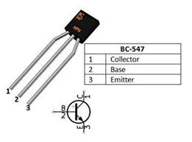
HARDWARE REQUIREMENTS
Hardware of this project consists of a transistor, two resistors, an LED, Pushbutton switch.
The touch sensor circuit with a transistor works by utilizing the transistor as a switch that activates when a small voltage is applied through the touch input. When a conductive object, such as a human finger, touches the sensor plate (a metallic pad or wire), it allows a small current to flow into the base of the transistor. This current is enough to switch the transistor from its OFF state to the ON state.
Hardware Used:
1. TRANSISTOR:
Touching the sensor plate sends a small current to the transistor's base, turning it ON and activating an output like an LED or buzzer. Removing the touch turns the transistor OFF.

Slide 4
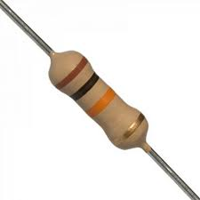
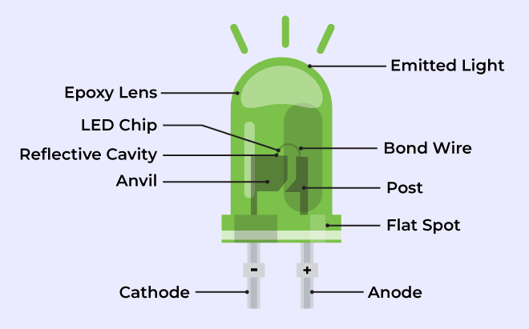
2. Resistors:
A resistor is an electrical component that limits or regulates the flow of current in a circuit. It is used to protect components, divide voltage, and control current, ensuring the circuit operates safely and efficiently.
3. LED:
An LED (Light Emitting Diode) is a semiconductor device that emits light when current flows through it. It is energy-efficient, long-lasting, and commonly used for indicators, displays, and lighting.

Slide 5
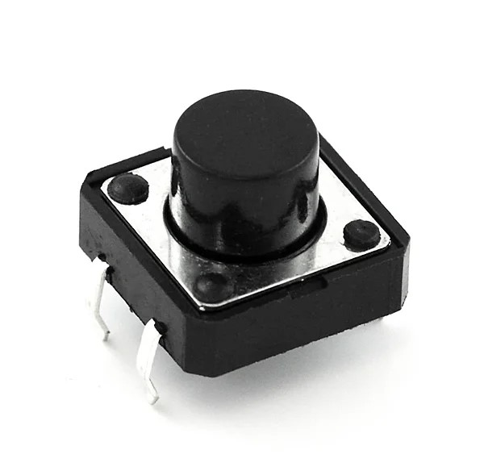
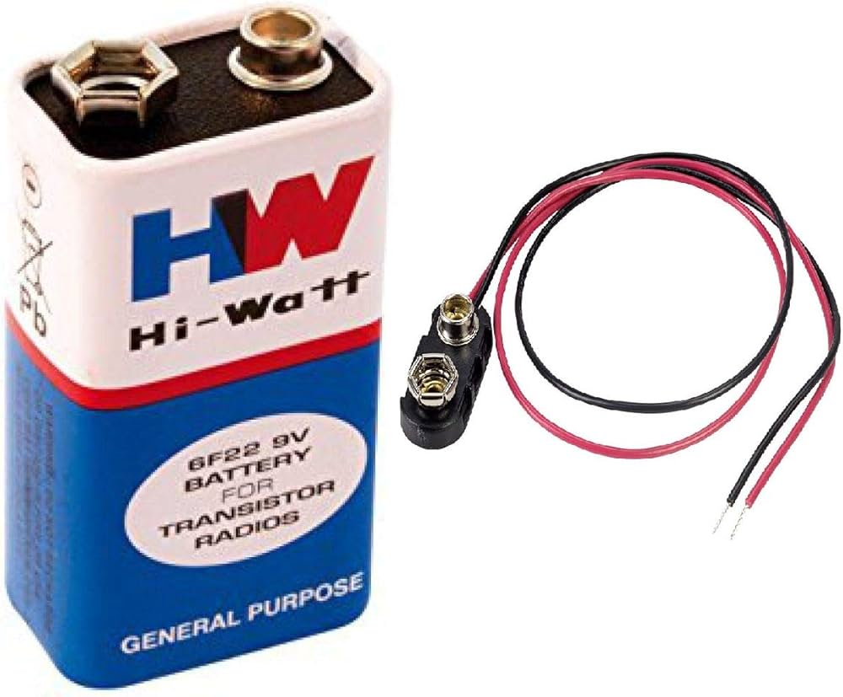
4. PUSHBUTTON:
A pushbutton is a simple mechanical switch that opens or closes a circuit when pressed. It is commonly used for user input in devices, such as turning on/off systems or triggering actions.
5. BATTERY:
A battery is a portable energy source that stores electrical energy in chemical form and releases it as electrical power when needed. It consists of one or more electrochemical cells and is used to power electronic devices, from small gadgets to larger systems.

Slide 6
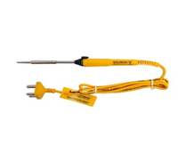
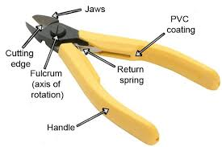
Hand tools:
1. Soldering Iron:
A soldering iron is a tool used to melt solder, a metal alloy, to join electronic components together. It heats up to a high temperature, allowing the solder to flow and create strong electrical connections on circuit boards.
2. Wire Cutter:
A wire cutter is a tool used to cut wires and cables. It has sharp blades that allow for clean, precise cuts, making it essential for electrical work, electronics, and general wire management.

Slide 7
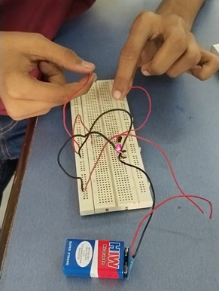
WORKING OF PROJECT
In this touch sensor project, the working begins when a user touches the sensor plate, which detects the presence of the finger. The touch allows a small current to flow into the base of the transistor, which acts as a switch. Once the base current reaches a certain threshold, the transistor is activated, allowing a larger current to flow from the collector to the emitter. This in turn powers the connected LED, causing it to light up. A resistor is used in the circuit to regulate the current and protect the LED. If a pushbutton is incorporated, pressing it resets the circuit, turning off the LED and returning the system to its initial state. The project is powered by a battery or power supply, ensuring efficient operation with low power consumption, thanks to the use of a transistor for amplification and control. This setup demonstrates the interaction between a touch sensor, transistor, and LED, with the pushbutton providing manual control.

Slide 8
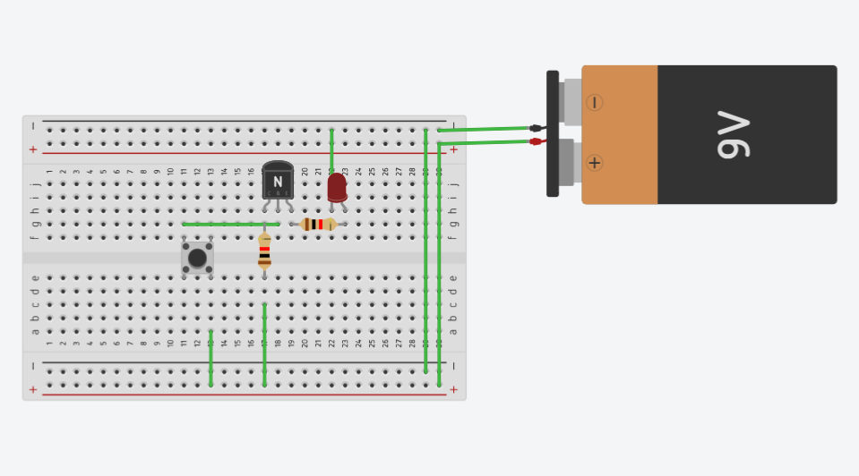
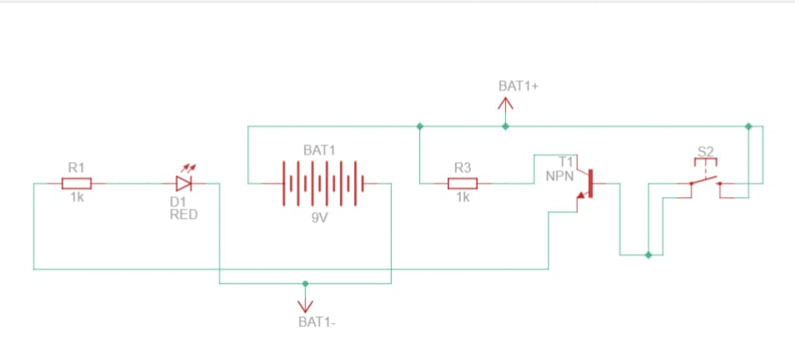
TINKERCAD CIRCUIT AND DESIGN

Slide 9
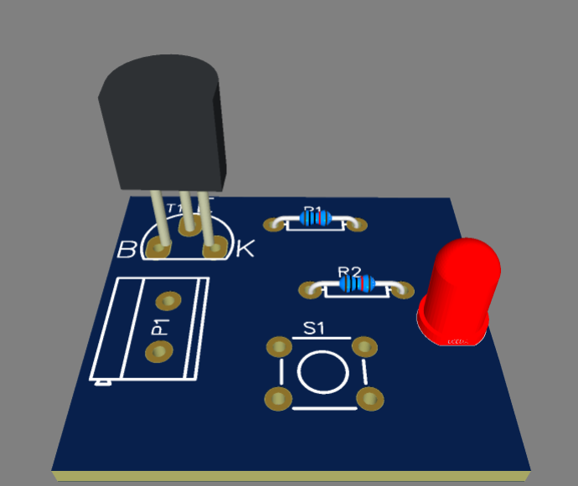
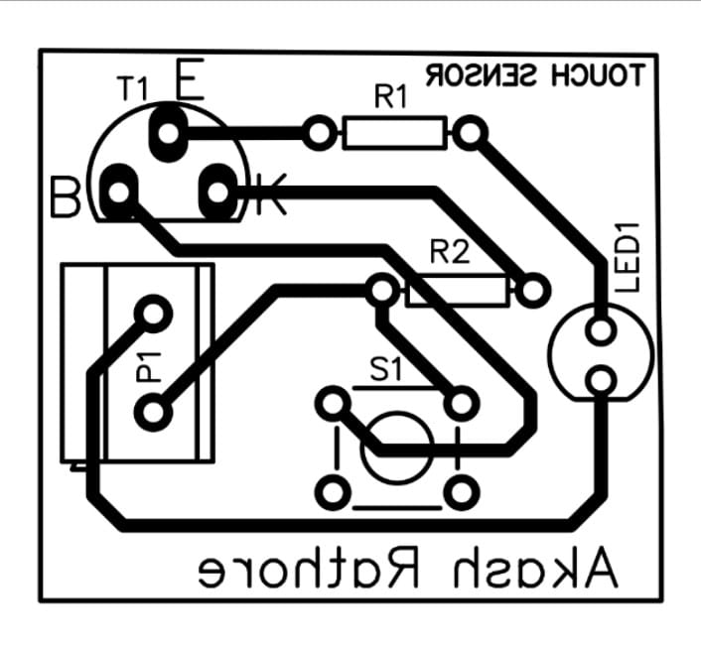
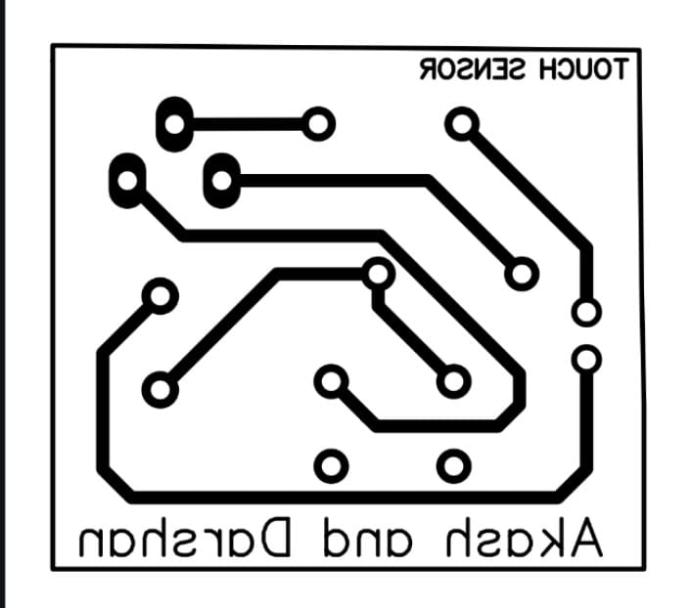
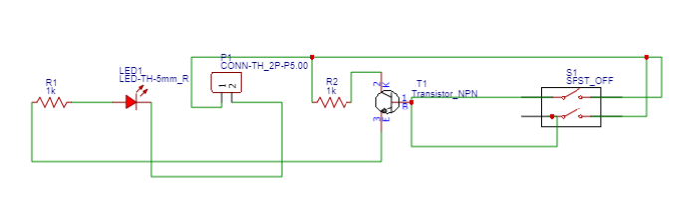
ESAYEDA CIRCUIT AND DESIGN
3D MODEL:
PCB ARTWORK WITH COMPNENTS:
PCB ARTWORK WITHOUT COMPONENTS:
CIRCUIT DIAGRAM:

Slide 10

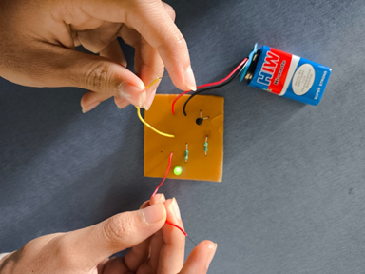
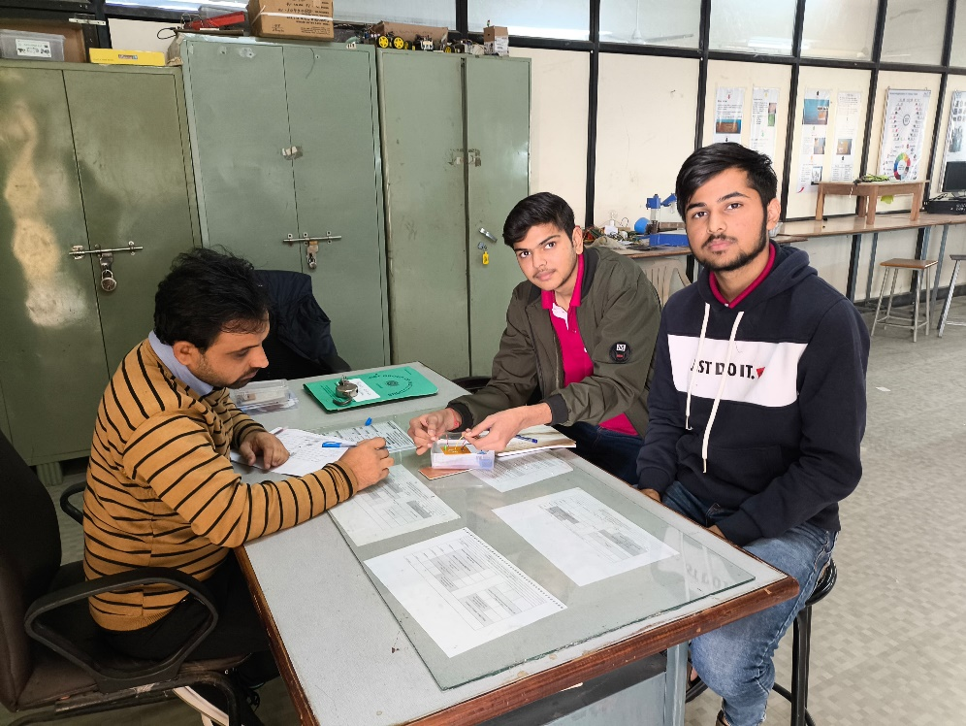
PCB MAKING
PCB MAKING:

Slide 11
SCOPE
The scope of the touch sensor project is vast and extends across various fields of technology and innovation. It includes the following aspects:
Learning and Implementation:
  Understanding the principles of touch-based sensing technology.
  Implementing a functional prototype to demonstrate its working.
Applications in Real-World Devices:
  Integration into home automation systems, such as touch-controlled lights or appliances.
  Use in consumer electronics like smartphones, laptops, and wearable devices.
Innovation and Research:
  Exploring new ways to use touch sensors in robotics, medical devices, and industrial control systems.
  Advancing user interfaces for enhanced interactivity and efficiency.
Skill Development:
  Developing practical skills in circuit design, microcontroller programming, and troubleshooting.
  Gaining experience with components like transistors, resistors, and capacitive touch sensors.
Future Expansion:
  Adapting the project for advanced applications, such as multi-touch interfaces or gesture recognition.
  Incorporating wireless communication for IoT (Internet of Things) integration.

Slide 12
PURPOSE
The primary purpose of the touch sensor project is to design a system that replaces traditional mechanical buttons with a touch-based interface, offering a modern, efficient, and durable solution. This project demonstrates the practical application of touch sensor technology by detecting physical touch and converting it into an electrical signal to trigger an output, such as lighting up an LED.
It aims to:
Provide hands-on learning about touch-sensitive circuits and their components.
Showcase the functionality and advantages of touch technology, such as seamless operation and reduced wear and tear.
Highlight real-world applications in home automation, electronics, and industrial systems.
Encourage innovation in developing advanced touch-based systems for user-friendly and intuitive interfaces.
The project serves as a stepping stone for exploring cutting-edge technologies like gesture recognition and multi-touch interfaces, paving the way for integration into modern devices and systems.

Slide 13
APPLICABILITY
1.Home Automation
  Touch-controlled lights, fans, and appliances for intuitive operation.
Consumer Electronics
  Integration in smartphones, laptops, smartwatches, and other gadgets.
Industrial Automation
  Replacing mechanical buttons in control panels for enhanced durability.
Healthcare
  Non-invasive and responsive control in medical devices.
Robotics
  Enhancing human-machine interaction for advanced robotics applications.
Education
  Teaching sensor-based technologies and circuit design principles.
Research and Development
  Exploring IoT, gesture recognition, and innovative user interfaces.
Public Utility Systems
  Use in ATMs, kiosks, and other touch-based public devices for improved usability.

Slide 14
THANK YOU
ANY QUESTIONS?

