Slide 1

Web Push Notifications
VInay Nandina
Athira Lekshmi
Akash Agarwal

Slide 2
Why?
Engage your subscribers
Even if the user closes the application
Increases the effective time spent by the user on the application
Notify the subscribers about promotions, offers, discounts & thereby boosting sales
Prompt & assured content delivery to all the subscribers
Optimize user experience
Higher opt-ins as compared to emails & sms
Existing hybris notification extension only supports email & sms services

Slide 3
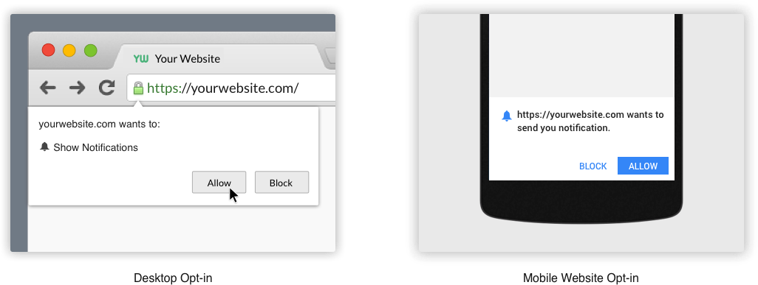

What?

Slide 4
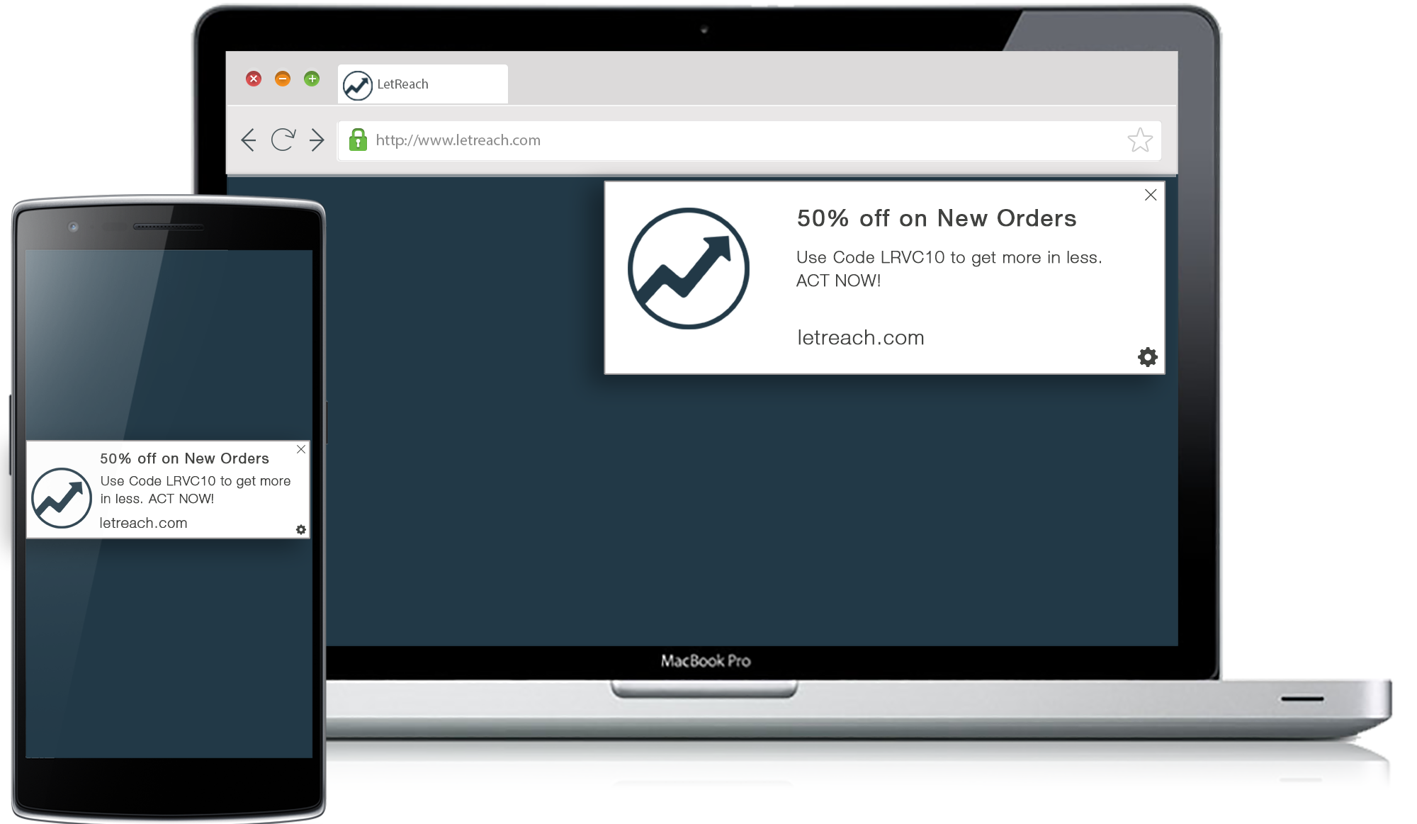
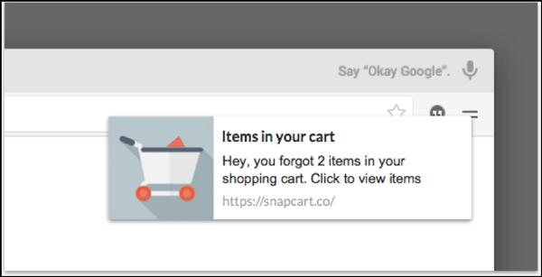

Slide 5
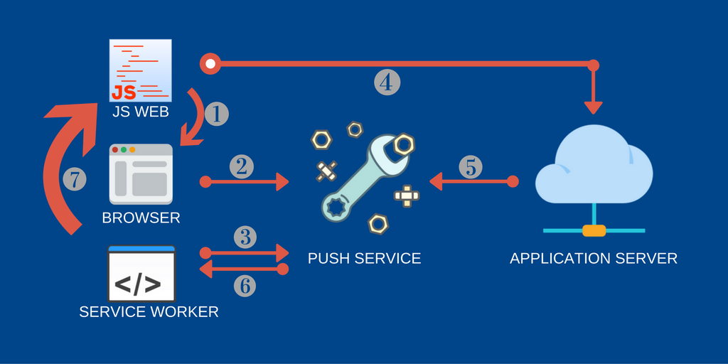
Workflow for push notifications

Slide 6
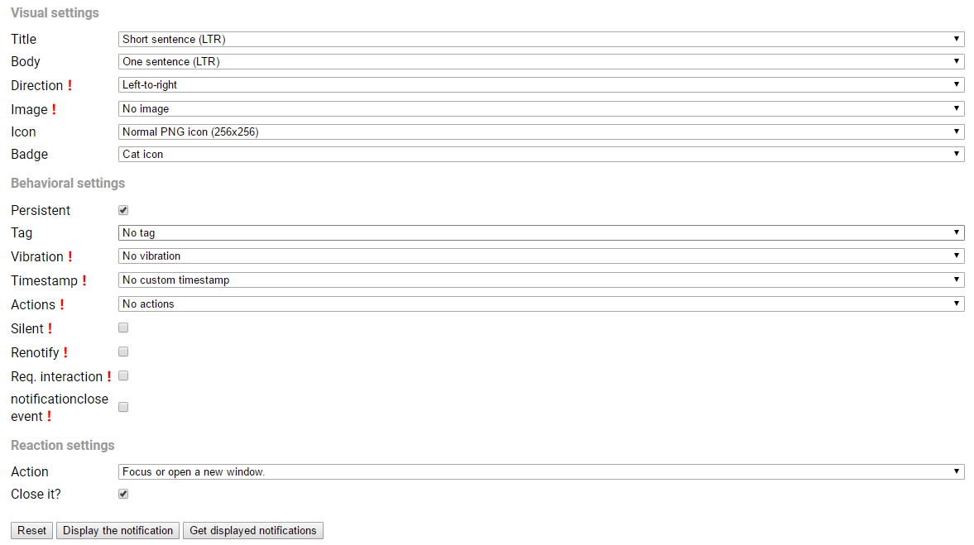
Notification Customization

Slide 7
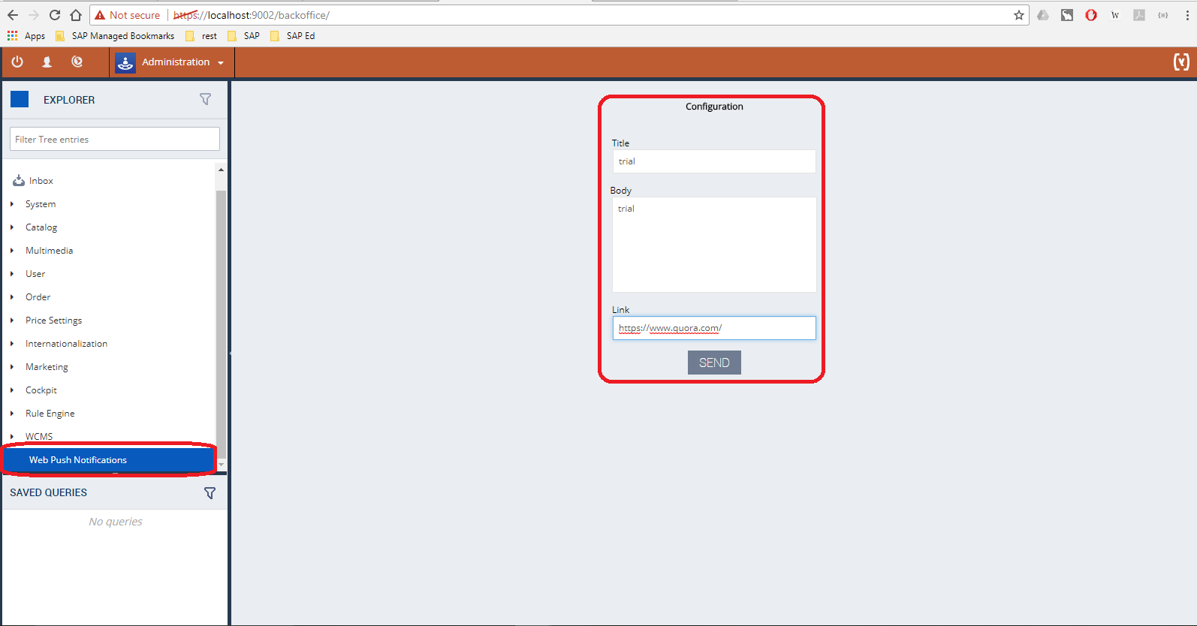
Our take
A backoffice widget dedicated for customized notifications.

Slide 8
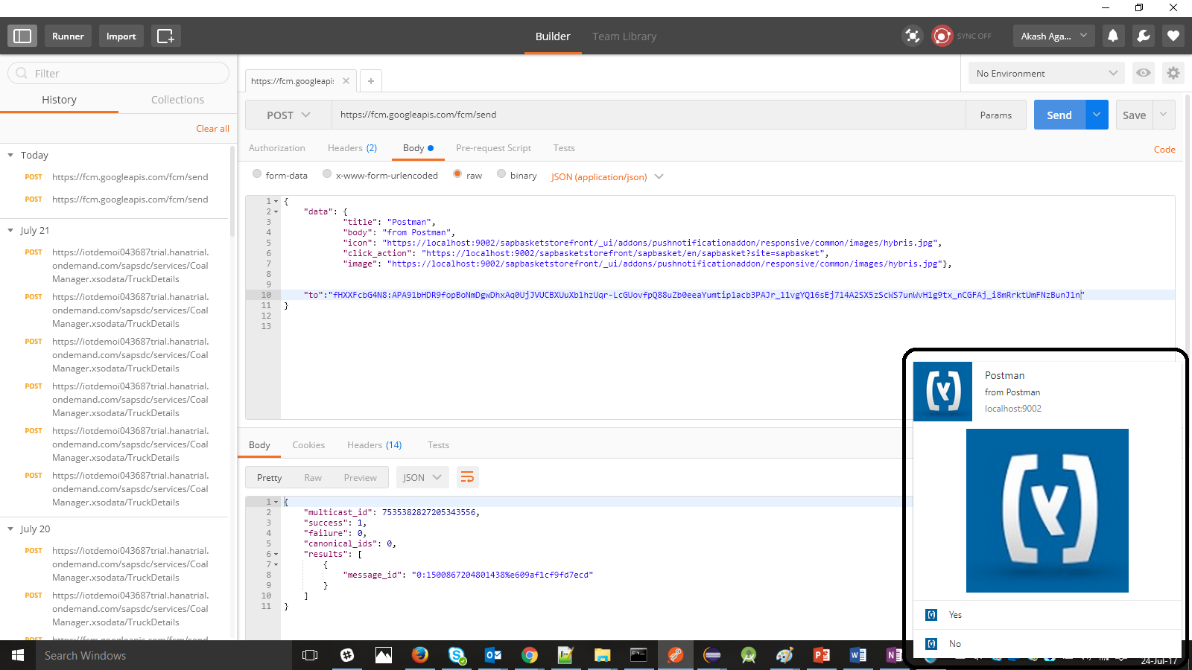
And the output!

Slide 9
Thank you :)

