Slide 1
Retail Sales & Customer Response Analysis
Final Internship Project
By: Laya Venkatesh | Internship Studio

Slide 2
Project Overview
Objective: Analyze sales transactions and customer responses to identify patterns.
Key Tasks:
Data loading and merging.
Data cleaning and preprocessing.
Statistical and graphical analysis.
Insights generation.

Slide 3
Tools & Technologies Used
Languages: Python (Pandas, NumPy)
Visualization: Matplotlib, Seaborn
Data Storage: CSV → Cleaned in Jupyter Notebook
Reporting: Excel Dashboards & PowerPoint

Slide 4
Data Loading
Datasets Used:
Retail_Data_Transactions.csv: Contains transaction details (customer_id,trans_date,tran_amount).
Retail_Data_Response.csv:Contains customer responses (customer_id, response).
Merged Dataset: Combined transaction and response data for comprehensive analysis.

Slide 5

Dataset Exploration
Dataset Shape: 125,000 rows × 4 columns.
Columns:
customer_id: Unique identifier.
trans_date: Transaction date.
tran_amount: Transaction amount.
Response: Binary (0 or 1).
Code Snippet:

Slide 6
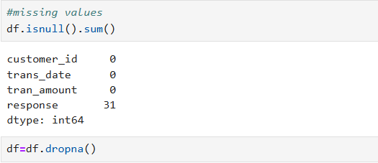
Data Cleaning
Missing Values: 31 missing values in response column (dropped).

Slide 7

Data Preparation
Data Types:
Converted trans_date to datetime.
Converted response to integer.

Slide 8
Statistical Summary
Key Metrics:
Mean transaction amount: $64.99.
Response rate: 11%
Column | Count | Mean | Std Dev | Min | Max
tran_amount | 125,000 | 64.99 | 22.86 | 10 | 105
response | 124,969 | 0.11 | 0.31 | 0 | 1

Slide 9
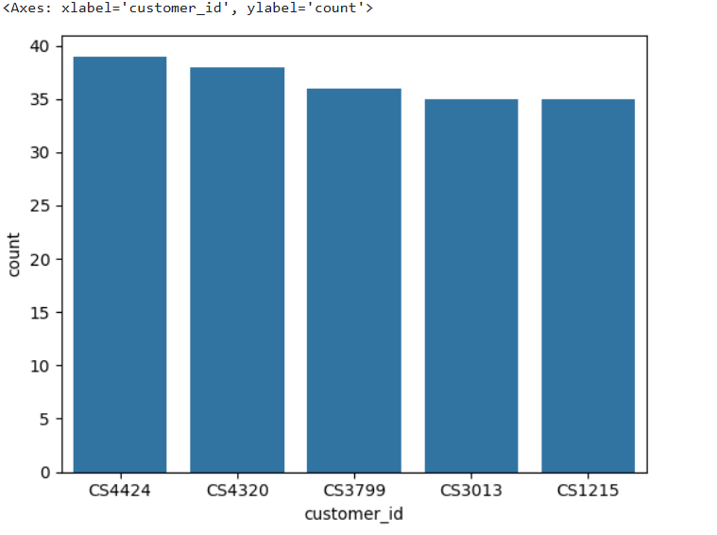
Top 5 Customers by Number of Orders
CS4424 leads with 39 orders
Drop-off after top 2 customers is significant

Slide 10
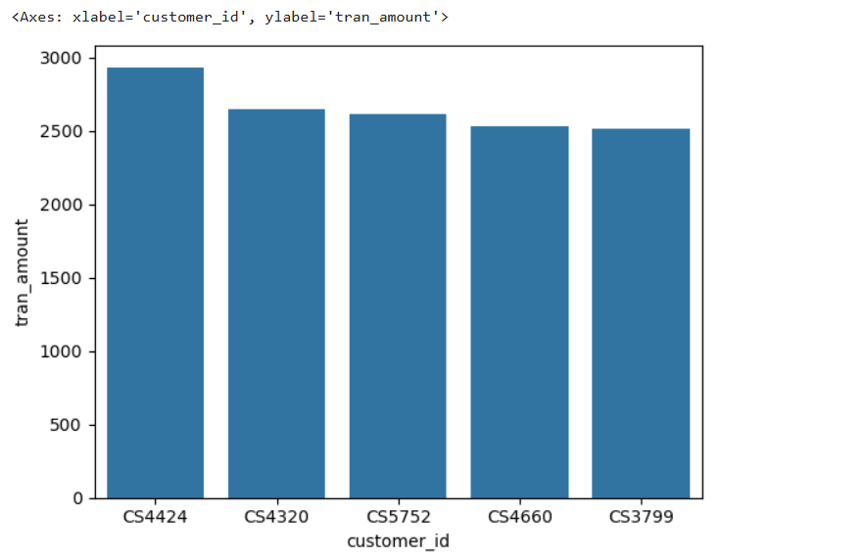
Top 5 Customers by Total Spending

Slide 11
Monthly Sales Line Chart

Slide 12
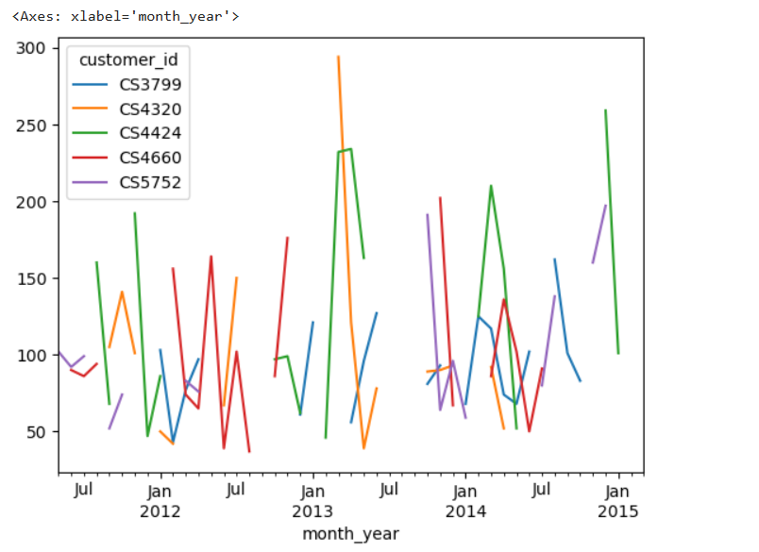
Identifying High-Value Customers

Slide 13
Customer Value Segmentation: Frequency vs. Monetary Value

Slide 14
Conclusion
Processed 125,000+ transactions (2011-2015)
Identified top customers:
CS4424 ($2,933 spent | 39 orders)
Discovered sales peaks:
August ($726K) & October ($725K)

