Slide 1
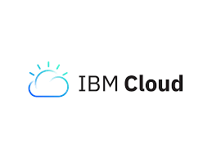

Slide 2
HISTORY
1960 : Developed first Virtual Machine
1997 : Term "Cloud Computing" is introduced
2005 : SoftLayer Technologies are founded
2013 : SoftLayer Technologies are acquired by IBM
2016 : user acccess

Slide 3
INTRODUCTION
Cloud computing refers to the delivery of computing services, including storage, processing power, and software, over the internet (the cloud) instead of relying on local servers or personal computers to handle these tasks. In a cloud computing model, users can access and use computing resources as needed on a pay-as-you-go basis, similar to a utility service.

Slide 4
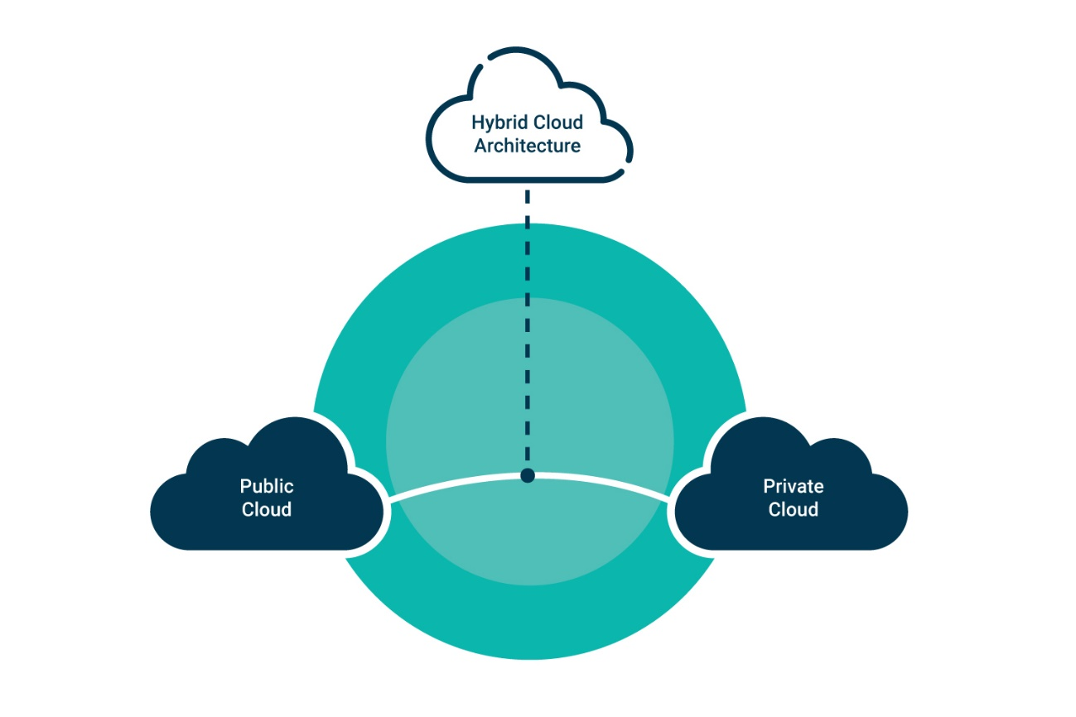
HYBRID CLOUD MODEL
A hybrid cloud is a computing environment that combines public and private clouds. It allows users to run applications using a combination of computing, storage, and services in different environments.
Non-Critical Activities
Critical Activities

Slide 5
Advantages:
1.Scalability
2.Flexibility
3.Security
4.Cost Efficiency
Disadvantages:
1.Network issues
2.Security Complaince
3.Dependency on the infrastructure

