Slide 1

SMART INDIA HACKATHON 2026
TITLE PAGE
Problem Statement ID – SIH26176
Problem Statement Title- ORCA: Marine Ecosystem Reasoning with Collaborative Agents.
Theme- Miscellaneous
PS Category- Software
Team ID-
Team Name - CodeCatalysts

Slide 2
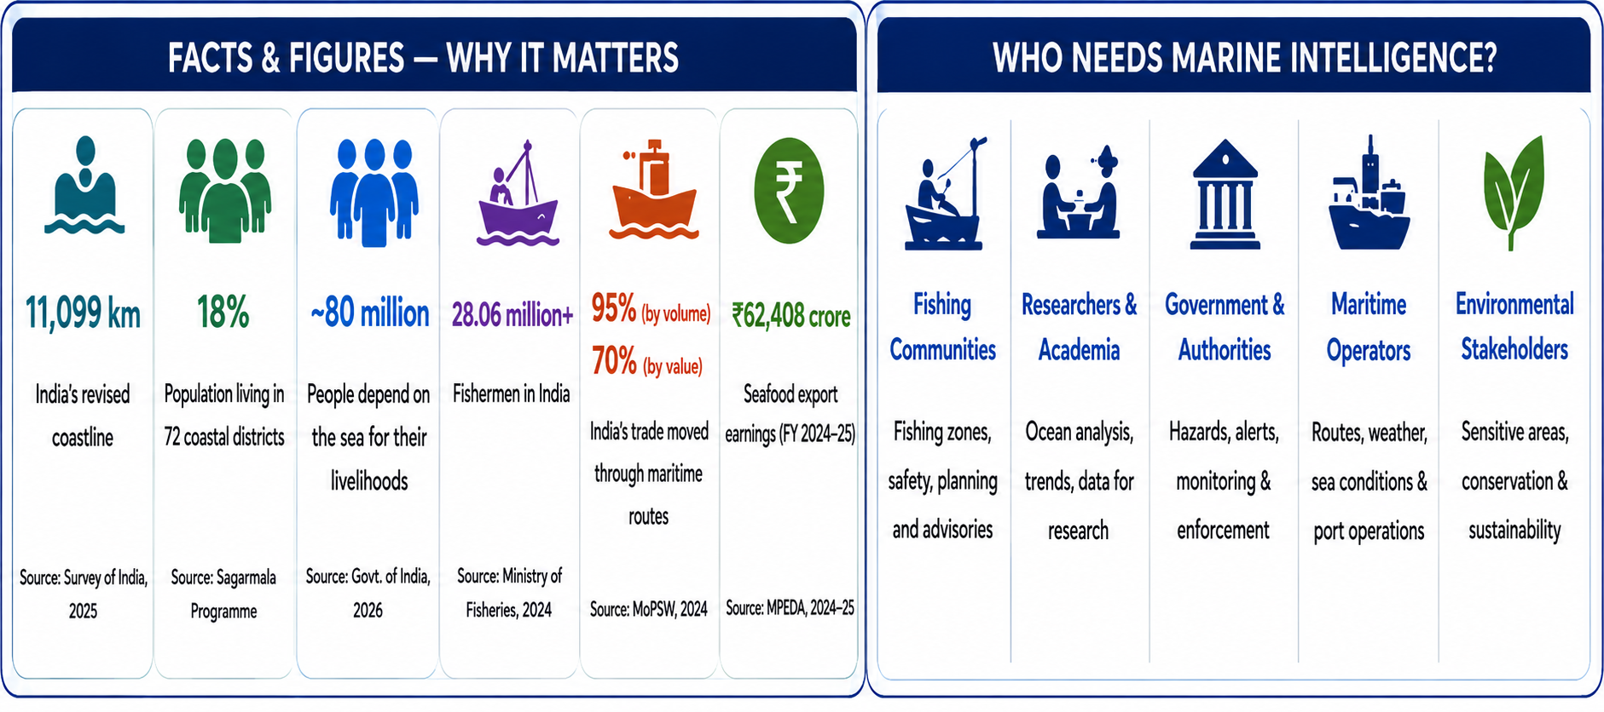
ORCA — Agentic AI for Ocean Intelligence
CodeCatalysts
HOW IT ADDRESSES THE PROBLEM
Bridges fragmented maritime portals into unified, life-saving intelligence:
• Unifies Fragmented Feeds: Aggregates scattered data from IMD, INCOIS, ISRO, NOAA & Coast Guard into one pane.
• Eliminates Manual Search: Instant, authoritative answers in <1.5s, eliminating multi-portal searching.
• Craft & Vessel Aware: Tailors safety guidance specifically for vessel type (artisanal skiffs vs commercial trawlers).
• Simplifies Complexity: Converts raw GRIB rasters and buoy metrics into clear Douglas sea-state advisories.
• Multi-Modal Delivery: Delivers 60 FPS vector maps, safe fairway corridors, risk scores, and evidence tables.
• 8 Collaborative AI Agents 1 Planning + 7 Domain Agents coordinating asynchronously with zero hallucination.
• Native Indic Voice Copilot Full STT/TTS in 12+ coastal languages tailored for low-literacy seafarers.
• 60 FPS Fluid Canvas HUD Windy-style real-time particle streams & SST thermal fronts over vector maps.
• Deterministic Safety & Routing 0–100 Risk Engine + Cape Comorin fairway corridors (0% land crossing guarantee).
• Automated GMDSS Distress Dispatch Instant Coast Guard MRCC routing (Kochi/Mumbai/Chennai) with SHA-256 receipts.
DETAILED SOLUTION
INNOVATION & UNIQUENESS
• Operational Ocean Platform: Real-time agentic system delivering zero-hallucination decision support for coastal safety.
• Conversational Marine Copilot: Natural queries via Text & Voice in 12+ Indic languages (Tamil, Malayalam, Hindi, Telugu, etc.).
• 8 Collaborative AI Agents: Dynamic orchestration decomposing complex queries across domain specialists.
• Multi-Source Telemetry: Live satellite (NOAA GHRSST L4, ISRO OCM-3), weather models (Open-Meteo), and in-situ buoys (INCOIS).
• Maritime Cockpit HUD: 60 FPS Windy canvas fluid simulation, turn-by-turn fairway routing, and GMDSS distress SOS beacon.

Slide 3
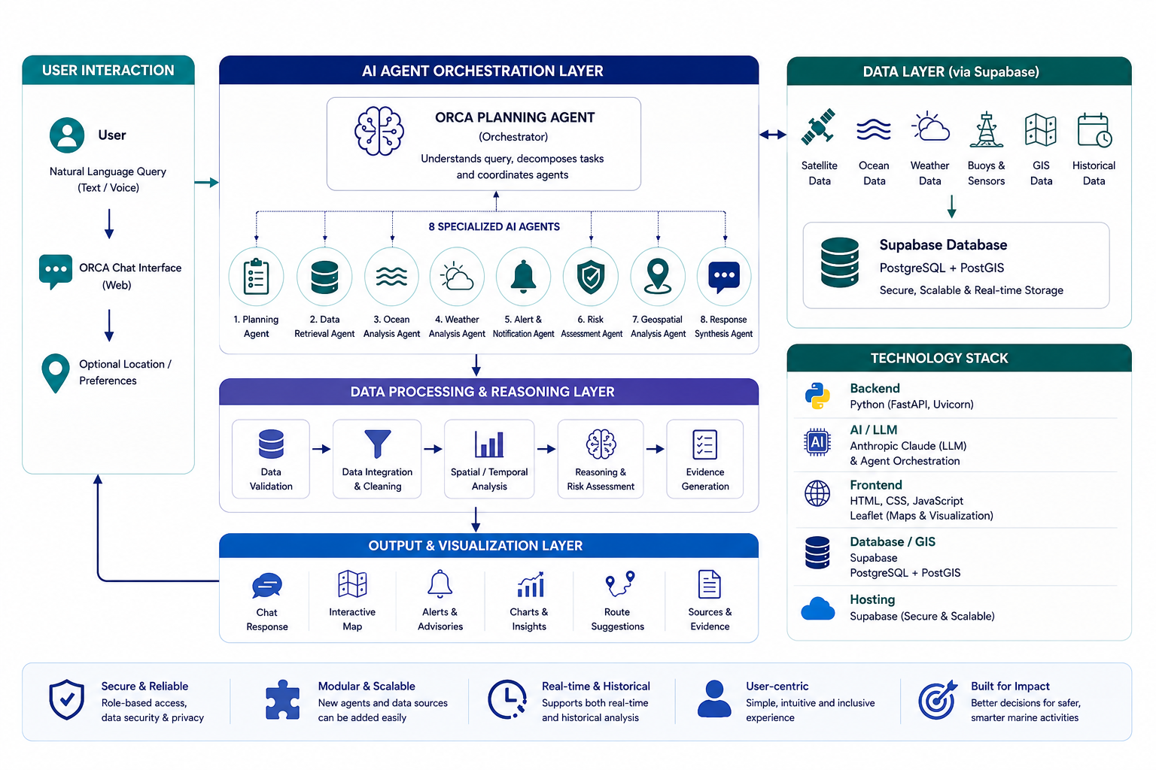
TECHNICAL APPROACH
CodeCatalysts
IMPLEMENTATION FLOW
1
USER INPUT
Natural text/voice + auto GPS location
2
PLANNING
Intent classification & agent delegation
3
8 AI AGENTS
Specialized domain multi-agent team
4
DATA RETRIEVAL
Satellite + Weather + Buoys + GIS
5
VALIDATE & ANALYSE
Quality control & <12h freshness check
6
REASON & ASSESS
Risk Engine (0–100) + Fairway Routing
7
OUTPUT
60 FPS Windy map + GMDSS + Evidence

Slide 4
FEASIBILITY AND VIABILITY
CodeCatalysts
CHALLENGES & RISKS HOW WE HANDLE THEM
1. Diverse Formats & Sources: ➔ Unified Pydantic v2 schemas & ingestion pipeline
2. Data Freshness & Lags: ➔ Freshness penalty (+8 risk if telemetry age > 12h)
3. Incomplete / Conflicted Data: ➔ In-situ OMNI buoys cross-validate satellite grid
4. LLM Hallucinations: ➔ Pure deterministic math engine (LLM for intent only)
5. Heavy Spatial Queries: ➔ Embedded Ray-Casting & Haversine index (<5ms)
6. Safe Nautical Routing: ➔ IMO Douglas/Beaufort rules & Cape Comorin fairway
7. API Downtime / Offline: ➔ PWA Offline Service Worker & pre-seeded local cache
8. Privacy & Distress Security: ➔ Stateless tokens & encrypted GMDSS SHA-256 dispatch
FEASIBILITY
• Reliable Data Sources — Open-Meteo, NOAA CoastWatch GHRSST L4, ISRO MOSDAC OCM-3, INCOIS Buoys, IMD.
• Proven Technologies — Python 3.13 FastAPI, Supabase PostGIS, Leaflet.js, React 19, PWA offline caching.
• Modular Multi-Agent Design — 8 independent domain agents with plug-and-play connector abstractions.
• Scalable Infrastructure — Supabase cloud backend + embedded zero-dependency spatial index (<5ms latency).
• 100% Tested MVP — Fully validated production codebase with 34/34 passing automated tests.
VIABILITY
• Multi-Stakeholder Value — Artisanal canoes, mechanized trawlers, merchant vessels, port masters & Coast Guard.
• Continuous Dynamic Feeds — Satellite passes refreshed daily (GHRSST L4) and weather hourly (Open-Meteo).
• Extensible Maritime Horizons — Plug-in readiness for Blue Carbon monitoring, mariculture & offshore wind.
• Rapid National Scalability — Pilot tested in Kochi, Mumbai, Chennai; ready for all 72 coastal districts.

Slide 5
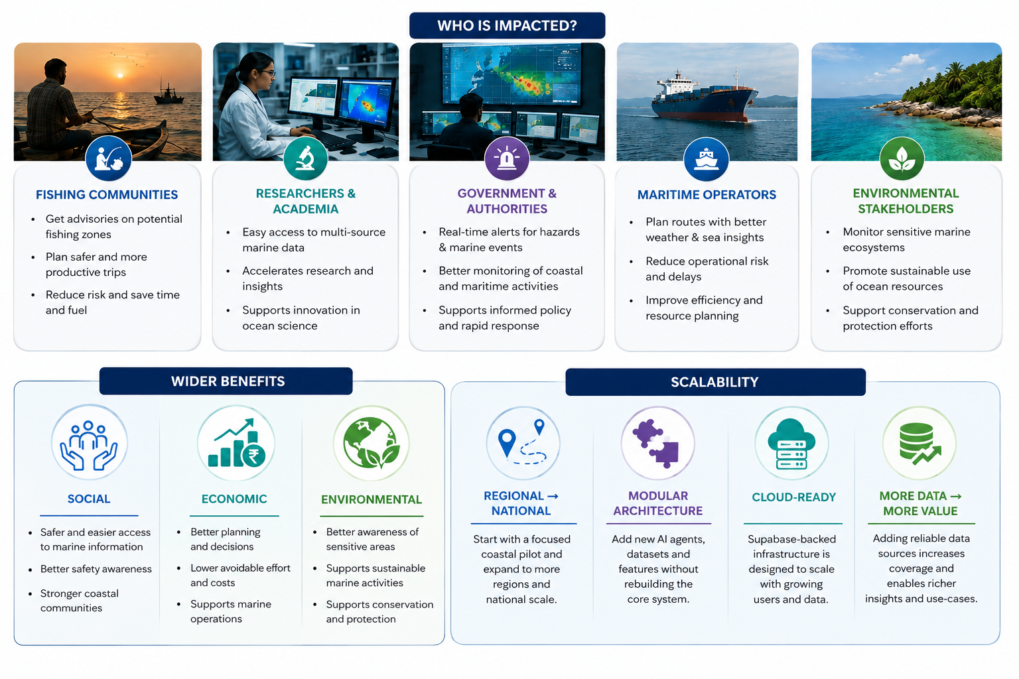
IMPACT AND BENEFITS
CodeCatalysts
5

Slide 6
RESEARCH AND REFERENCES
CodeCatalysts
RESEARCH BASIS
DATA SOURCE GROUPS
REFERENCE AREAS
• Marine Earth Observation (SST Fronts & Radiometry)
Satellite Observation
• INCOIS (MoES) — PFZ Advisories & Ocean State Forecasts
• ISRO MOSDAC — Oceansat-3 & INSAT-3D Satellite Data
• IMD (MoES) — Cyclone Warnings & Port Danger Signals 1–11
• Indian Coast Guard — MRCC Search & Rescue Protocols
• NOAA CoastWatch — Global GHRSST Level-4 Telemetry
• Survey of India & NIOT — Deep-Sea Buoys & Tide Gauges
NOAA GHRSST L4 OSTIA, ISRO Oceansat-3 OCM, Copernicus
• Operational Oceanography (Douglas & Beaufort Scales)
Physical Oceanography
SST, Chlorophyll-a, Wave Swell, Ocean Currents & Tides
• Geospatial & Nautical Routing (Geodesic Fairways)
Meteorological Feeds
Open-Meteo GFS/ECMWF, Wind Vectors, Gusts & Squalls
• Multi-Agent Systems (Collaborative Delegation)
Safety & Warning Advisories
• Conversational Marine UX (12+ Indic Voice Dialects)
IMD Marine Warnings, Port Signals 1–11, Damini Lightning
Maritime GIS Boundaries
• Evidence & Data Provenance (Audit Latency Ledgers)
EEZ 200 NM, IMBL Borders, Marine Protected Areas (MPAs)
Historical & In-Situ Baselines
INCOIS Deep-Sea OMNI Buoys, Coastal Tide Gauges & CMFRI
Production release integrates verified live APIs from Open-Meteo, NOAA CoastWatch, ISRO MOSDAC, and INCOIS.

