Slide 1
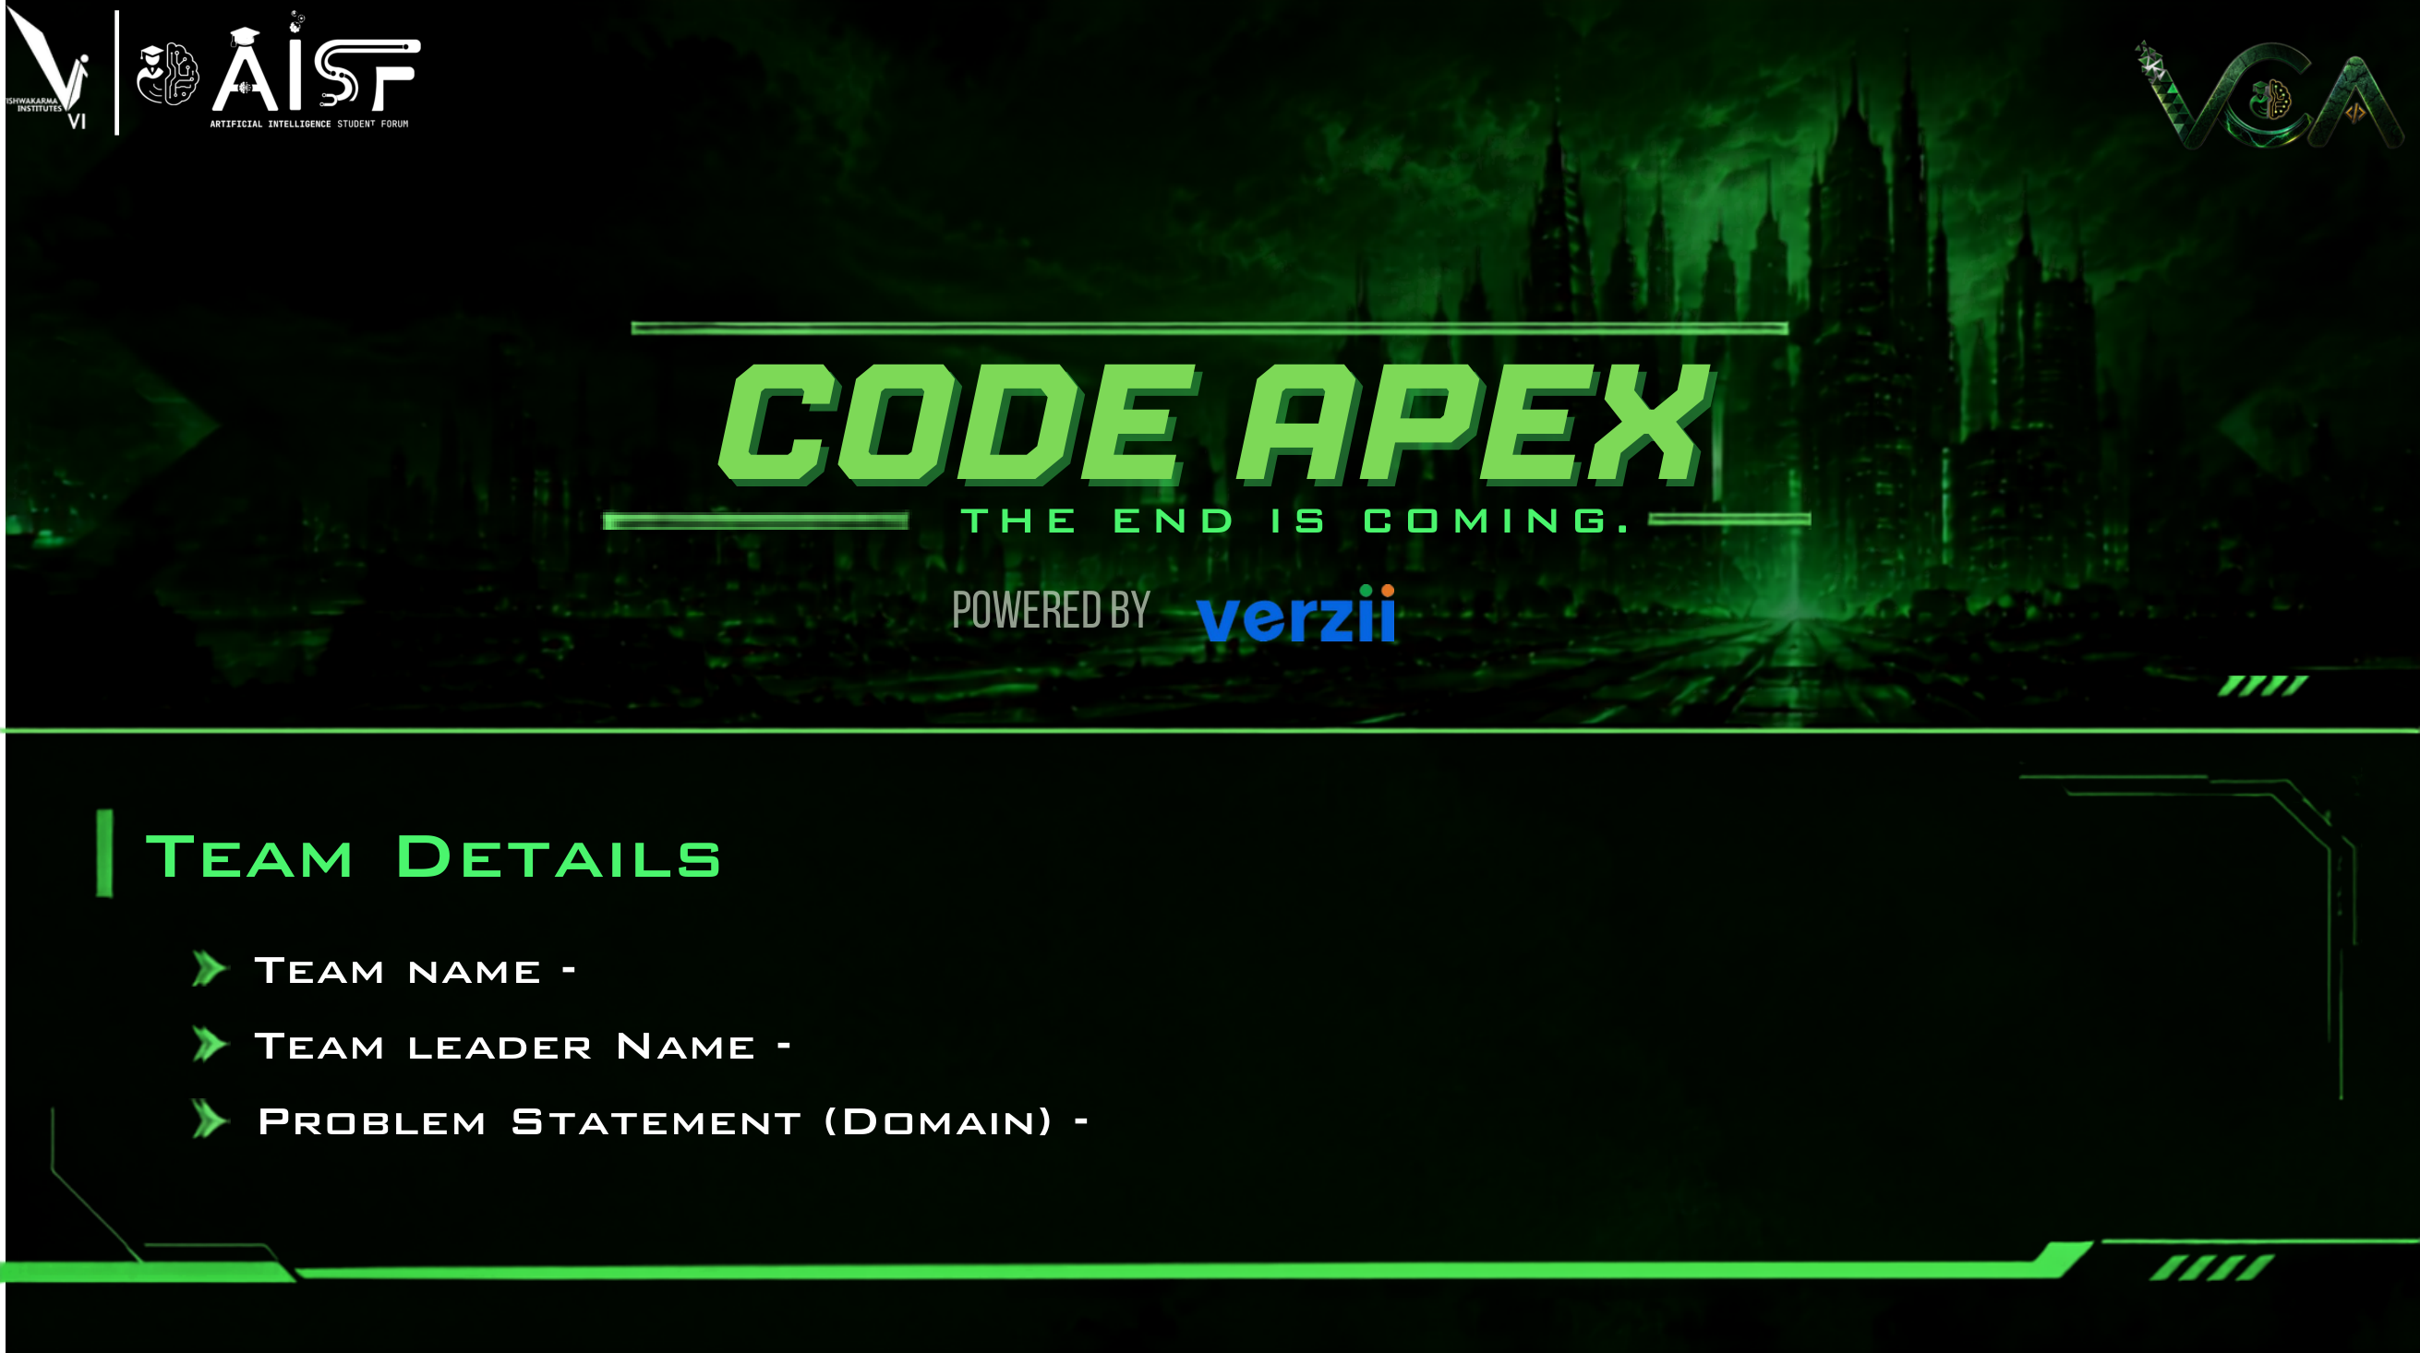
VALENCE
A Modern, Multi-Core Replacement for Redis — Built in Pure Rust
Uses all CPU cores • Cuts RAM bills by 79% via NVMe • Zero crash risk during backups
Team Valence Systems
Akash Ray & Team
Cloud Infrastructure & High-Performance Data Systems

Slide 2
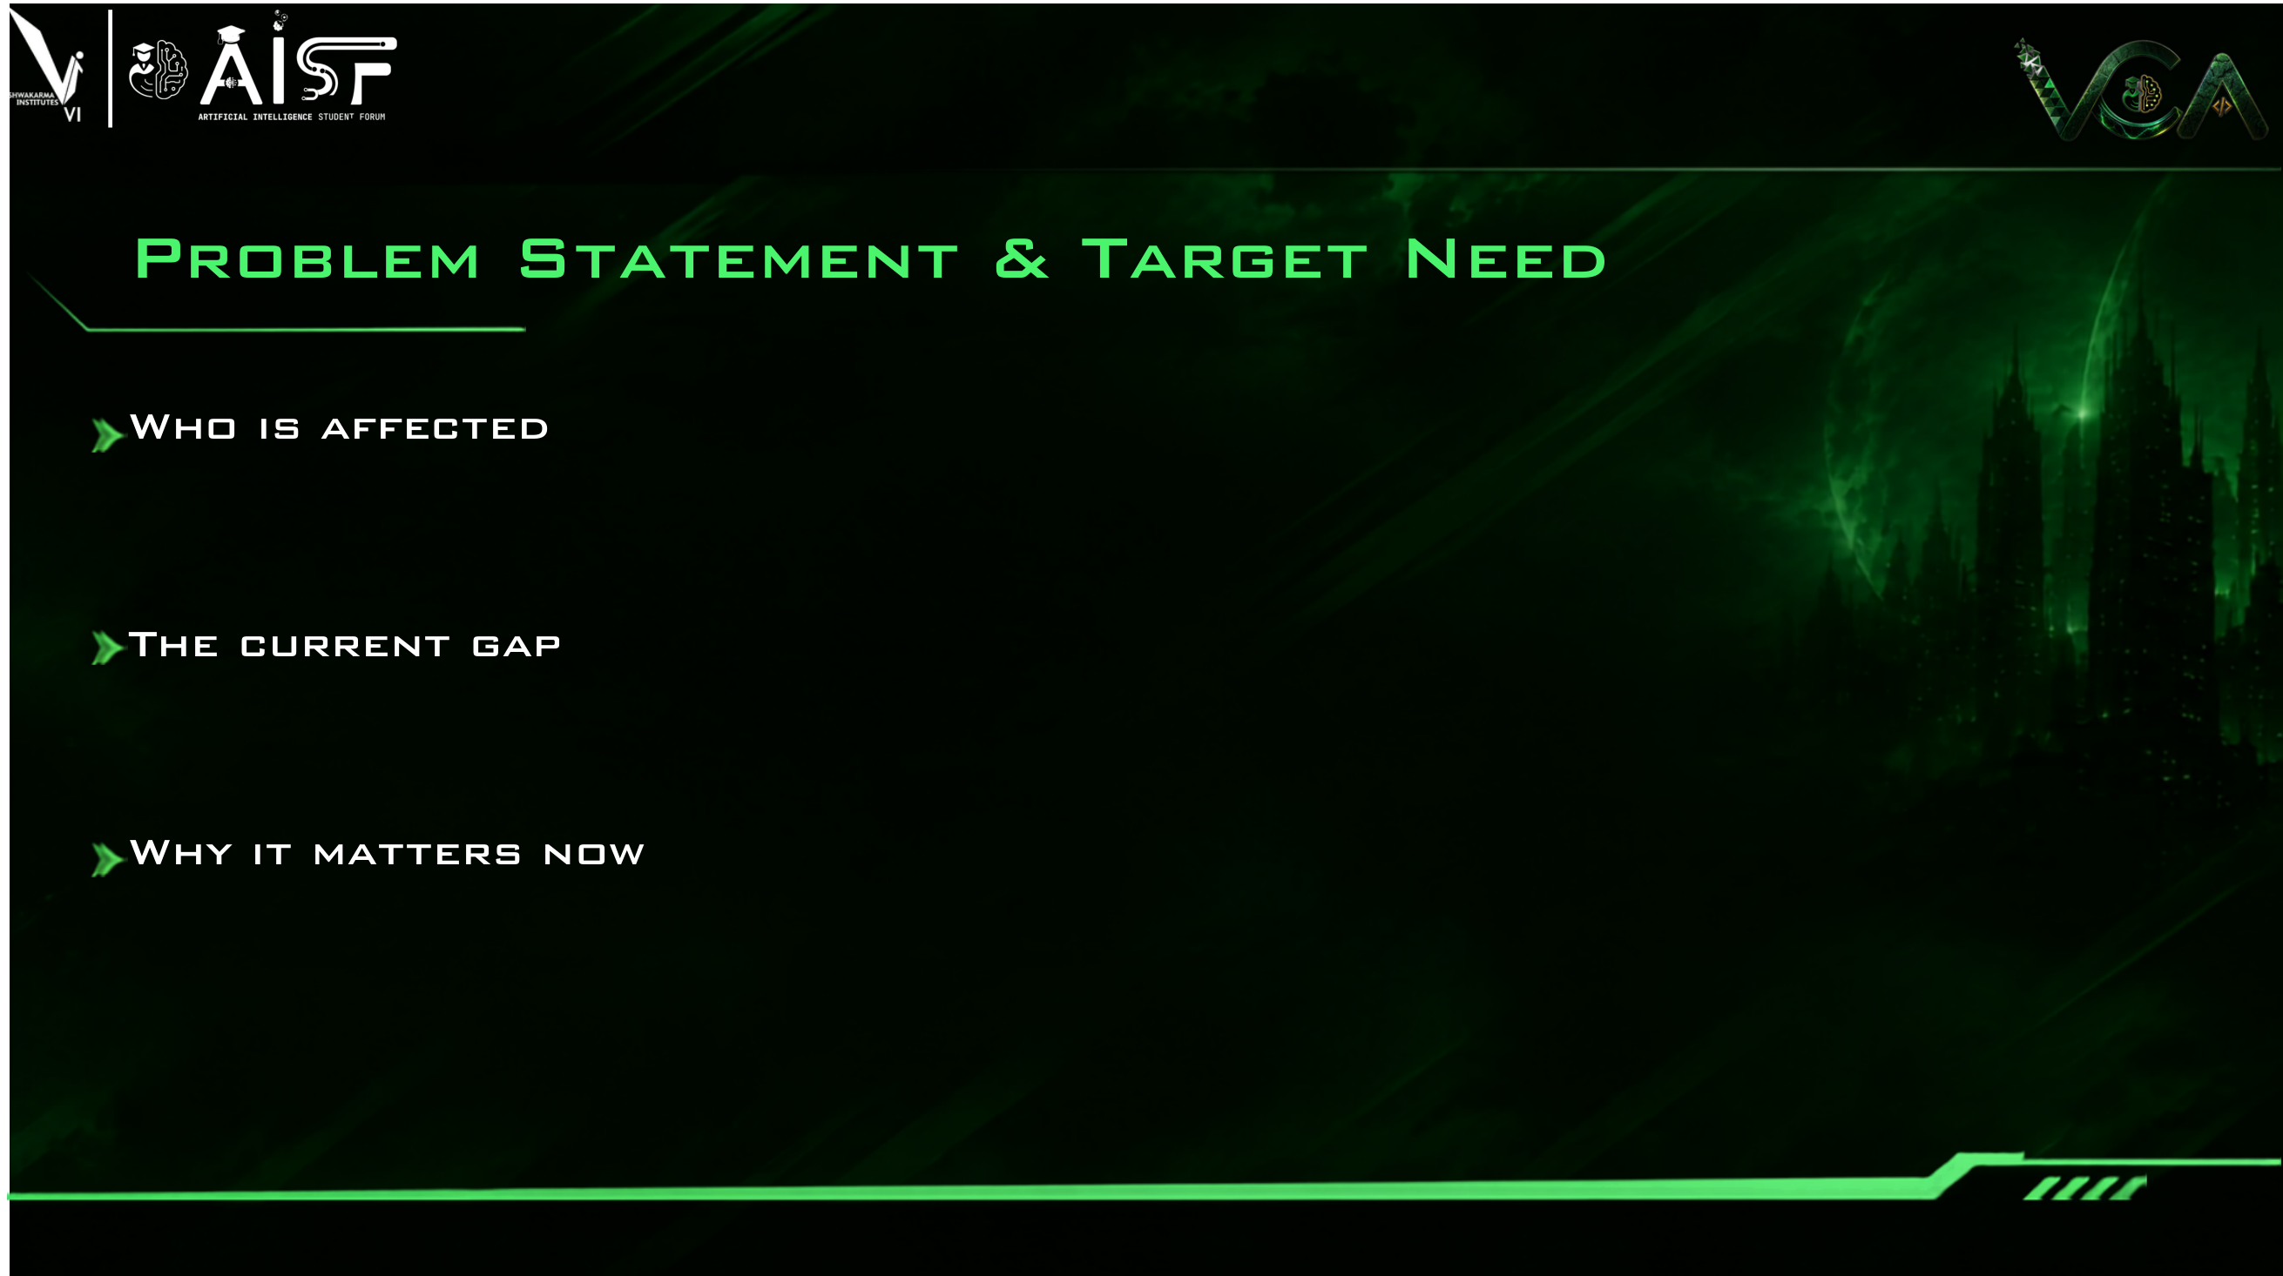
Every modern app uses an in-memory cache (like Redis) so their websites feel instant — Twitter, Uber, Netflix, and Fintech.
Engineering teams end up paying thousands of dollars every month to AWS for memory they barely touch.
1. The 1-Core Bottleneck: Redis was built 15 years ago for single-core servers. On a 64-core cloud instance, 63 cores sit idle while 1 core is maxed out.
2. The 'Cold RAM' Waste: Over 80% of cached keys are never read after 24 hours. Yet companies keep paying expensive RAM prices to store them.
3. The Backup Freeze: When Redis saves to disk, it duplicates its memory table. If memory is full, the server freezes or crashes with an Out-of-Memory (OOM) error.
• AI & Real-Time Explosion: LLM sessions, agent memory, and vector caching require microsecond speeds at lower cost.
• Modern SSDs are Microsecond Fast: Fast NVMe drives can now store cold keys without slowing down the app.
• Immediate Cloud Savings: Slashing database RAM by 79% saves real companies thousands of dollars on AWS every month.

Slide 3
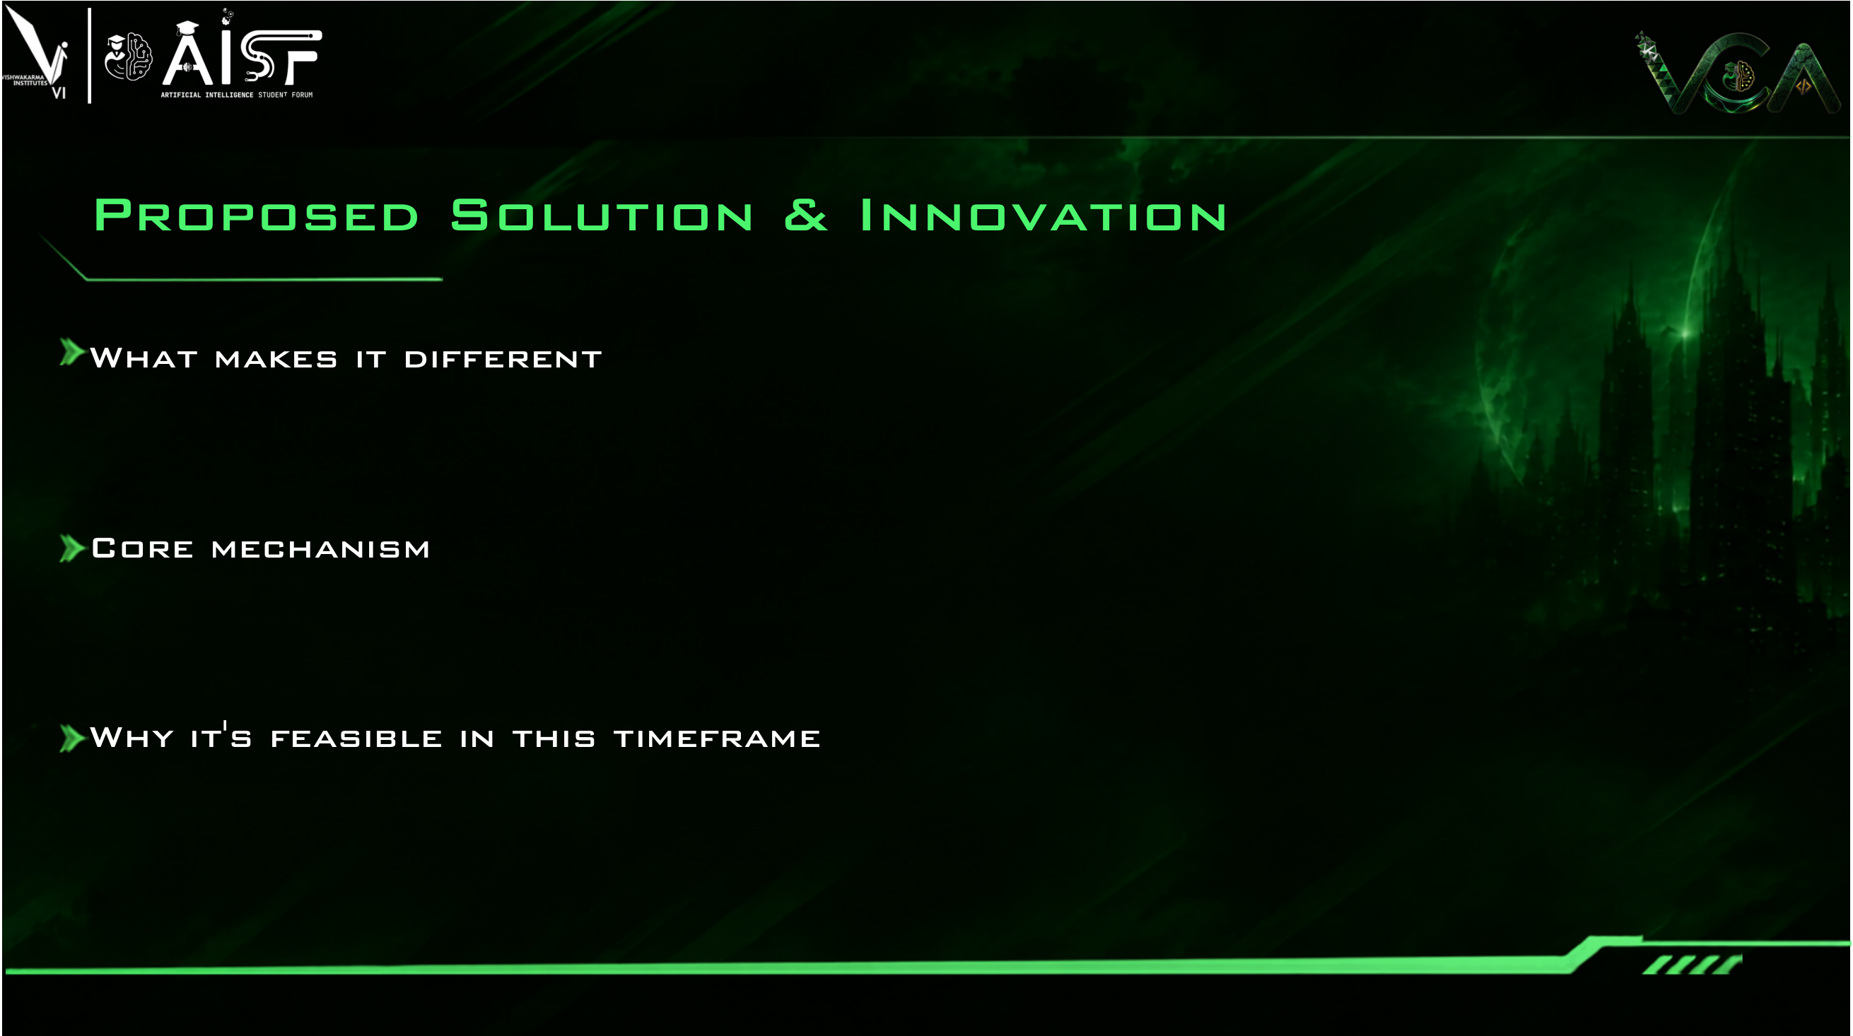
• Built From Scratch in Pure Rust: Zero C code, zero garbage collector pauses, zero memory safety bugs.
• Drop-in Redis Compatible: Speaks the standard Redis RESP3 protocol — existing apps can switch with zero code changes.
• AVX2 Vector Acceleration: Uses CPU vector instructions to read incoming commands at 289 million ops per second.
• Uses All CPU Cores: Gives every CPU core its own worker thread with lock-free ring queues. Threads never fight or wait in line.
• Smart NVMe Tiering (2-bit CLOCK): Popular data stays in fast RAM; untouched data moves to SSD disk, cutting RAM costs by 79.1%.
• Safe Forkless Snapshots: Streams backups directly to disk without duplicating memory. No server freezes, no Out-of-Memory crashes.
• 100% Fully Built & Verified Today: Not a mock idea — all 8 phases are complete and passing all 105 automated test suites.
• Bitmapped Slab Allocator: Custom memory slabs allocate in 1.19 nanoseconds with zero memory fragmentation.
• Live Web Console & CLI: Running live right now on localhost for judges to test hands-on.

Slide 4
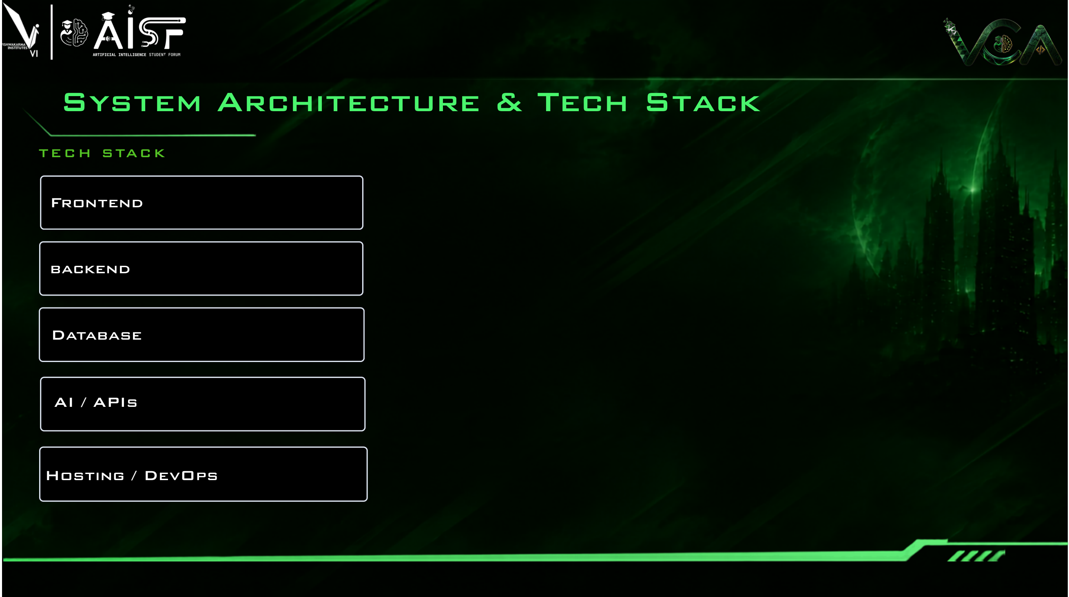
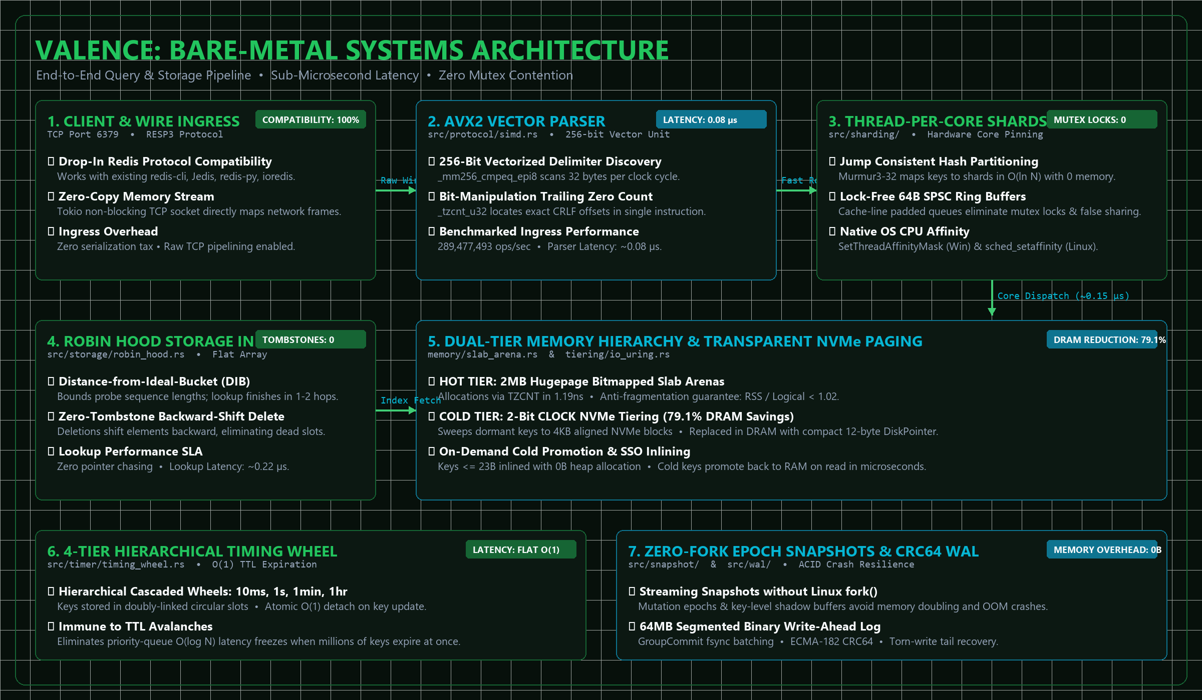
React 19, TypeScript, Vite
Custom Vanilla CSS Design System
Pure Rust 2021, Tokio Async
Lock-Free SPSC Rings, AVX2 SIMD
Flat Robin Hood Map, Slab Arenas
NVMe 4KB Paging, 2-Bit CLOCK
RESP3 Protocol, Diagnostic CLI Engine
Criterion Microbenchmark Harness
Native CPU Core Pinning (Win/Linux)
Valence Studio Web Console

Slide 5

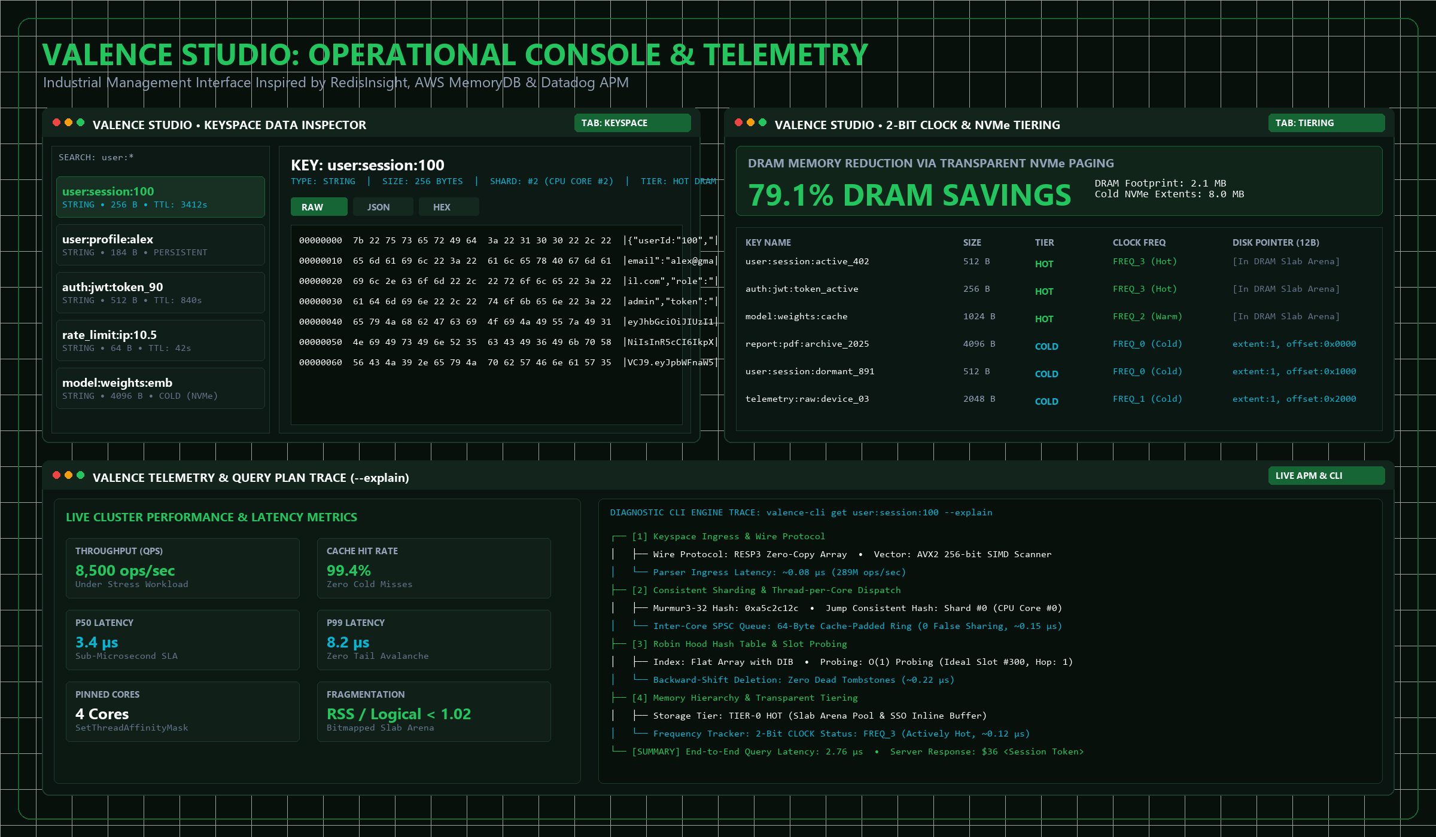

Slide 6

BUILT TODAY (100% VERIFIED)
All 8 Core Engine Phases in Rust:
• Flat Robin Hood Map (0 tombstones)
• 4-Tier Timing Wheel (O(1) detach)
• Thread-per-Core Shards & SPSC Rings
• 64-bit Bitmapped Slab Allocator
• Forkless Snapshots & CRC64 WAL
• 2-Bit CLOCK NVMe Tiering (79.1% cut)
• AVX2 SIMD Scanner (289M ops/s)
Verified Test Suite:
• 105 / 105 automated tests passing
Valence Studio:
• Full 7-panel web console + CLI
IN PROGRESS / UNDERWAY
Distributed Clustering:
• Multi-node Raft consensus replication
• Automatic shard rebalancing via gRPC
Kernel Acceleration:
• Linux io_uring submission queues for direct NVMe disk block reads
Client Libraries:
• High-throughput async drivers for Python, Rust, and Node.js
Security:
• RESP3 TLS encryption & ACL users
BEYOND THE HACKATHON
Serverless Elastic Cache:
• Auto-scaling cloud tier with S3 cold object storage spillover
Global Multi-Region Replication:
• Conflict-free replicated data types (CRDTs) across worldwide cloud regions
Commercial Managed Cloud DB:
• Managed cloud database offering undercutting AWS ElastiCache by 60%
Enterprise Compliance:
• SOC2 audit trails & backup sync

Slide 7

WHO BENEFITS
Startups & Growing Apps:
• Cut cloud caching bills by 70–80% without rewriting existing Redis application code.
High-Throughput Systems:
• Fintech, gaming, and real-time ad tech get predictable sub-microsecond latency without GC pauses.
Platform & SRE Teams:
• Zero Out-of-Memory crashes during backups and automatic crash recovery via WAL.
THE MARKET OPPORTUNITY
$15B+ In-Memory Database Market:
• Dominated by Redis, AWS MemoryDB, and Aerospike.
Fixing Cloud Hardware Waste:
• 64-core cloud servers are wasted by legacy single-core engines; Valence scales linearly across all cores.
Huge Dollar Savings:
• Slashing 79% of RAM across large enterprise clusters saves tens of thousands of dollars every month.
GROWTH BEYOND A DEMO
Open-Source Adoption:
• Releasing Valence core under Apache 2.0 / MIT to build a global community of systems engineers.
Battle-Testing & Reliability:
• Jepsen chaos testing for network partition tolerance and crash resilience.
Commercial SaaS Tier:
• Fully managed cloud offering competing directly with AWS ElastiCache.

Slide 8
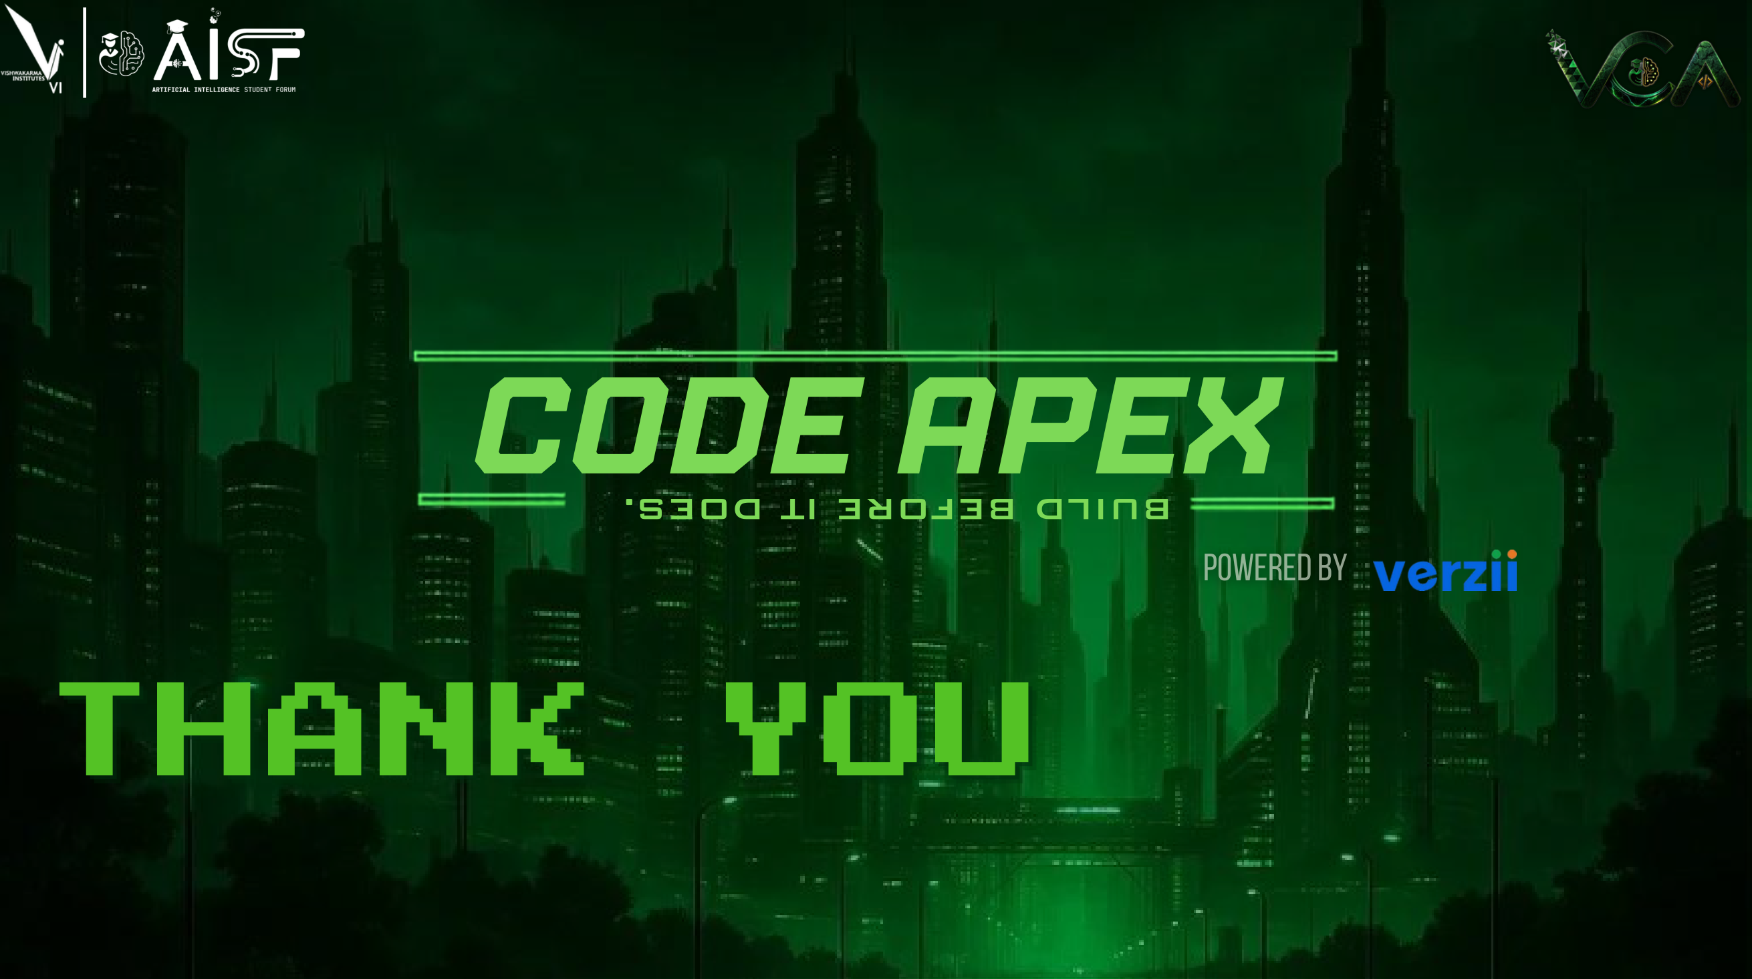
LIVE SYSTEM DEMONSTRATION & VERIFICATION
🌐 Live Web Management Studio: http://localhost:5173/ (Interactive 7-Panel Console)
⚡ Automated Test Verification: 105 / 105 Passing Tests (cargo test --release)
🔍 Diagnostic Terminal Engine: target\release\valence-cli.exe --explain (AVX2 SIMD Trace)
🚀 1-Click Interactive Launcher: start_demo.bat (Windows) & start_demo.sh (Linux/macOS)
💬 Ready for Judge Questions & Live Terminal Benchmarking!

