Slide 1
A Study On Statistical
Techniques For Credit Scoring
Akash Singh
Roll No - 3001802108
Reg No - 213001818010008
Maulana Abul Kalam Azad University Of Technology
Department Of Applied Statistics
Term project – 4
Supervisor – Dr. Sushovon Jana

Slide 2
Introduction
01
Building A Credit Scorecard Is A Very Typical Industry-Level Problem, Such As -
Assessing credibility for credit card transactions or customers, enabling actions like issuing credit cards or balance transfer offers for high-credit customers.
Giving promotions or premium rights to high-value customers in an e-commerce platform.
Creating an intelligible customer scoring system that can be easily explained to non-technical individuals, facilitating clear explanations in case of false alarms to managers, customers, or the business side.
02
Dataset Collection- Default of Credit Card Clients Dataset
The description can be found on Kaggle. The original dataset can be found at UCI.
There are 25 variables:
ID: the customer ID
25 features include: limit balance, sex, education, marriage, age, repayment, amount of bill statement, amount of previous payment
Label: Default payment (1=yes, 0=no)
03
Problem Statement
Develop a scorecard system to promote credit card usage by offering balance transfer deals (0% APR for 6 months with a 3% fee) to existing customers. The system should effectively identify low-default-risk customers to prevent potential financial losses and the need for collection agency involvement.

Slide 3
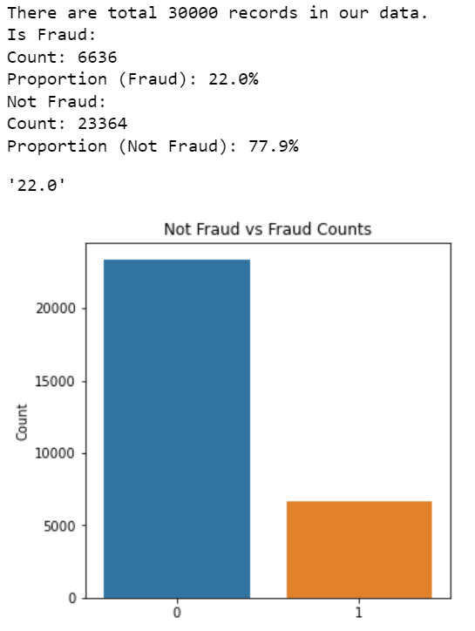
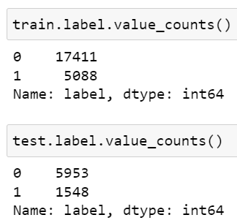
Data Preprocessing
Train & Test Split
In a real-life project, one may want to split the train and test by date/time, it’s not good to do a random split, because it will break the time series and may cause overfitting .I have used the user ID as the time to do the splitting.
Contents Title
Contents Title
Default Label Rate
22% fraud rate (default people), that’s a pretty high default rate in the historical data

Slide 4
Feature Filtering
What Is Feature Filtering ?
Feature filtering, or feature selection, is the process of choosing the most important and relevant features from a dataset, removing irrelevant or redundant ones. It improves model performance, reduces complexity, and enhances interpretability.
Approach
First, I have performed feature filtering to drop the features that have low information value and high correlation.
Techniques Use
Weight of evidence (WOE)
Information Value (IV)
Weight of evidence (WOE)
Describes the relationship between a predictive variable and a binary target variable
Information Value (IV)
Measures the strength of that relationship based on WOE. The industry level is to drop features with an IV lower than 0.02

Slide 5
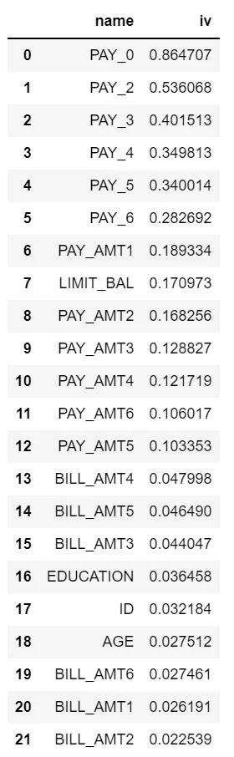
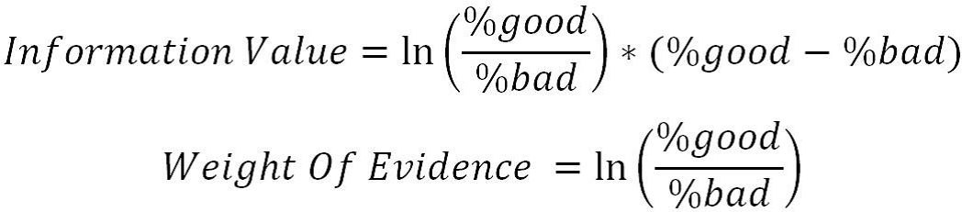
Conclusions Of Feature Filtering
So I kept 23 features in total, and drop 2 features [‘SEX’, ‘MARRIAGE’] because they have low IV (Less than 0.02).
This is the IV ranking for all the features. We can see that PAY_0 has the highest IV, which makes sense because this feature indicates the most recent repayment status. EDUCATION and AGE have a low IV compared to payment status and amount.

Slide 6
Feature Binning
What Is Feature Binning ?
Feature binning is a data preprocessing technique that discretizes continuous numerical features into distinct bins or intervals. It simplifies the data, captures non-linear relationships, and improves algorithm performance by grouping similar values together.
Advantages of Feature Binning ?
It simplifies the logistic regression model and reduces the risk of model overfitting
Logistic regression is a generalized linear model, and its expressive ability is limited; Feature binning can introduce nonlinearity into the model, which can improve the expressive ability of the model and help better model fitting
The discretized features are very robust to abnormal data: for example, the value of a feature is 1 if age > 30, and 0 otherwise. If the features are not discretized, an abnormal data point “300 years old” will impact the model fitting
It can treat null data as an individual class .

Slide 7
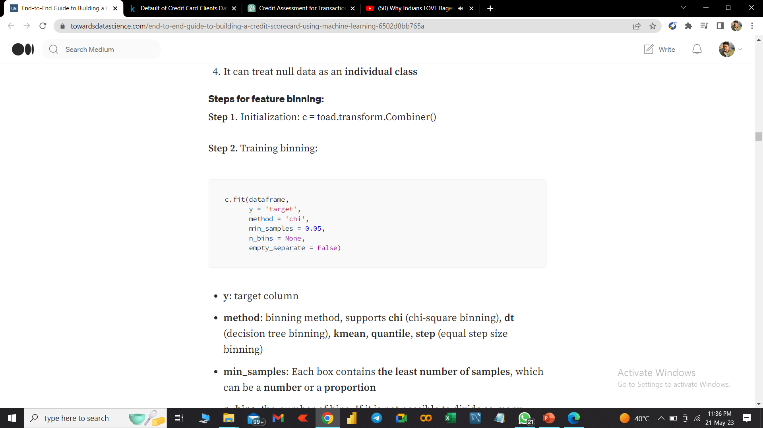
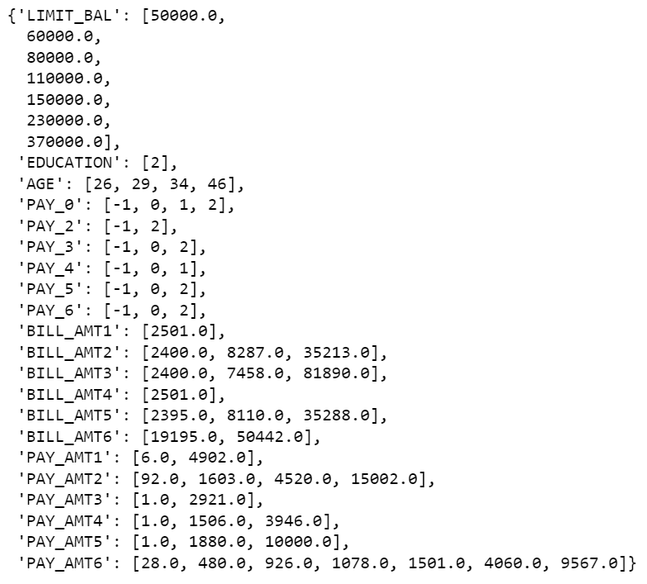
Feature Binning
Method -
The Binning Result -
Binning Method: Choose a method (chi, dt, kmean, quantile, step) for binning the target column (y).
min_samples: Specify the minimum number of samples required in each bin.
n_bins: Determine the desired number of bins (if feasible) for the binning process.
empty_separate: Decide whether to handle empty bins separately.
labels: Choose whether to convert the binning results into box labels or use numerical representations.

Slide 8
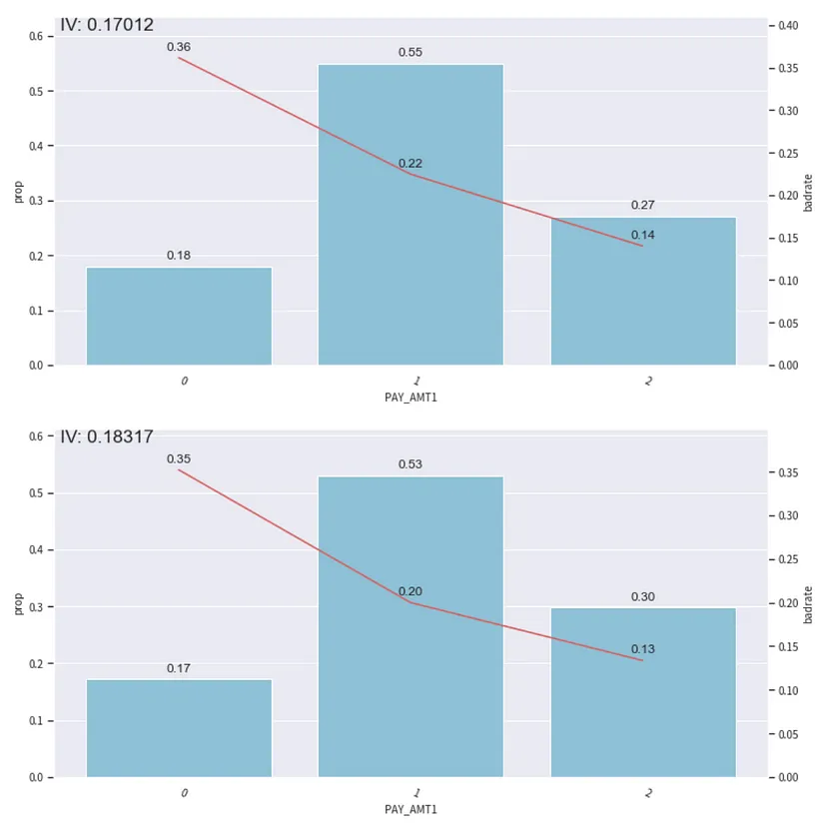
Conclusion After Feature Binning
In this plot, the bar plot represents the proportion of the data in the corresponding bin; the red line represents the proportion of default customers.
We need to make sure that the binning has monotonicity, which means the line is trending in the same direction with no sudden jump or drop.
This plot looks ok, if there is a sudden jump or drop, we need to use c.set_rules(dict) to combine the binning.

Slide 9
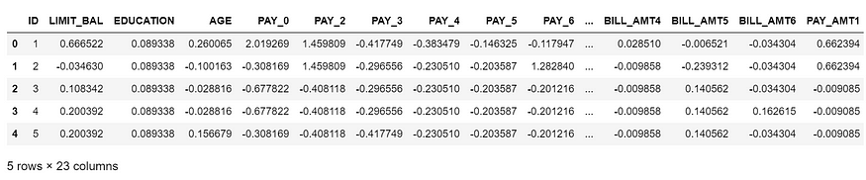
Transform To WOE & Calculate PSI
WOE transformation is performed after the binning is Done.
Columns that do not need to be transformed by WOE. Note: All columns will be transformed, including the columns that have not been binning, and the columns that do not need to be converted by WOE will be deleted through exclude, especially the target column.

Slide 10
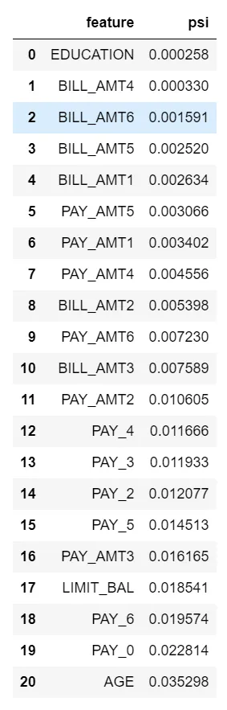
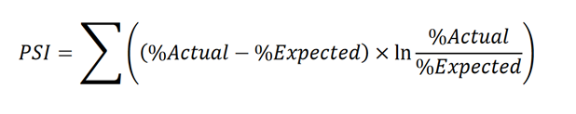
Transform To WOE & Calculate PSI
Calculate PSI
PSI (Population Stability Index) reflects the stability of the distribution. We often use it to screen features and evaluate model stability. The industry level is to drop features with a PSI greater than 0.2

Slide 11
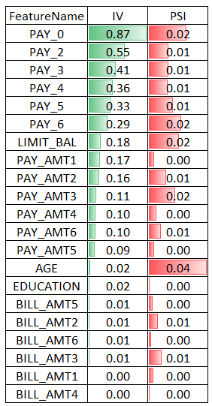
Output Final Information Value
This step is to output the IV after the WOE transformation, it’s a little bit different than the raw features’ IV.
The idea is to get the features with the highest IV and lowest PSI.

Slide 12
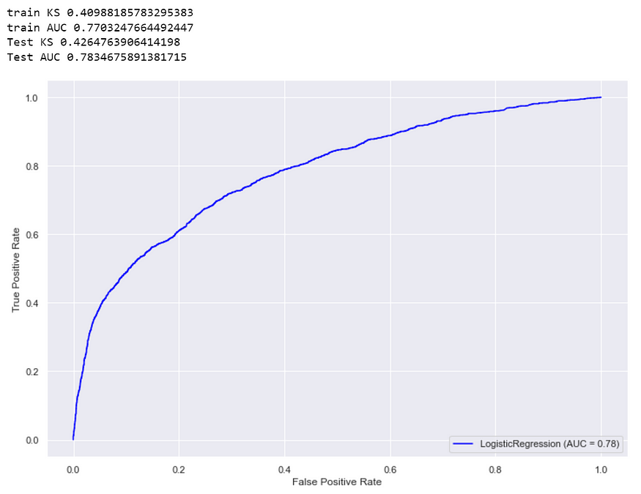
Model Tuning
Logistic Regression
The most used algorithm in the credit scorecard modeling process is Logistic Regression. The reasons are as follows:
Simple linear relationship: the relationship between variables is a linear relationship
Good Interpretability: the effect of input variables on target variables is readily available
Give probabilities instead of discriminative classes: the customer’s characteristic information (such as marriage, age, historical credit performance, etc.) can be integrated and converted into a probability value, which provides an intuitive basis to predict whether the customer is good or bad. That is, the larger the value, the smaller the probability that the customer will default in the future.
Easy to deploy: testing, deployment, monitoring, tuning, etc., are relatively simple
We can see that there is not a big difference between the train AUC and test AUC or train KS and test KS. This means our model does not overfit.

Slide 13
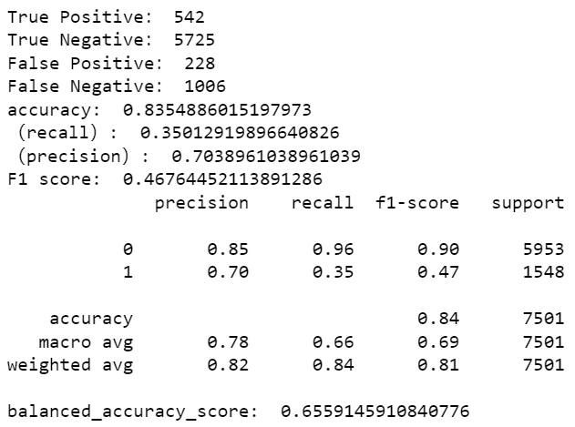
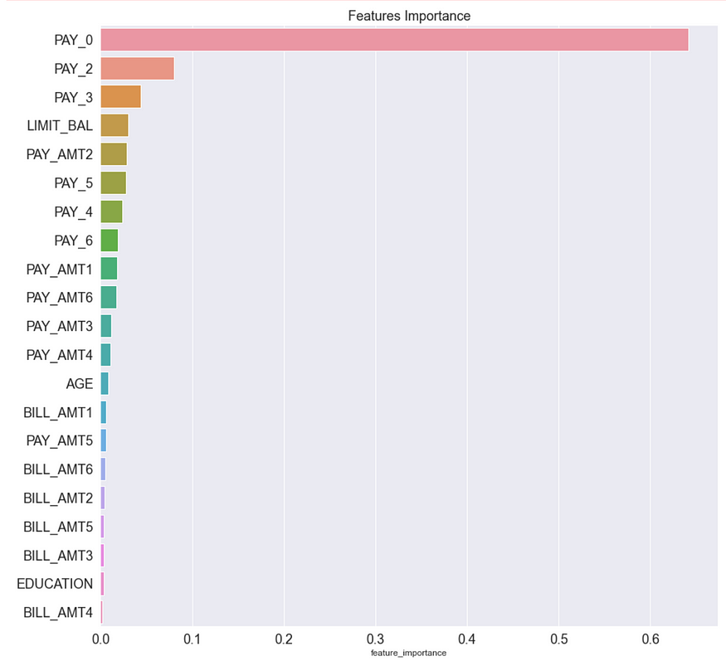
Model Tuning
Train a Gradient Boosting Classifier and check the feature importance table
To see if a GBDT model will perform better than LR and compare the feature importance table with IV.
As we can see from the feature importance table, GBDT puts a lot of weight (64%) on the PAY_0 feature.

Slide 14
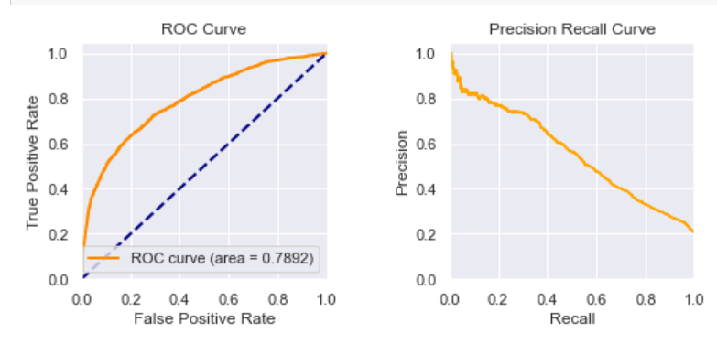
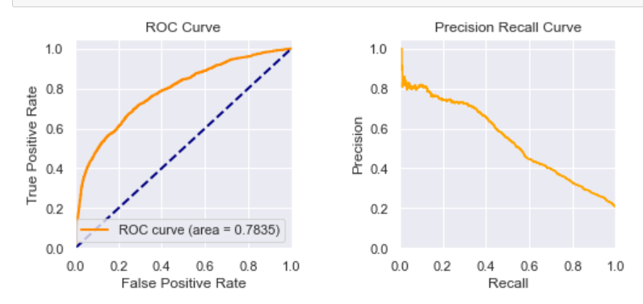
Model Production
The ROC and Precision-Recall curve look ok.
Let’s train our production model for Logistic Regression
AUC of LR: 0.7835
AUC of GBDT: 0.7892
Not a big difference between these models. So it’s ok to use LR to build a scorecard.

Slide 15
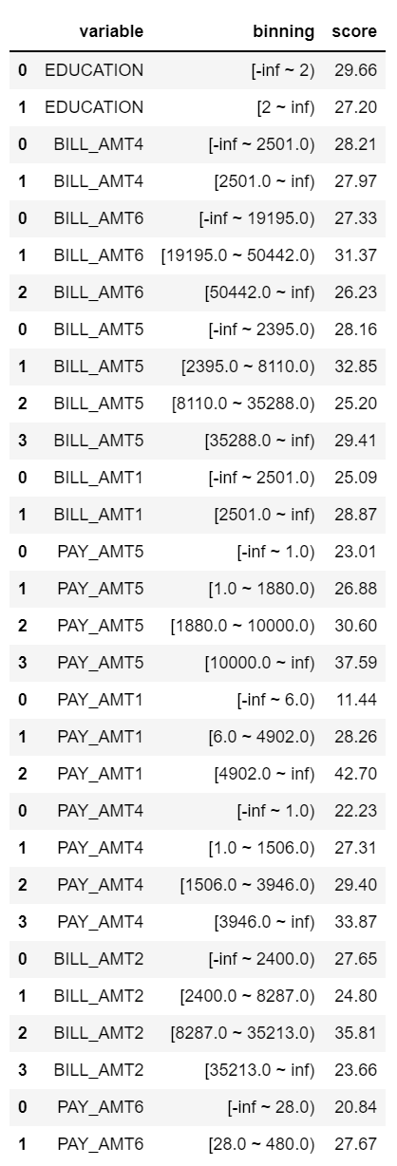
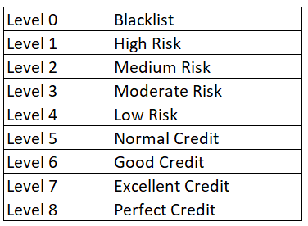
Scorecard Tuning
The following parameters are the most important ones for Scorecard Tuning.
base_score = 1000, base_odds = 35 , pdo = 80, rate = 2
The actual meaning is that when the base odds are 35, the benchmark score is 1000, and when the ratio is twice the benchmark, the benchmark score drops by 80 points.
Here we have our scorecard; once we get this table, we can throw this CSV file to the developer and let them develop a service to score each customer.
But there is something more we need to do; for a typical scorecard, we need to have a score range, and each range presents a level of trust.
In this way, the business side people are more easily to perform an action against different level customers.
we can set the credit level like this:

Slide 16
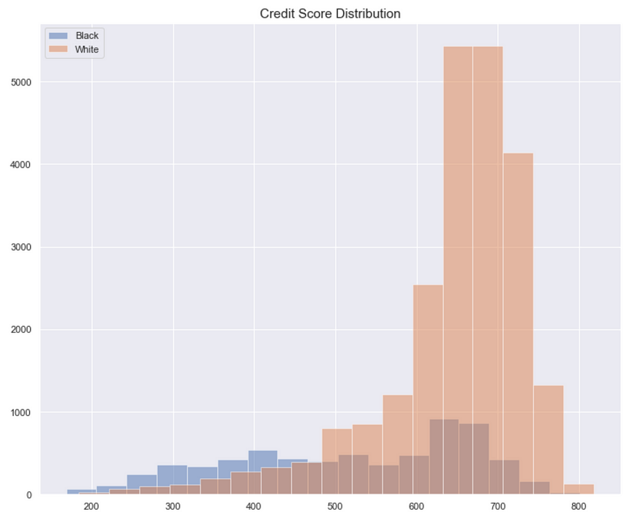
Distribution Analysis
We need to plot the score distribution of default customers vs good customers in order to split the credit levels (level 0 to level 8).
Black means default customers, and white means good customers.
A good model will clearly separate the black/white distribution.
The ideal distribution is a smile shape
Good customers with high credit scores->to the very right
Default customers with low credit scores-> to the very left.
Our current model doesn’t separate these distributions very well. For me, I would go back to explore more features to increase the predictive power. But we can always build a baseline model first and improve based on that.

Slide 17
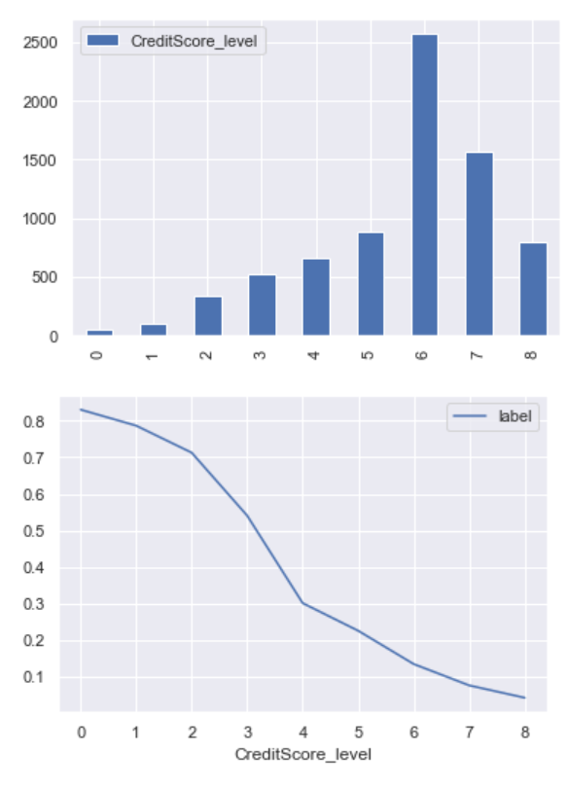
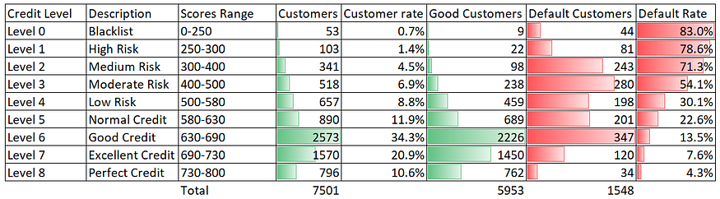
Threshold Tuning
We need to perform threshold tuning for different credit levels, and that’s a trade-off between loss & coverage.
Let’s say that your boss is OK with some loss, but you have to cover 70% of good customers for next month.
In other words, your goal is to find a threshold with ≤10% loss and ≥70% coverage.
By examining each level, you will have a loss and coverage table. For example, if you send the balance transfer offers to all the people 7501 (L0-L8) you will incur a 21% loss rate (1548/7501).
To reach the goal (≤10% loss and ≥70% coverage), you need to pick L6-L8 with a 10.1% loss (347+120+34)/(2573+1570+796) and a 75% coverage (2226+1450+762)/5953.
Basically, next month (assuming that the test set is next month’s data) the business-side people will send the balance transfer offers to customers with a Level 6 rating or above, a total of 4939 customers.
This plot indicates the distribution of each credit level and the credit default rate at that level.

Slide 18
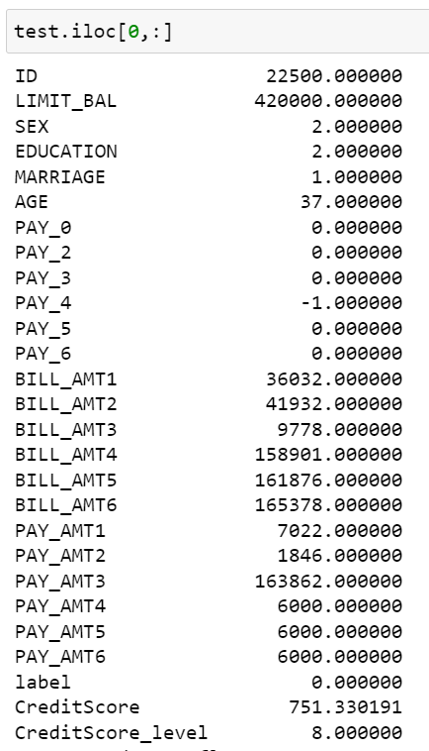
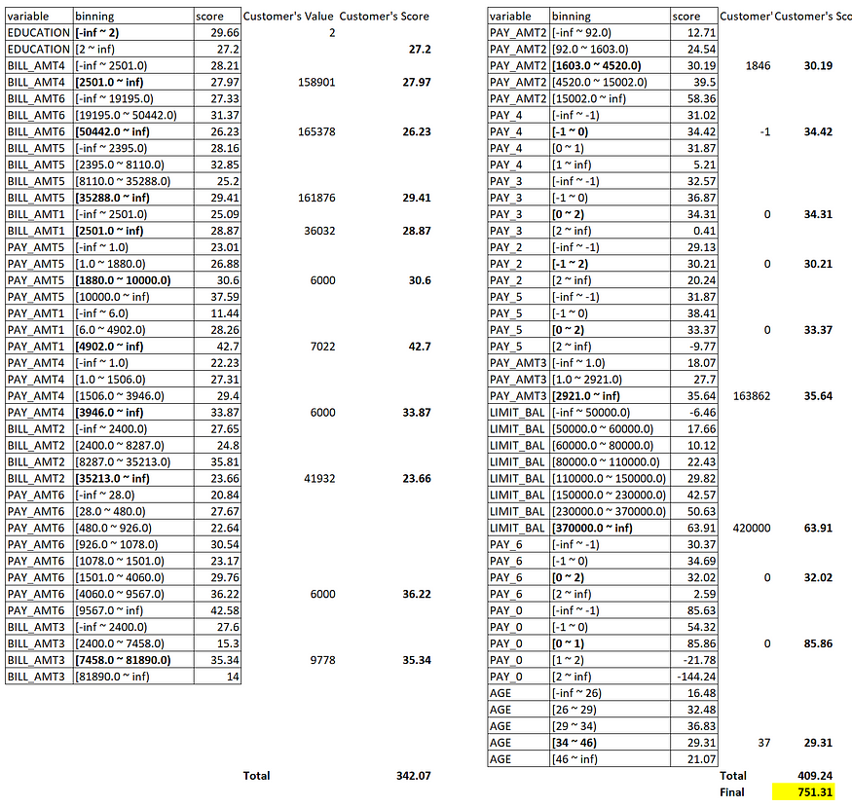
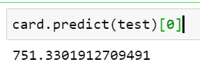
Manually Test Our Scorecard
Can we send a balance transfer offer to a customer with the following information next month?
Inference by toad:
We can see that this customer is a Level 8 customer with Perfect Credit. So we can issue him/her a balance transfer offer.

Slide 19
Conclusion
For future work, as a data scientist, One can try using other ML models to build the scorecard, such as Deep Neural Networks, to increase the accuracy further and lower the false positive rate to improve customer satisfaction.
References
• Thomas, L. C. (2002). Credit scoring and its applications. Philadelphia
• Baesens, B., Roesch, D., Scheule, H., & Smaers, P. (2015). Credit risk analytics: Measurement techniques, applications, and examples in SAS. John Wiley & Sonshttps
• Hand, D. J., & Henley, W. E. (1997). Statistical classification methods in consumer credit scoring: A review. Journal of the Royal Statistical Society: Series A (Statistics in Society
• Gerasymchuk, S., & de Leeuw, J. (2013). Predicting credit card customer attrition using data mining techniques. Expert Systems with Applications
• Thomas, L. C., & Edelman, D. B. (2002). The credit scoring toolkit: Theory and practice for
retail credit risk management and decision automation. Oxford University Press.
• Bartlett, J. E., Kotrlik, J. W., & Higgins, C. C. (2001). Organizational research: Determining
appropriate sample size in survey research. Information Technology, Learning, and Performance Journal
• Baesens, B., Setiono, R., & Mues, C. (2003). Using neural network rule extraction and decision tables for credit-risk evaluation. Management Science
• Crook, J., Banasik, J., & Thomas, L. (2007). Neural networks and genetic algorithms for predicting bankruptcy. Neural Computing & Applications .
• Lim, A. (2014). Predicting creditworthiness using logistic regression and decision trees. International Journal of Business and Management.
• Hastie, T., Tibshirani, R., & Friedman, J. (2009). The elements of statistical learning: Data mining, inference, and prediction (2nd ed.). Springer.

