Slide 1
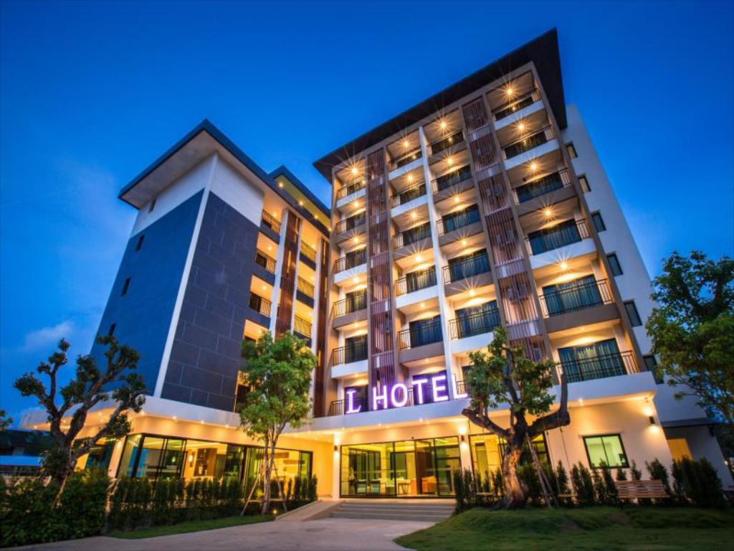
HOTEL RESERVATION SYSTEM
Batch : Oracle Applications
Team : UncertainGeek
AKASH (178028)
ARCHANA BORKAR (177356)
MINNI JHA (177777)
YASHWANTH K.A (178032)
PROJECT GUIDED BY :
ANIL ANCHAN

Slide 2
CONTENT
ABSTRACT
ER DIAGRAM
AIM METHODOLOGY
MD50 (FUNCTIONAL REQUREMENT)
MD70 (TECHNICAL SPECIFICATION)
CODING STANDARD
APPLICATION AND PRODUCT USED
IMPLEMENTATION : SQL* LOADER AND PL/SQL PROCEDURE
PROJECT FLOW
FORMS CREATION AND REPORT CREATION AND FLOW
REGISTRATION ON ORACLE APPLICATION
CONCLUSION

Slide 3
ABSTRACT
The main Aim of our project is to build an application that manages the reservation of hotel from group of hotels.
The Application has been designed using Orcale Forms and Report and few data has been inserted in all the table database using SQL* LODER, and PLSQL Procedure .
The Application will be able to add, delete and update the hotels, guest details and reservation records and also generate the bill for the new reservation by the guest.

Slide 4
“Hotel Reservation System” has been designed to computerized the following functions that are performed by the system:
Search Hotel
Make Reservations
Add Payment
Issue Billing Report
Manage Hotels( Add, delete, update Hotels)
Manage Guest(Add, Update Guest )
Manage Reservation Details(Add, Update, Delete)

Slide 5
HOW IT WORKS?
The main purpose of our project is to perform each customer’s activity in computerized way rather than manually which is time consuming.
This project is used by two types of users-
Users
Administrator
where user can use it to book the hotel ,from the group of hotels
&
Administrator can maintain the record related to the hotels reservation system.

Slide 6
BENEFITS
The Application will have history about reservation and guest so that can be called whenever they are needed which helps is checking any mistake.
Making the reservation easier.

Slide 7
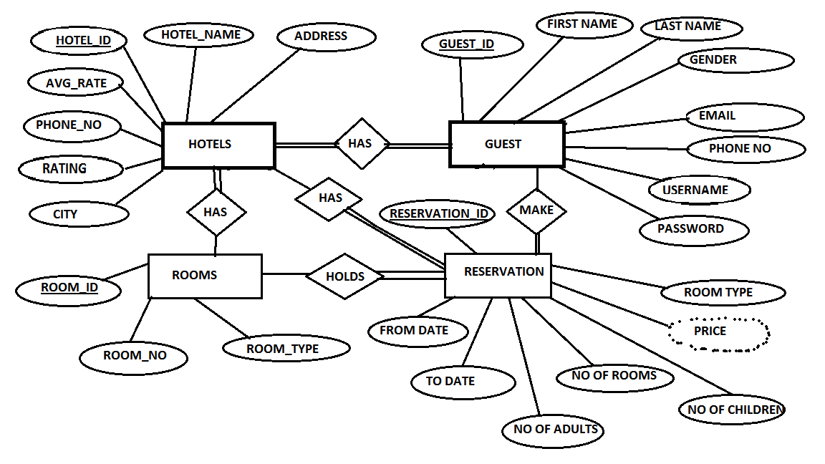
ER DIAGRAM

Slide 8
AIM METHODOLOGY
This is an application implementation methodology developed by Oracle Corporation.
Sequence of order of task to complete implementation is called AIM Methodology.
We use this methodology for Oracle Apps projects implementation.
This has been done in 6 phases.
1. Definition
2. Operational Analysis
3. Solution Design
4. Build
5. Transition
6. Production.

Slide 9
Definition
We started with Planning of the project.
Then we Reviewed the organization’s business objectives.
Evaluate feasibility of meeting those objectives under time, resource and budget constraints.
Strategies, objectives and approaches are determined for the AIM process.
Operational Analysis
Our Project team develops Business requirements.
Assessed the level of fit between the business requirements and standard application functionality.
Gaps are identified and corresponding solutions developed.

Slide 10
Solution Design
Develop the detailed designs to meet the future business requirements.
Project team members created the detailed of process solutions develops using Operational Analysis.
The project team carefully scrutinizes these solutions and chooses the most cost effective alternatives.
Build
Coding Standards and testing of all customizations and other custom software were done.
Policy and procedure changes relating to business process modifications were developed.
Business system testing were performed to validate the developed solutions meet business requirements.

Slide 11
Transition
Deployed the finished solutions in to the oracle Application
The project team trained the young users to use the Application.
Production
This is the last phase of implementation, and the beginning of the system support cycle.

Slide 12
MD 50 (FUNCTIONAL REQUIREMENT)
Following are the functionalities of our system. Whenever, the description of the functionality is not adequate: you can make appropriate assumptions and Proceed.
The system should be able to read the file UG_HOTELSDATA.dat and import the data into
HOTELS Table using SQL * LOADER and PL/SQL Procedure.
The system should be able to read the file UG_RESERVATION.dat and import the data into
RESERVATION Table using SQL * LOADER and PL/SQL Procedure.
The system should be able to read the file UG_ROOMS and import the data into
ROOMS Table using SQL * LOADER and PL/SQL Procedure.
The system should be able to read the file UG_GUEST.dat and import the data into
GUEST Table using SQL * LOADER and PL/SQL Procedure.
===============================================================================================================
In the system there must be a form to make reservation for a particular hotel from a group of hotels.
In the system there must be a form for our new guest to sign up to our portal.
In the system there must be required number of validations carried out based on functionality in the project.
The system should be able to generate the Billing Report for all the customer who has booked the hotel with us .

Slide 13
MD70(TECHNICAL SPECIFICATION)
MD 70 is an Technical specification document which would be prepared by us as a technical team by adding the technical things like as Tables, view, columns etc. which are going to be used to fulfill the specific requirement which has been defined based on our functional MD 50 document.
It includes the approaches you take like, pseudo code, validation, Data source, SQL statements
We have normalized the database table which we have created for the Project.
We have also followed all coding standard while creating table, forms, reports.
We have done validations wherever required in the project..

Slide 14
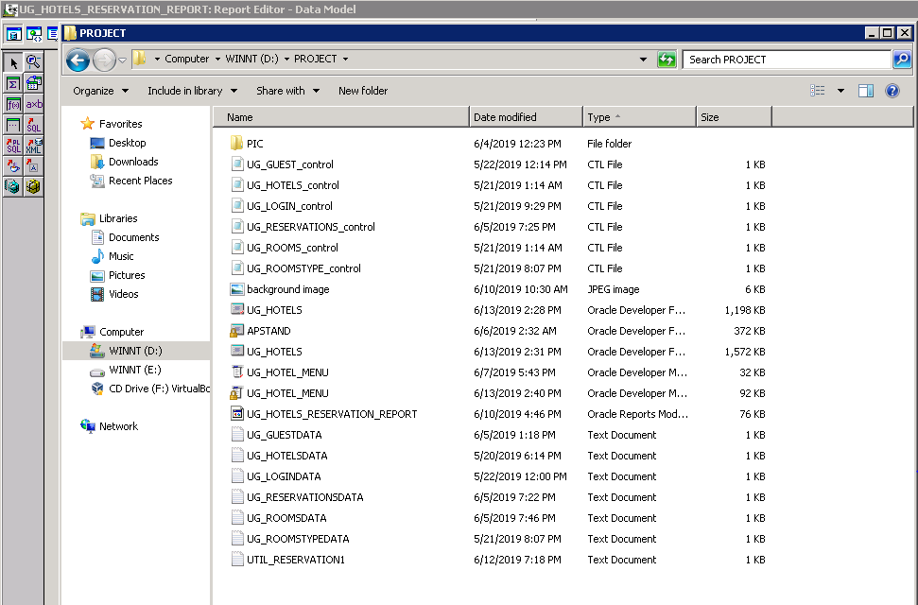
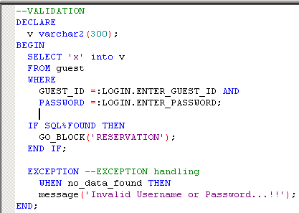
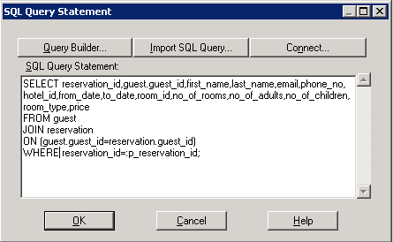
Coding Standard:
The central Purpose of any coding standard for SQL and PL/SQL must deal with database performance, clarity of the code and maintainability of the code.
Coding standard are also used for a unified look of the project and not just for the code .
Example: We have followed this standard to not just to create table but also create file to have unified look of the project.

Slide 15

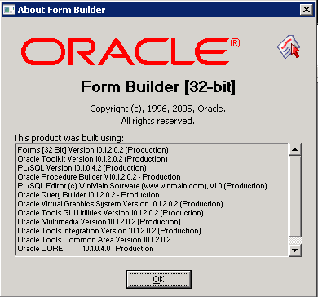
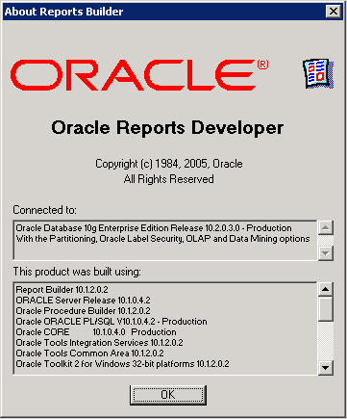
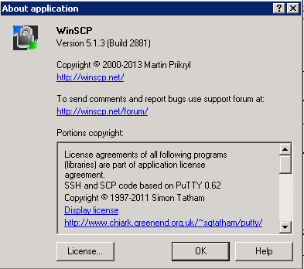
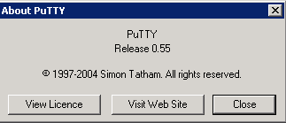
APPLICATIONS AND PRODUCT USED:
Product Used :Oracle Developer Suite –DevSuiteHome
Main Application Used :Oracle Forms and Reports
Other Applications Used : PUTTY and WinSCP

Slide 16
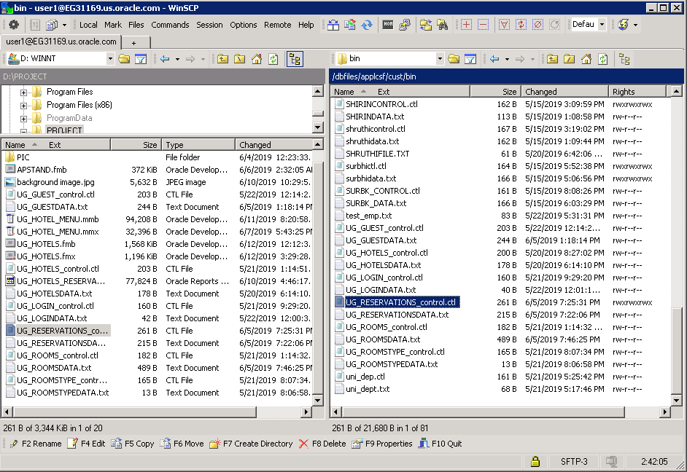
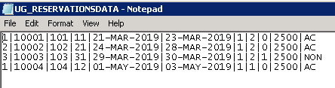
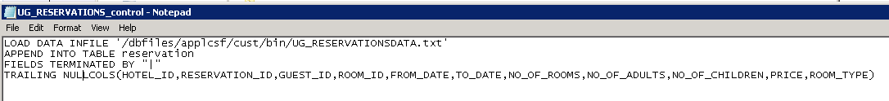
IMPLEMENTATION
SQL*LOADER
DUMPED DATA TO THE DATABASE TABLE
USING SQL*LOADER
Example of one of the data dumped
using SQL*LOADER

Slide 17
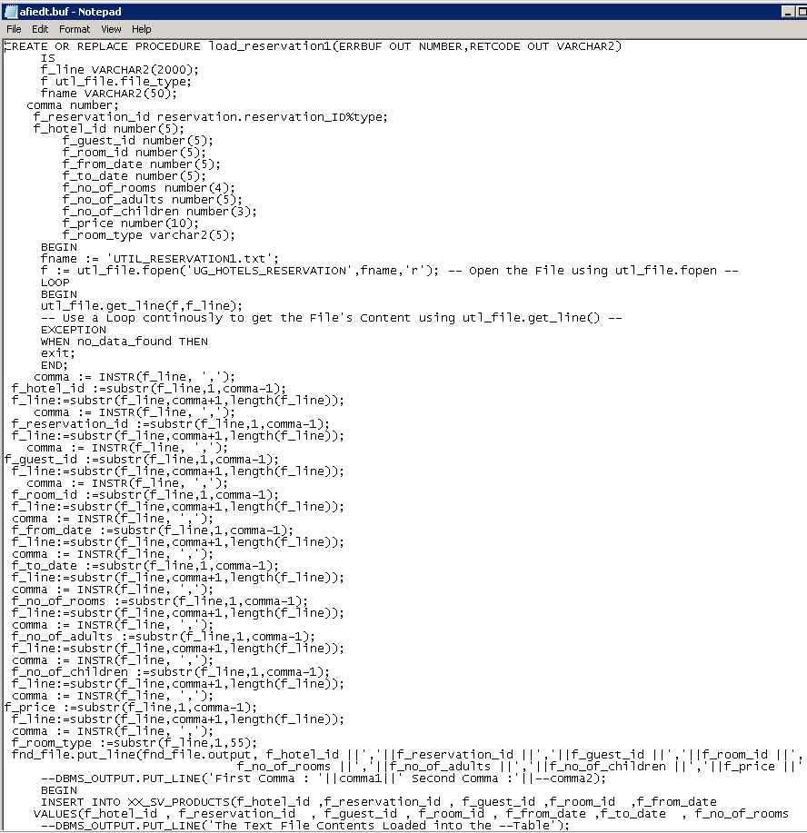
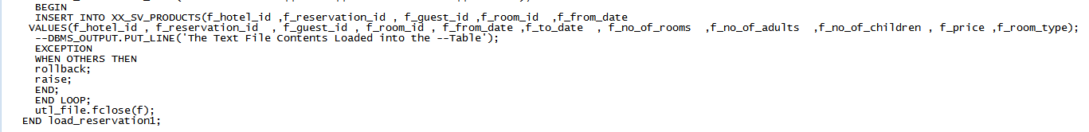
PL/SQL PROCEDURE

Slide 18
PROJECT FLOW
UI FLOW OF THE PROJECT
SEARCH HOTEL
LIST OF HOTELS
HOTEL
DESCRIPTION
BOOK HOTEL
LOGIN
RESERVATION FORM
PAYMENT
SUCCESSFULLY BOOKED
SIGN UP

Slide 19
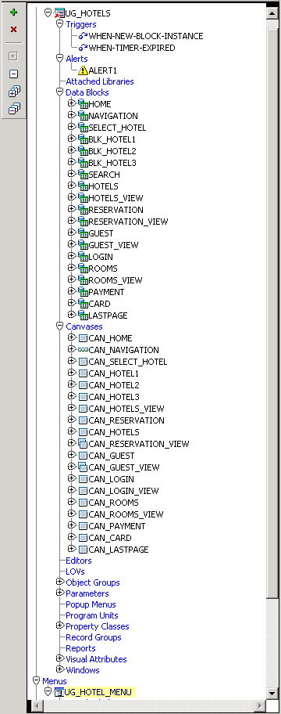
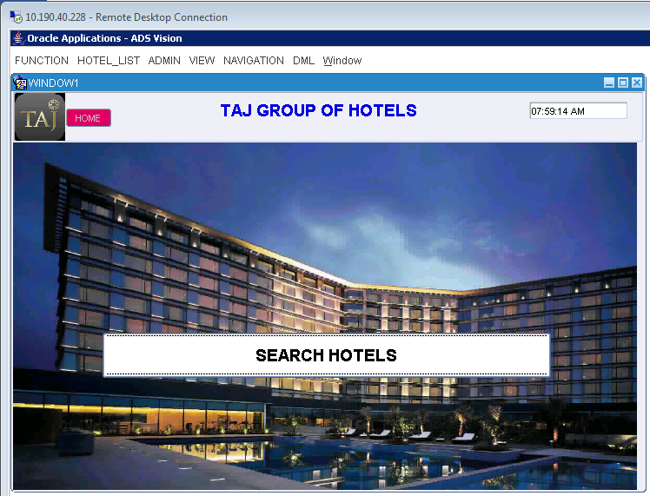
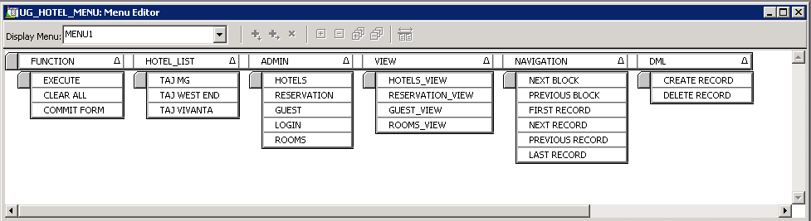
FORMS AND MENU CREATIONS PROCESS AND FLOW
We used APSTAND Template
to create Form

Slide 20
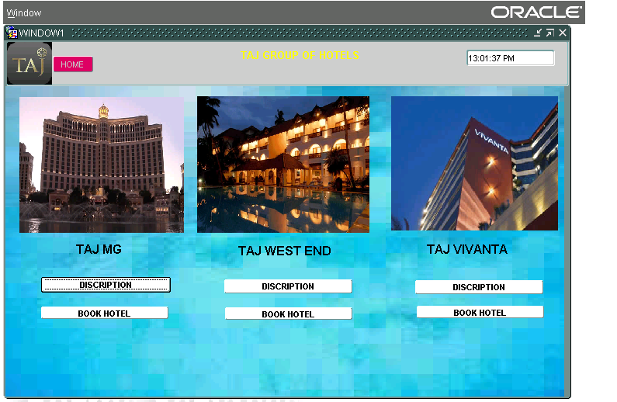
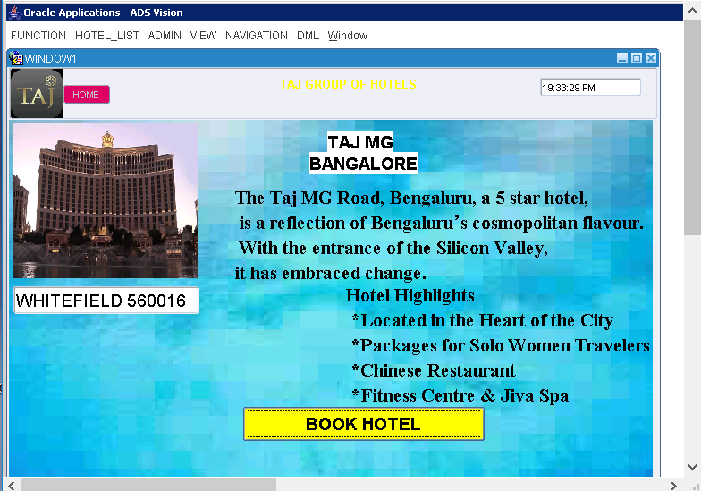
GROUP OF HOTELS FORM
DESCRIPTION OF HOTEL

Slide 21
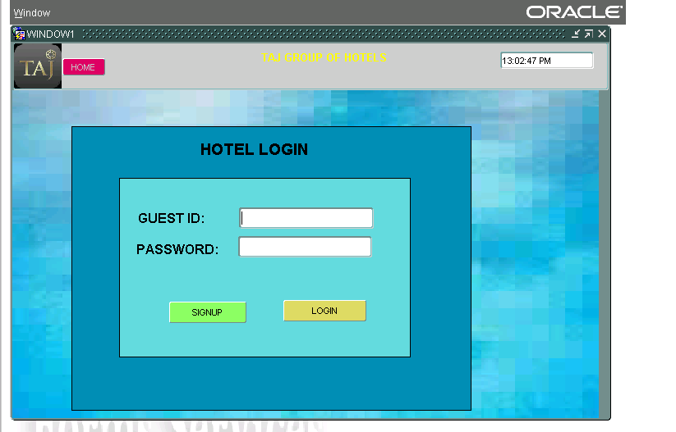
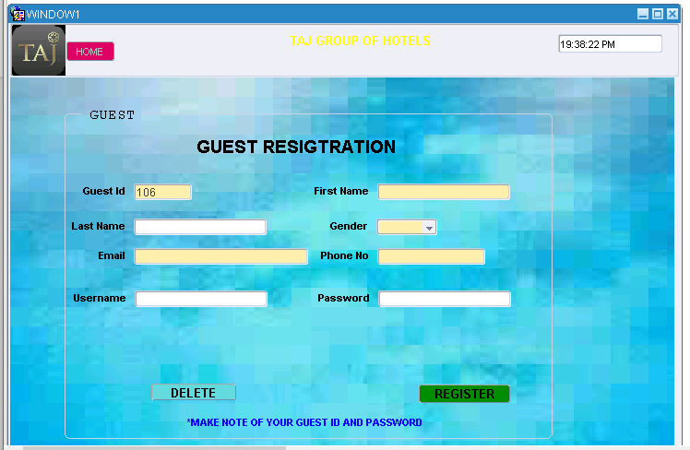
LOGIN INFO
GUEST REGISTRATION FORM

Slide 22
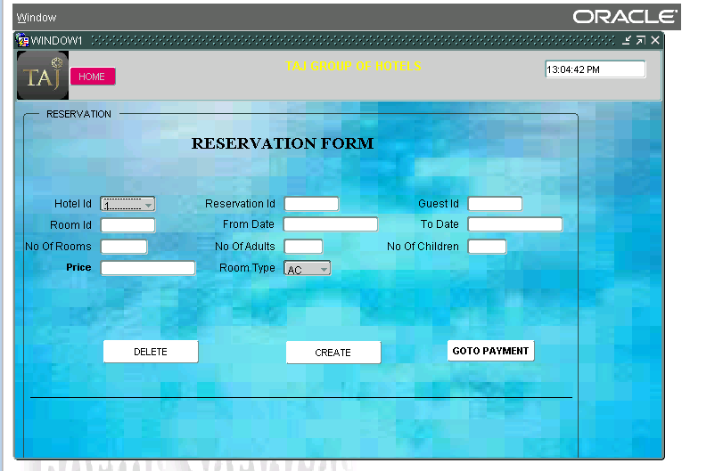
LOGIN INFO
RESERVATION DETAILS

Slide 23
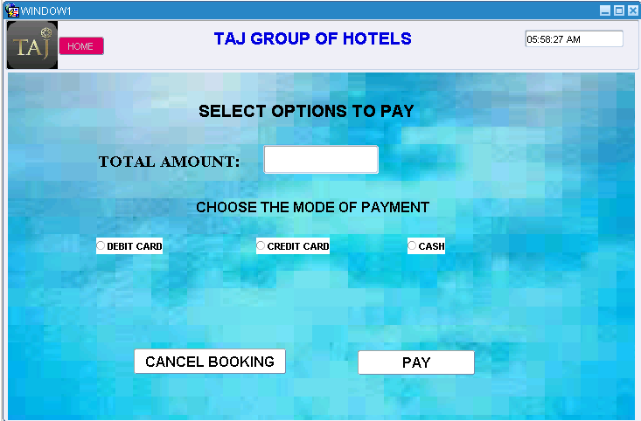
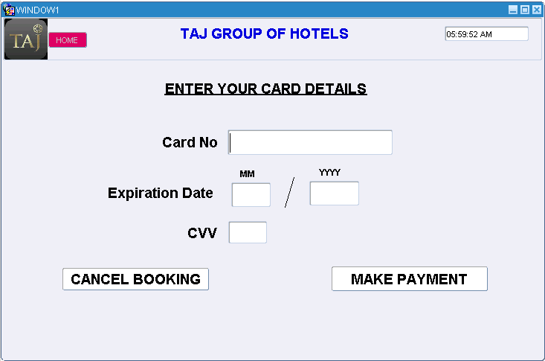
PAYMENT PAGE
CARD DETAILS

Slide 24
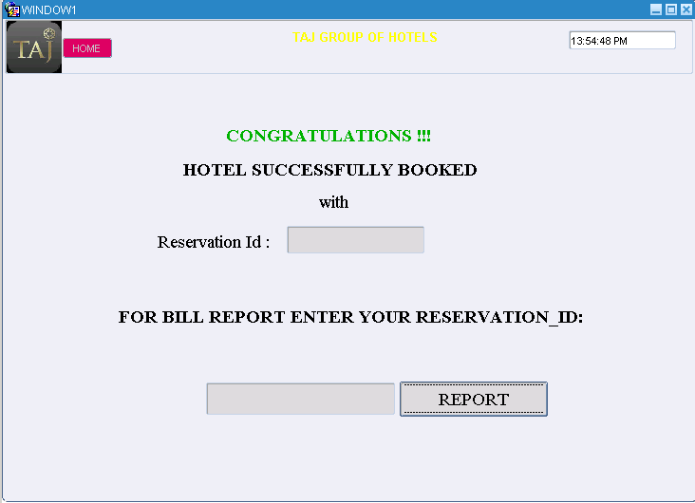
REPORT PAGE

Slide 25
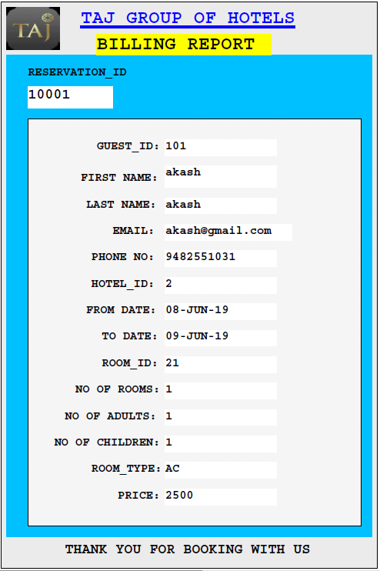
SAMPLE REPORT

Slide 26
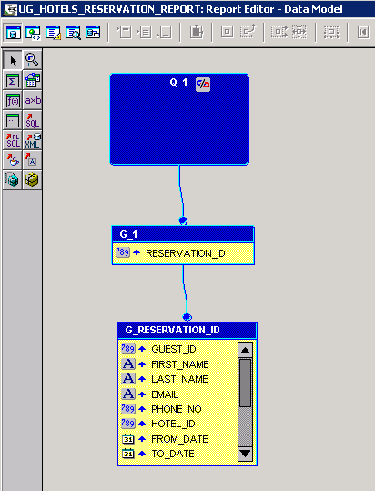
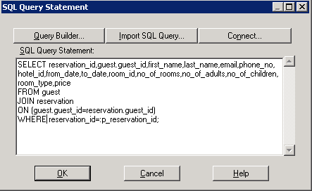
REPORT CREATION
WE HAVE COMBINED TWO TABLE TO GENERATE THE BILLING REPORT AFTER RESERVATION IS MADE BY THE GUEST USING THERE RESERVATION ID.
THE TWO TABLE ARE :
RESERVATION TABLE
&
GUEST TABLE

Slide 27
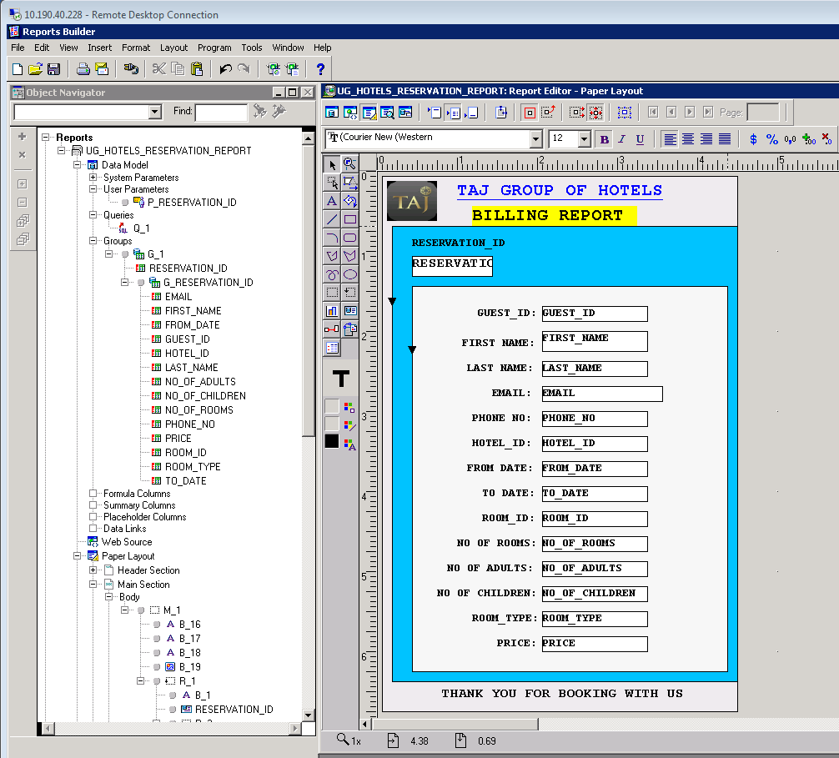
OVERVIEW OF OUR REPORT CREATION

Slide 28
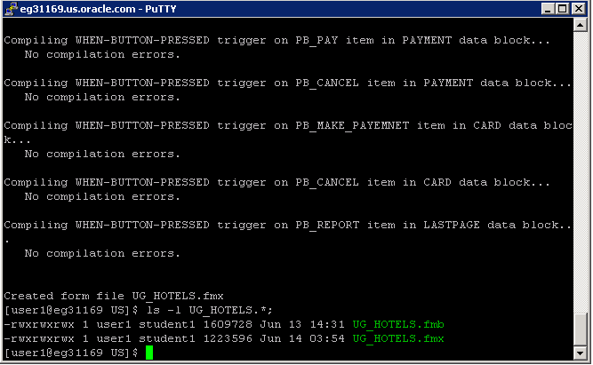
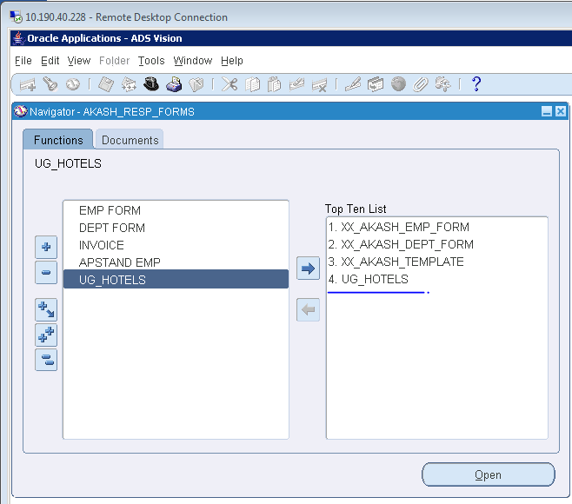
REGISTRING OUR FORMS AND REPORT ON ORACLE APPLICATIONS
After linking all Forms ,Reports, Menu together.
We have saved our forms and moved it to winSCP to /dbfiles/applcsf/cust/forms/US from the local folder.
We have saved our Reports and moved it to winSCP to /dbfiles/applcsf/cust/reports/US from the local folder.
Then we have compiled our forms and menu in PUTTY.
Then we successfully Registered the Forms and Reports on the Oracle Application.

Slide 29
CONCLUSION:
We have developed the project using Oracle Forms and Reports by following all the Coding Standards and Procedure and also done validation where ever required in our project and have successfully registered and implemented the project on the Oracle Application.
There is always a Scope of Enhancement for the Project which we are looking at and will be implementing in coming days.
In future enhancement we are aiming to add various category in our hotel reservation system and making reservation for the Restaurant, Transportation.

Slide 30
DEMO OF OUR PROJECT

Slide 31
THANK YOU

