Slide 1


Bankruptcy Prediction System
Team Members: Ashwini Salwadgi Anuja Borse Akash Sanjay Dingore Devesh Gaonkar Rudra Shukla Pranjalee Navnath Bokde Mayur Santosh Vaidya

Slide 2

content
Project Architecture
Introduction to Bankruptcy Prediction System
Dataset Details
Data Preprocessing And EDA
Visualization
Details about Model Building
Model Selections
Deployment

Slide 3
Project Architecture
Datasets
-Import Libraries
-Load Datasets
Data Preprocessing/EDA
-Construct an extra columns for locations
-Changes in the inappropriate blanks values in columns
Data Visualization
-Numerical Data Visualization
-Outliers Detection through Boxplot
Data Cleaning
-Missing Value Treatment
-Checking Duplicates
Model Selection
Model Deployment

Slide 4

Introduction to Bankruptcy Prediction System
Bankruptcy prediction is the problem of detecting financial distress in businesses which will lead to eventual bankruptcy.
Problem Statement:
The data were collected from the Taiwan Economic Journal for the years 1999 to 2009. Company bankruptcy was defined based on the business regulations of the Taiwan Stock Exchange
This study extends this research by applying machine learning techniques to a quarterly data set covering financial ratios.

Slide 5
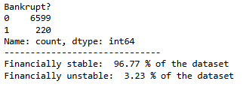
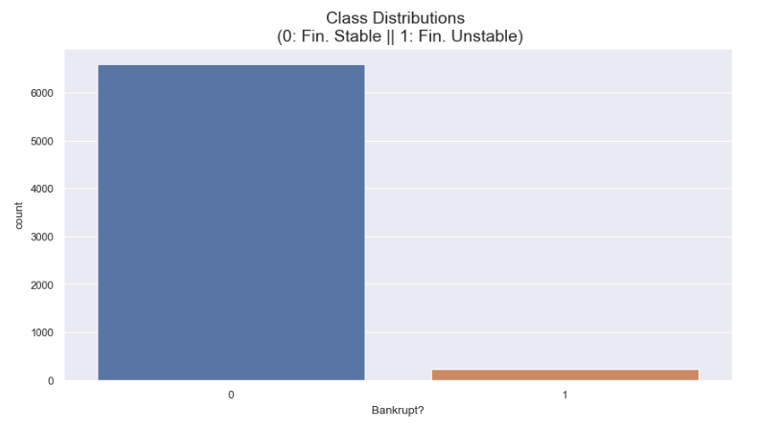
Dataset Details
Bank.csv – the dataset we are using in our project.
No. of Rows: 6819
No. of Columns: 96

Slide 6
Data Preprocessing And EDA
Check Data Types
Display Descriptive Statistics
Check Null Values
Check Duplicate Values

Slide 7
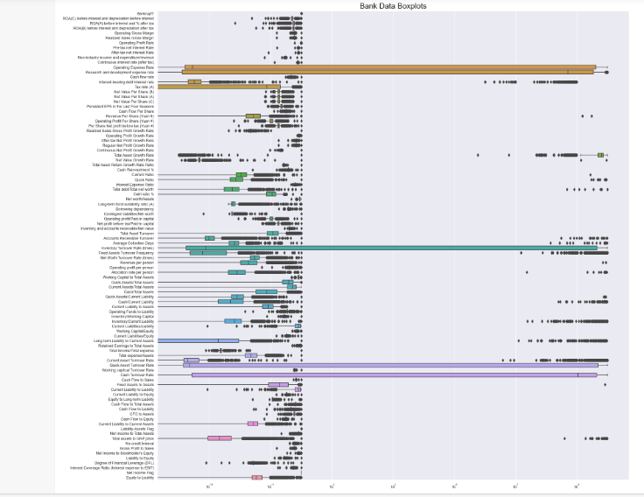
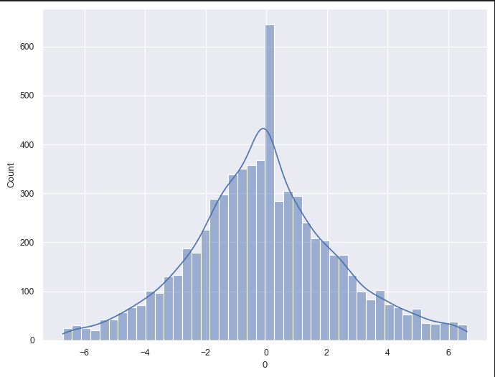
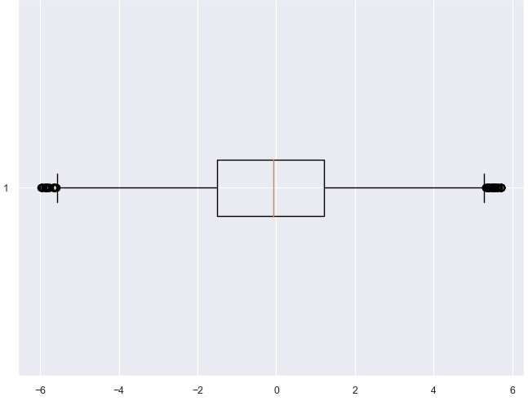
Data Visualization

Slide 8
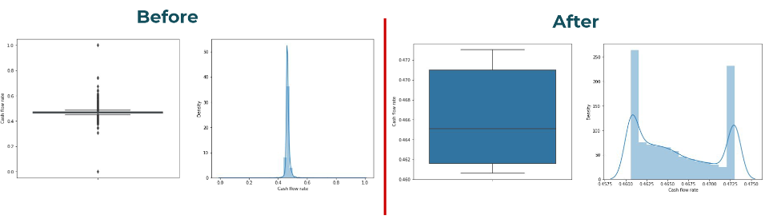
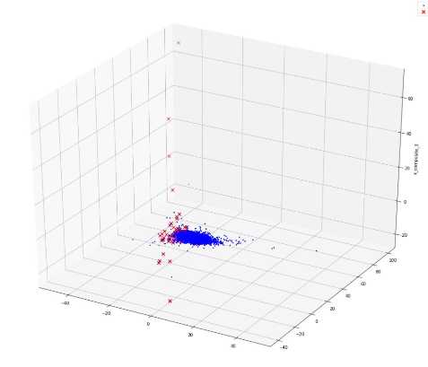
Detecting and Capping Outliers
3D visualization
using PCA

Slide 9
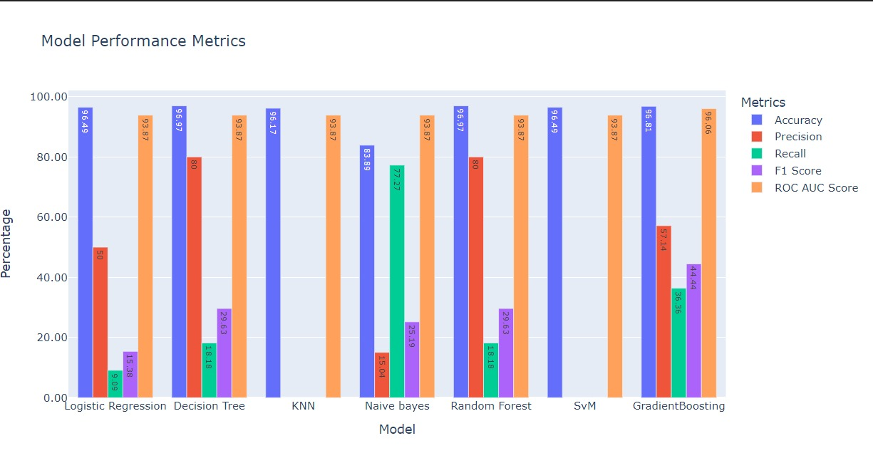
Model Selection and Model Building

Slide 10
Bagging for Decision Tree
Bagging for Decision Tree
Correlation Analysis
The absolute value of correlations
Correlation Analysis
Sorts correlations in descending order
Mutual Information
Information obtained about one random variable through another random variable
ANOVA F test
Identify the features that have the most significant linear relationships with the target variable

Slide 11
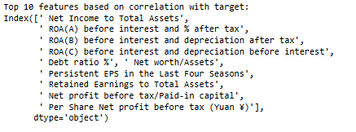

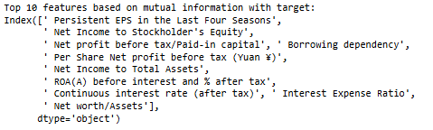
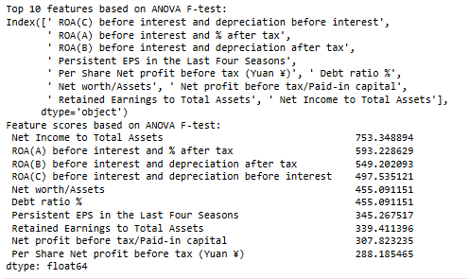
Correlation Analysis
Mutual Information
ANOVA F test

Slide 12
Deployment
Deployment is the process by which a ML model is moved from an offline environment and integrated into an existing production environment such as a live application.
It is a critical step that must be completed in order for a model to serve its intended purpose and solve the challenges it is designed.
Here, we are using ‘Stremlit’ for deploying our application.

Slide 13
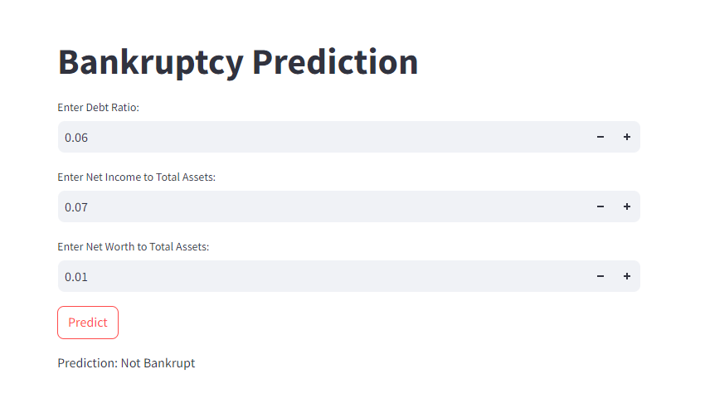

Slide 14


Challenges in project
Complexity in Exploratory Data Analysis (EDA):
Interesting but Challenging.
Variable Selection: Identifying the most relevant variables for analysis.
Effective Visualization: Creating impactful and insightful visualizations.
Model Building Hurdles:
Accuracy Challenge
Trial and Error: Built 5-6 models.
Final Selection: Chose the model that provided the most accurate recommendations.

Slide 15


References
Pandas documentation Link- https://pandas.pydata.org/docs/
Matplotlib documentation- https://matplotlib.org/stable/index.html
Streamlit documentation- https://docs.streamlit.io/
https://www.kaggle.com/

Slide 16


Any Questions……?????

Slide 17




Thank You……!!!!!!!!!!!!!!!!

