Slide 1
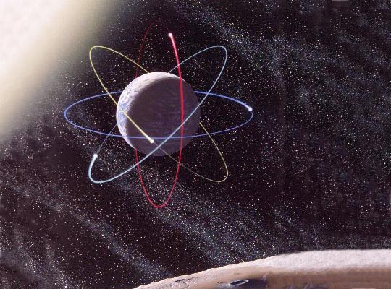
Mathematical Modeling
UAB/EdGrid
John C. Mayer
UAB/Mathematics
Graduate Assistants:
Clinton Curry
Brent Shivers

Slide 2
Mathematical Modeling
Creates a mathematical representation of some phenomenon to better understand it.
Matches observation with symbolic representation.
Informs theory and explanation.
The success of a mathematical model depends on how easily it can be used, and how accurately it predicts and how well it explains the phenomenon being studied.

Slide 3
Mathematical Modeling
A mathematical model is central to most computational scientific research.
Other terms often used in connection with mathematical modeling are
  Computer modeling
  Computer simulation
  Computational mathematics
  Scientific Computation

Slide 4
Mathematical Modeling and the Scientific Method
How do we incorporate mathematical modeling/computational science in the scientific method?

Slide 5
Mathematical Modeling
Problem-Solving Steps
Identify problem area
Conduct background research
State project goal
Define relationships
Develop mathematical model
Develop computational algorithm
Perform test calculations
Interpret results
Communicate results
Notes:
Identify problem area.
Conduct background research: Find the back-ground information to narrow the focus of the problem.
Internet and library research
A mentor
Textbook and teachers
State project goal: Write a reasonable problem definition.
What do you want to find out?
What do you expect to discover?
Define relationships: Focus on how variables are related
State governing principles = laws/relationships from physics, biology, engineering, economics, etc.
State simplifying assumptions, e.g., no friction system (physics), no immigration of population (economics), constant growth rate (biology), etc.
Define input and output variables/parameters
Give units
Develop mathematical model: Define mathematical relationships between variables.
Variables (Output and input) and parameters (constants). Output variables give the model solution . The choice of what to specify as input variables and what to specify as parameters is somewhat arbitrary and often model dependent. Input variables characterize a single physical problem while parameters determine the context or setting of the physical problem. For example, in modeling the decay of a single radioactive material, the initial amount of material and the time interval allowed for decay could be input variables, while the decay constant for the material could be a parameter. The output variable for this model is the amount of material remaining after the specified time interval.

Slide 6
Syllabus: MA 261/419/519
Spring, 2006

Slide 7
Syllabus: MA 261/419/519
Introduction to Mathematical Modeling
Prerequisite: Calculus 1
Goals
  Learn to build models
  Understand mathematics behind models
  Improve understanding of mathematical concepts
  Communicate mathematics
Models may be mathematical equations, spreadsheets, or computer simulations.

Slide 8
Contact Information
Instructor: Dr. John Mayer - CH 490A
  mayer@math.uab.edu - 934-2154
  ??
Assistant: Mr. Robert Cusimano - CH 478B
  rob5236@uab.edu - 934-2154
  ??MW 4:00 – 5:30 PM (computer lab CB 112)
Assistant: Ms. Jeanine Sedjro – ??
  ??
  ??MW 6:45 – 8:00 PM (computer lab CB 112)

Slide 9
Class Meetings
Lectures.
  Monday and Wednesday
  5:30 – 6:45 PM
  CB15 112.
Computer lab.
  Monday and Wednesday
  4:00 – 5:30 PM
  6:45 – 8:00 PM
  CB15 112.

Slide 10
Software Tools
Spreadsheet:
  Microsoft EXCEL
Compartmental Analysis and System Dynamics programming:
  Isee Systems STELLA

Slide 11
Computer Lab
The only computer labs that have STELLA installed are CB15 112 and EDUC 149A.
Always bring a formatted 3.5” diskette to the lab.
Label disk: “Math Modeling, Spring, 2006, Your Name,
Math Phone Number: 934-2154”

Slide 12
Assignments
One or two assignments every week.
First few assignments have two due dates.
  Returned next class.
  Re-Graded for improved grade.
Written work at most two authors.
  You may work together with a partner on the computer.

Slide 13
Midterm Tests
Two tests, one about every 5 weeks.
Given in the computer lab.
Basic building blocks relevant to the kinds of models we are constructing.
Mathematics and logic behind the computer models.

Slide 14
System Dynamics Stories and Projects
System Dynamics Stories.
  Scenarios describing realistic situations to be modeled.
  Entirely independent work – no partners.
  Construct model and write 5-10 page technical paper (template provided).
Project due date to be announced.
  Begin work about middle of term.
  Preliminary evaluation three weeks prior to due date.

Slide 15
Grading
 | MA 261 | MA 419 | MA 519
Assignments | 40% | 30% | 30%
Tests (2) | 30% | 30% | 25%
Model 1 | 10% | 10% | 10%
Model 2 | na | na | 10%
Paper | 20% | 20% | 15%
Lesson Plan | na | 10% | 10%

Slide 16
A Course Sampler

Slide 17
Topics for Tools
Spreadsheet Models
  Data analysis: curve fitting.
  Recurrence Relations and difference equations.
  Cellular Automata: nearest-neighbor averaging.
Compartmental Models
  Introduction to System Dynamics.
  Applications of System Dynamics.
  System Dynamics Stories (guided projects).

Slide 18
Spreadsheet Models: Excel
Curve fitting – introduction to (linear) regression
Difference Equations: modeling growth
Nearest-neighbor averaging

Slide 19
Morteville by Doug Childers
Anthrax detected in Morteville
Is terrorism the source?
Infer geographic distribution from measures at several sample sites
Build nearest neighbor averaging automaton in Excel
Form hypothesis
Get more data and compare
Revise hypothesis

Slide 20
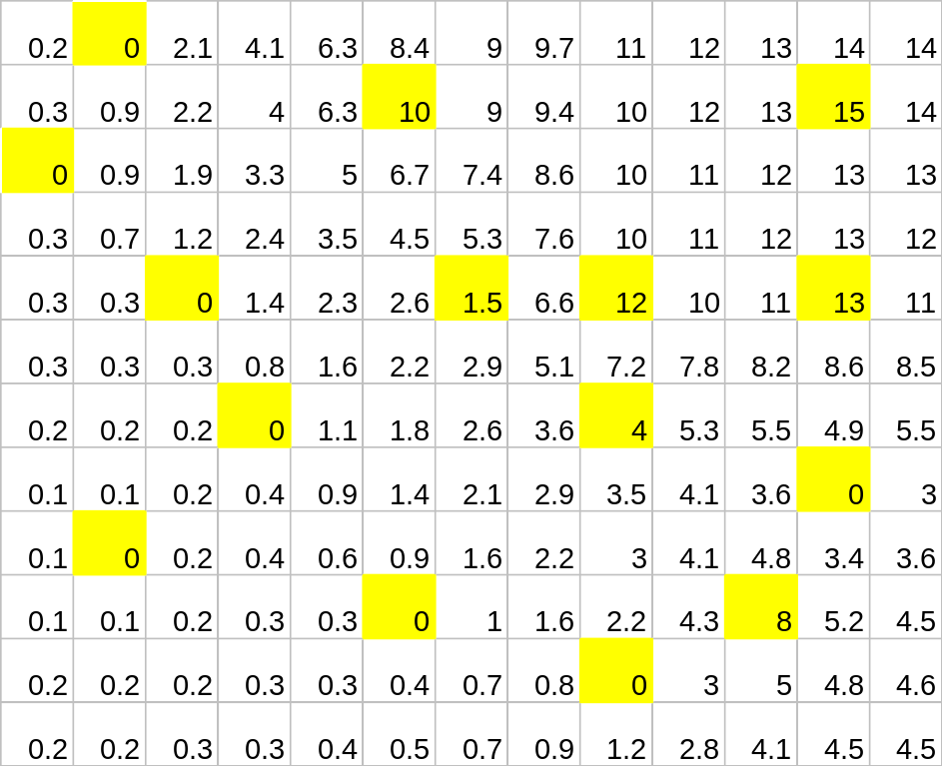
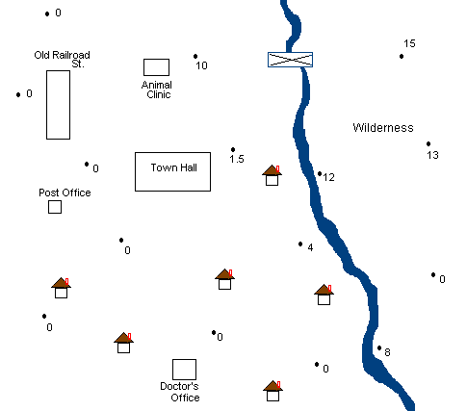
Morteville View 1

Slide 21
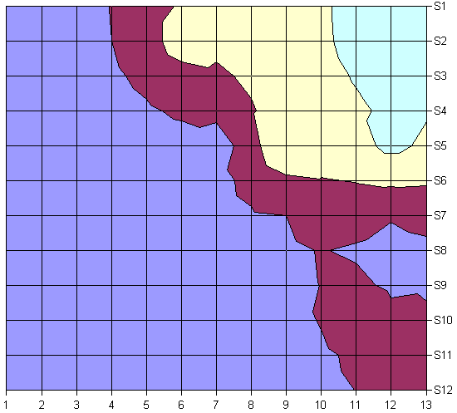

Anthrax Distribution 1

Slide 22
Compartmental Modeling
How to Build a Stella Model
Simple Population Models
Generic Processes
Advanced Population Models
Drug Assimilation
Epidemiology
System Stories

Slide 23
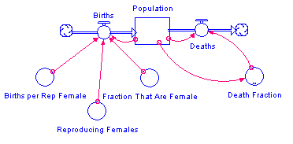
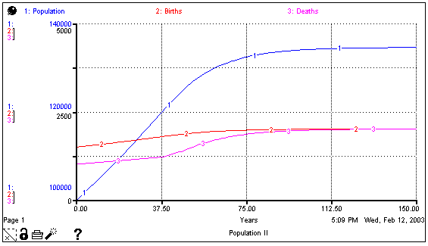
Population Model
Stella Model
Equations
Graphical Output
Population(t) = Population(t - dt) + (Births - Deaths) * dt
INIT Population = 100000 {people}
INFLOWS:
Births = Population*Fraction_That_Are_Female*Reproducing_Females*Births_per_Rep_Female {people/year}
OUTFLOWS:
Deaths = Population*Death_Fraction {people/year}
Births_per_Rep_Female = 66/1000 {people/1000 rep females/year}
Fraction_That_Are_Female = 0.5 {females/people}
Reproducing_Females = .45 {rep females/female}
Death_Fraction = GRAPH(Population)
(120000, 0.01), (125000, 0.011), (130000, 0.013), (135000, 0.015), (140000, 0.017), (145000, 0.019), (150000, 0.02)

Slide 24
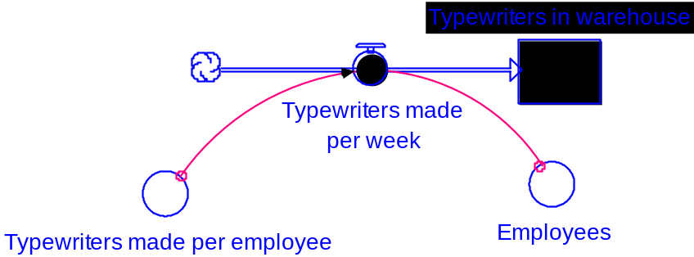
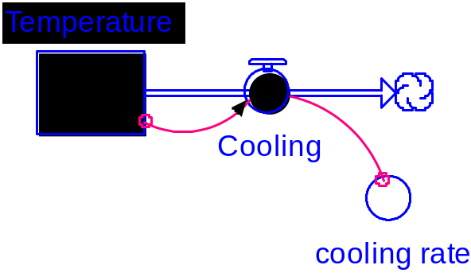
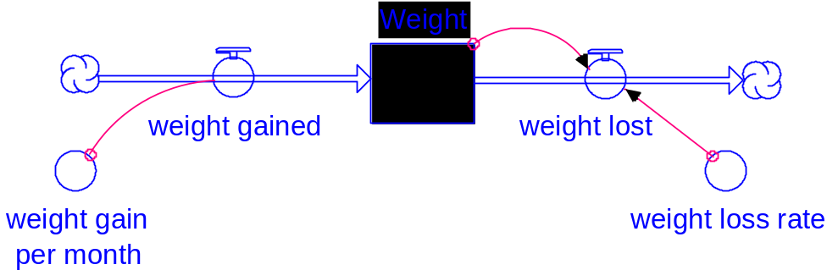
Generic Processes
Linear model with external resource
Exponential growth or decay model
Convergence model

Slide 25
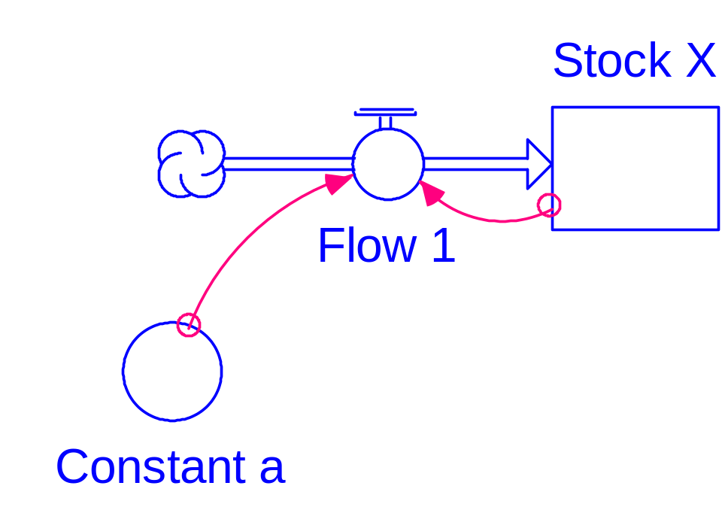
Calculus Example
STELLA Diagram
Flow is proportional to X.
STELLA Equations:
Stock_X(t) = Stock_X(t - dt) + (Flow_1) * dt
  INIT Stock_X = 100
  Flow_1 = Constant_a*Stock_X
  Constant_a = .1

Slide 26
Connecting the Discrete to the Continuous
Stock_X(t) = Stock_X(t - dt) + (Flow_1) * dt
(Stock_X(t) - Stock_X(t - dt))/dt = Flow_1
    Flow_1 = Constant_a*Stock_X(t – dt)
(X(t) - X(t - dt))/dt = a X(t - dt)
Let dt go to 0
dX/dt = a X(t) (a Differential Equation)

Slide 27
Solution to DE
dX/dt = a X(t)
dX/X(t) = a dt
Integrate
log (X(t)) = at + C
X(t) = exp(C) exp(at)
X(t) = X(0) exp(at)

Slide 28
System Dynamics Stories and Projects

Slide 29
System Dynamics Stories and Projects
Scenarios describing realistic situations to be modeled.
Fully independent work.
Construct model.
Write 5-10 page technical paper (template provided).

Slide 30
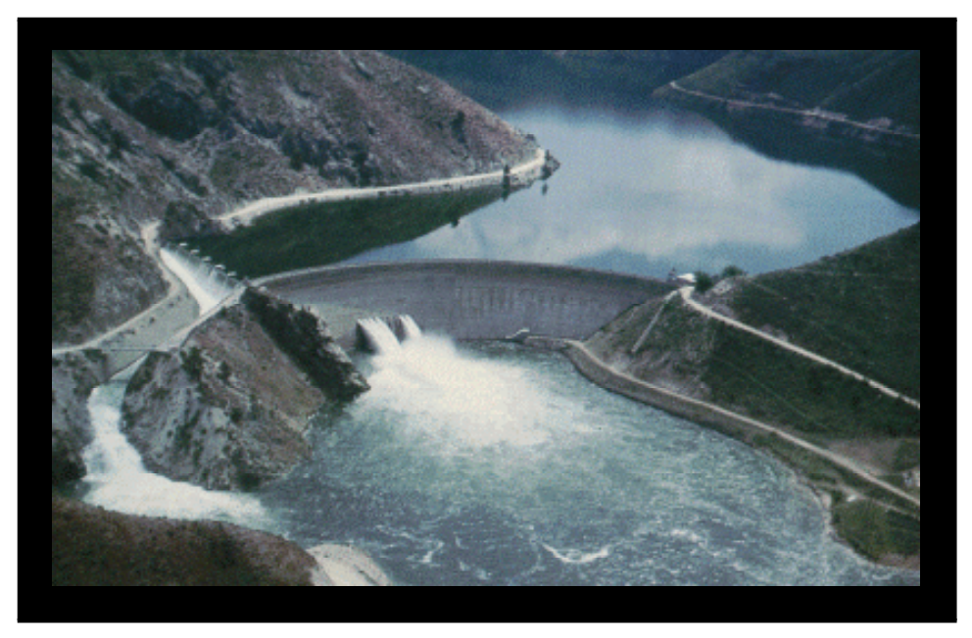
Modeling a Dam 2
Boysen Dam has several purposes: It "provides regulation of the streamflow for power generation, irrigation, flood control, sediment retention, fish propagation, and recreation development." The United States Bureau of Reclamation, the government agency that runs the dam, would like to have some way of predicting how much power will be generated by this dam under certain conditions.
– Clinton Curry
Boysen Dam

Slide 31
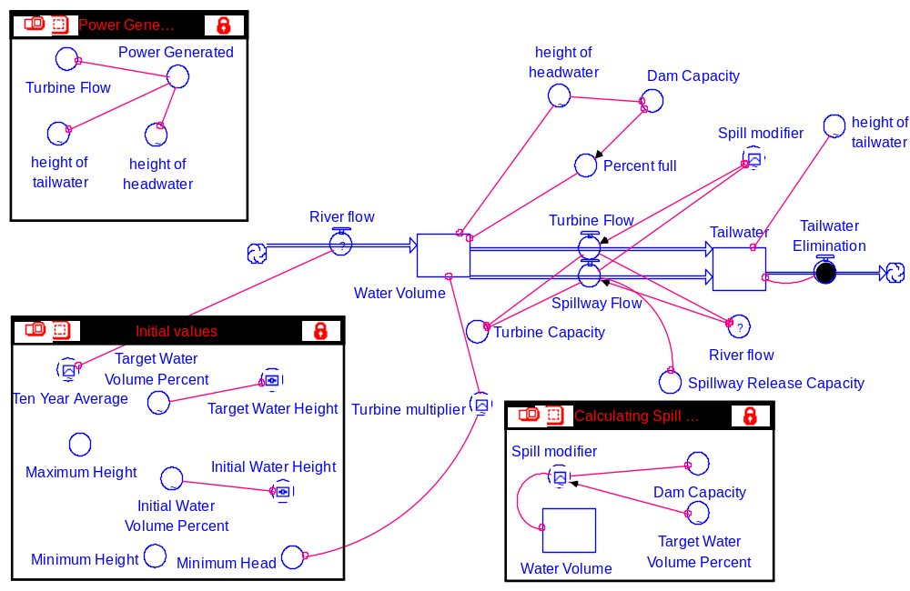

Slide 32
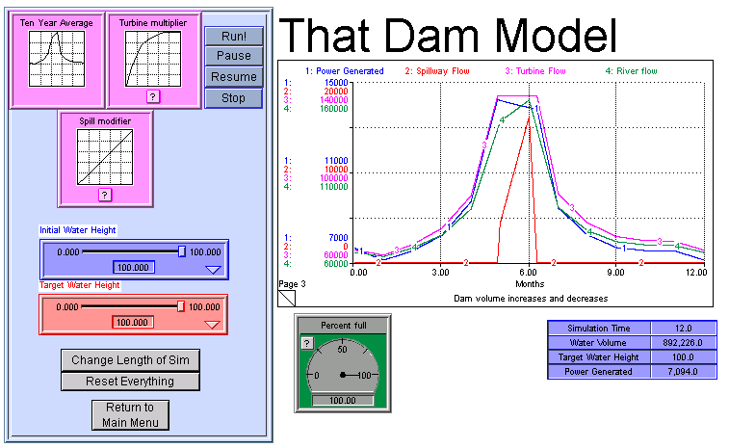
Boysen Dam

Slide 33
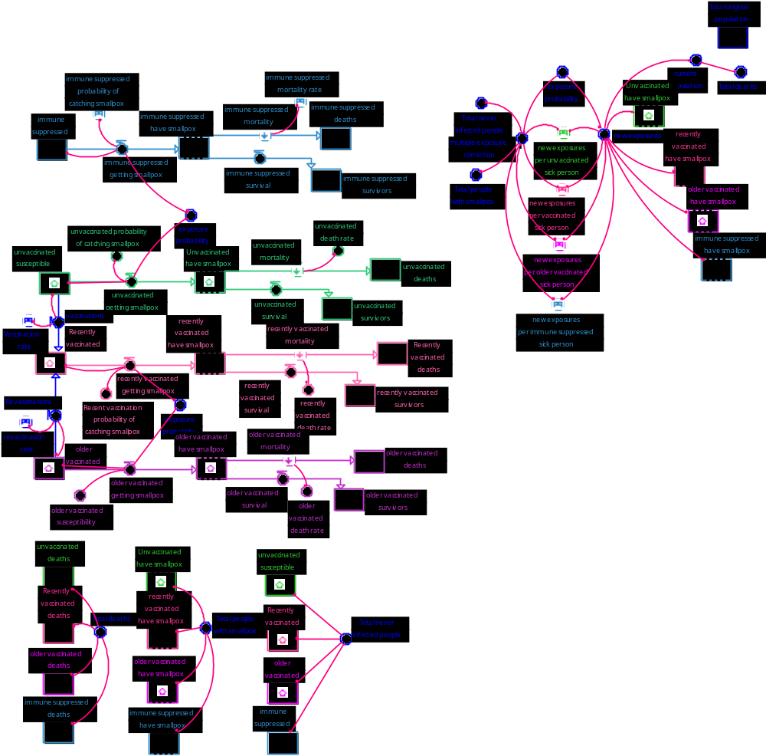
Modeling a Smallpox Epidemic
One infected terrorist comes to town
How does the system handle the epidemic under different assumptions?
– Alicia Wilson

