Slide 1

Sustainable Development Goal 12
Responsible Consumption and Production
Ensure sustainable consumption and production patterns.

Slide 2
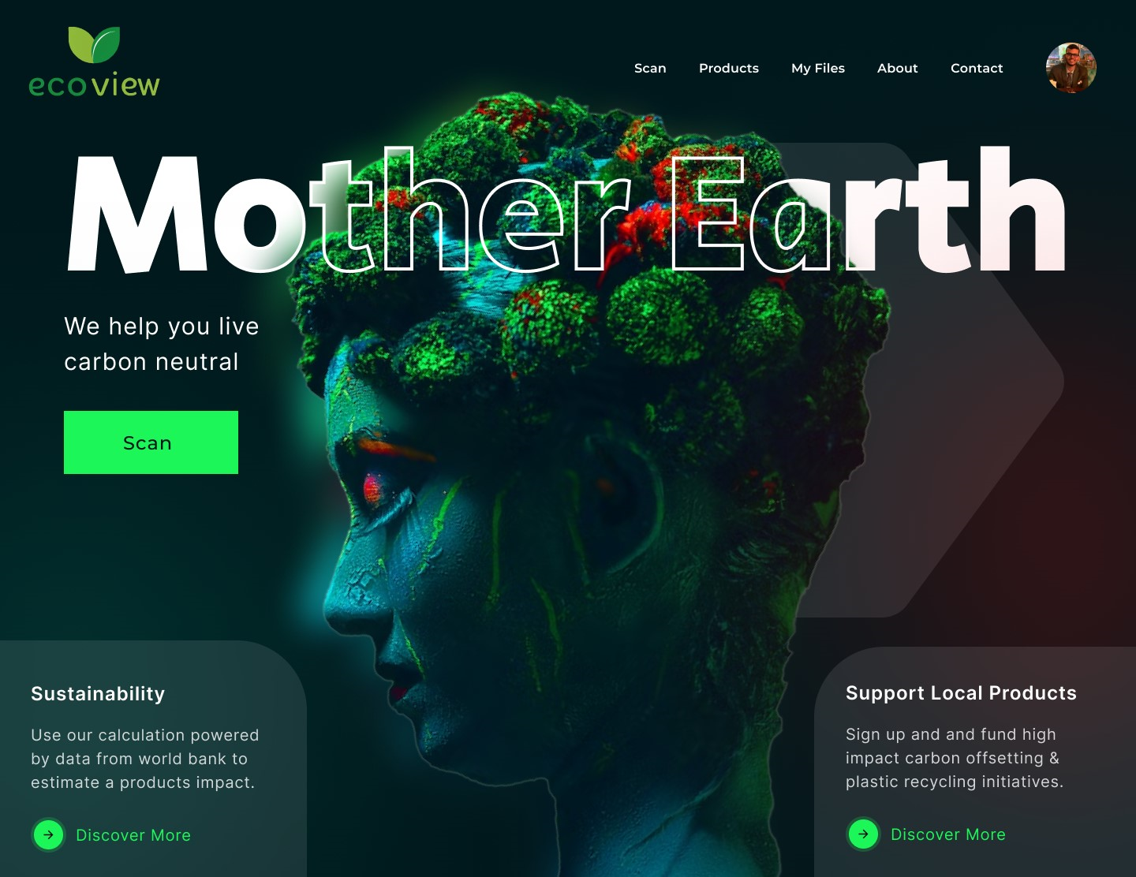
Ecoview Scanner Overview
Welcome to the Ecoview Scanner, a revolutionary tool that transforms your shopping experience. By scanning barcodes, this website provides instant insights into the sustainability of products, empowering you to make environmentally conscious choices

Slide 3
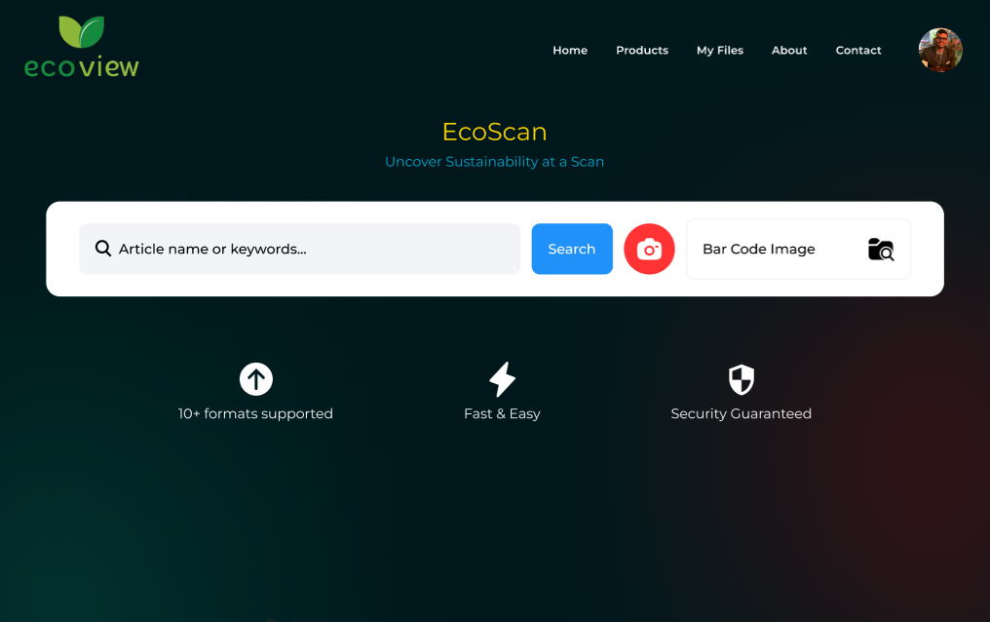
Scanning Process
Scan any product's barcode using our user-friendly interface. Behind the scenes, our sophisticated algorithms evaluate key sustainability factors such as environmental impact, ethical sourcing, manufacturing practices, and adherence to recognized certifications. The process is seamless, giving you real-time results.

Slide 4

Determining Sustainability
Environmental Impact
Sourcing
Assessing the product's carbon footprint and resource usage.
Evaluating the sustainability of raw materials and their origins.
Manufacturing Practices
Certifications
Considering ethical labor practices and eco-friendly production methods.
Recognition of adherence to established sustainability standards.

Slide 5
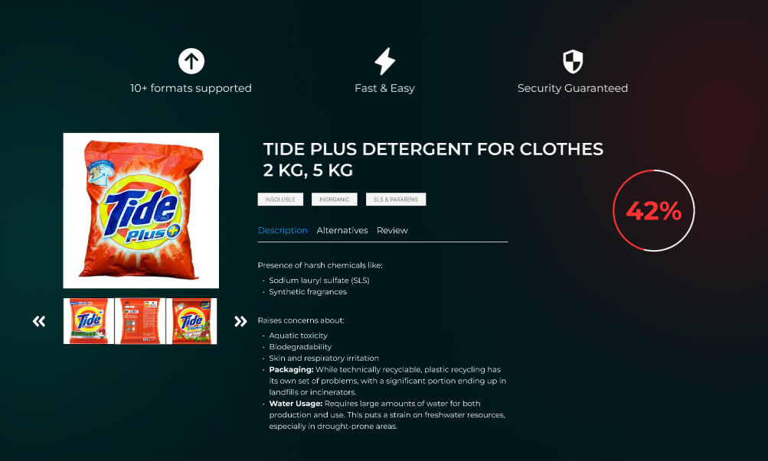
Scan Results
A sample scan result for a specific product, showcasing details such as product name, brand, sustainability rating (e.g., out of 10), and key sustainability information. For instance, it might highlight that the product uses recycled materials and supports fair trade practices.

Slide 6

Sustainable Alternatives
1
Expand Option
2
Informed Consumer Choices
3
Positive Impact
Access alternative products with higher sustainability ratings to widen your choices.
Discover recommendations that align with your environmental values.
Opt for products that contribute to a greener and healthier world.

Slide 7
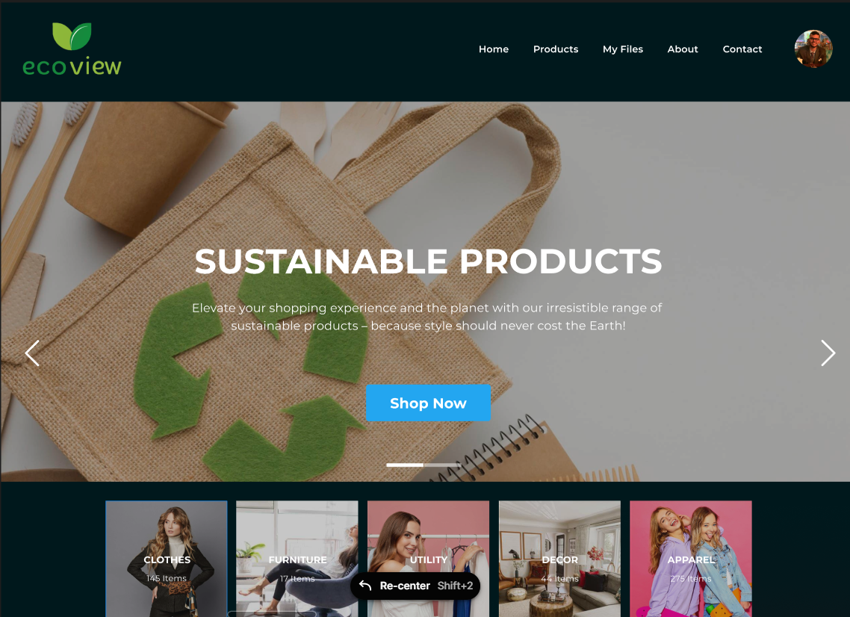
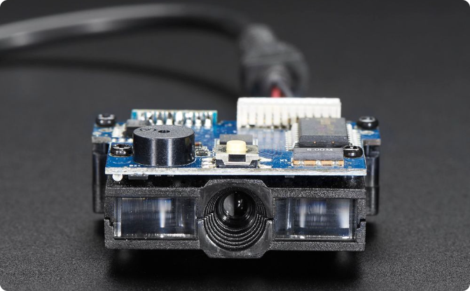

User-Friendly Interface
Intuitive Design
Simple Navigation
Effortless and straightforward barcode scanning process for users of all levels.
Illustrations highlighting the easy-to-use and visually appealing website interface.

Slide 8
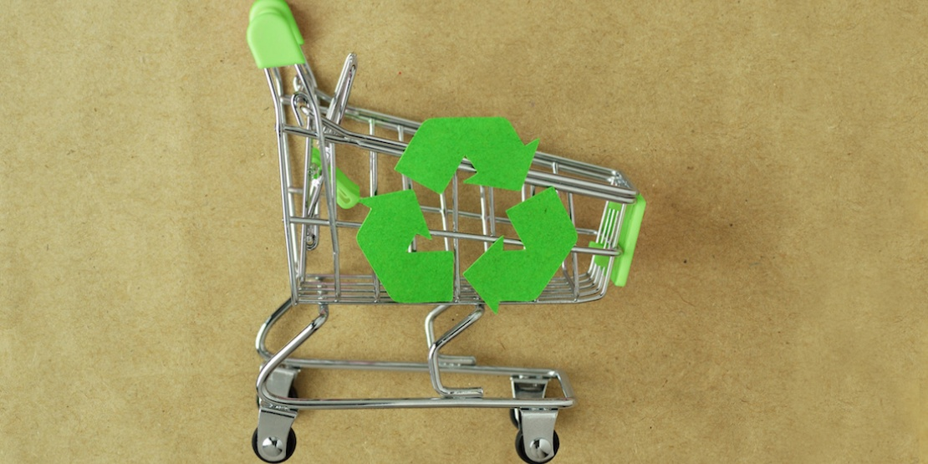
Benefits of Sustainable Shopping
Reduced Environmental Impact
Informed Consumer Choices
Make choices that contribute to a healthier planet.
Empower yourself with knowledge for conscious decision-making.
Contribution to Sustainability
Be part of a global movement towards a more sustainable future.

Slide 9

Try it Out!
1
Take the First Step
Visit our website to start your journey towards sustainable living.
2
Discover the Impact
Scan barcodes and uncover the sustainability details of your purchases.
3
Join the Movement
Be part of shaping a world where every purchase supports a more sustainable and ethical future.

Slide 10

Resource Links
Explore Further
Frontend Repository:
https://github.com/akash85246/ecoView
Backend Repository:
https://github.com/r3tr056/ecolens_ml
https://github.com/r3tr056/ecolens_api
Figma Design Repository:
https://www.figma.com/ecoView

