Slide 1

Employee Attrition Analytics & Predictive Insights
An end-to-end data pipeline: Python EDA, PostgreSQL Relational Warehousing, and Interactive Power BI Executive Dashboard
PYTHON
POSTGRESQL
POWER BI
V1.0 — PRODUCTION READY

Slide 2


Executive Summary
This document outlines the end-to-end data architecture, EDA, database relational modeling, and interactive visualization framework developed to quantify and mitigate workforce attrition — delivering actionable business intelligence to executive decision-makers.
Key Takeaway: Workforce turnover is heavily concentrated in high-pressure roles (Technology and Healthcare), driven primarily by excessive overtime, below-average job satisfaction, and poor work-life balance. Operational interventions targeting work schedules and structured career progression offer the highest return on retention investment.

Slide 3



End-to-End Architecture & Workflow
A robust three-tier data analytics architecture engineered for production-grade HR intelligence.
Data Ingestion & Hygiene
Relational Storage & SQL Warehousing
Executive Visual Analytics
Python/Pandas: automated ingestion, type casting, text normalization, median imputation, IQR outlier inspection, and deduplication.
Power BI: multi-page dashboard with DAX metrics, interactive cross-filtering, dark-mode design, and smart narrative summaries.
PostgreSQL & SQLAlchemy: programmatic connection, schema management, structured persistence, and complex SQL aggregate profiling.

Slide 4

Exploratory Data Analysis & Data Preparation
Data Integrity Pipeline
Categorical Standardization
Whitespace trimming and Title Case conversion to eliminate string redundancy.
Statistical Imputation
Median-based imputation for skewed variables like DistanceFromHome and CompanyTenure.
Outlier Detection
IQR bounds (Q1 - 1.5 \times IQR to Q3 + 1.5 \times IQR) with boxplot verification.
Distribution Analysis
Seaborn correlation matrices and distribution plots to pinpoint primary turnover vectors.

Slide 5
Database Warehousing & SQL Analytical Engine
The refined dataset was loaded via SQLAlchemy into a PostgreSQL instance (Attrition). Optimized SQL queries addressed key business domains.
Business Domain
SQL Concept
Analytical Objective
Workforce Volume
COUNT(*)
Establish baseline headcount.
Turnover Baseline
GROUP BY Attrition
Attrition vs. retention volumes.
Role Risk Profiling
GROUP BY Job Role, Attrition
Identify high-turnover functional areas.
Workload Impact
GROUP BY Overtime, Attrition
Turnover variance from mandatory overtime.
Satisfaction & WLB
GROUP BY Job Satisfaction / WLB
Turnover rates across satisfaction and WLB tiers.
Compensation Analysis
AVG(Monthly Income) GROUP BY Job Level
Salary distribution across roles and levels.
Tenure & Remote Work
AVG(Years at Company) GROUP BY Remote Work
Correlate retention with remote status and tenure.

Slide 6
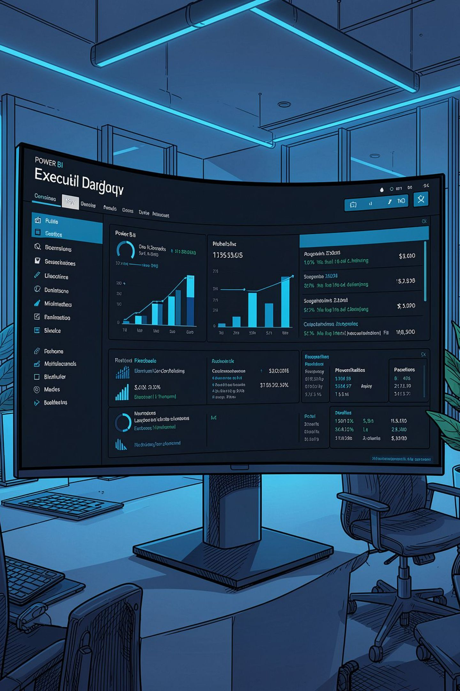
Business Intelligence Dashboard Architecture
A cohesive 3-page interactive Power BI report built to strict corporate UI/UX standards: dark-themed containers, unified typography, and intuitive global slicers.
Page 1: Overview Dashboard
Page 2: Attrition Deep Analysis
Executive high-level metrics: Total Headcount (74.50K), Avg. Monthly Income ($7.34K), Avg. Age (38.53), Avg. Tenure (15.72 yrs). Macro distributions across Job Roles, Gender, Education, and Company Size.
Granular diagnostic view across key friction vectors: Job Role, Overtime, Job Satisfaction, Work-Life Balance, Education, and Remote Work. Includes executive insight callouts.
Page 3: Insights & Recommendations
5 top-line KPI benchmarks, a prioritized Strategic Recommendation Table, and an AI Smart Narrative summary.

Slide 7
Dashboard — Page 1: Overview Metrics
74.50K
$7.34K
Total Headcount
Avg. Monthly Income
Organization-wide employee baseline
Across all roles and levels
38.53
15.72
Average Age
Avg. Tenure (yrs)
Workforce demographic profile
Years at company average
Macro distributions displayed across Job Roles, Gender, Education Level, and Company Size provide executives with an at-a-glance workforce composition view.

Slide 8
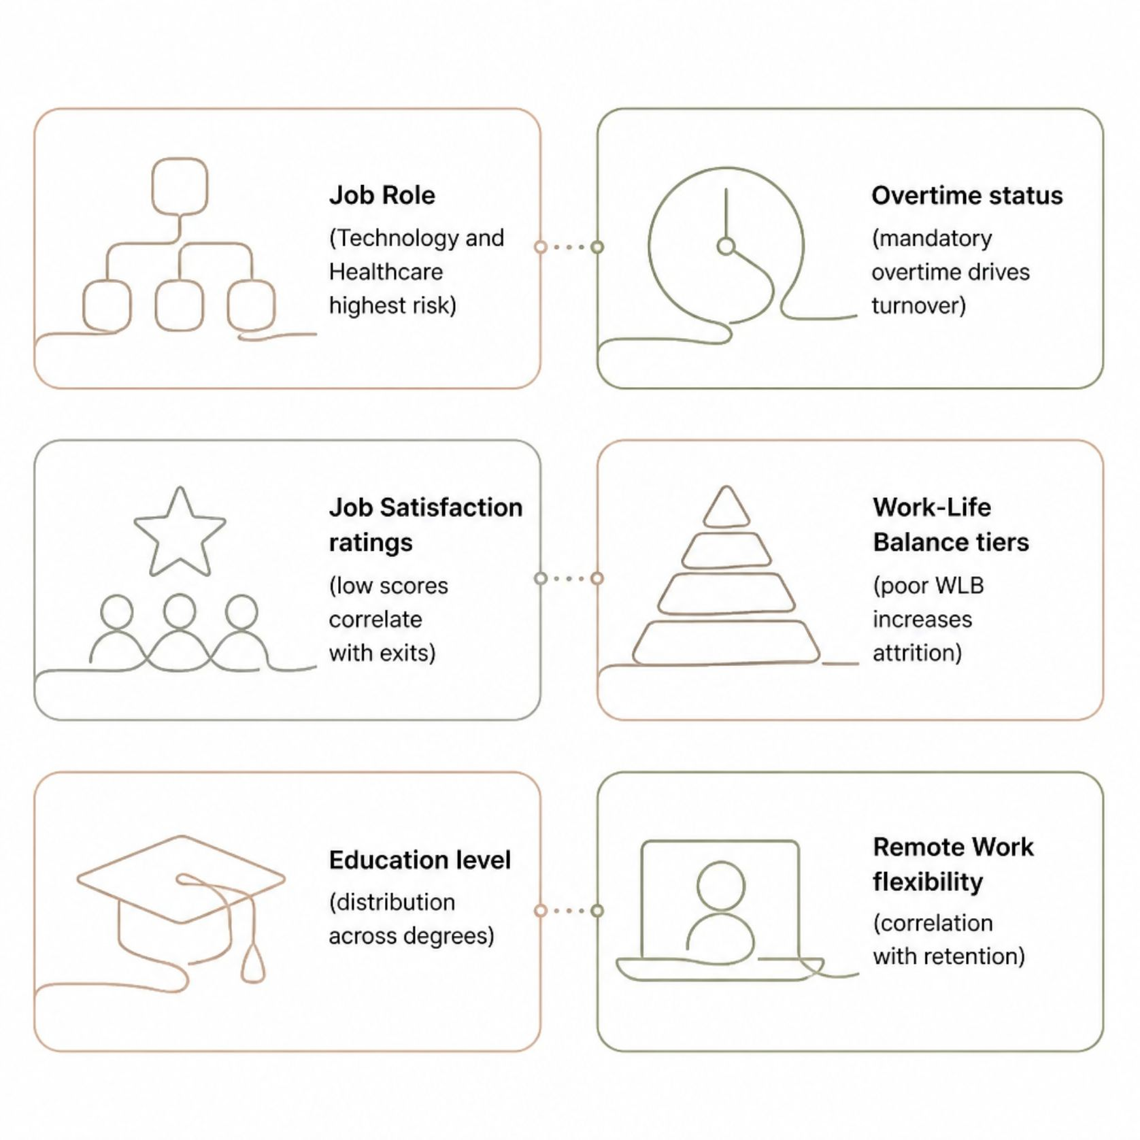
Dashboard — Page 2: Attrition Deep Analysis
Granular Diagnostic View
Page 2 breaks down turnover across the six key friction vectors, enabling executives to slice and dice data interactively for root-cause analysis.
Job Role breakdown — Technology & Healthcare highest risk
Overtime status — mandatory overtime drives turnover variance
Job Satisfaction ratings — low scores correlate strongly with exits
Work-Life Balance tiers — poor WLB increases attrition rates
Education level and Remote Work flexibility correlations

Slide 9

Key Findings & Strategic Recommendations
Cap Excessive Overtime
1
Implement overtime thresholds and resource rebalancing, specifically targeting high-burnout teams in Technology and Healthcare.
Target High-Attrition Roles
2
Establish clear career progression pathways and structured stay-interviews for mid-level technical staff to combat stagnancy.
Boost Role Satisfaction
3
Launch structured peer-to-peer recognition programs and performance incentives to address declining job satisfaction.
Proactive HR Interventions
4
Deploy quarterly pulse surveys to flag declining team satisfaction metrics early, allowing proactive intervention before resignations occur.

Slide 10


Smart Narrative Summary
What the Data Tells Us
Key attrition drivers across the organization are excessive overtime, low job satisfaction, and poor work-life balance — heavily impacting Technology and Healthcare roles.
Strategic recommendations focus on:
Implementing overtime caps
Defining structured career growth pathways
Enhancing recognition programs
Deploying proactive HR pulse checks
Goal: Stabilize retention and increase employee tenure through targeted operational interventions.

