Slide 1

Code Optimization

Slide 2
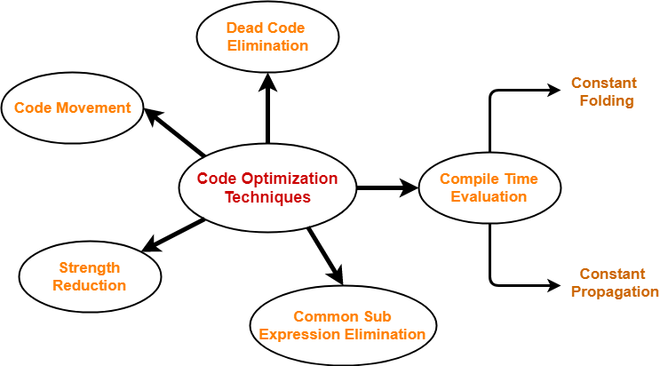

Slide 3
Compile Time Evaluation
A) Constant Folding
B) Constant Propagation

Slide 4
Constant Folding
In this technique,
As the name suggests, it involves folding the constants.
The expressions that contain the operands having constant values at compile time are evaluated.
Those expressions are then replaced with their respective results.
Example-
Circumference of Circle = (22/7) x Diameter
Here,
This technique evaluates the expression 22/7 at compile time.
The expression is then replaced with its result 3.14.
This saves the time at run time.

Slide 5
Constant Propagation
In this technique,
If some variable has been assigned some constant value, then it replaces that variable with its constant value in the further program during compilation.
The condition is that the value of variable must not get alter in between.
Example-
pi = 3.14
radius = 10
Area of circle = pi x radius x radius
Here,
This technique substitutes the value of variables ‘pi’ and ‘radius’ at compile time.
It then evaluates the expression 3.14 x 10 x 10.
The expression is then replaced with its result 314.
This saves the time at run time.

Slide 6
Common Sub Expression Evaluation
In this technique,
As the name suggests, it involves eliminating the common sub expressions.
The redundant expressions are eliminated to avoid their re-computation.
The already computed result is used in the further program when required.
Example-
Code Before Optimization | Code After Optimization
S1 = 4 x i S2 = a[S1] S3 = 4 x j S4 = 4 x i // Redundant Expression S5 = n S6 = b[S4] + S5 | S1 = 4 x i S2 = a[S1] S3 = 4 x j S5 = n S6 = b[S1] + S5

Slide 7
Code Movement
In this technique,
As the name suggests, it involves movement of the code.
The code present inside the loop is moved out if it does not matter whether it is present inside or outside.
Such a code unnecessarily gets execute again and again with each iteration of the loop.
This leads to the wastage of time at run time.
Example
Code Before Optimization | Code After Optimization
for ( int j = 0 ; j < n ; j ++) { x = y + z ; a[j] = 6 x j; } | x = y + z ; for ( int j = 0 ; j < n ; j ++) { a[j] = 6 x j; }

Slide 8
Dead Code Elimination
In this technique,
As the name suggests, it involves eliminating the dead code.
The statements of the code which either never executes or are unreachable or their output is never used are eliminated.
Code Before Optimization | Code After Optimization
i = 0 ; if (i == 1) { a = x + 5 ; } | i = 0 ;

Slide 9
Strength Reduction
In this technique,
As the name suggests, it involves reducing the strength of expressions.
This technique replaces the expensive and costly operators with the simple and cheaper ones.
Code Before Optimization | Code After Optimization
B = A x 2 | B = A + A
Here,
The expression “A x 2” is replaced with the expression “A + A”.
This is because the cost of multiplication operator is higher than that of addition operator.

Slide 10
Other Optimization Techniques
if optimization
Forward store
Function Inlining
Induction Variable Elimination
Loop Fusion

