Slide 1
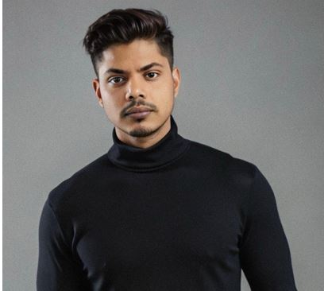
Akash Deep
LLMOps, Python Development, Senior Analyst
Work experience
RAG pipeline, Agent Framework for LLM, Generative AI Expert, SME (01/2023 – present)
Providing support and technical guidance for building the Optimized enterprise Gen AI agentic framework and RAG pipeline with secure access of API and governance Responsibilities: Collaborating with internal/external Vendors and Tech Developers to identify & enhance the pipeline with the newer stacks and technologies, Production bug resolution and guidance. Technologies: Python, Langchain, Langgraph, Opensearch, AWS cloud, Serverless Architecture, Github Mono repo, Mlops, LLMops
Project name
Remittance Prediction, Data
scientist Telecom (01/2020 – 12/2022)
Build a regression Model which predicts
remittances at daily level which has added a
value to the business by identifying any
anomalous transaction and finalizing business
estimates
Technologies: ML, Cloud, Mlops, Workflow architecture, Github Action, AWS services
Pipeline build, Database, Dataiku
Methodologies: Agile.
Multi class labelling Of drug Pharma (02/2018–
11/2019)
Designed and developed MLOPs pipeline using
AWS Sagemaker, DAG, Sharepoint REST API
For IAS Team (Pfizer). Also Developed a data
ETL pipeline for IAS team in Pfizer using
Python. We had experimented with many
Transfer learning approach with Multiple model
like SAP BERT, BIO Bert and many more to
finalize the best model for the business
Technologies: Mlops, Model Automated Inference pipeline
Python, AWS, DAG, Sharepoint, Rest API,
Model store, Model drift
Methodologies: Agile
Feasibility test of Complex Anamoly
detection project on Dataiku Pharma (03/2017 –
02/2018)
I have re-desined the existing Anamoly detection
project that was using RRCF Algorithm to
predict the Anomaly and it was validated using
CO-DISP score. I have redesined it to aligned
on Dataiku Platform as the business wanted to
deploy this project in production and build
Automation capability
Technologies: Deep learning, Transfer learning,
Python, Model store, Model drift
Methodologies: Agile
Functional/ technical skills
Expert
Cloud Architect
LLMOps, MLOps, DevOps
Python, Generative AI
Prompt Engineering
Intermediate
Requirement Analysis and Estimation
Model Transfer learning
Beginner
Reinforcement learning
Data Labelling for RLFH
Language skills
English (Professional Working Proficiency)
Hindi(Native)
Professional background
Experienced Generative AI Engineer with 6+ years in MLOps, Proposing the technical optimized solution and LLM deployment
on AWS SageMaker. Skilled in building automated training and notifcation pipelines,
confguring vector databases like OpenSearch and Chroma for optimized embedding
storage. Expert in designing enterprise-level AI infrastructure using Python and
FastAPI, hosted on AWS with CI/CD pipelines via GitHub Actions and OIDC.
Profcient in managing GitHub Mono Repos and familiar with tools such as Dataiku,
Alteryx, DAG's etc. Consumer goods and services, Distribution).
Akash graduated in BE CSE in 03/2017 from SJBIT, Bangalore India
Trainings & Certifications
Dataiku Core designer• Dataiku ML Practitoner • Dataiku MLOPs • Dataiku Designer specialist • AWS Solution Architect• Azure Devops•
Hackerrank Python• Hackerrank SQL • Machine learning• Statistics for data science• Tableau• Deep learning

