Slide 1
Explainable A.I.
Introduction

Slide 2
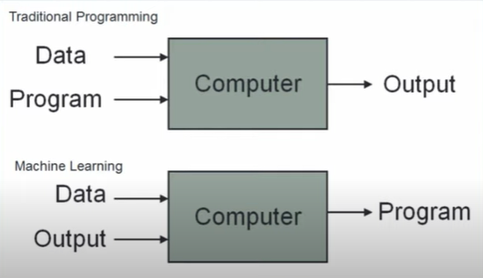
Shift to data driven programming

Slide 3
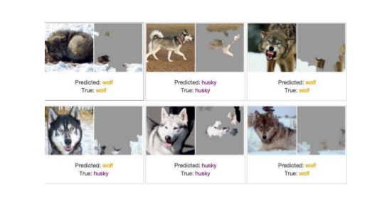
The Husky vs Wolf classifier

Slide 4
Breaking into the Black Box
❖ Explainable AI (XAI) | Interpretable AI | Explainable Machine Learning (XML) is an artificial intelligence in which the results of the solution can be understood by humans.
What is our model learning?
Which part of the input is most important?
How we can trust the prediction of the model?
How we ensure our model is robust?

Slide 5
Why Explainable AI is important?
Trust
Regulatory compliance
Detecting Bias
Generalization
Hypothesizing about new knowledge
Robust Models
Debugging and enhancing AI models

Slide 6
Defining Explainable AI
XAI can be defined as the process of making some component of the data processing pipeline, in the machine learning life cycle, understandable to a user.
It allows us to investigate model behaviours through tracking model insights on deployment status, fairness, quality and concept drift.
Objectives:
- Prediction Accuracy
- Traceability
- Decision Understanding

Slide 7
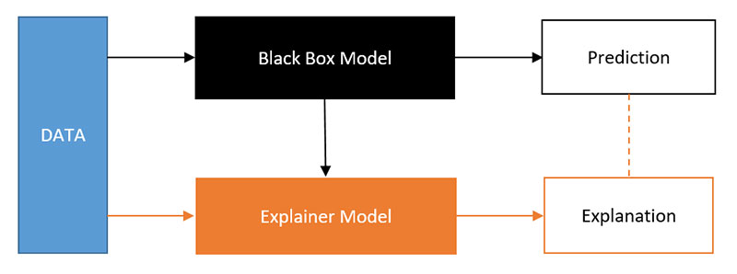
Defining Explainable AI
A procedure P is defined to be δ-explainable if it derives and communicates information I from a complex (unexplainable) model to a target model that results in the target model’s expected error (for a given task) to improve by a factor of δ.
We achieve transparent algorithm, transparent model and transparent model components

Slide 8
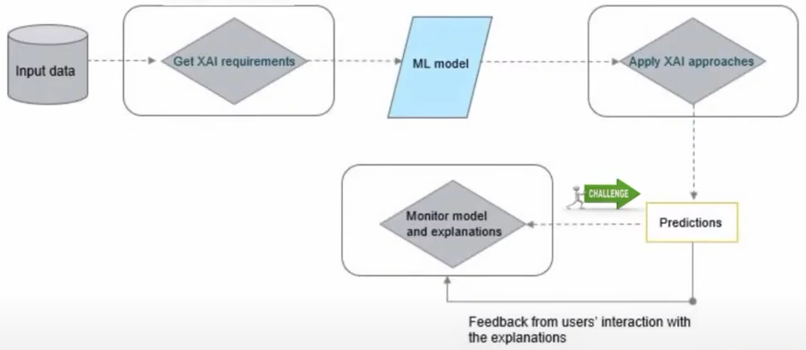
How Explainability can be achieved?
Three Stages of Explainablility:
Pre-modelling explainability
Explainable modelling
Post-modelling explainability

Slide 9
Pre-modelling explainability
It is a collection of methods for gaining a better understanding of dataset used for model development.
Methods :
Exploratory Data Analysis
Dataset description standardization
Explainable feature engineering
Dataset summarization

Slide 10
Explainable modelling
Develop inherently more explainable models, such that models are explainable by design.
Methods :
Adopting an inherently explainable model family
Hybrid explainable models
Joint prediction and explanation
Explainability through architectural adjustments
Explainability through regularization
Linear Models
Decision Trees
Rule Sets
Decision Sets
Generative additive Models
Case-Based Reasoning methods
Deep KNN
Deep weighted averaging classifier
Self Explaining Neural Network
Contextual Explanation Networks
BagNets
Teaching Explanations for Decisions framework
Multimodal Explanations
Visual Explanation
Rationalizing Neural Predictions
Explainable CNN
Attention Mechanism
Tree Regularization
Constrain Local Explanation
Saliency Learning

Slide 11
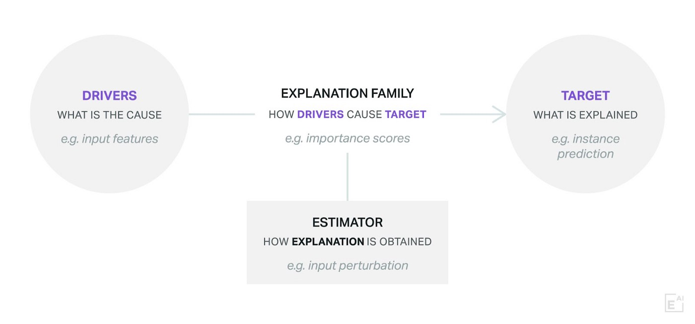
Post Modelling Explainability
Four Aspects of post-hoc explainability:
Explanation Targets
Explanation drivers
Explanation Family
Explanation Estimation Methods / Estimator

Slide 12
Explanation Targets and Drivers
Explanation Targets
It consists of what is to be explained about the model, e.g.- a prediction.
Explanation of a Target can widely vary on Type, Scope and Complexity.
Explanation Drivers
What is cause behind the occurrence of the Target.
Drivers can be input feature, training sample, Hyper parameter settings, choice of optimization algorithm or choice of model architecture.

Slide 13
Explanation Family
The explanation family aspect deals with the form of the information to be communicated to be the user. The information is about how a target is caused by drivers for a given AI model.
Classification of Explanation Family:
Importance scores
Decision Rules/List
Decision Trees
Dependency plots
Verbal Explanations
Counterfactual
SHAP (SHapley Additive exPlanations)
LIME (Local Interpretable Model-agnostic Explanations)
Influence Functions
KT method
Anchors method
BETA Method
DeepRED
PDP (partial dependency plot)
ICE (individual conditional expectation)
SOCRAT( Structured-Output Causal RATionalizer)
LSTMViz
GAN Lab

Slide 14
Explanation Estimation Methods/Estimator
It refers to the computational process used to obtain explanations.
Classification based on Applicability :
Model Agnostic
Model Specific
Classification based on Mechanism :
Perturbation Mechanism
Backward Propagation Mechanism
Proxy Mechanism
Activation Optimization Mechanism
Tree Ensemble
Deep Networks
Quantitative Input Influence
Layer-Wise Relevance Propagation
DeepLIFT
Guided Backdrop
SmoothGrad
Integrated Gradients

Slide 15
SAIRAM

