Slide 1
WORKSHOP
Gen AI Foundations
& Prompt Engineering
01
SESSION
Session 1 · 2 Hours · Includes Hands-On Exercises
Akash Sharma
Software Engineer @ Microsoft
PART 1: Foundations (40 min) · PART 2: Prompting Techniques (40 min) · PART 3: Exercises & Wrap-up (40 min)

Slide 2
Workshop Agenda — 2 Hours
0:00 – 0:10
Introductions, goals, and quick poll: 'How do you use AI today?'
Welcome & Icebreaker
0:10 – 0:40
What is AI / Gen AI? LLMs explained simply. How they learn. OpenAI API, Hugging Face & Ollama hands-on.
Part 1: Gen AI Foundations
0:40 – 1:20
ACE framework, TCEPFT method, prompt types, live demos & 3 exercises.
Part 2: Prompt Engineering
1:20 – 1:45
Master prompts, iterative refinement, debugging prompts, reusable templates.
Part 3: Advanced Topics
1:45 – 2:00
Key takeaways, Q&A, and homework walkthrough.
Wrap-up + Homework Brief

Slide 3
01
Gen AI Foundations
What is AI? How do LLMs work? Key concepts explained.

Slide 4
What is Generative AI?
The Simple Analogy
Traditional AI
Imagine the world's most well-read person — someone who has read every book, article, chat message, and code file ever written.
Now imagine they can respond to ANY question, draft ANY document, and write ANY code — instantly, 24/7.
That's Generative AI. It doesn't look things up — it generates from what it learned.
Classifies & predicts from structured data. Example: spam filters, recommendation engines.
Generative AI
Creates new content — text, images, code, audio — by learning patterns from massive datasets.
Large Language Models
The engine behind ChatGPT, Gemini, Claude. Trained on trillions of words. Output = next best word.

Slide 5
How LLMs Actually Work
01
02
03
04
Tokenization
Embeddings
Transformer
Generation
→
→
→
Text is broken into tokens
(~¾ of a word each). 'Hello world' → 2 tokens.
Tokens become vectors — numbers in high-dimensional space encoding meaning & relationships.
Attention mechanism weighs relationships between tokens across the full context window.
Model predicts the next most-likely token, sampling from probability distribution.
💡 Key Insight: LLMs don't 'know' facts — they learned statistical patterns. This is why they can hallucinate. Always verify important outputs!

Slide 6
LESSON 01
What is a Language Model?
The one-sentence explanation
A language model is a program that learns patterns from text so it can predict what word comes next — and from that simple trick, it can write, answer questions, and even hold a conversation.
Here is a simple example
Think about how your phone suggests the next word when you text. It guesses “you” after “thank” because it learned that pattern. A language model does the same thing — just way better, because it learned from a huge amount of text.

Slide 7
LESSON 01
What is a Large Language Model?
The one-sentence explanation
570 GB
An LLM is a program that read billions of texts, learned patterns in language, and can now write, answer, summarize, translate, and reason.
GPT-3 training data
175B
Here is a simple example
Imagine reading every book, every website, every conversation ever written. You'd become incredibly good at predicting what comes next in any sentence. An LLM did exactly that — but it read WAY more than any human ever could.
GPT-3 parameters
~30 days
Typical training time

Slide 8
LESSON 01
What an LLM Is — and Isn't
✓ WHAT IT IS
✗ WHAT IT IS NOT
A pattern machine
A search engine
Learned statistical patterns across trillions of words of human language.
It doesn't look things up. It generates from memory.
A text generator
Sentient or conscious
Given any input, it predicts the most contextually appropriate continuation.
No feelings, no awareness. Just very sophisticated math.
A knowledge store
Always right
Facts, code, languages, styles — all encoded in 100B+ parameters.
It can 'hallucinate' — confidently say things that are wrong.

Slide 9
LESSON 01
Real-World Applications of LLMs
Chatbots & Assistants
Automated code generation
Tools like ChatGPT and Google Gemini are LLMs you can talk to. They help with homework, answer questions, brainstorm ideas, and even act as tutors for any subject you're studying.
LLM can be used to generate code
Content Creation
Automated incident resolution
LLMs can write essays, emails, social media posts, and even code. They help you draft, edit, and polish your writing — like having a 24/7 writing buddy.
Agentic AI using LLM can help in automated incident resolution.
Search & Research
Video and voice
LLMs power tools like Google Search summaries, translate 100+ languages instantly, and can summarize a 50-page research paper in seconds — perfect for late-night study sessions.
Generate production quality videos and voice overs with realistic human voice and pronunciation.

Slide 10
LESSON 01

Slide 11
LESSON 01
How do they Work?
Large Data
Word, text, books, articles etc on which model is to be trained. Potentially many PB of data. 1GB data ~ 178million words. 1PB data = 1MillionGB
Architecture
GPT – Transformer Architecture. Finding context of a word in relation to every other word.
Training
Trained on this architecture. Find best guess and iterate on that to correctly generated the most accurate result. Tumkur is a person.
Tumkur is a town
Tumkur is a city

Slide 12
LESSON 02
Tokenization: AI's Reading Glasses
What is a token?
"cat"
→ 1 token
Computers don't understand words — they understand numbers. Tokenization breaks text into small pieces called tokens, each converted to a number the AI can process.
Common short words
"running"
→ 2 tokens
"run" + "ning"
Here is a simple example
You can't read full words, but you're great with letter chunks. 'Unbelievable' → ["Un", "believ", "able"]. Each chunk = one token. That's all tokenization is.
"unbelievable"
→ 3 tokens
Long & rare words split up
"1234"
→ 4 tokens
Numbers split in small groups

Slide 13
LESSON 03
Embeddings: Words as Points in Space
After tokenizing, each token is converted to a vector — a list of ~4,000 numbers that encodes its meaning. Similar words land near each other in this high-dimensional space.
Here is a simple example
The Famous Equation
Think of a map where every word is a city. 'King' and 'Queen' are close together. 'Happy' and 'Joyful' are neighbours. 'Banana' is far from 'Democracy'. The AI uses these distances to understand meaning.
king − man + woman ≈ queen
Vector arithmetic works on meaning. The model learned this automatically from reading text — it was never explicitly told.
~4,096
Similar
Meaning
Numbers per token in large models
words have similar vectors
is encoded as geometry

Slide 14
LESSON 03
Embeddings: Cont..
king − man + woman ≈ queen
 | Battle | Horse | King | Man | Queen | Woman
Authority | 0 | 0.01 | 1 | 0.2 | 1 | 0.2
Event | 1 | 0 | 0 | 0 | 0 | 0
Has tail | 0 | 1 | 0 | 0 | 0 | 0
Rich | 0 | 0.1 | 1 | 0.3 | 1 | 0.2
Gender | 0 | 1 | -1 | -1 | 1 | 1
Dimensions
King | -Man | +Women | Result ≈ Queen
1 | 0.2 | 0.2 | 1
0 | 0 | 0 | 0
0 | 0 | 0 | 0
1 | 0.3 | 0.2 | 0.9
-1 | -1 | 1 | 1

Slide 15
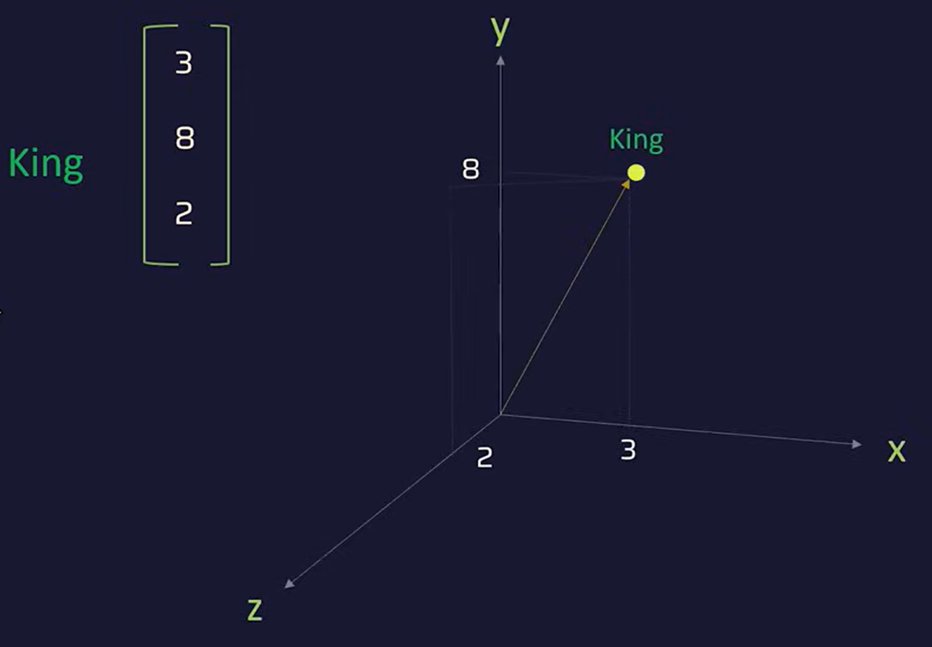
LESSON 03
Embeddings: Cont..
King in a 3 dimension

Slide 16
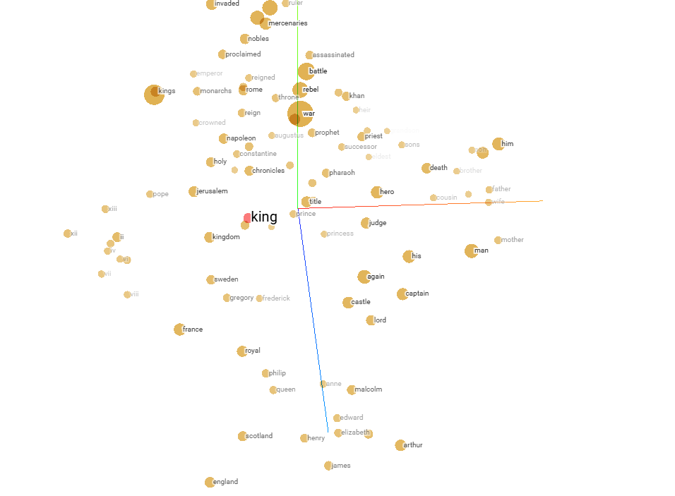
LESSON 03
Embeddings: Cont..
King in a 300+ dimension space

Slide 17
LESSON 03
Dimensions: Why 300+ Numbers Per Word?
On the previous slide we showed only 5 dimensions (authority, event, has tail, rich, gender). But real models like GPT use 300 to 12,288 dimensions per word. Each dimension captures some aspect of meaning — most are abstract patterns that even humans can’t easily name.
“King” in 300 Dimensions (simplified)
How Are Dimensions Generated?
king = [0.92, -0.71, 0.44, 0.03, ...
...0.88, -0.15, 0.67]
Each number captures a hidden feature:
Dim 1 → royalty? Dim 2 → gender? Dim 3 → formality?
Dim 4 → animacy? ... Dim 300 → ???
Most dimensions don’t have neat human labels. The model discovers abstract patterns we can’t easily name.
Nobody hand-picks these dimensions. They are learned automatically during training:
1. Start random — Every word gets a random list of 300 numbers
2. Read context — The model sees billions of sentences and notices which words appear near each other
3. Adjust numbers — Words in similar contexts get pushed closer in the 300-number space
4. Repeat billions of times — After trillions of adjustments, the numbers encode real meaning
Word2Vec
GPT-3
Why More?
300 dims — Google, 2013
12,288 dims — OpenAI, 2020
More dims = finer meaning shades

Slide 18
LESSON 04
Training: The One Task That Explains Everything
During training, the model is shown billions of sentences with the last word removed. Its job: predict the missing word. Do this a trillion times — and deep understanding of language emerges.
Here is a simple example
1
Pre-training
"The sky is ___" → You'd say "blue." Now imagine doing this for every kind of sentence — factual, creative, technical, emotional — billions of times. That's training.
Trillion words, predict next token. Weeks on 1,000s of GPUs.
Temperature: Why AI isn't always predictable
2
Instruction Tuning
🥶 Low temp: Picks the safest, most likely word. Good for facts.
🔥 High temp: Samples creatively. More surprising, occasionally weird.
Fine-tune on Q→A examples. Teach it to be actually helpful.
3
Human Feedback (RLHF)
Humans rate outputs. Model learns to prefer better answers.

Slide 19

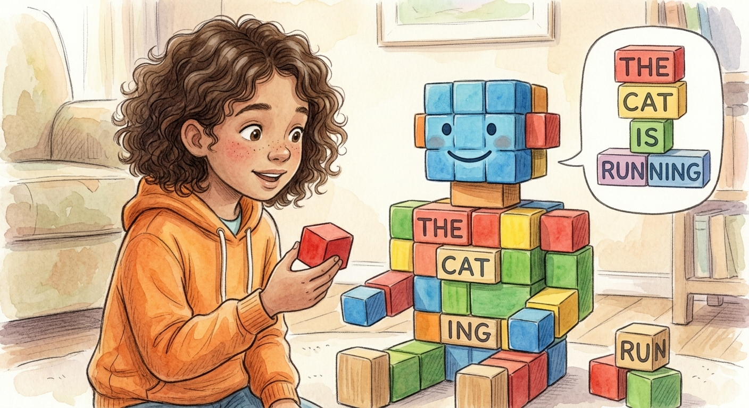
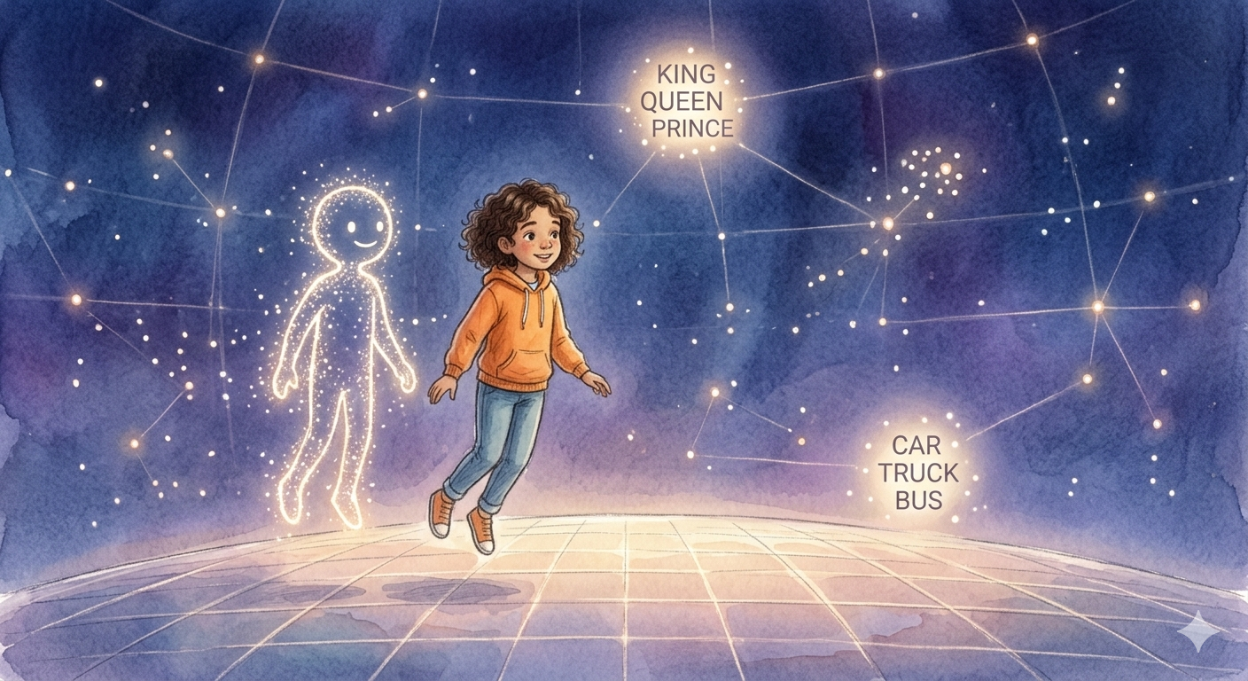
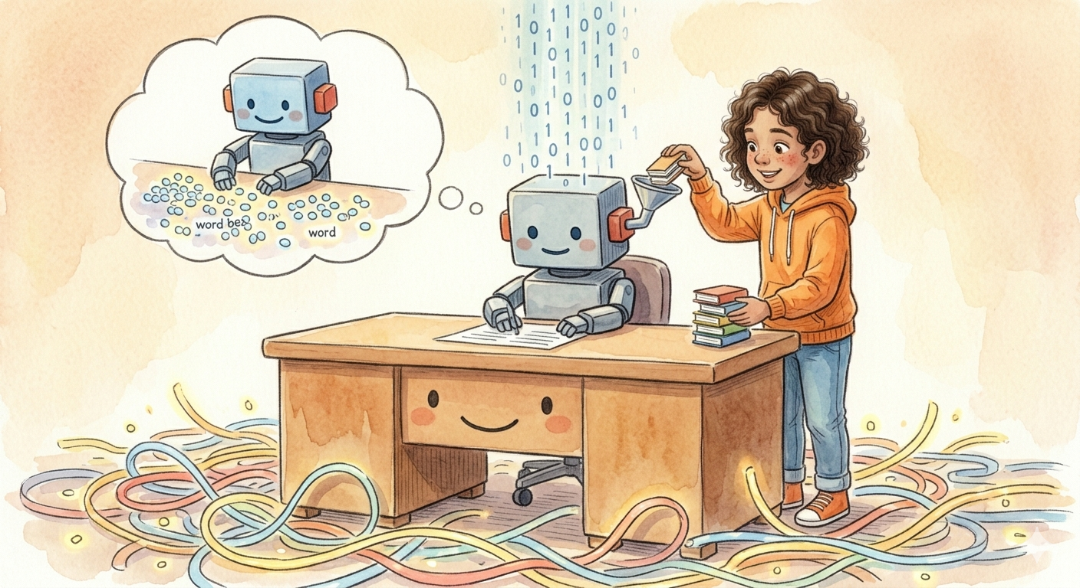
Quick Recap 💡
Everything we just covered — in one slide
🧠
🔍
LLM
Tokens
A giant pattern-learning machine trained on human language. Not magic — math.
Text is broken into chunks (tokens), each converted to a number. ~1 token ≈ ¾ word.
🔢
🎯
Training
Embeddings
Tokens become vectors — lists of numbers that place meaning in geometric space.
Predict the next word. Repeat a trillion times. Understanding emerges from scale.
🎤 Questions ?

Slide 20
LESSON 06
Attention: The Core Innovation
Attention lets the model figure out which words are most relevant to understanding each other word. When processing any word, it 'attends to' the related words around it — simultaneously.
Positional
Where is each word in the sentence?
Semantic
What do words mean together?
Here is a simple example
"The bank was steep, so I grabbed a rock." When you see "bank," your brain checks — money or riverbank? It looks at nearby words ("steep," "rock") to decide. That's exactly what attention does.
Syntactic
Grammar & language structure
Multi-Head Attention: not one kind — many kinds at once.
Different 'heads' track: word positions · grammar relationships · word meanings · coreference — all in parallel.
Long-Range
Connect ideas paragraphs apart

Slide 21
LESSON 06
Contextual Embedding
Same word, different meanings. Embeddings shift in vector space depending on the words around them.
dish-ness
dish
1.09
-0.72
0.66
...
-0.8
rice-ness
rice dish
Indian rice dish
Indian-ness

Slide 22
LESSON 06
Contextual Embedding (cont.)
I made a sweet Indian rice dish called kheer
dish
rice ness
indian ness
sweet ness
dish
1.09
-0.72
0.66
...
-0.8
+
-0.43
0.91
0.18
...
-0.75
+
0.29
0.67
0.52
...
0.85
+
0.39
-0.11
-0.98
...
-0.46
=
1.34
0.75
0.38
...
-1.15
Static Embedding
Contextual Embedding

Slide 23
LESSON 06
The Transformer Architecture
Predictions
Norm
Feed-Forward
Network
Norm
Norm
Nx
Layers
Feed-Forward
Network
Nx
Layers
Multi-Headed
Cross-Attention
Norm
Norm
Multi-Head
Self-Attention
Masked Multi-Head
Self-Attention
Norm
Norm
Embeddings / Projections
Embeddings / Projections
Source Sequence
Shifted Target Sequence

Slide 24
LESSON 07
The Transformer Architecture
1. Input Tokens
Text split into token IDs
The 2017 Revolution
Google's 2017 paper 'Attention Is All You Need' introduced the Transformer. Every modern AI — GPT-4, Claude, Gemini — is built on this one idea.
2. Embedding Layer
Token IDs → vectors
3. Positional Encoding
Add word-order info
Here is a simple example
Before Transformers, AI read text like a slow reader — one word at a time. Transformers read the whole sentence at once, like scanning a photo vs. reading pixel by pixel.
4. Multi-Head Attention
All tokens attend to each other
5. Feed-Forward Layer
Per-token processing
Repeat N layers →
Early layers = syntax. Late layers = world knowledge, reasoning, style.
6. Output Logits
Probability over vocabulary

Slide 25
Working with LLMs as a Software Engineer
Three access patterns — choose based on your use case
☁️ Cloud APIs
🤗 Hugging Face
🦙 Ollama
Managed · Scalable · Paid
Open-source · Flexible · Self-hostable
Local · Private · Free
Models
GPT-4o, Claude 3.5,
Gemini 1.5
Llama 3, Mistral,
Falcon, BERT, 500k+
Llama 3, Mistral,
Phi-3, Gemma (local)
Setup
pip install openai
export OPENAI_API_KEY=…
pip install transformers
torch diffusers
brew install ollama
ollama run llama3
Call
client.chat.completions
.create(model="gpt-4o",
messages=[…])
pipeline("text-generation",
model="meta-llama/…")
(prompt)
ollama.chat(model=
"llama3",messages=[…])
Cost
Pay per token
~$0.005/1K tokens
Free (self-host) or
Inference API (paid tier)
100% free
Runs on your machine
Best for
Production apps,
max capability needed
Research, fine-tuning,
custom model needs
Privacy, offline dev,
local experimentation

Slide 26
Using LLM APIs — Code Walkthrough
1 · OpenAI (cloud)
Key Parameters
from openai import OpenAI
client = OpenAI() # reads OPENAI_API_KEY
response = client.chat.completions.create(
model="gpt-4o",
messages=[
{"role": "system", "content": "You are a helpful assistant."},
{"role": "user", "content": "Explain transformers simply."}
],
temperature=0.7
)
print(response.choices[0].message.content)
temperature
0–2 · creativity vs focus
max_tokens
output length cap
top_p
nucleus sampling cutoff
system msg
persistent role/instructions
3 · Hugging Face (local/API)
2 · Ollama (local, same interface)
from transformers import pipeline
gen = pipeline(
"text-generation",
model="meta-llama/Meta-Llama-3-8B"
)
out = gen("Explain transformers:",
max_new_tokens=200)
print(out[0]["generated_text"])
import ollama # pip install ollama
response = ollama.chat(
model="llama3", # model pulled locally
messages=[
{"role": "user", "content": "Explain transformers simply."}
]
)
print(response["message"]["content"])
💡 All three share near-identical interfaces — learn one, switch freely. Ollama even mirrors the OpenAI SDK.

Slide 27
02
Prompt Engineering Techniques
Frameworks, structures and patterns for powerful prompts.

Slide 28
What Is Prompt Engineering?
"Figuring out what questions to ask will be more important than figuring out the answers."
— Sam Altman, CEO OpenAI
📌
⚡
👥
Definition
Why It Matters
Who Needs It
Prompt engineering is the art and science of designing inputs that guide AI to produce accurate, useful, and relevant outputs.
Same AI model — wildly different outputs. A well-crafted prompt can be the difference between a useless answer and a business solution.
Everyone using AI tools: developers, marketers, educators, managers, researchers — any professional leveraging AI in their work.

Slide 29
The ACE Prompting Framework
A
Act (Role)
• Act like a senior financial analyst
• Act like a compassionate doctor
• Act like a startup marketing consultant
Tell the AI who to be.
C
Constrain
• Use data from 2022–2025 only
• Keep response under 200 words
• Format as a numbered list
Set boundaries for the response.
E
Enhance
• Be motivating and direct
• Use simple language for a 10-year-old
• Make it professional and concise
Add tone, style or emotional context.

Slide 30
TCEPFT — The Master Prompt Formula
Take Coffee EAT Pancake For Tea
T
Task
Give me a 30-day LinkedIn content plan
C
Context
I am an MBA student specialising in marketing
E
Exemplar
Format like: Day 1 – Topic – Key message (2 lines)
P
Persona
You are a social media coach with 10+ years experience
F
Format
Give output as a table with Day, Topic, Hook columns
T
Tone
Professional, inspiring and motivating

Slide 31
Types of Prompts
📋 Instructional
💬 Conversational
✨ Creative
Direct the AI to complete a specific task.
Enable back-and-forth dialogue with context.
Generate original, imaginative content.
"Summarize this article in 3 bullet points."
"How do you think AI will affect jobs in 2030?"
"Write a story where an AI discovers it can dream."
🔍 Analytical
🔄 Chain-of-Thought
🎭 Role-Based
Request data interpretation or comparisons.
Ask AI to reason step-by-step.
Assign a persona or expert identity.
"Compare Python and JavaScript for data science."
"Think step by step: how would I solve this math problem?"
"As a UX designer, critique this app wireframe."

Slide 32
Good vs. Bad Prompts — Live Examples
❌ Bad — Startup Pitch
✅ Good
Write something about my product.
Act as a startup marketing expert. Write a 3-sentence elevator pitch for a mobile app that helps college students track study habits. Tone: energetic and motivating.
❌ Bad — Resume Writing
✅ Good
Help me with my resume.
Review my resume bullet for a Data Analyst role. Improve it using strong action verbs and quantifiable results. Keep it under 25 words. Current: 'Did data analysis for reports.'
❌ Bad — Study Planning
✅ Good
Give me a study plan.
Create a 7-day study plan for GATE 2026 (CS). I can study 3 hours/day on weekdays and 6 hours on weekends. Prioritize: DSA, OS, Networks. Format as a daily schedule.

Slide 33
03
Hands-On Exercises
Apply what you learned. Open your AI tool of choice!

Slide 34
✏️ Exercise 1 · 10 minutes
The Online Grocery Prompt
🎯 Your Task:
Your parents called and need help ordering groceries online. Write a TCEPFT prompt to help them get started.
Steps:
1
Open ChatGPT, Gemini, or Claude
2
Write your prompt using TCEPFT: Task (order groceries), Context (elderly parent, specific store), Exemplar, Persona, Format, Tone
3
Run it and evaluate: Is the output helpful? What's missing?
4
Refine once based on what you find — share your improvement
💡 Tip: Start simple — even a basic prompt is better than none. Then add layers.

Slide 35
✏️ Exercise 2 · 10 minutes
The LinkedIn Content Plan
🎯 Your Task:
Ask AI to give you a 30-day content plan for LinkedIn (or your preferred social media) on a topic you care about.
Steps:
1
Pick your topic: tech, finance, fitness, cooking, career advice, etc.
2
Apply ACE: Act (expert in your topic) + Constrain (30 days, platform, post length) + Enhance (tone that matches your voice)
3
Add TCEPFT layers: include an Exemplar format for the posts
4
Get the plan, then ask: 'Write post #1 for me in full'
💡 Tip: Add your own context — the more specific you are, the more usable the output.

Slide 36
✏️ Exercise 3 · 10 minutes
The Startup Brainstorm
🎯 Your Task:
Brainstorm a startup idea with AI — or if you already have one, stress-test it.
Steps:
1
If you have an idea: 'Act as a VC investor. Critique my startup idea: [describe it]. List 3 strengths and 3 weaknesses.'
2
If you don't: 'Based on my background in [field], suggest 5 startup ideas solving real problems. Format as: Name, Problem, Target User, Revenue model.'
3
Pick your favourite idea and ask: 'What's the biggest risk for this startup and how would you mitigate it?'
4
Optional: Ask it to write a 60-second elevator pitch
💡 Tip: Use chain-of-thought: Ask AI to think step by step before giving you the final answer.

Slide 37
04
Advanced Topics
Master prompts, debugging, and building your prompt library.

Slide 38
Debugging & Iterative Refinement
Common Prompt Errors:
❌ Vague Instructions
✅ Fix: Add specifics: topic, audience, length, format
❌ Conflicting Constraints
✅ Fix: Don't say 'very detailed' AND 'under 50 words'
❌ Missing Context
✅ Fix: Always tell AI WHO you are and WHY you need it
❌ No Persona Set
✅ Fix: Use 'Act as…' to unlock domain-specific quality
🔄 The Refinement Loop: Draft → Test → Identify Gap → Tweak One Variable → Repeat

Slide 39
Master Prompts & Reusable Templates
Master prompts are saved, reusable system instructions that define how the AI behaves before your actual question.
Research Assistant Template
Before answering, search for current information, cross-verify with 2 sources, and flag any conflicting data. Always cite your reasoning. If uncertain, say so.
Use for: Research, fact-checking, analysis
LinkedIn Content Generator
Act as a LinkedIn content strategist. Write posts in first person, conversational style, with a hook opening line, 3 key insights, and a CTA question at end. Max 150 words.
Use for: Personal branding, content marketing
Code Review Template
Review this code for: (1) bugs, (2) performance issues, (3) security risks, (4) readability. For each issue found, show the bad code and your improved version with explanation.
Use for: Software development, code quality

Slide 40
📚
Homework
Deepen your learning between sessions. Takes 2–3 hours.

Slide 41
📚 Homework — Session 1: Gen AI & Prompt Engineering (2–3 hours)
Complete at your own pace. Bring your outputs to the next session for review.
Task 1 · ~45 min
Create 5 reusable prompts for your daily work or studies. Test each one 3 times, refine, and save the best version.
Build Your Prompt Library
Task 2 · ~40 min
Set up OpenAI Python SDK. Write a script that sends a prompt, reads the response, and experiments with temperature (0.2 vs 1.2). Then try the same prompt in Ollama locally in different models. Take a screenshot of ollama running locally.
Call the OpenAI API and/or Install ollama locally
Task 3 · ~30 min
Browse huggingface.co/models. Document differences vs GPT-4o and any hugging face model.
Explore Hugging Face
Task 4 · ~25 min
Apply TCEPFT to 3 real-life tasks: one work task, one learning task, one creative task. Screenshot results and share in the group.
TCEPFT Challenge
📤 Deliverable: Create a folder by your name: Put the output of all Tasks under [yourname]/week1 folder. Due by Wednesday.

Slide 42
Key Takeaways — Session 1
🧠
Gen AI creates new content from patterns — it doesn't look things up from a database.
🎯
A good prompt has role, context, constraints, format, and tone baked in.
🔤
Use TCEPFT as your structured formula for any important prompt.
🔄
Iterate! The first prompt is a draft. Test, tweak, and improve.
📋
Master prompts save time — build your personal prompt library.
⚠️
Always verify AI outputs on important matters — hallucinations are real.

Slide 43
Thank You!
Session 1 Complete — See you at Session 2!
Questions? Let's discuss!
🔗 linkedin.com/in/pallavrustogi
Homework reminder: Build & share your 3 best prompts before next session!

