Slide 1







Technology Trends & Analysis
Akash Kumar
May 2022

Slide 2



OUTLINE
Executive Summary
Introduction
Methodology
Results
Visualization – Charts
Dashboard
Discussion
Findings & Implications
Conclusion
Appendix

Slide 3

EXECUTIVE SUMMARY
Trends in Programming Languages
Trends in Databases
Future expectations in Programming Languages
Future expectations in Databases
Demographic Survey that includes:
Technological gap in Countries
Gender gap in Jobs

Slide 4

INTRODUCTION
About:
Analyzing the trends in software development in present and future aspirations of people.
Purpose
Understanding Present demands in programming languages.
Analyzing future skill requirements.
Understanding Highly demanding database skills and IDEs.

Slide 5

METHODOLOGY
Data Collection Sources:
Survey Data
Data Exploration
Data Cleaning
Data Visualization
IBM Cognos Dashboard
Presentation through:
MS-PowerPoint

Slide 6
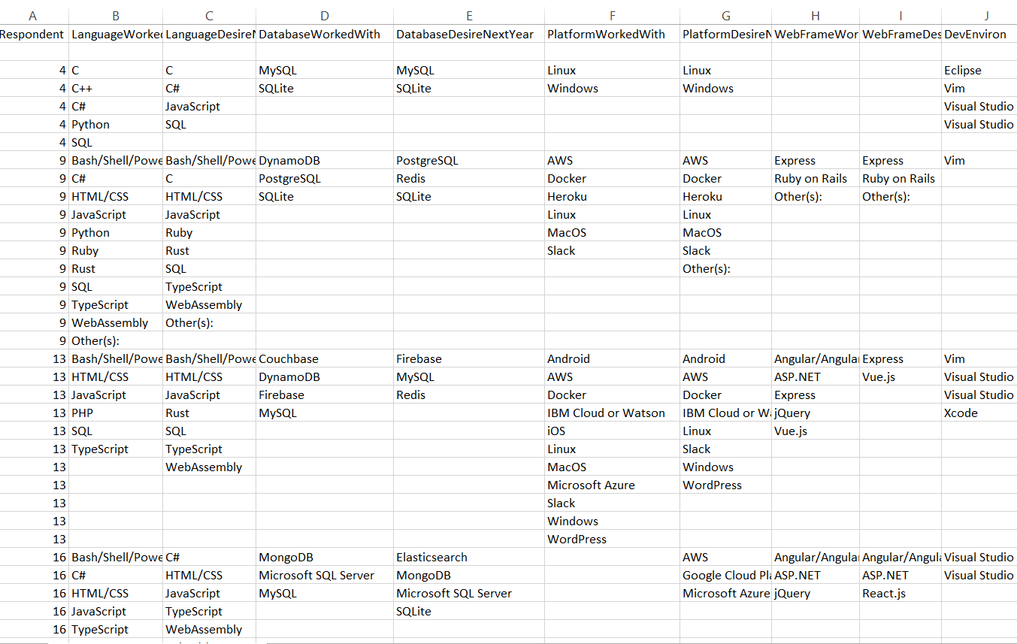
RESULTS
Results are based on this Survey Data:

Slide 7
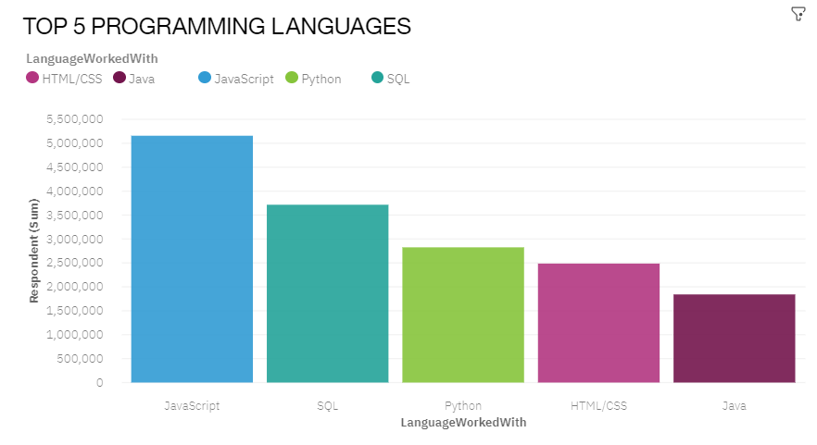
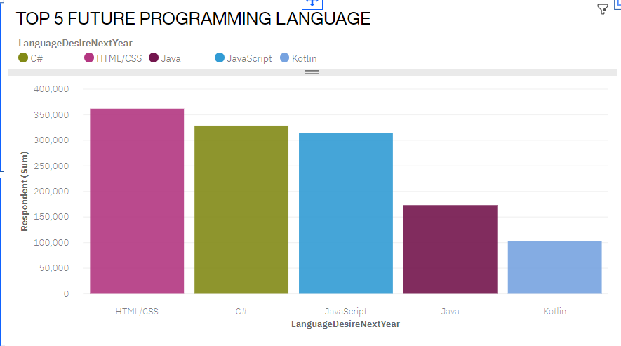
PROGRAMMING LANGUAGE TRENDS
Current Year
Next Year

Slide 8
PROGRAMMING LANGUAGE TRENDS - FINDINGS & IMPLICATIONS
Findings
JavaScript , SQL and Python are currently the leading languages.
HTML/CSS will be popular in future years.
JavaScript will be still demanding in Future.
Implications
Big Data Companies will need SQL learners.
Python will be required as advancement in ML/AI.
JavaScript will be required for Web or App Development.

Slide 9
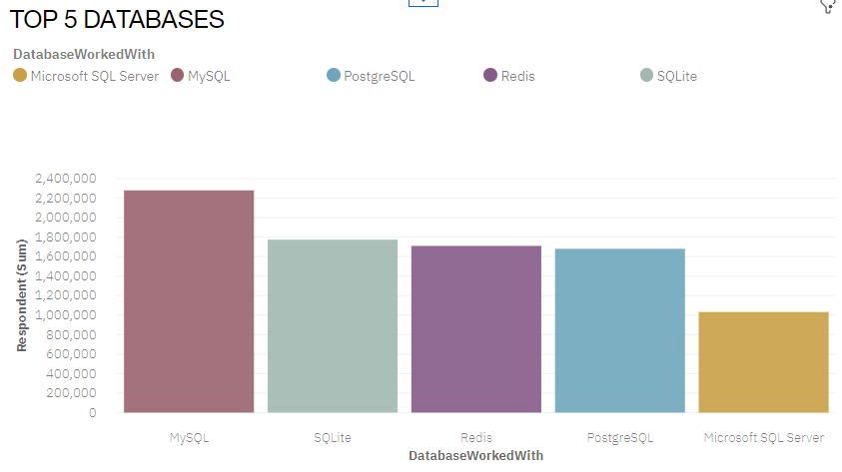
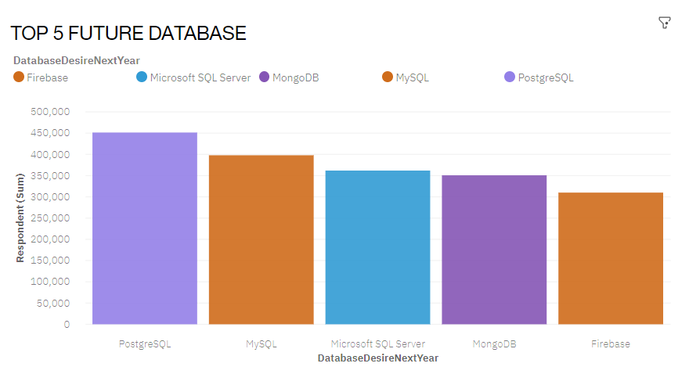
DATABASE TRENDS
Current Year
Next Year

Slide 10
DATABASE TRENDS - FINDINGS & IMPLICATIONS
Findings
MySQL , SQLite and Redis are currently the leading Database.
MongoDB will be popular in future years.
MySQL will be still demanding in Future.
Implications
Open source Database are still favorable .
Redis supports abstract data types
Firebase will became popular to build apps on android $ iOS on its patform.

Slide 11

DASHBOARD
https://eu-de.dataplatform.cloud.ibm.com/dashboards/538baf02-ff83-41ba-af71-6069fb0396f8/view/621bc31819952af641bdb1e407cc2c507c652d09b2bbd65089d47b495a627797f36e1698c82b4e5b8f120d36f2e91350cb

Slide 12
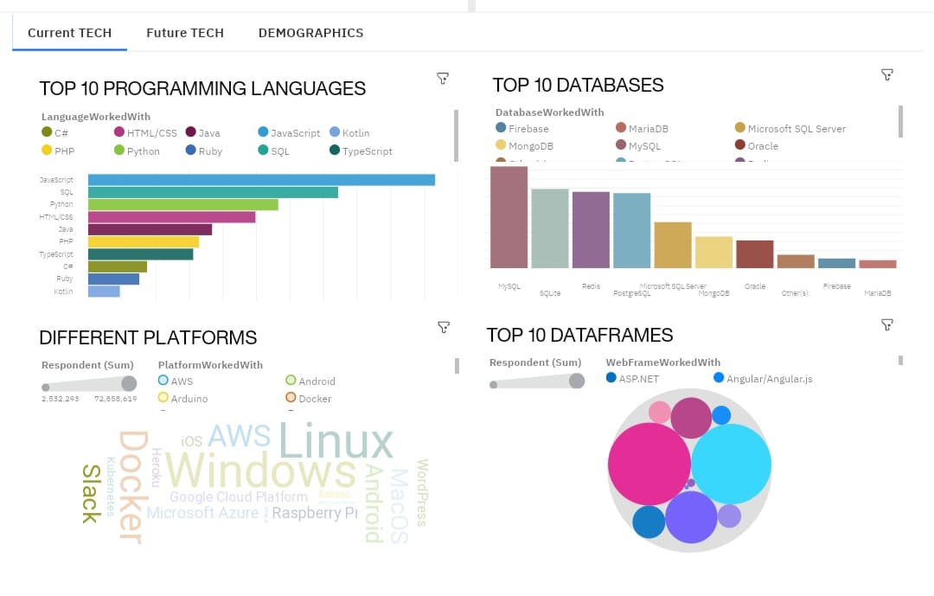
PRESENT TECHNOLOGY DASHBOARD

Slide 13
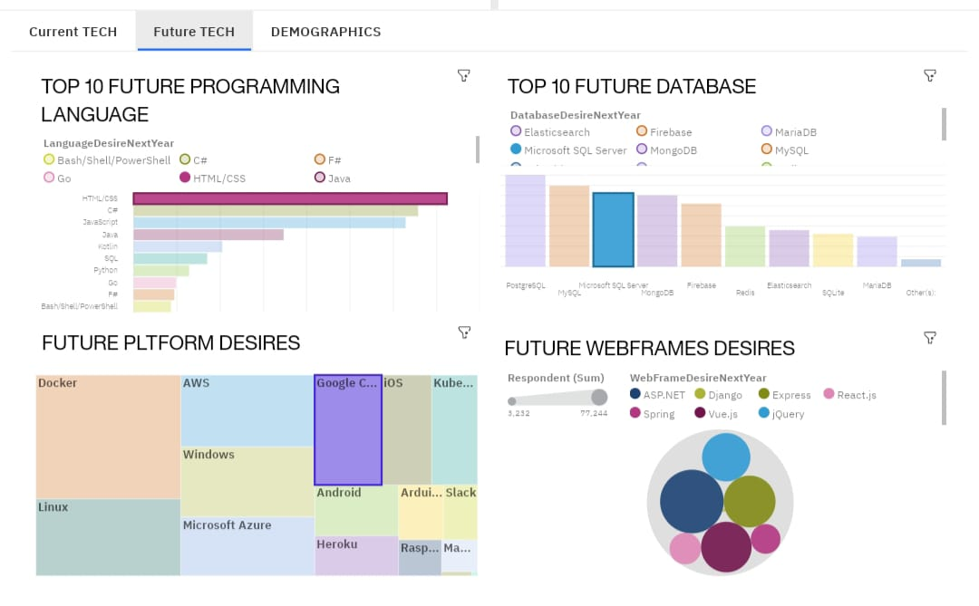
DASHBOARD 2(FUTURE TECHNOLOGY)

Slide 14
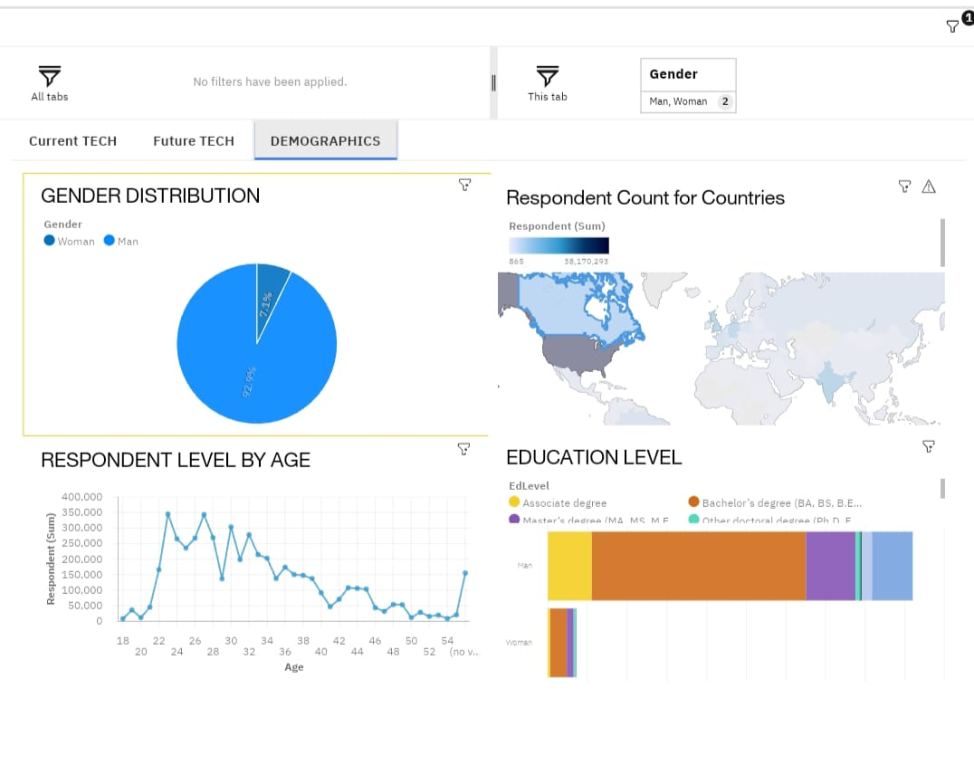
DEMOGRAPHIC DASHBOARD

Slide 15
DISCUSSION
Technology Trends in Present and in Future
Gender gap in jobs
Technological gaps between developed and developing countries
Reskilling of workers
Reducing Age and education discrimination

Slide 16
OVERALL FINDINGS & IMPLICATIONS
Findings
Fast changing Technology
Gender gaps in employment
Neglecting poor countries in terms of technology
Implications
Companies need to adopt to changing technologies as soon as possible
Women needs to be provided technical jobs too
Every country should be provided equal opportunity in terms of technology

Slide 17

CONCLUSION
Technological trends for present and Future years
Machine Learning to be incorporated for better analysis
Demographic overview try to should be identical for every country
Women should be in Technical jobs too.

Slide 18
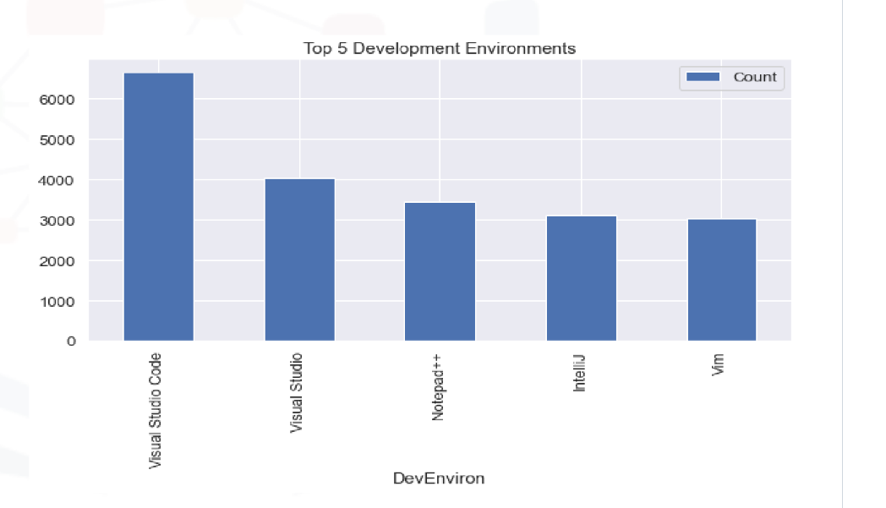

APPENDIX

Slide 19
GITHUB JOB POSTINGS

Slide 20
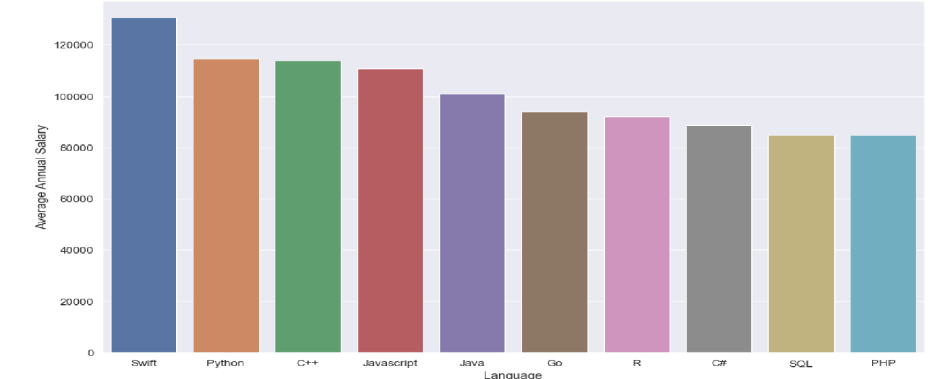
POPULAR LANGUAGES

