Slide 1
Factors influencing the Residential home prices across U.S the most( last 20 years) :
By Akash Kumar

Slide 2
Supply Factors:
Construction Spending
Available Homes
Building Permits
Median Sale Price
Data source- https://fred.stlouisfed.org

Slide 3
Demand Factors:
USA GDP
Unemployment
Mortgage Rates
Median Earning
Data source- https://fred.stlouisfed.org

Slide 4
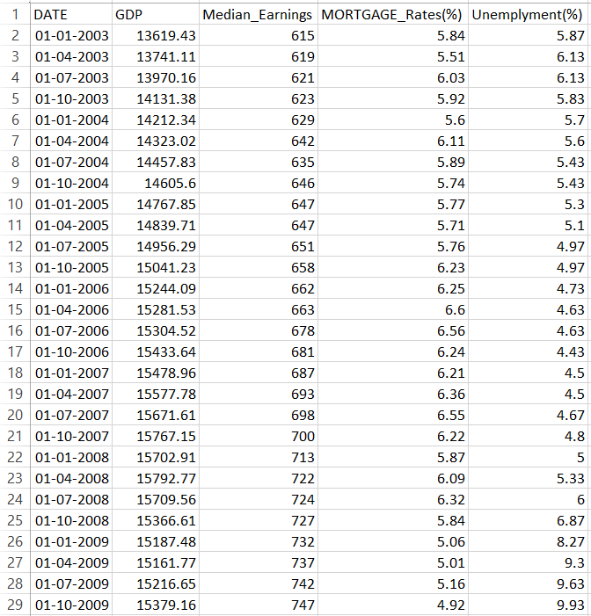
Demand Data:
Demand Data

Slide 5
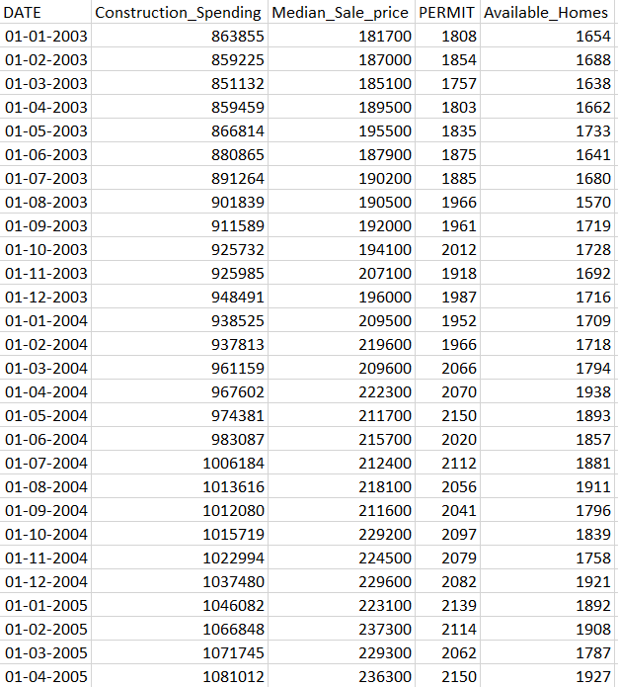
Supply Data:
Supply_Data

Slide 6
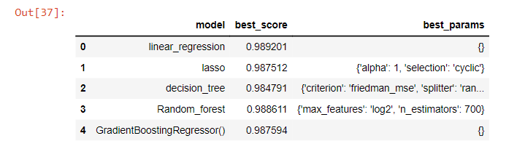
Model Preparation:
Linear_regression Model came out with the best result and hence our model was built on it.

Slide 7
Multivariable Regression Equation :
Y(HPI) =-105.0920945056065 + ( (0.00010521880234370685 * Construction_Spending) + (0.00024336966155251742 * Median_Sale_price) + (0.007119514508761982 * PERMIT) + -0.01240970448293741 * Available_Homes) + (0.006776578686678256 * GDP) + (-0.08345488979271427* Median_Earnings) + (8.26607678053101* MORTGAGE_Rates(%)) + (2.9367223347201112 * Unemplyment (%))
Home_Price_Model

Slide 8
Conclusion:
GDP , House_Permit , Mortgage rates and unemployment has higher positive impact on House Price which is directly increases as price .
Available_homes and Median_Earnings has Negative impact on prices.
It shows that increase in available house decreases the price of house .
However, it's crucial to remember that real-world housing markets are influenced by numerous other factors, and this equation provides a simplified representation of these relationships. Further analysis and consideration of local market dynamics are often necessary for accurate predictions.

