Slide 1



Introductory Sessions
Session 01 : Introduction to Programming
We will be Starting Soon...

Slide 2
Introductory Sessions
Session 01 : Introduction to Programming
Welcome

Slide 3

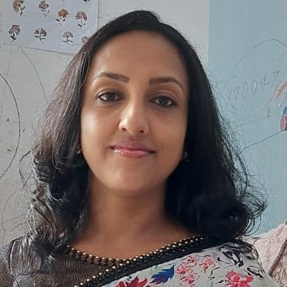
Introductory Sessions
Dr. Sulochana Sooriyaarachchi
Senior Lecturer
University of Moratuwa

Slide 4
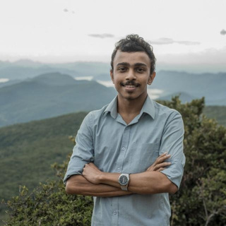
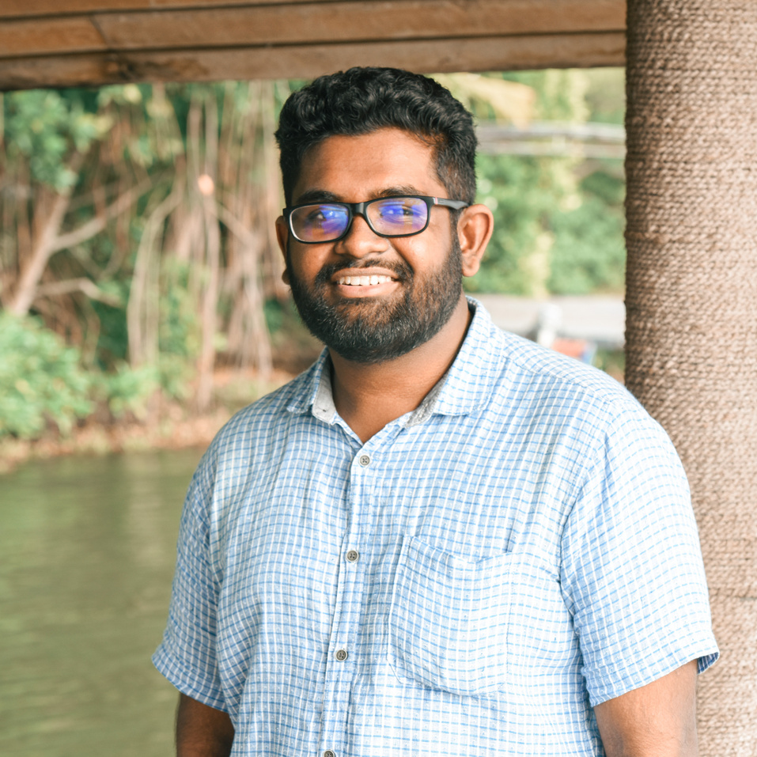
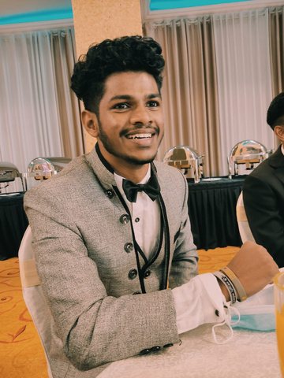
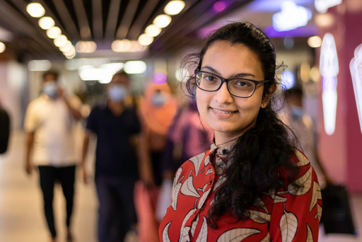
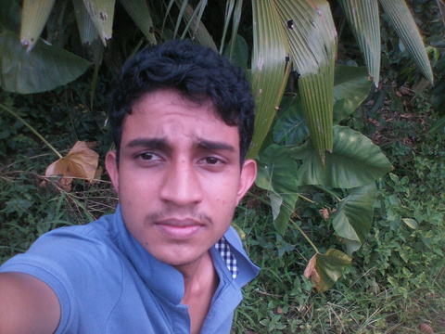
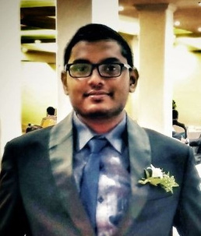
Introductory Sessions
Session 01 : Introduction to Programming
Hasitha Jayaweera
Banula Kumarage
Kasun Pavithra
Piumini Kaveesha
Kasun Isuranga
Mohamed Ishad
Undergraduate
University of Moratuwa
Undergraduate
University of Moratuwa
Undergraduate
University of Moratuwa
Undergraduate
University of Moratuwa
Undergraduate
University of Moratuwa
Undergraduate
University of Moratuwa

Slide 5
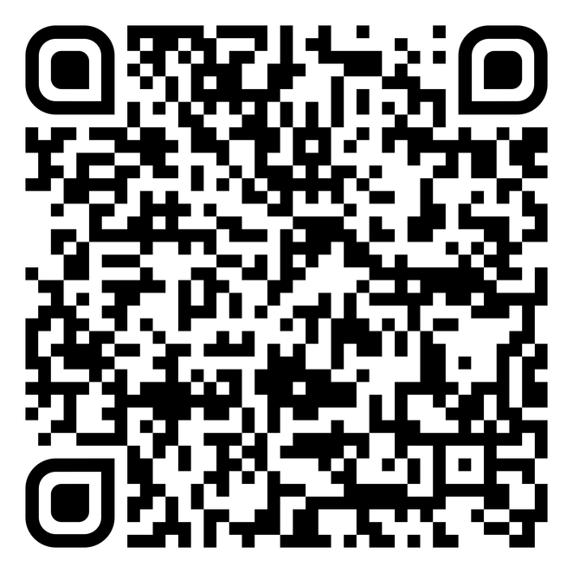
Introductory Sessions
Hurry up and get registered now!
Visit robo.cse.mrt.ac.lk or scan the QR code below

Slide 6
Introductory Sessions
Session 01 : Introduction to Programming
Thank you for joining

Slide 7
Introductory Sessions
Session 01 : Introduction to Programming
We will be back soon...

