Slide 1

Loan Defaulter Analysis Project
Genpact Data Science Prodegree Capstone
Project Using Python
Submitted by
Vishal Kavatkar
Akash Aarekar
Deepak Gupta
Nilesh Humbe
Ramesh Raulo

Slide 2
Project ABSTRACT
This project is about managing the credit risk by using the past data and deciding whom to give the loan to in the future. The text files provided contain complete loan data for all loans issued by XYZ Corp. through 2007-2015. The data contains the indicator of default, payment information, credit history, etc.
The objective is to build a data model for predicting the probability of default, and choose a cut-off based on suitability. Alternatively using a modelling technique which gives binary output.
Information provided:
Dataset containing loan data
Data dictionary

Slide 3
Data Management – Methodology overview
Understanding Business Requirements
Start
Data Source
Feature Engineering
Environment
Modelling
Data Acquisition & Understanding
Data Wrangling
Exploration
Cleaning
Model Handling
Model Evaluation
Deployment
Customer Acceptance
End
Scoring & Performance Monitoring

Slide 4
EDA & Data segmentation
Exploratory Data Analysis: We want to show the power of visualizations
Dropping of column which has null values exceeding 50%
Only 11 columns had less than 50%na values
Conversion of data type from objects to integer
Conversion of issue _d column into date and time to meet the problem statement needs
Removal of columns which has no relevance to our desired outcome
Data Cleaning
Filing the null values in the relevant columns
Cross verification of all data types

Slide 5

Feature Engineering
Train test splitting as per the problem statement
Verification of train and test data
Perform correlation matrix on independent variable
Heat map using matplotlib
Multicollinearity
Scaling dataset
Model Building
Data preprocessing using SK learn
Check and remove columns which having correlation
Multi collinearity checking and dropping of columns which having multi collinearity more than 5

Slide 6

Testing and Cross-validation
First Model tested was Logistic regression
The accuracy of the model on training data - 0.9676098287416233
Where as the accuracy of the model on testing data - 0.9989882914187657
Which resulted in an Over fit Model
Second Model tested was Decision Tree
The accuracy of the model on training data - 1.0
Where as the accuracy of the model on testing data - 0.2446661556241269
The outcome was not a realistic value
The last Model tested was Random Forest
The accuracy of the model on training data - 0.996550791514880
Where as the accuracy of the model on testing data - 0.906946157647544
The final results was as per the desired outcomes (Best Fit Model)

Slide 7
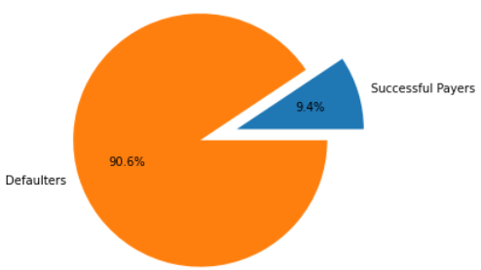
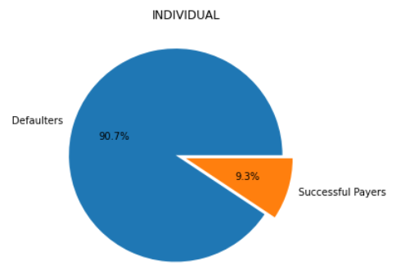
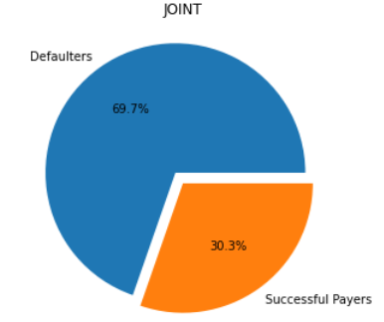
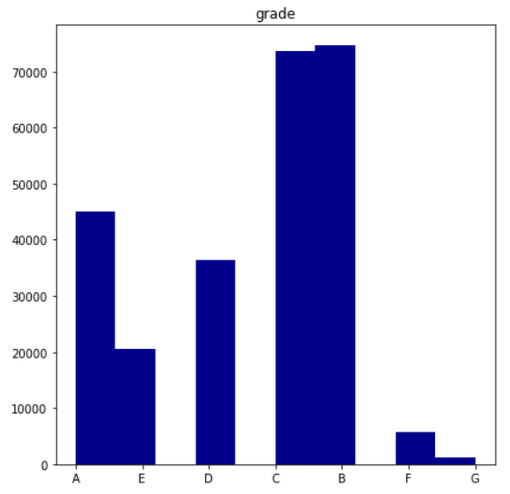
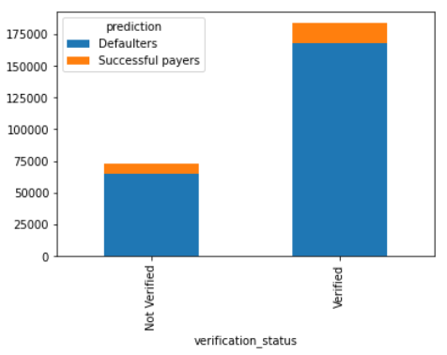
Data Visualization

Slide 8
Insights & Recommendations
Insights
Based on the predictive analysis done by the team we have the following insights
More defaulters who have applied for loan on individual application
Successful payers are mostly who have applied loan on Joint applicants
Recommendations
We recommend the banks to assess their client grading system as almost all grades have very high numbers of defaulters as A Grade applicants are more defaulters
The verification process needs to be reviewed and understand the shortcomings as 72% verified applicants are defaulters

Slide 9
Thank You

