Slide 1

SARA-Net: A Multimodal Deep Learning Framework for Flood Risk Assessment in the Sundarbans using SAR Imagery
Course Name: Computer Science Applications and Advancements
Faculty: Dr. Muhammad Hasibur Rashid Chayon
Presented By Group No: G07
Name | ID
Asmaul Hossain Akash | 25-93883-3
Dolon Akter Mim | 25-93901-3
Tazin Jannat Bushra | 25-93877-3
Tithi Karmakar | 25-93876-3

Slide 2
List of Contents
Introduction
Background
Problem Statement
Objective
Related Works
Methodology
Result and Discussion
Conclusion
Reference

Slide 3
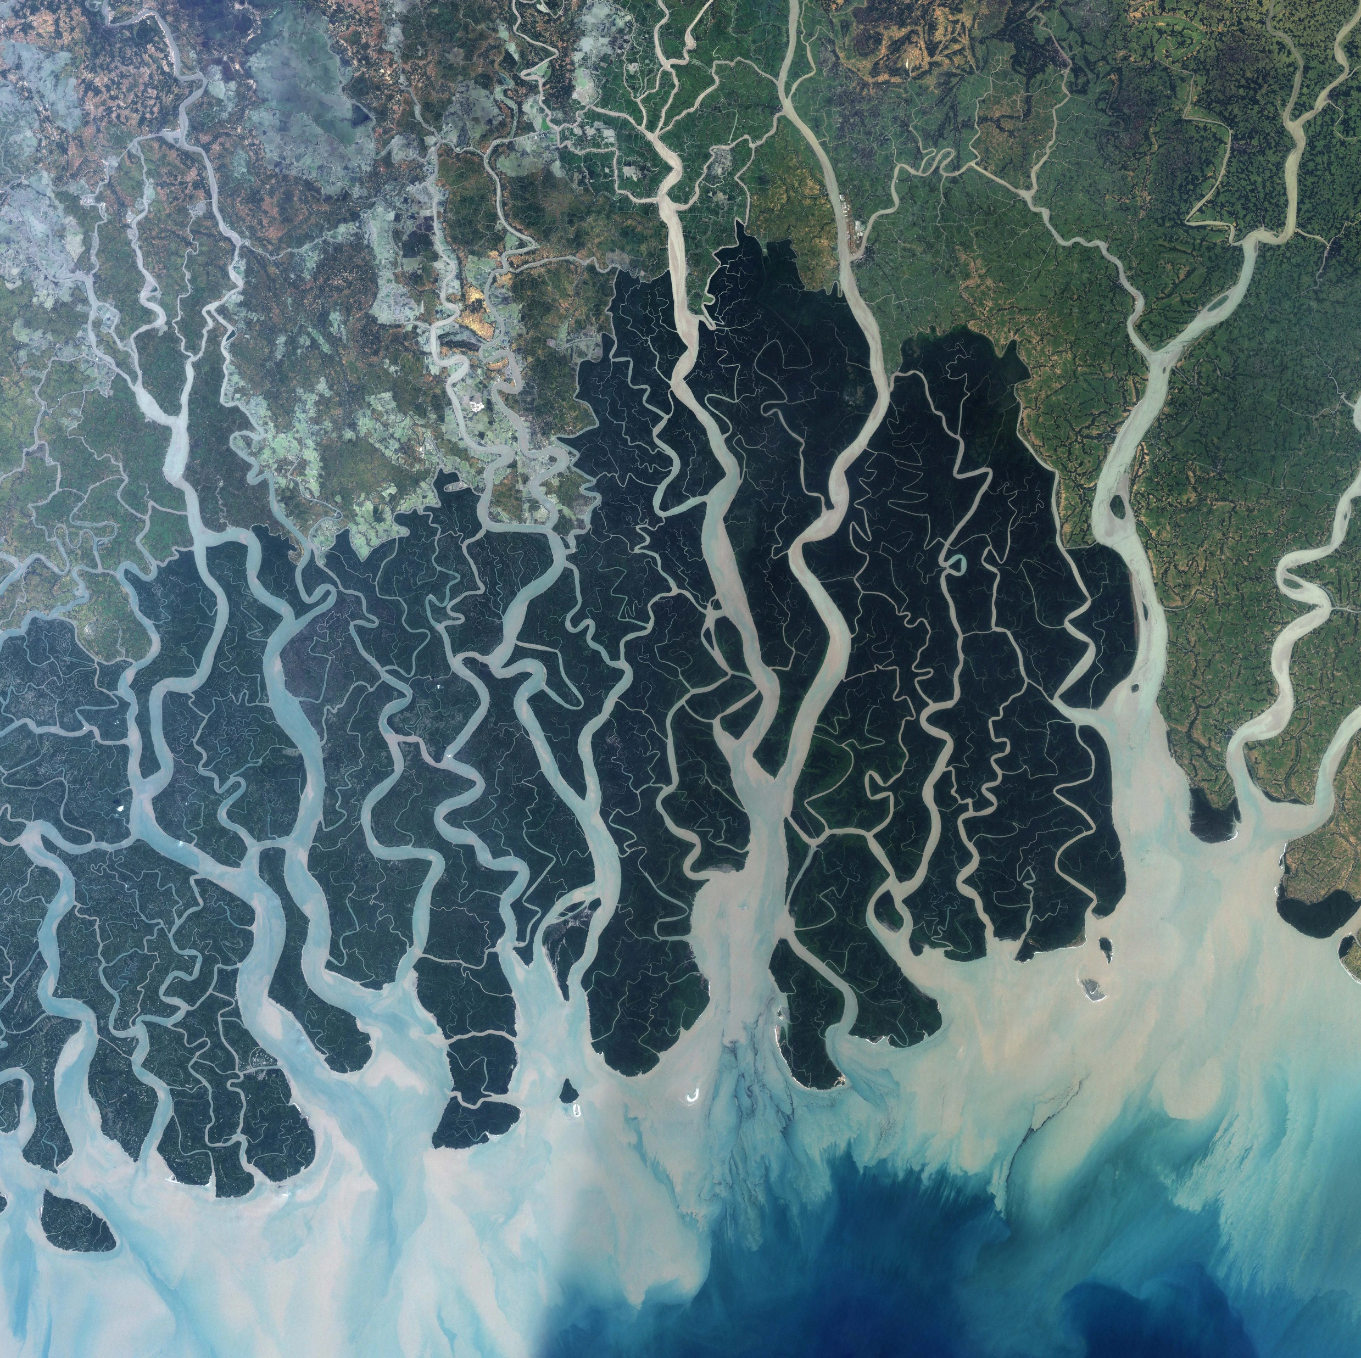
Introduction
Global Significance: World’s largest mangrove forest protecting coastal regions.
Economic Lifeline: Supports livelihoods through fisheries and natural resources.
The Crisis: Climate change and human activities threaten ecosystem balance.
Research Motivation: To address the rapid decline in forest health, our study proposes a novel Multimodal Data Fusion approach.
Notes:
I’d like to start by introducing our focus area: the Sundarbans. As many of you know, this is the largest mangrove forest in the world and acts as a crucial shield for our country, protecting millions from devastating cyclones. It is also the economic backbone for the local population. However, this ecosystem is currently facing a crisis due to rising salinity and climate change. Our research was motivated by the urgent need to monitor this decline more effectively using advanced AI, which I will explain shortly.

Slide 4
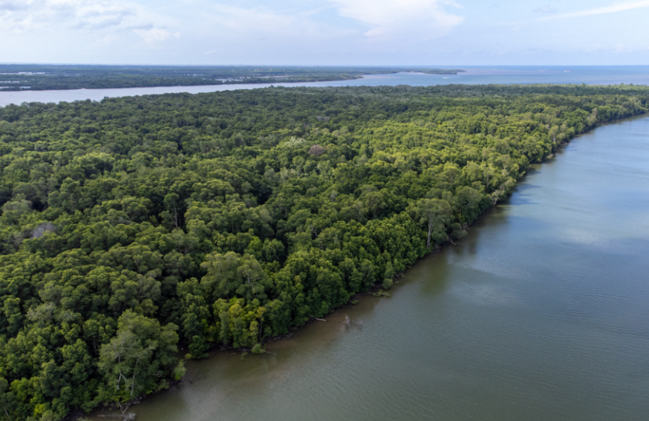
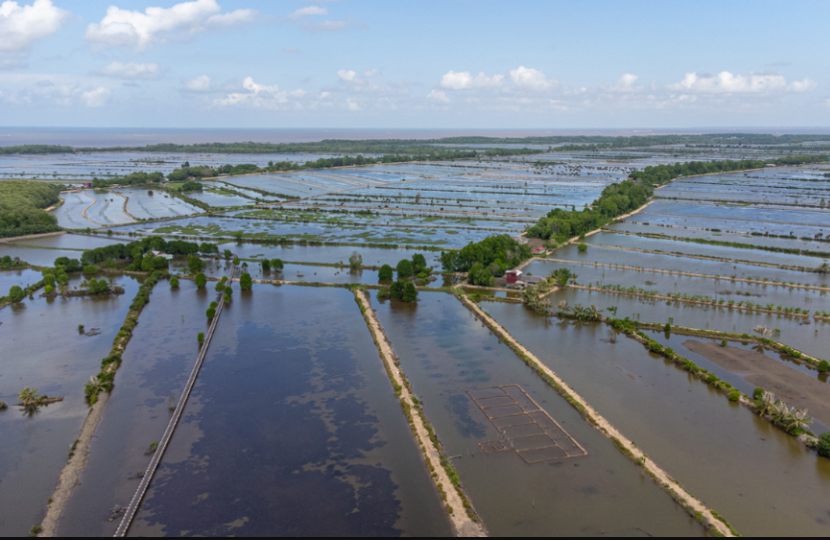
Background
Ecological Context: World’s largest mangrove forest providing critical protection against cyclones.
The Crisis: Threatened by salinity intrusion, sea-level rise, and irregular rainfall.
Socio-Economic Impact: Soil degradation is driving shifts from agriculture to shrimp farming.
The Gap: Existing monitoring methods are limited due to cloud-affected optical data and lack of integrated analysis.
This is what a healthy mangrove area looks like
Degraded or Shrimp Farming Area
Notes:
In related works we can see significant gaps remain in the current literature.
First, we have standard CNNs like ResNet and VGG. While papers by Rafiq and others show they achieve high internal accuracy, they often fail to generalize when tested on new data.
Second, we have Vision Transformers. As Gella and others demonstrated that these are powerful, but they are incredibly data-hungry and computationally expensive, making them difficult to deploy in clinical settings.
Finally, existing hybrid models often skip the hardest test: that is external validation.
This leaves a clear Unsolved Gap: The field is flooded with papers focusing on 'Lab Metrics.' What is missing is a single framework that is simultaneously Accurate, Generalizable to new hospitals, and Explainable to doctors. That is the specific gap that our work addresses

Slide 5
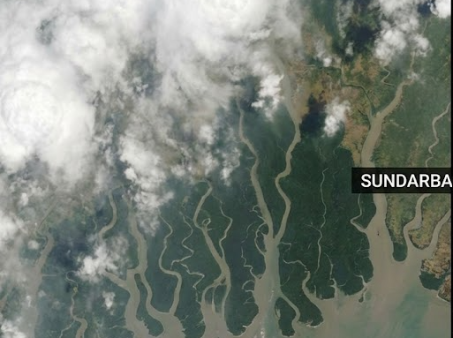
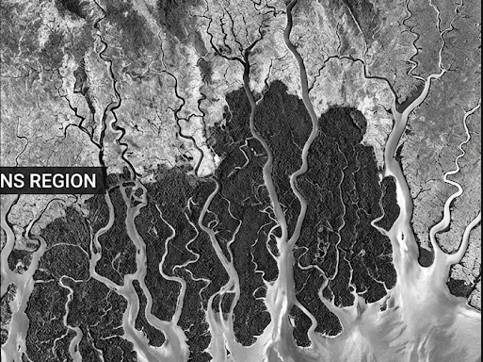
Problem Statement
The Blind Spot (Cloud Cover): Traditional optical satellites (e.g., Landsat, Sentinel-2) are ineffective during heavy monsoon clouds.
Disconnected Data: Environmental factors like salinity or forest loss are studied in isolation.
The What vs. Why Gap: Satellites show where flooding occurs but not why; weather stations lack visual verification.
Insufficient Monitoring: Current systems are sporadic, localized, and lack year-round coverage.
Notes:
In related works we can see significant gaps remain in the current literature.
First, we have standard CNNs like ResNet and VGG. While papers by Rafiq and others show they achieve high internal accuracy, they often fail to generalize when tested on new data.
Second, we have Vision Transformers. As Gella and others demonstrated that these are powerful, but they are incredibly data-hungry and computationally expensive, making them difficult to deploy in clinical settings.
Finally, existing hybrid models often skip the hardest test: that is external validation.
This leaves a clear Unsolved Gap: The field is flooded with papers focusing on 'Lab Metrics.' What is missing is a single framework that is simultaneously Accurate, Generalizable to new hospitals, and Explainable to doctors. That is the specific gap that our work addresses

Slide 6
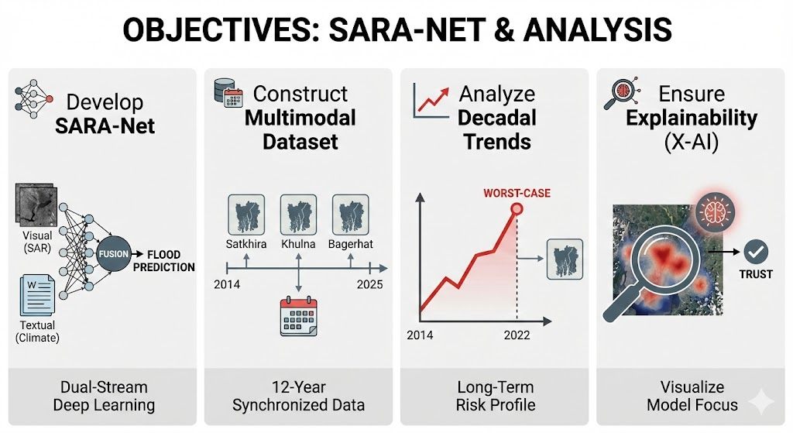
Objective
Develop SARA-Net: A dual-stream model that fuses Visual and Textual data.
Dataset Creation: To construct a multimodal dataset spanning 2014–2025 for Satkhira, Khulna, and Bagerhat.
Trend Analysis: To analyze a 12-year risk profile to identify vulnerable zones.
Explainability: To use X-AI to visualize exactly where the model looks when predicting floods.
Notes:
In related works we can see significant gaps remain in the current literature.
First, we have standard CNNs like ResNet and VGG. While papers by Rafiq and others show they achieve high internal accuracy, they often fail to generalize when tested on new data.
Second, we have Vision Transformers. As Gella and others demonstrated that these are powerful, but they are incredibly data-hungry and computationally expensive, making them difficult to deploy in clinical settings.
Finally, existing hybrid models often skip the hardest test: that is external validation.
This leaves a clear Unsolved Gap: The field is flooded with papers focusing on 'Lab Metrics.' What is missing is a single framework that is simultaneously Accurate, Generalizable to new hospitals, and Explainable to doctors. That is the specific gap that our work addresses

Slide 7
Related Work
Socio-Economic Impact
Islam [1] found that while 90% of residents face environmental threats, 79% lack the resources to adapt.
Chakma et al. [3] discovered that salinity intrusion has forced ~30% of locals to abandon traditional professions.
Limitation: Studies are mostly survey-based and localized.
Remote Sensing (Physical Monitoring)
Roy et al. [6] and Enan et al. [2] successfully mapped forest degradation using optical satellites (Sentinel-2/Landsat).
Wahid et al. [12] confirmed sharp salinity increases in the central Sundarbans.
Limitation: Shampa et al. [16] emphasize that these optical sensors are blind during the cloudy monsoon season.
Deep Learning & AI
Li et al. [14] and Wang et al. [23] demonstrated that CNNs can effectively integrate diverse environmental data.
Limitation: Chakma & Akter [17] highlight the "Black Box" problem, where models fail to explain why a flood is predicted.
How We Fill the Gap
Unlike Shampa et al. [16], we use SAR (Radar) to see through clouds.
We solve the transparency issue using Jiang et al.’s [24] LayerCAM visualization.
Domain | Key Insight | Critical Gap
Social Studies | Islam [1] & Chakma et al. [3] highlighted the human struggle to adapt. | Small sample sizes; hard to generalize.
Remote Sensing | Roy et al. [6] mapped forest loss using optical data. | Shampa et al. [16] note optical failure during cloudy monsoons.
Existing AI | Wang et al. [23] automated mangrove mapping. | Chakma & Akter [17] note the lack of explainability ("Black Box").
Notes:
In related works we can see significant gaps remain in the current literature.
First, we have standard CNNs like ResNet and VGG. While papers by Rafiq and others show they achieve high internal accuracy, they often fail to generalize when tested on new data.
Second, we have Vision Transformers. As Gella and others demonstrated that these are powerful, but they are incredibly data-hungry and computationally expensive, making them difficult to deploy in clinical settings.
Finally, existing hybrid models often skip the hardest test: that is external validation.
This leaves a clear Unsolved Gap: The field is flooded with papers focusing on 'Lab Metrics.' What is missing is a single framework that is simultaneously Accurate, Generalizable to new hospitals, and Explainable to doctors. That is the specific gap that our work addresses

Slide 8
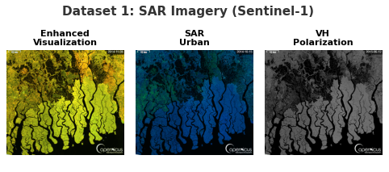
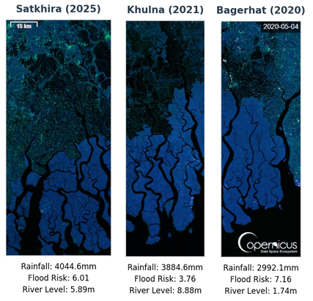
Methodology (Dataset & Preprocessing)
Multimodal Data Sources:
  Visual (Sentinel-1): SAR imagery processed into three levels for all-weather monitoring.
  Textual (Climate): Synchronized rainfall and river level data from the Climate Simulation Dataset.
Preprocessing Pipeline:
  OCR Timestamping: Automated extraction of years from raw SAR image frames.
  Spatial Segmentation: Images sliced into specific zones: Satkhira, Khulna, Bagerhat.
  Total 2325 unique images were created based on regions (775 each).
  Years covered from 2014 to 2025 and mapped with the images.
Data Augmentation:
  Applied random rotations, horizontal flips, and color jitter to prevent overfitting and ensure the model learns generalized features.
Notes:
In related works we can see significant gaps remain in the current literature.
First, we have standard CNNs like ResNet and VGG. While papers by Rafiq and others show they achieve high internal accuracy, they often fail to generalize when tested on new data.
Second, we have Vision Transformers. As Gella and others demonstrated that these are powerful, but they are incredibly data-hungry and computationally expensive, making them difficult to deploy in clinical settings.
Finally, existing hybrid models often skip the hardest test: that is external validation.
This leaves a clear Unsolved Gap: The field is flooded with papers focusing on 'Lab Metrics.' What is missing is a single framework that is simultaneously Accurate, Generalizable to new hospitals, and Explainable to doctors. That is the specific gap that our work addresses

Slide 9
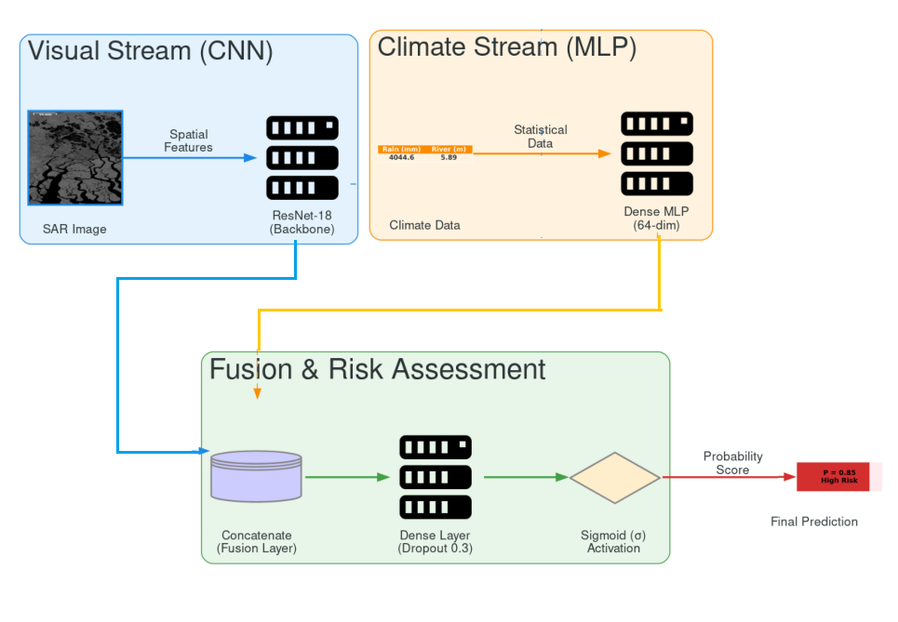
Methodology (Architecture)
Dual-Stream Design: SARA-Net processes data in parallel:
  Visual Stream: Uses ResNet-18 to extract spatial features from satellite images.
  Climate Stream: Uses a Dense MLP to process statistical rainfall and river data.
Fusion Layer: Merges the two streams into a single unified vector.
Output: A Sigmoid classifier generates a final probability score (0.0 to 1.0) for flood risk.
Modality Dropout: Randomly drops 10% of inputs during training to force the model to learn from both data sources.
Transparency: Integrated LayerCAM (X-AI) to visualize exactly which pixels drive the decision.
Notes:
In related works we can see significant gaps remain in the current literature.
First, we have standard CNNs like ResNet and VGG. While papers by Rafiq and others show they achieve high internal accuracy, they often fail to generalize when tested on new data.
Second, we have Vision Transformers. As Gella and others demonstrated that these are powerful, but they are incredibly data-hungry and computationally expensive, making them difficult to deploy in clinical settings.
Finally, existing hybrid models often skip the hardest test: that is external validation.
This leaves a clear Unsolved Gap: The field is flooded with papers focusing on 'Lab Metrics.' What is missing is a single framework that is simultaneously Accurate, Generalizable to new hospitals, and Explainable to doctors. That is the specific gap that our work addresses

Slide 10
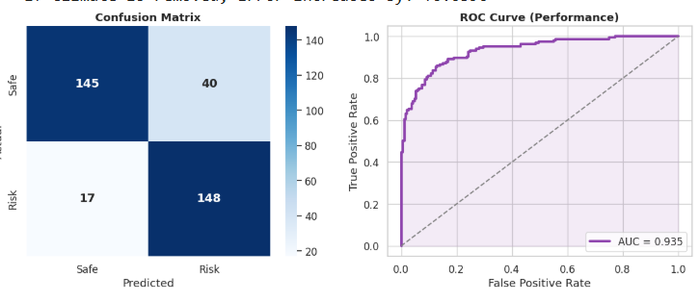
Results – Performance Matrix
Model Accuracy: 83.71% accuracy was Achieved.
ROC-AUC Score: Reached 0.94, indicating "Safe" and "High Risk" scenarios.
Key Findings: The model is robust and stable, producing very few false alarms compared to traditional single-source methods.
Notes:
In related works we can see significant gaps remain in the current literature.
First, we have standard CNNs like ResNet and VGG. While papers by Rafiq and others show they achieve high internal accuracy, they often fail to generalize when tested on new data.
Second, we have Vision Transformers. As Gella and others demonstrated that these are powerful, but they are incredibly data-hungry and computationally expensive, making them difficult to deploy in clinical settings.
Finally, existing hybrid models often skip the hardest test: that is external validation.
This leaves a clear Unsolved Gap: The field is flooded with papers focusing on 'Lab Metrics.' What is missing is a single framework that is simultaneously Accurate, Generalizable to new hospitals, and Explainable to doctors. That is the specific gap that our work addresses

Slide 11
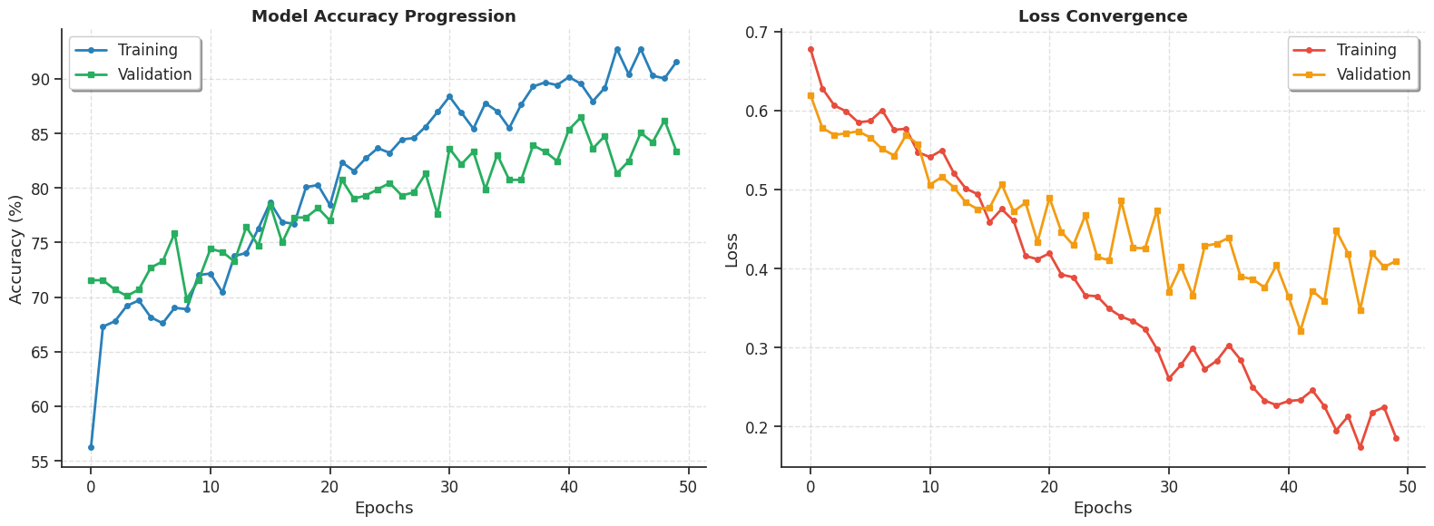
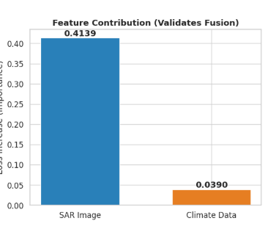
Results – Feature Importance
The Ablation Test: We tested the model by removing inputs one by one.
Visual Impact (Primary): Removing SAR images increased the error significantly (+0.41), proving that satellite imagery is the main driver.
Climate Impact (Secondary): Removing climate data increased the error slightly (+0.04), acting as a crucial refining context.
Findings: The model relies primarily on what it sees (SAR), while using rainfall statistics to confirm the severity.
Notes:
In related works we can see significant gaps remain in the current literature.
First, we have standard CNNs like ResNet and VGG. While papers by Rafiq and others show they achieve high internal accuracy, they often fail to generalize when tested on new data.
Second, we have Vision Transformers. As Gella and others demonstrated that these are powerful, but they are incredibly data-hungry and computationally expensive, making them difficult to deploy in clinical settings.
Finally, existing hybrid models often skip the hardest test: that is external validation.
This leaves a clear Unsolved Gap: The field is flooded with papers focusing on 'Lab Metrics.' What is missing is a single framework that is simultaneously Accurate, Generalizable to new hospitals, and Explainable to doctors. That is the specific gap that our work addresses

Slide 12
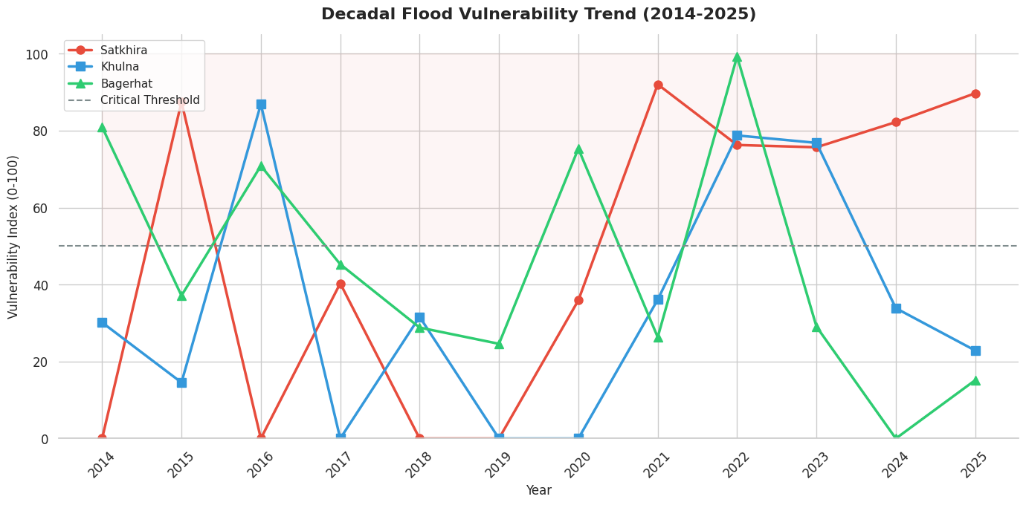
Results – Trend Analysis (2014-2025)
Rising Threat: The 12-year analysis shows that overall flood risk is trending upward across the ecosystem.
Most Vulnerable Zone: Satkhira consistently shows the highest and most persistent risk (indicated by the Red Line in our graphs).
Event Validation: The model correctly identified historical disasters without being explicitly told:
  2020: Flagged Cyclone Amphan as a major High-Risk event.
  2022: Detected peak vulnerability across all districts due to record rainfall.
Notes:
In related works we can see significant gaps remain in the current literature.
First, we have standard CNNs like ResNet and VGG. While papers by Rafiq and others show they achieve high internal accuracy, they often fail to generalize when tested on new data.
Second, we have Vision Transformers. As Gella and others demonstrated that these are powerful, but they are incredibly data-hungry and computationally expensive, making them difficult to deploy in clinical settings.
Finally, existing hybrid models often skip the hardest test: that is external validation.
This leaves a clear Unsolved Gap: The field is flooded with papers focusing on 'Lab Metrics.' What is missing is a single framework that is simultaneously Accurate, Generalizable to new hospitals, and Explainable to doctors. That is the specific gap that our work addresses

Slide 13
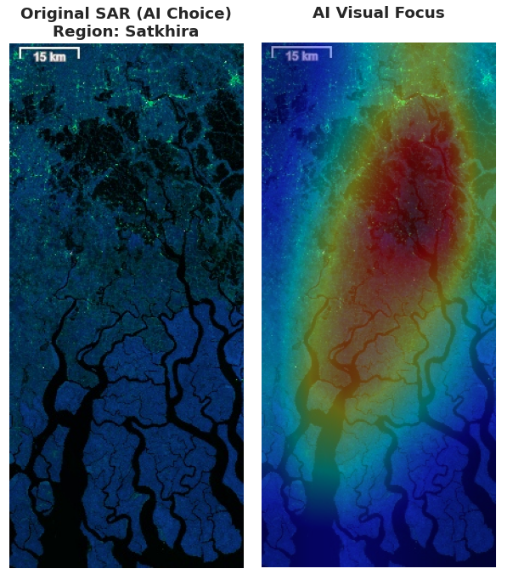
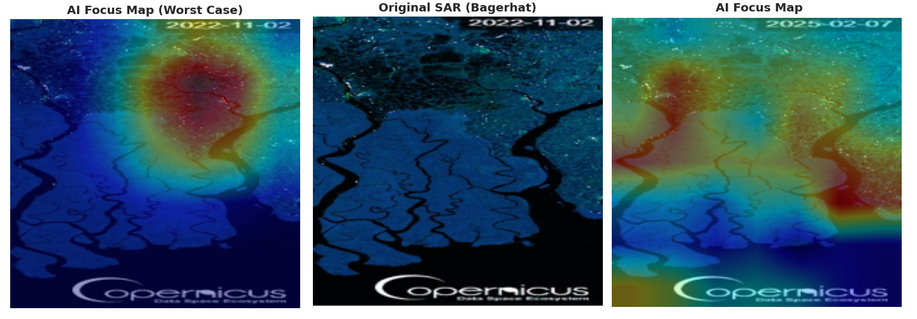
Results – Visual Verification (X-AI)
We used LayerCAM heatmaps to verify if the AI understands where the water is.
Critical Insight: Satkhira was identified as the highest-priority zone for immediate disaster management intervention.
Case Study: Bagerhat District
  2022 (Worst Case): Under extreme rainfall (4506mm), the heatmap shows massive, widespread red zones covering the land.
  2025 (Normal): Under normal rainfall (1451mm), the heatmap restricts its focus only to the riverbanks.
Validation: Not just guessing, it intelligently adapts its visual focus based on the actual environmental severity.
Notes:
In related works we can see significant gaps remain in the current literature.
First, we have standard CNNs like ResNet and VGG. While papers by Rafiq and others show they achieve high internal accuracy, they often fail to generalize when tested on new data.
Second, we have Vision Transformers. As Gella and others demonstrated that these are powerful, but they are incredibly data-hungry and computationally expensive, making them difficult to deploy in clinical settings.
Finally, existing hybrid models often skip the hardest test: that is external validation.
This leaves a clear Unsolved Gap: The field is flooded with papers focusing on 'Lab Metrics.' What is missing is a single framework that is simultaneously Accurate, Generalizable to new hospitals, and Explainable to doctors. That is the specific gap that our work addresses

Slide 14
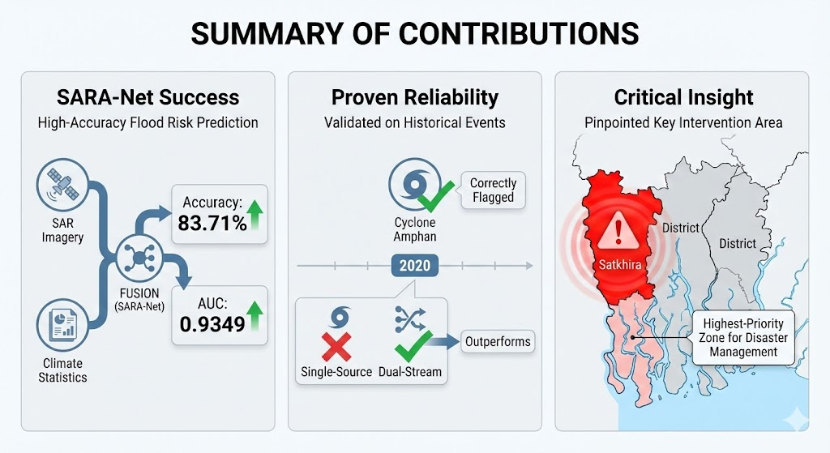
Conclusion
Summary of Contributions
  SARA-Net Success: We successfully fused radar imagery (SAR) with climate statistics to predict flood risks with 83.71% accuracy and an AUC of 0.9349.
  Proven Reliability: The dual-stream approach significantly outperforms single-source methods, accurately flagging historical events like Cyclone Amphan (2020).
  Critical Insight: Satkhira was identified as the highest-priority zone for immediate disaster management intervention.
Notes:
In conclusion, we have successfully developed TriFuse-xNet, a hybrid framework that bridges the gap between lab accuracy and clinical utility. We proved that by fusing complementary features, we can achieve superior robustness on unseen data while maintaining transparency through XAI. Our next step is to scale this architecture to handle Whole Slide Images and integrate Vision Transformers, moving us one step closer to an AI assistant that clinicians can fully trust.

Slide 15
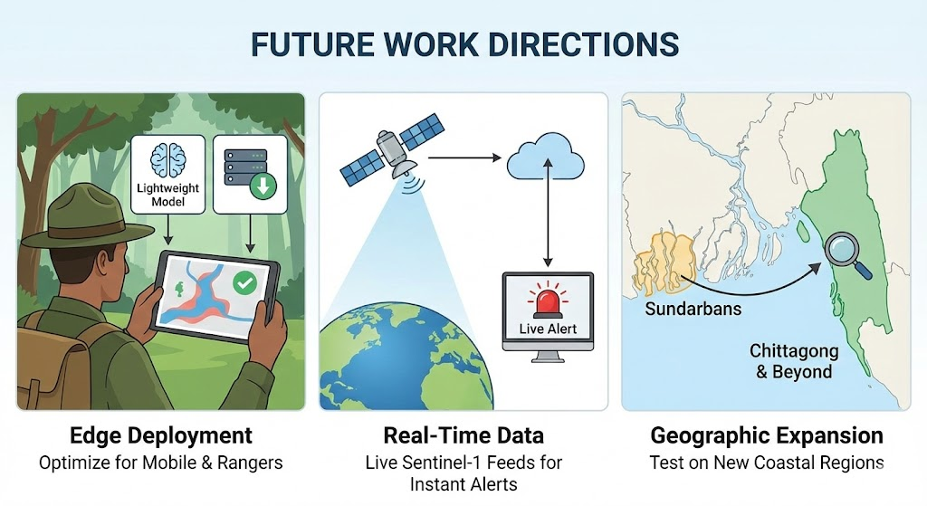
Future Directions
  Edge Deployment: We aim to optimize the model to be lightweight, allowing it to run on standard computers or mobile devices for local rangers (overcoming current GPU requirements).
  Real-Time Monitoring: We plan to connect the system to live Sentinel-1 satellite feeds to transform this research into a live disaster warning system.
  Geographic Expansion: We will test the model on other coastal regions (e.g., Chittagong) to improve its ability to generalize to new landscapes.
Notes:
In conclusion, we have successfully developed TriFuse-xNet, a hybrid framework that bridges the gap between lab accuracy and clinical utility. We proved that by fusing complementary features, we can achieve superior robustness on unseen data while maintaining transparency through XAI. Our next step is to scale this architecture to handle Whole Slide Images and integrate Vision Transformers, moving us one step closer to an AI assistant that clinicians can fully trust.

Slide 16

Thank you!
Questions?

