Slide 1
Virtualization & Cloud Computing
Customer Clustering Using K-Means Algorithm Over Google Cloud Platform
Assignment 3
By: Group - 4
Prince Dubey (G23AI2014)

Slide 2
ABSTRACT
Businesses face challenges in accurately segmenting customers so that they can enhance their marketing strategies.
In this project we have used ML model- K-Means clustering for the data classification task.
A Flask web app presents the segmentation results.
The solution is then deployed on Google Cloud Platform for reliability and scalability.
We have also later established the benefits of deploying an web application over cloud platform rather than on local machines.

Slide 3
URLs To Project
Github link of our project:
https://github.com/PKD-DB/vcc_assignment_project
Link to our web app. We have disabled it for the moment due to cost issue.
https://customersegmentation-435711.dt.r.appspot.com/

Slide 4
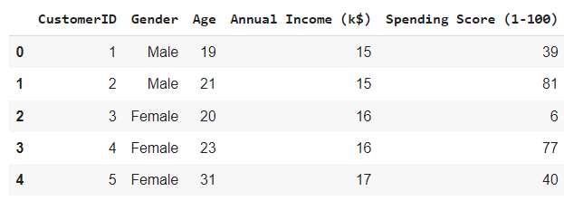
Code Working - K-Means Clustering
We used K-Means clustering for our classification task in this case. We had a dataset of Mall_Customers.csv.
The data had columns :

Slide 5
We select our features for model building then based on correlation matrix.
1. Annual Income 2. Spending Score

Slide 6
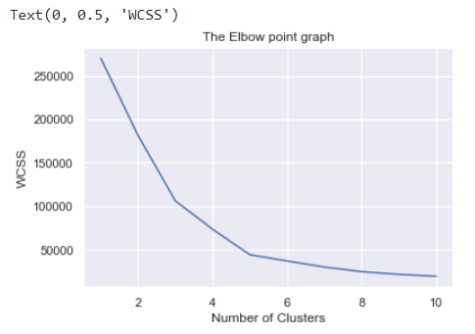
Then, we used WCSS to help us figure out number of clusters.
Based on this its clear we will be going forward with 5 clusters.

Slide 7
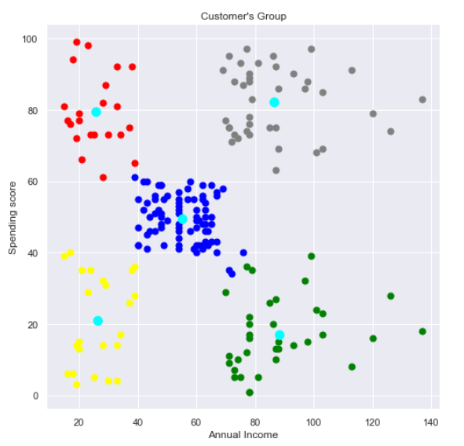
After applying our model we get our desired clusters.

Slide 8
Deploying The Project On Cloud
We created a project vcc-assignment-g23ai2014 on GCP
and used the same under which our model get deployed
We used app engine service to host our application
We use the model.pkl to store the trained K-Means models, and serializing using pickle module.
We can then Flask App and a app.yaml file to visualize our model through a web application.
We then deployed our model over Google cloud.

Slide 9
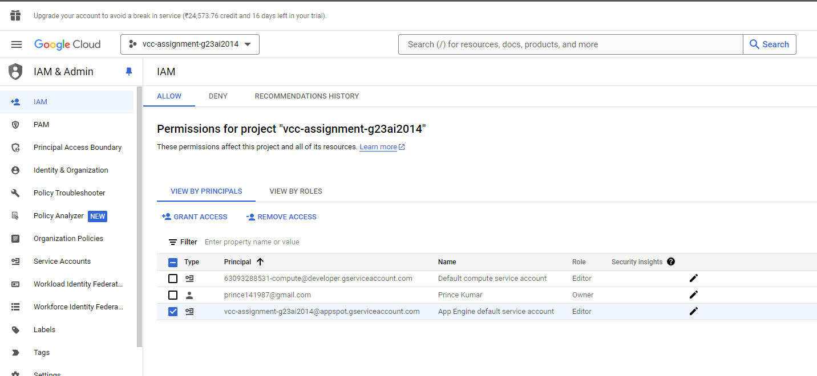
Deploying The Project On Cloud

Slide 10
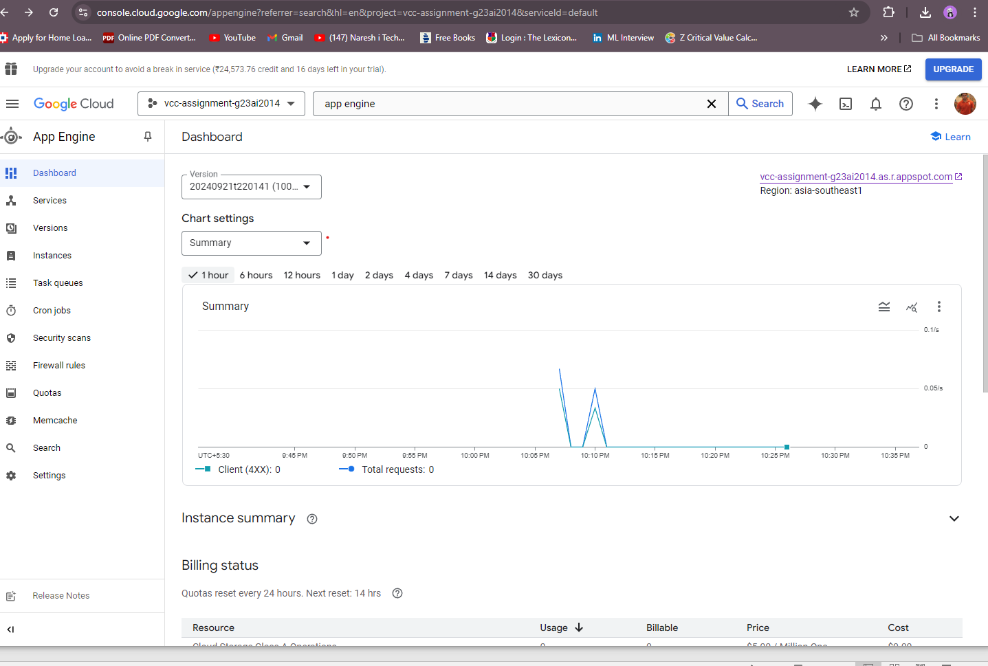
Deploying The Project On Cloud

Slide 11
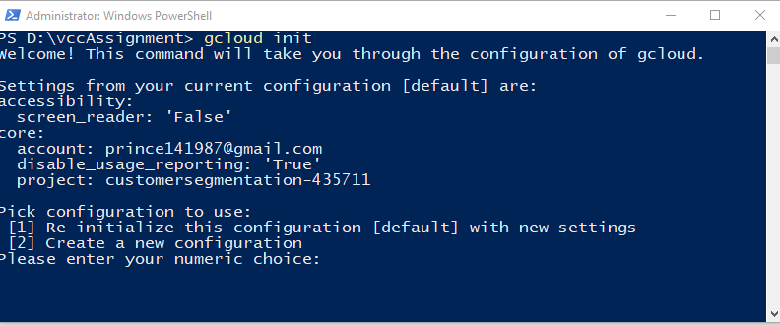
Deploying The Project On Cloud
We use the model.pkl to store the trained K-Means models, and serializing using pickle module.
We can then Flask App and a app.yaml file to visualize our model through a web application.
We then deployed our model over Google cloud.

Slide 12
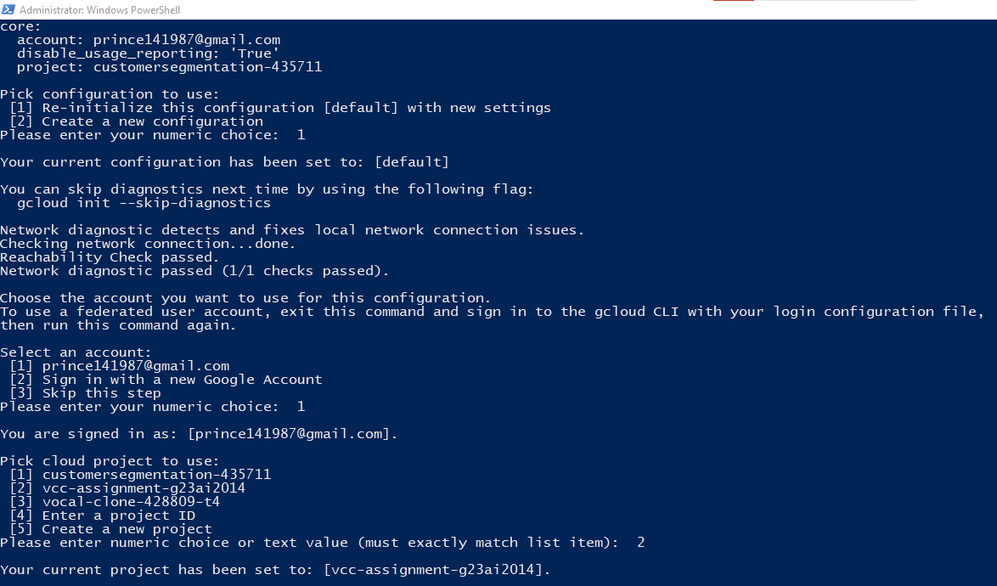
Deploying The Project On Cloud

Slide 13
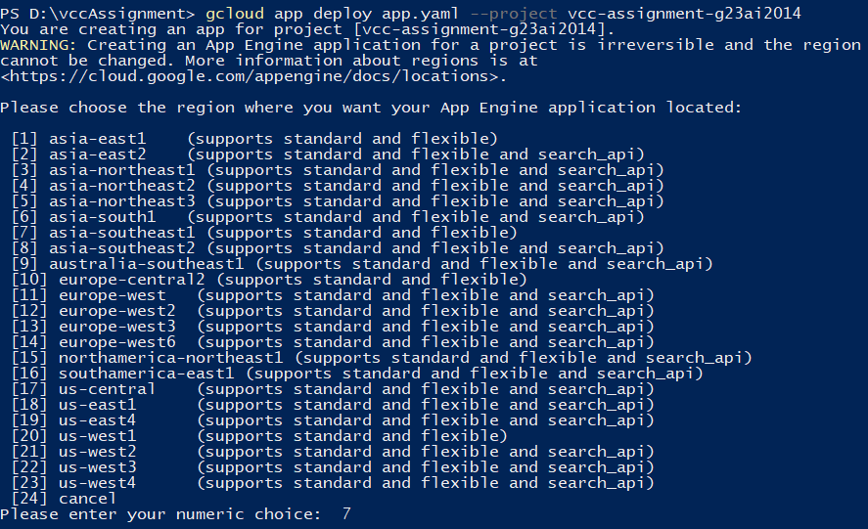
Deploying The Project On Cloud

Slide 14
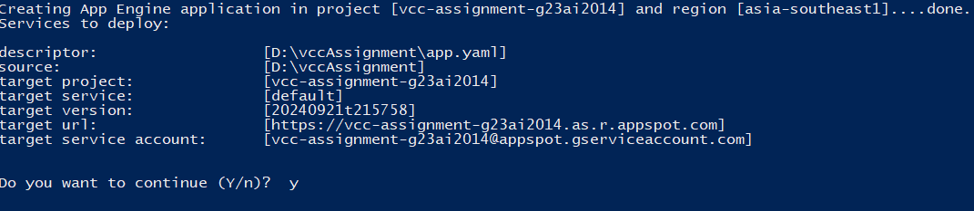
Deploying The Project On Cloud

Slide 15
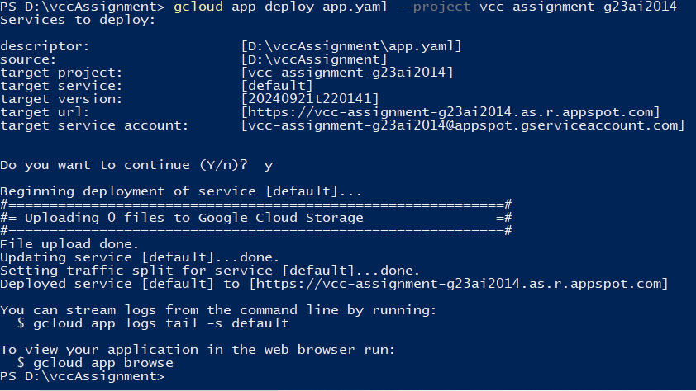
Deploying The Project On Cloud

Slide 16
Deploying The Project On Cloud

Slide 17
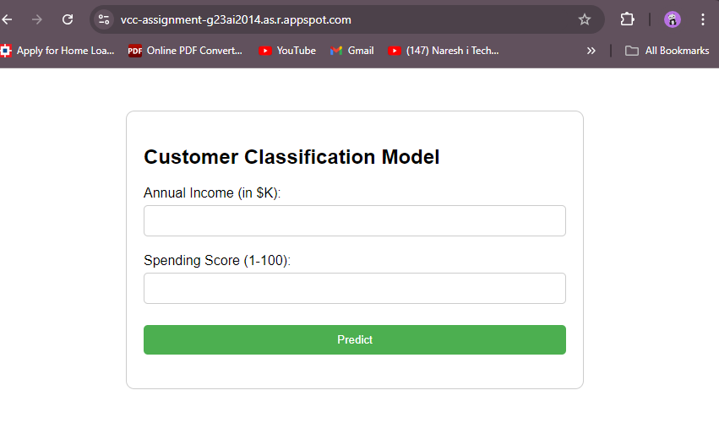
Final Outcome
Our project divides the customers into 5 clusters. The U.I interface looks like this:

Slide 18
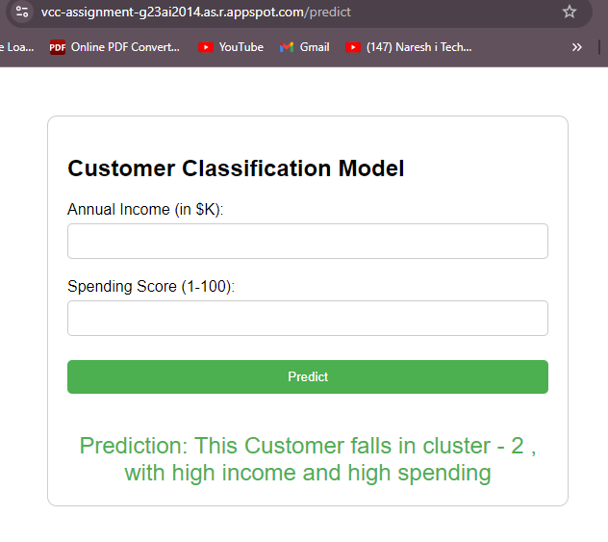

Slide 19
GCP V/S LOCAL SYSTEM
Scalability: GCP handles traffic spikes better than local setups.
Management: GCP automates updates and scaling processes.
Cost: Local development may incur higher maintenance costs over time.
Accessibility: GCP allows access from anywhere with internet.
Performance Metrics: Discuss any observed differences in response times.

Slide 20
CONCLUSION
Deploying the customer segmentation application on GCP not only improved scalability and security but also provided a powerful platform for innovation, paving the way for future enhancements and expansions in data-driven decision-making.

Slide 21
THANK YOU

