Slide 1
Brazilian E-Commerce
MIS-64038-001-202010: Analytics In Practice
Objective
Sales Forecasting
Customer Churn
Geolocation Analysis
Conclusions
Group 3
Sai Sumanth
Chujun Huang
Harika Penjerla
Mallikarjun Sasnur
Sushmita Singh

Slide 2
Objective
Sales Forecasting
Customer Churn
Geolocation Analysis
Notes:
Today’s agenda is to focus on three main aspects of the business-like Sales Forecasting, Customer Churn and Geolocation Analysis.

Slide 3
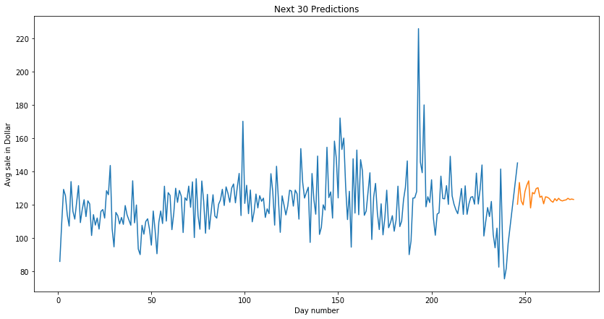
Sales Forecasting
Notes:
Sales forecasting: Average sales for next 30 days will be around130 million

Slide 4
Customer Churn
Notes:
Above picture shows the outline of our dashboard which we plan to explain using tableau and explain the insights about customer groups and necessary strategies needed to be taken.

Slide 5
Geolocation Analysis

Slide 6
Conclusion
Loyal customers need more attention in our business so by providing more promotions/offers can be a useful strategy.
Credit cards is the most used Payment type by the customers,to improve customer satisfaction by offering credit card rewards points.
Sales forecasting for the next 30 days seems to be around 130 million dollars which is less than last two months. So, it necessary improve customer online experience and product categories.
Time series prediction results shows that the next 15 days, the sales could potentially hit low.

Slide 7

By-Akash Bhor

