Slide 1

Senior Thesis Fall Summary
Larry Gates

Slide 2
What Is the thesis
Finding areas of congestion using traffic flow data
Determine an appropriate advertisement at place
Including time of day for advertisement

Slide 3
What I am Doing
Teaching myself Introduction to Hadoop with guidance by Sriram
Downloading datasets
Setting up the cluster
Planning the flow of the project
Notes:
I was motivated to do the project to gain experience in researching a topic as preparation for graduate school. The idea of learning how to use a tool unfamiliar to me and applying to a topic is difficult but a useful skill to obtain. Currently, congestion in traffic is unavoidable now a day with the increasing number of automobiles on the road, especially during rush hour. During the summer between my sophomore and junior year, I noticed an electronic billboard on my hour drive home. Due to the traffic during rush hour, I could see the billboard clearly for a couple of minutes. If a company could request time to make sure the advertisement was seen by the maximum number of people, then advertisement agencies can adjust prices for a given time, to maximize profits. A thought later occurred to me that if an electronic billboard sold times that lined up with traffic lights in a city, then when the light was red, traffic facing the billboard could display that advertisement on the billboard during the red light. With that, the billboard company could charge for the prime time.

Slide 4
Why it is important
Use of traffic dataset
Patterns in traffic data
Machine learning with advertisements
Notes:
Using Dr. Mohan’s lesson plans for Introduction to Hadoop, I have been teaching myself a condensed version of using Hadoop Ecosystem. Through the lesson plans, I am strongly familiar with the workings of Hadoop’s internal systems, along with several of the services that work with Hadoop. I did get experience with various services, such as Pig and Hive, through some of the labs for the course.
Using the instruction manual from Apache, I set up a cluster that runs Ambari-Server, which is a Hadoop Ecosystem. The cluster runs with 5 nodes and can run various Hadoop labs. The server holds all available services that were initially provided by Apache and has been operational.
Since the beginning of the fall term, I have been collecting data from the Data Portal of Chicago. Using a bash script, every 5 minutes the script downloads 3 different layouts of traffic data for a given region of Chicago, along with traffic data for a given segment of Chicago. Since the website does not upload a new spreadsheet every 5 minutes, the script checks if the spreadsheet that was downloaded is not the same as the previous file that was downloaded. If the set of 3 files is the same, the new 3 files will be deleted. Currently, there are over 4,000 spreadsheets for both segment and region data from September 18th, 2016 to October 31st, 2016, with about 24 per day.

Slide 5
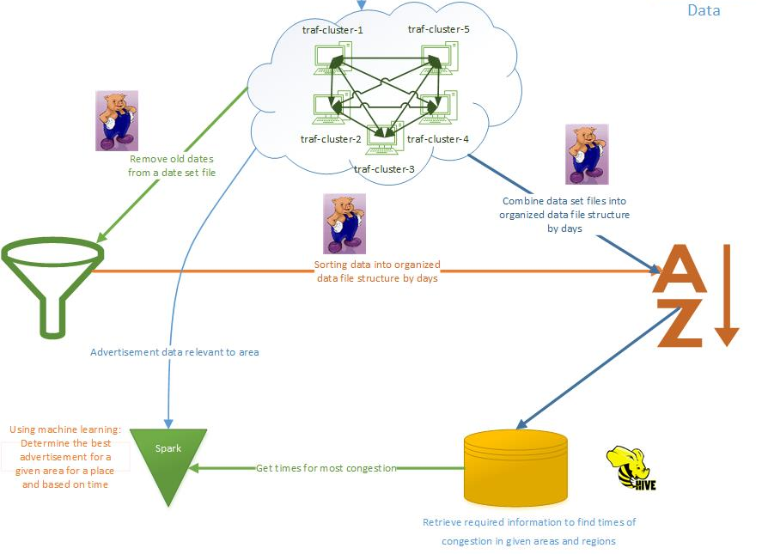
What are my future plans

