Slide 1

Senior Thesis Winter Update
Larry Gates

Slide 2
What is the Thesis? (Refresher)
Finding areas of congestion using traffic flow data
Determine an appropriate advertisement at place
Including time of day for interval
Notes:
Using Chicago Data Portal, I have been collecting over 12,000 files for the individual segment data of Chicago and over 12,000 files for the individual Region Data of Chicago. There are 29 regions that cover the entire city of Chicago except O’Hare airport area. There are over 1250 segments over 300 miles of arterial roads. Currently, I am unsure what segments are in a given region. I have contacted the data set owner multiple times to get a more accurate answer, worse case, I can use to longitude and latitude components of each segment and region.

Slide 3
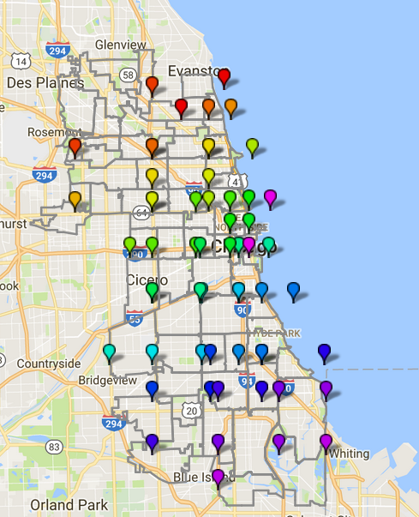
What does the data look like?
Notes:
The thin gray lines are the area codes and each color blimp represents the opposite corner of a given region. Red starts at 1, light purple is 29. I will explain what the purpose of the data was and the current use of it in the following slide

Slide 4
What I have Done?
Experimented with various tools
Pig
Hive
Spark
Advertisement Data
Traffic Data
Notes:
I have attempted to use various tools to find trends. The first tool is Apache Pig, which I use to clean up the data and sort into a nice file structure. The file structure is putting all the data for a given day into a folder and order the file by region and time. The use of Apache Hive was created for strong SQL users. I found the program not very helpful for my instance, as I need to merge the data together. The last tool I attempted to work with was Apache Spark, to use the machine learning library. I was not able to master the Machine Learning Library, but found using map-reduce would seem to be simpler for me and easier to implement.
The advertisement data posed a challenge. My original intention was to take economic factors for a given zip code and determine the type advertisement for a given zip code. I discovered that a given segment stretched across multiple zip codes, figuring out how to account for this was beyond my knowledge and time. I decided since there are a large amount of segments, I decided that I assume every segment has a billboard, and that have N advertisements with a themes and a ranking of success. I will then find the best one for a segment if there is any form of congestion in a given area. N will increase as I perfect my system.
I will continue to collect the same traffic data until the end of the quarter.

Slide 5
What AM I Doing?
Implementing the Map-Reduce for the Advertisement Data
Cleaning up the Implementation of the Traffic Data

Slide 6
What am I Planning?
Finishing up the implementations
Uncover additional data
Prepare for the poster presentation

