Slide 1

Team Name : Team-Phoenix
Team Leader Name : Akash Boddula
Problem Statement : Intelligent Candidate Discovery & Ranking — rank the best-fit candidates for a job description by genuine fit, not keywords.

Slide 2
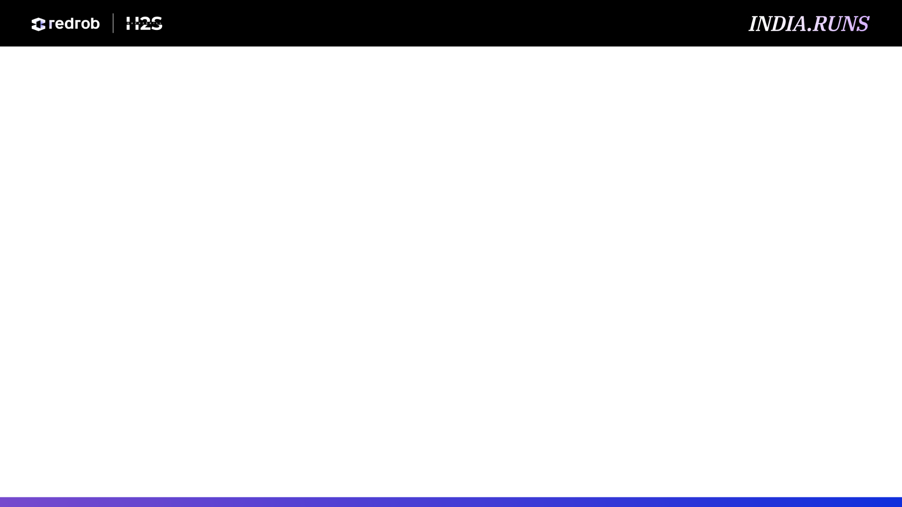
Solution Overview
▸ A hybrid candidate ranker. It reads each candidate's full profile and ranks the top 100 by genuine fit — combining AI semantic understanding with a structured, recruiter-style scoring model.
▸ Four layers working together: (1) dense embeddings that grasp meaning, (2) structured fit rules, (3) integrity guards that reject fakes, (4) behavioural signals for real availability.
▸ What makes it different: AI-skill credit is GATED by title/career credibility — so a Marketing Manager who lists 'RAG' earns almost nothing, while a genuine engineer earns full weight.
▸ Sees plain-language fits: surfaces people who built ranking/retrieval systems but never wrote the buzzword — which keyword filters miss entirely.
▸ Trustworthy & fast: every pick has an explainable score + honest reason; runs in ~37s on a CPU with no paid LLM API calls.

Slide 3
JD Understanding & Candidate Evaluation
▸ Requirements extracted from the JD: production embeddings & vector search; a shipped ranking / recsys / search system at scale; product-company (not services-only); 5–9 yrs; evaluation rigor (NDCG/MRR/MAP); Noida/Pune; a pragmatic shipper, not research-only.
▸ Most important candidate signals: current + past job titles, what they actually built (career-history text), real retrieval/ranking evidence, experience band, product-vs-services history, and behavioural availability.
▸ Fit beyond keywords: we embed a distilled version of the JD and match each profile by meaning; we read career descriptions, not just the skills list; and we gate buzzword credit by whether the title/career makes it believable.

Slide 4
Ranking Methodology
▸ Retrieve: every profile is pre-embedded with a sentence-transformer (all-MiniLM-L6-v2, 384-d) and indexed with FAISS; we score cosine similarity to a distilled JD query.
▸ Score (weighted blend 'fit'): title .22 · what-they-built .22 · career-arc .14 · semantic-retrieval .13 · semantic-full .11 · experience .10 · location .08.
▸ Combine all signals: final = fit × behavioural × disqualifier × honeypot × stuffer — multipliers that sink unavailable, off-domain, fake, or impossible profiles.
▸ Rank: sort by final score (deterministic tie-break by candidate_id) and emit the top 100 with reasons.

Slide 5
Explainability & Data Validation
▸ Every decision is explained: each shortlisted candidate gets a 1–2 sentence reason built from their own facts — title, years, real employers, named skills — plus honest concerns (e.g. long notice, low response rate).
▸ No hallucinations: reasoning is composed only from fields actually present in the profile (no LLM, no invented skills); tone is tied to the rank so it never contradicts the score.
▸ Suspicious / low-quality profiles: honeypots (impossible tenure vs dates; 'expert' in many skills with 0 months used) are detected by simple arithmetic and crushed ×0.03; keyword-stuffers ×0.25–0.40.
▸ Reproducible: output is fully deterministic — two runs produce a byte-identical file.

Slide 6
End-to-End Workflow
▸ From JD to ranked candidates: one offline preparation step, then a fast CPU-only ranking pass.
Job
Description
Distil to query
+ lexicons
Embed 100K
profiles (offline)
Score: semantic +
structured + guards
Combine ×
multipliers
Sort →
Top 100
submission.csv
+ reasons

Slide 7
System Architecture
OFFLINE (once)
build_index.py
RANKING · rank.py · ~37 s · CPU only, no network
Read every profile
↓
all-MiniLM-L6-v2
↓
embeddings.f16.npy
+ FAISS index
Dense semantic
cosine to JD query
Structured fit
title · built · exp · loc
Integrity guards
honeypot & stuffer kill
Behavioural
availability multiplier
Combine → final score
fit × behavioural × guards
Top 100 + reasoning
→ submission.csv

Slide 8
Results & Performance
▸ Ranking quality (released 100K pool): top-100 is 100% engineering titles; 86/100 sit in the ideal 5–9-yr band (mean 6.5); Noida & Pune are the #1 and #2 locations — exactly the JD's preference.
▸ Trap resistance: 0 honeypots and 0 keyword-stuffers in the top 100 (the spec disqualifies any submission with >10% honeypots).
▸ Meets every compute constraint: ~37 s for 100K candidates on a 12-core CPU (limit is 5 min), ≤16 GB RAM, CPU-only, no network and no LLM API calls during ranking.
▸ Production-shaped: heavy embedding is a one-time offline step (~20 min, allowed); the ranking step is pure fast array math and is byte-for-byte reproducible.

Slide 9
Technologies Used
▸ Python 3 — the whole system; clean and auditable.
▸ sentence-transformers (all-MiniLM-L6-v2) + PyTorch (CPU) — turns each profile into a meaning-vector so we match by intent, not keywords; small and CPU-friendly.
▸ FAISS — Facebook's similarity search; the vector-database / retrieval path.
▸ NumPy — all scoring is fast array math, which is why ranking takes seconds.
▸ scikit-learn — TF-IDF fallback so the pipeline runs even without the model present.
▸ Streamlit — the interactive sandbox demo. Why this stack: free, lightweight, CPU-only, no paid APIs, fully reproducible.

Slide 10
Submission Assets
▸ GitHub repository: github.com/akashboddula2425-hub/AI-candidate-ranking-system (code, README, requirements, reproduce command).
▸ Sandbox / demo: Live (GitHub Pages): akashboddula2425-hub.github.io/AI-candidate-ranking-system
▸ Ranked output: submission.csv (top 100 candidates, validated format).
▸ Reproduce command: python rank.py --candidates ./candidates.jsonl --out ./submission.csv
▸ Documentation: approach deck + detailed project guide (PDF) included in /docs.

Slide 11


