Slide 1





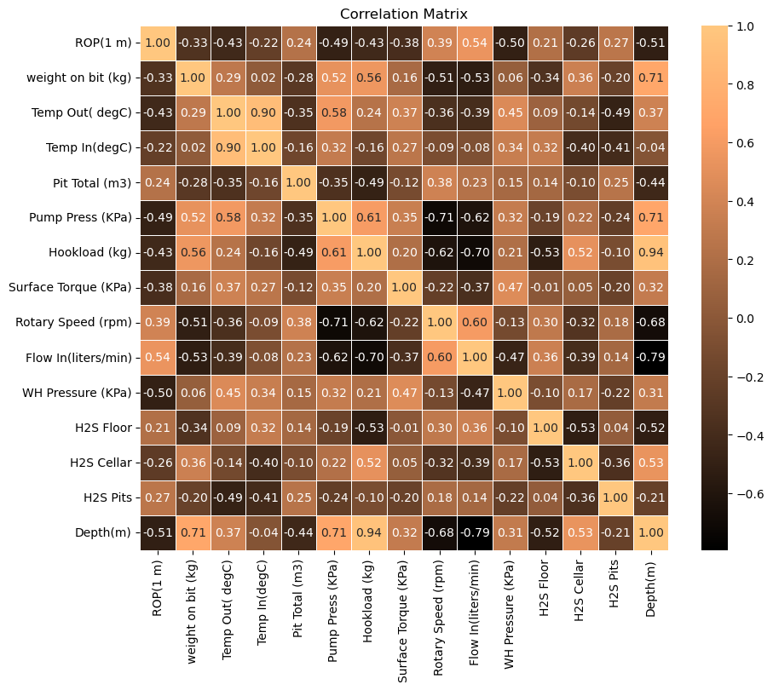
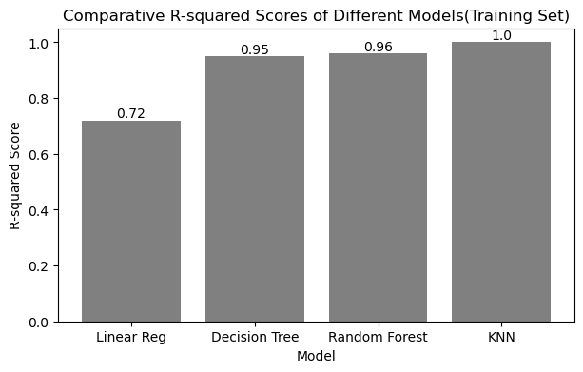
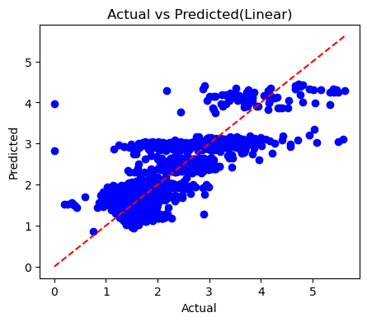
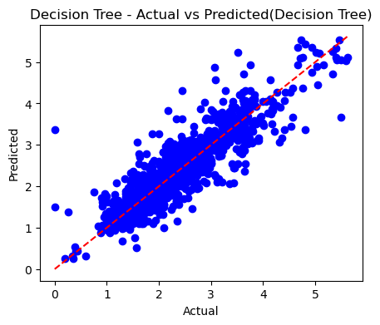
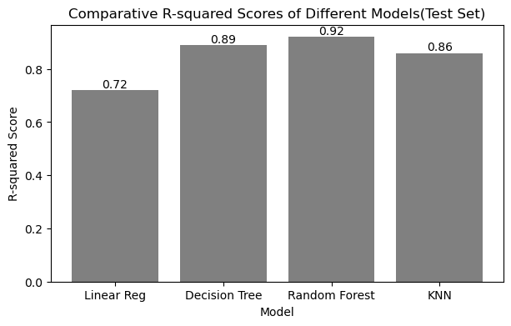
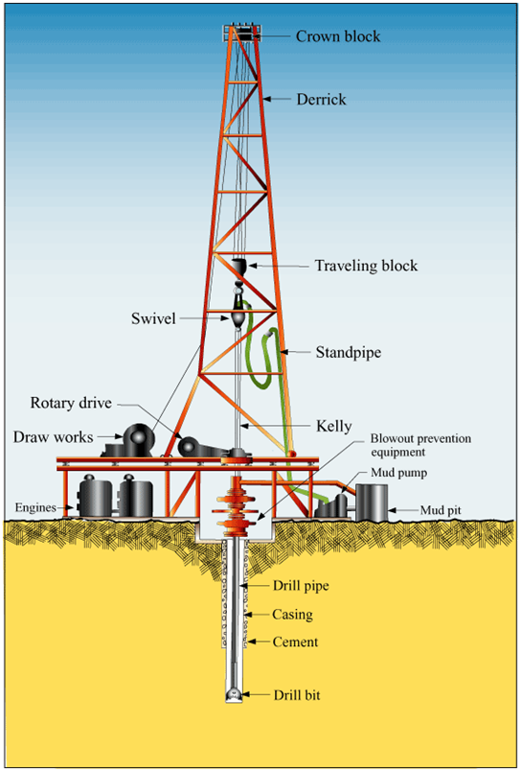
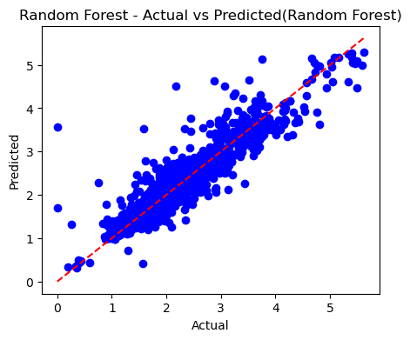
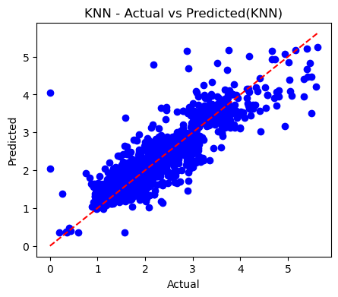
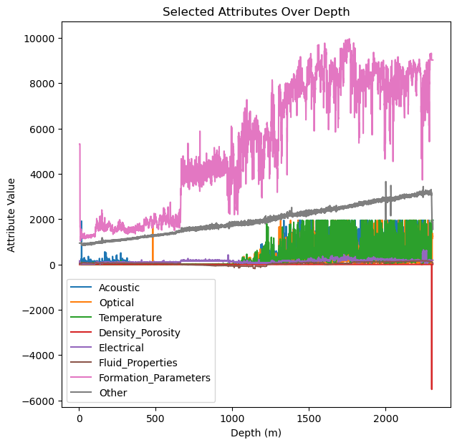
frame.pngframe.png
PIONEERING THE DRILL:
MACHINE LEARNING FOR PREDICTING RATE OF PENETRATION IN DRILLING OPERATIONS
Akash Borigi
University of Houston
aborigi@uh.edu
Rahul Krishna Gunneri
University of Houston
rgunneri@uh.edu
Dvijesh Shastri PhD
University of Houston-Downtown
shastrid@uhd.edu
Kalyan Venugopal PhD
University of Wyoming
kalyan.venugopal@uwyo.edu
ABSTRACT
OBJECTIVE
EVALUATION
RESULTS
In the oil and gas industry, the rate of penetration (ROP) is a critical parameter that directly impacts drilling efficiency and cost-effectiveness. Traditional methods for predicting ROP rely heavily on human expertise and historical data, often leading to suboptimal outcomes due to the complexity and variability of drilling conditions. Leveraging the power of machine learning, this study proposes a novel approach to predict ROP with higher accuracy and reliability. By integrating real-time sensor data, geological information, and drilling parameters, advanced machine learning algorithms such as simple computational and supervised machine learning methods are employed to model the intricate relationships between drilling variables and ROP. Therefore, it revolutionizes drilling operations by optimizing efficiency, reducing costs, and enhancing overall productivity in the oil and gas sector.
"Developing a machine learning model to predict drilling rate of penetration in oil and gas exploration for enhanced operational efficiency."
Model | Training RMSE | Test RMSE
Linear Regression | 0.45 | 0.47
Decision Tree | 0.19 | 0.29
Random Forest | 0.17 | 0.25
KNN | 0.0 | 0.33
METHODS
Domain Knowledge
Work Environment Selection
Data Behavioural Analysis
Pre-Processing
Modelling
Normalization
Transformation
Cross Validation
Prediction
BACKGROUND
Modeling Techniques:
Linear Regression
Decision Tree
Random Forest
K Nearest Neighbor
Normalization:
Min-Max Scaling
Z-Score Standard Scaling
Transformation:
Log
Square Root
Cube Root
Cross Validation:
Considered up to 10 splits for cross-validating the training set.
Integrated the ROP dataset with the geophysical well dataset for modeling and observed the same R-squared value using the Random Forest model due to its high performance in the test set. Included PCA (n-component=1) for data reduction technique while integration for each category.
CONCLUSIONS
"Random Forest outperformed other models with an RMSE of 0.25 and R-squared of 0.92. Future work includes deep learning methods and feature engineering for enhanced accuracy.”
Note: For Datasets and References please view the above provided QR code.
ACKNOWLEDGEMENT
This material is based upon work supported by the National Science Foundation under Grants numbers NSF IIS-2123247. Any opinions, findings, and conclusions or recommendations expressed in this material are those of the authors and do not necessarily reflect the views of the National Science Foundation.

