Slide 1
E-COMMERCE

Slide 2

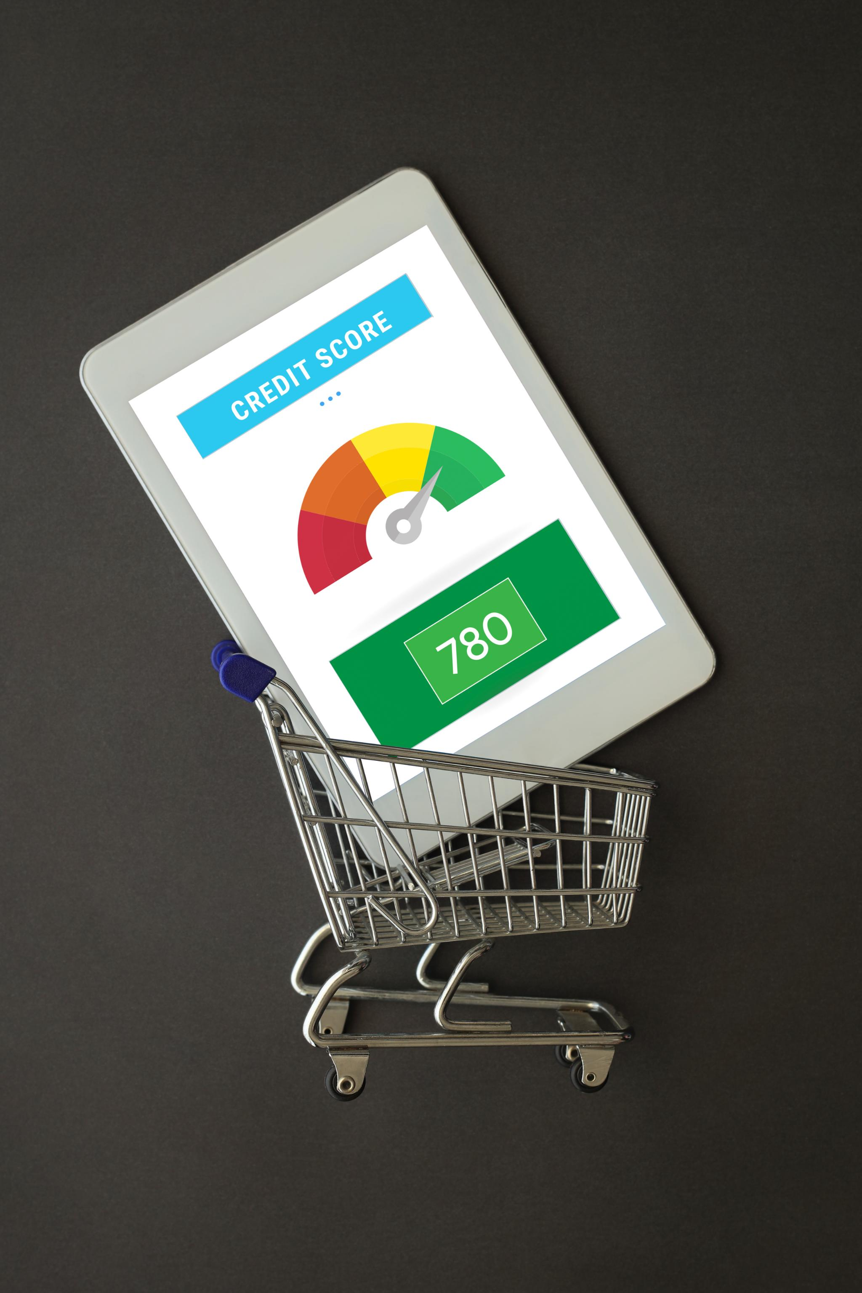
RFM Segmentation Insights
Data Preparation and Analysis
  Python was used for data cleaning and exploratory data analysis, preparing e-commerce transaction data for deeper insights.
Customer Segmentation by RFM
  RFM segmentation classified customers by recency, frequency, and monetary value, revealing distinct purchasing behaviors.
Actionable Business Insights
  Visualizing segment results enables targeted marketing and tailored engagement, optimizing strategies for each customer group.
Notes:
Image source: Microsoft 365 content library
Using Python for data preparation and EDA, we analyzed e-commerce transactions from Dec 2010 to Dec 2011. RFM segmentation (Recency, Frequency, Monetary) grouped customers based on purchase behavior. The results, visualized in Power BI, enable targeted marketing strategies and optimized customer engagement for each segment.

Slide 3

Problem and Objective Overview
Customer Identification Challenge
  Determining which customers to retain, upsell, or re-engage is a complex and ongoing problem for businesses.
Segmentation Model Proposal
  Using RFM and decile segmentation models helps quantify customer value and activity for better decision-making.
Targeted Marketing Recommendations
  By tracking revenue and volume by segment, we can suggest actionable and targeted marketing strategies.
Notes:
Image source: Microsoft 365 content library
Identifying which customers to retain, upsell, or re-engage is challenging. To address this, we propose building RFM and decile segmentation models to quantify customer value and activity. By tracking revenue and volume over time by segment, we aim to deliver actionable marketing recommendations for more targeted strategies.

Slide 4

Data Cleaning in Python
Essential Transaction Fields
  Key columns like InvoiceDate, CustomerID, Quantity, and UnitPrice are vital for data analysis and business insights.
Cleaning and Standardization
  Filled missing text, standardized IDs, and managed returns or cancellations to ensure consistent and reliable data quality.
Calculations and Quality Control
  Calculated total sales, converted date formats, and removed duplicates or outliers for high-quality analytics results.
Notes:
Image source: Microsoft 365 content library
Processed ~540K transactions with essential fields like InvoiceDate, CustomerID, Quantity, and UnitPrice. Cleaned data by filling text gaps, standardizing IDs, and handling returns or cancellations. Calculated TotalSales as Quantity × UnitPrice (rounded to two decimals), converted date formats, and removed duplicates or outliers for quality analysis.

Slide 5
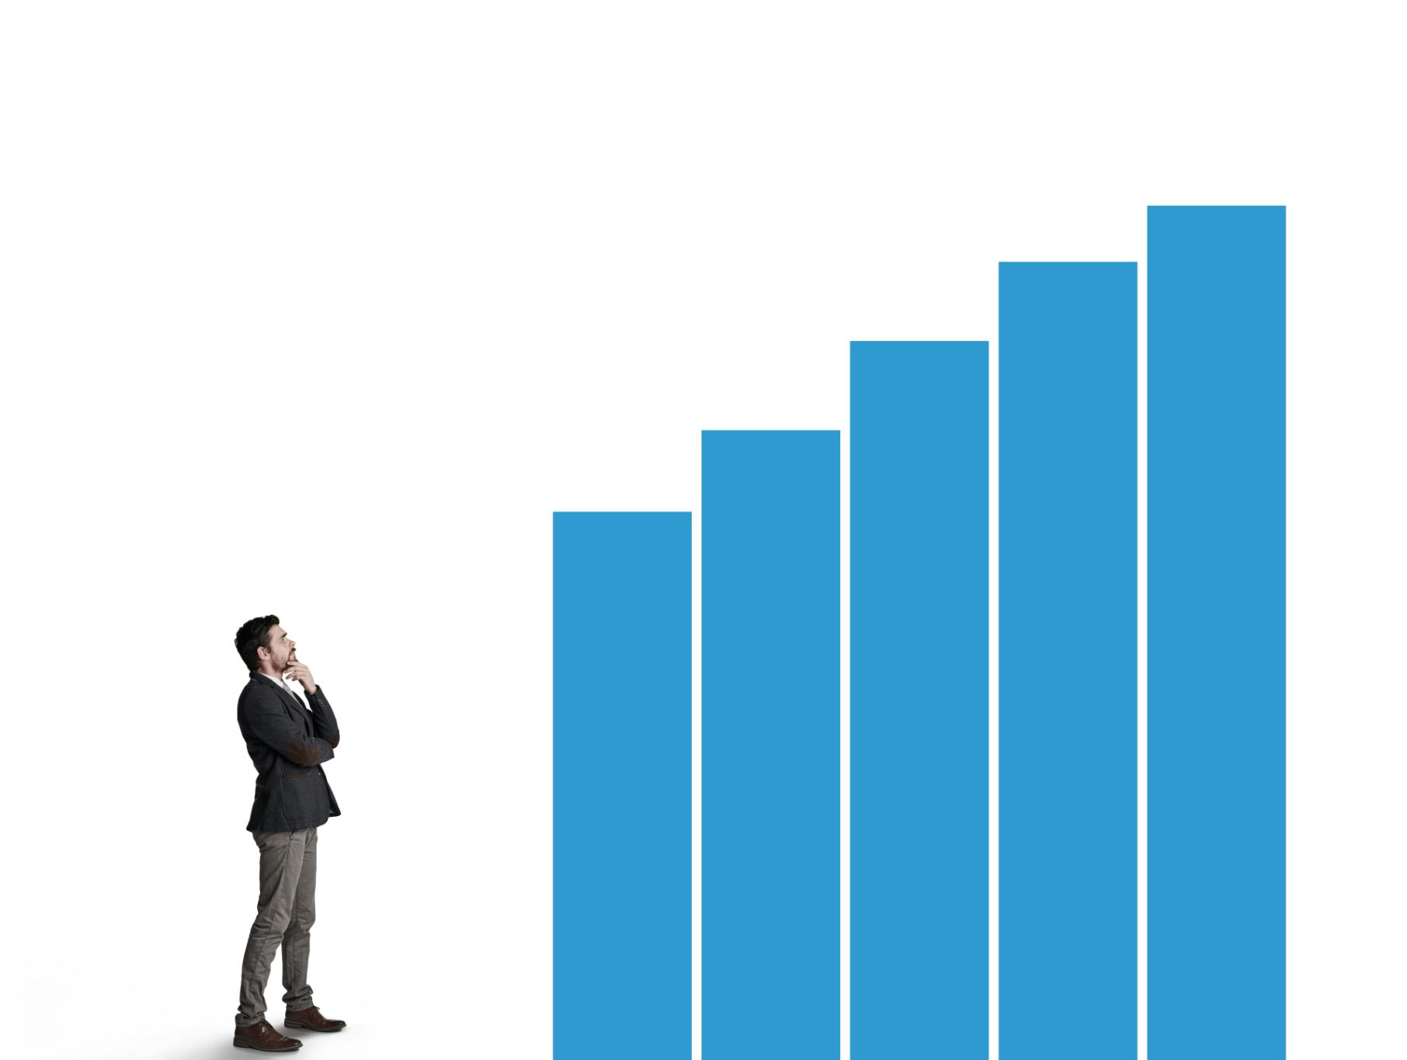
Key EDA Insights in Python
Seasonal Sales Patterns
  Sales peak at year-end and dip mid-year, highlighting a strong seasonality in purchasing behavior.
Weekday Sales Trends
  Sales are stronger mid-week than on weekends, revealing a clear weekday pattern in consumer activity.
Market Concentration
  A few countries account for the majority of total sales, showing significant market concentration.
Diverse Basket Values
  Average basket value varies by month and customer segment, suggesting differences in purchasing behavior.
Notes:
Image source: Microsoft 365 content library
Exploratory Data Analysis reveals a significant year-end sales lift and a noticeable dip mid-year, indicating seasonality. Sales are stronger mid-week compared to weekends, showing a distinct weekday pattern. A few countries dominate total sales, highlighting market concentration. Additionally, average basket values differ by month and customer segment, suggesting varied purchasing behaviors.

Slide 6

RFM & Deciling Method
RFM Scoring Explained
Customers are scored on recency, frequency, and monetary value to assess their engagement and value to the business.
RFM Segment Usage
Combined RFM scores create segments, enabling targeted marketing campaigns to reach specific customer groups effectively.
Deciling for Actionable Insights
Deciling sorts customers into ten groups, providing clear, actionable divisions for comparison and strategic marketing.
Notes:
Image source: Microsoft 365 content library
RFM analyzes customer value by scoring Recency (days since last purchase), Frequency (order count), and Monetary (total spend) from 1 to 5. These scores are combined into an RFM_Segment for campaign targeting. Deciling sorts customers into ten groups, enabling simple, interpretable comparisons and actionable marketing segmentations.

Slide 7
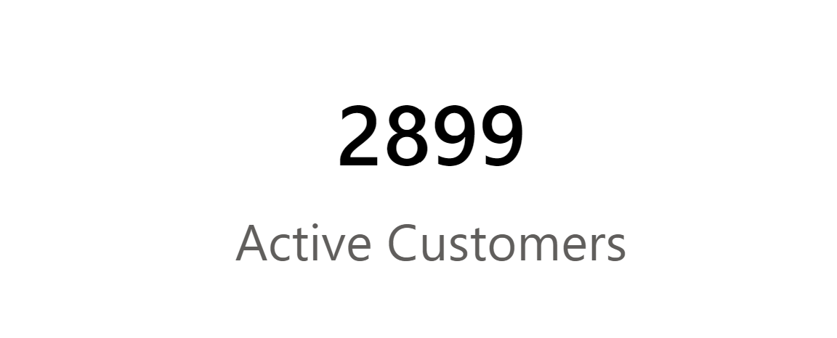

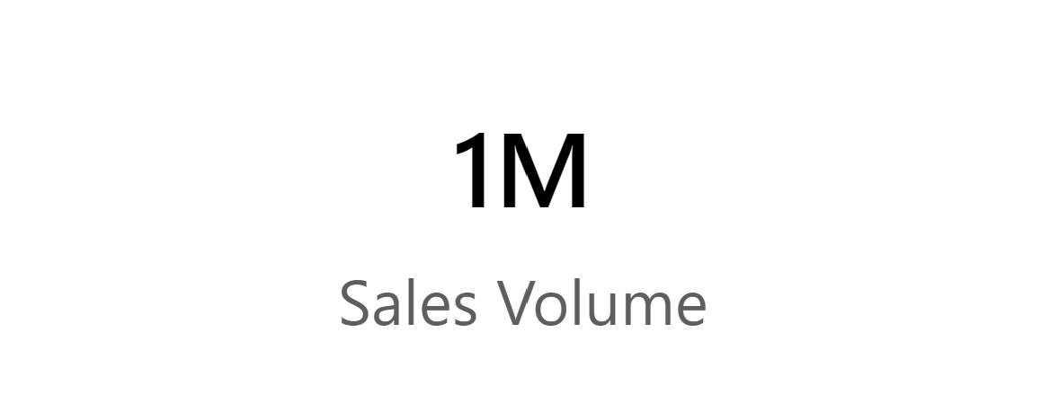
KPI Summary
Interactive KPI Analytics
Active Customer Base
Revenue and Sales Volume
There are approximately 2,899 active customers, indicating a robust and engaged user base.
Total Revenue has reached $2.15M, driven by sales of about 1.0M units.
Power BI slicers for Month and Country enable dynamic updates for all KPIs and visuals, supporting data-driven insights.

Slide 8
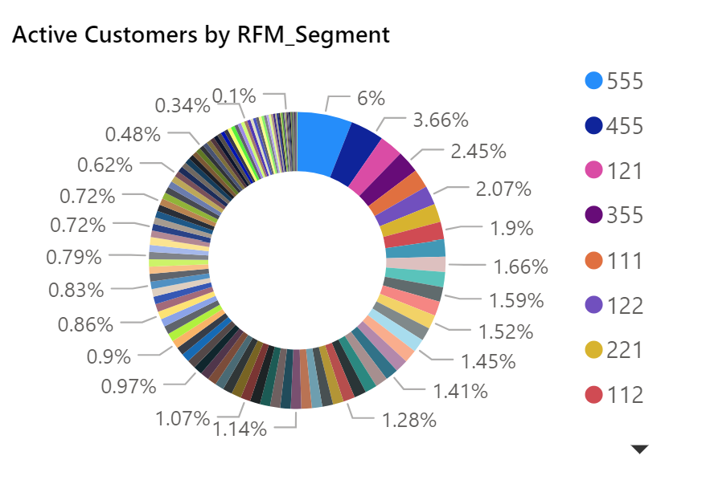
Segmentation Snapshot Insights
Loyal and High-Value Customers
  A small group of loyal and high-value customers contributes a significant portion of total company revenue, highlighting their importance.
Opportunities in At-Risk Segments
  At-risk and dormant segments offer growth potential through targeted reactivation strategies and personalized engagement.
R×F Matrix Analysis Overview
  Approximately 2,854 customers are scored using the R×F matrix, providing a structured segmentation of the active customer base.
Notes:
Image source: Microsoft 365 content library
Loyal and high-value customer segments contribute a disproportionately large share of total revenue. At-risk and dormant segments present opportunities for reactivation and growth. The R×F matrix analysis scores approximately 2,854 customers, and a donut chart visualizes the current mix of segments within the active customer base.

Slide 9
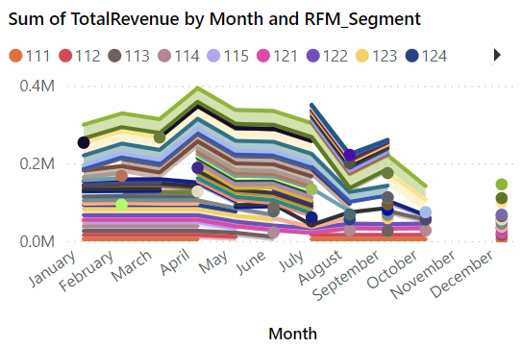
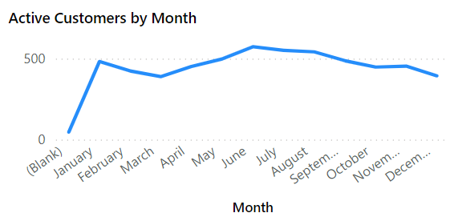
Unpacking Revenue Trends
Stacked area chart - segment contributions across months
Line chart - Active customers trend peaking mid-year
Notes:
Image source: Microsoft 365 content library
Revenue drivers are visualized by stacking segment contributions across months, highlighting how each segment impacts overall performance. Active customer trends show a noticeable mid-year peak, indicating seasonal activity. A totals table compares revenue and quantity as a sanity check, while slicers help uncover patterns specific to different countries.

Slide 10
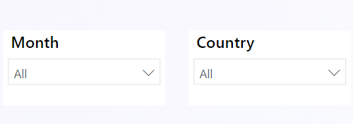
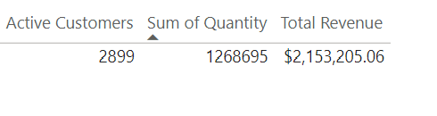
Totals table: Revenue vs. Quantity sanity check
Slicers chart: country-specific patterns

Slide 11

Unlocking Revenue Opportunities
Focus on High-Value Customers
  The top customer deciles drive most revenue, making it crucial to prioritize high-value segments for growth.
Retention Maximizes Lifetime Value
  Retention strategies should target loyal customers to boost engagement and optimize long-term revenue streams.
Win-Back At-Risk and Dormant Customers
  A large segment of at-risk and dormant customers can be reactivated with win-back initiatives, especially with seasonal offers.
Notes:
Image source: Microsoft 365 content library
The Pareto effect reveals that the top deciles generate most of the revenue, highlighting the importance of high-value customers. Retention efforts should target loyal segments to maximize engagement and lifetime value. Additionally, a significant at-risk and dormant customer pool exists, with win-back campaigns and seasonal timing offering strong potential for revenue uplift.

Slide 12
Effective Customer Retention Strategies
Tiered Loyalty Programs
  Tiered loyalty programs and VIP services provide exclusive perks, such as early-access drops, boosting customer retention and satisfaction.
Upselling and Cross-Selling
  Upselling and cross-selling to mid-tier customers with curated bundles and personalized recommendations increase engagement and average order value.
Re-Engagement Campaigns
  Re-engage inactive customers through win-back journeys and A/B tested offers to identify and deliver the most effective incentives.
Notes:
Image source: Microsoft 365 content library
Implement tiered loyalty programs and VIP services to enhance retention, offering perks like early-access drops. Upsell and cross-sell to mid-tier customers using curated bundles and look-alike product recommendations. Re-engage inactive customers through personalized win-back journeys, utilizing A/B tested offers to determine the most effective incentives.

