Slide 1
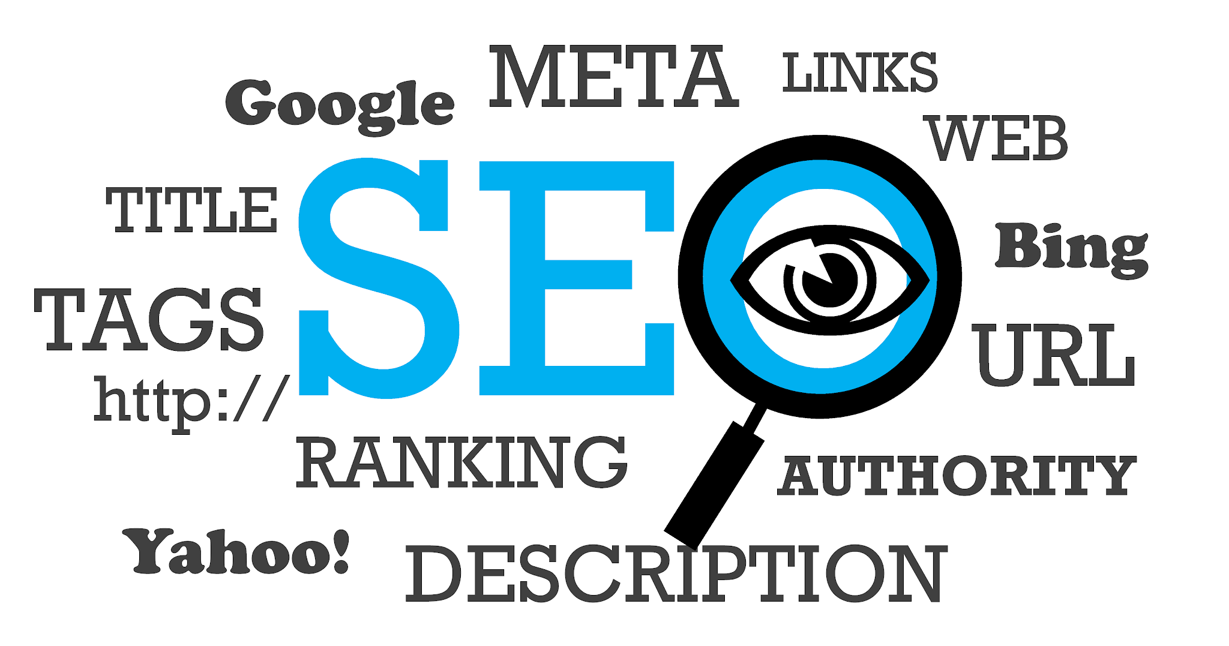

Slide 2

TEAM BUDDIES:
Documentation
Vedita, Preeth & Navya
Back End Developer
Vaishnavi & Akash
Project Manager
Akash
Front End Developer
Mourya, Vedita & Nikhil
Algorithm
Vaishnavi & Keshav

Slide 3

Introduction:
In the fast-evolving digital ecosystem, Search Engine Optimization (SEO) stands as the cornerstone of online success.
Our mission is to embark on a coding odyssey, crafting the "SEO Keyword Tracker and Analyzer," a dynamic tool geared towards both tracking and meticulously analyzing SEO keywords for a specific website.

Slide 4
ABSTRACT:
Utilizes Rabin Karp, Suffix Tree, Suffix Array, Naive String matching, Kmp Algorithm for search engine optimization.

Slide 5

Project Development Steps:
Keyword Selection.
Data Gathering.
Data Preprocessing.
Algorithm Integration.
API Development.

Slide 6

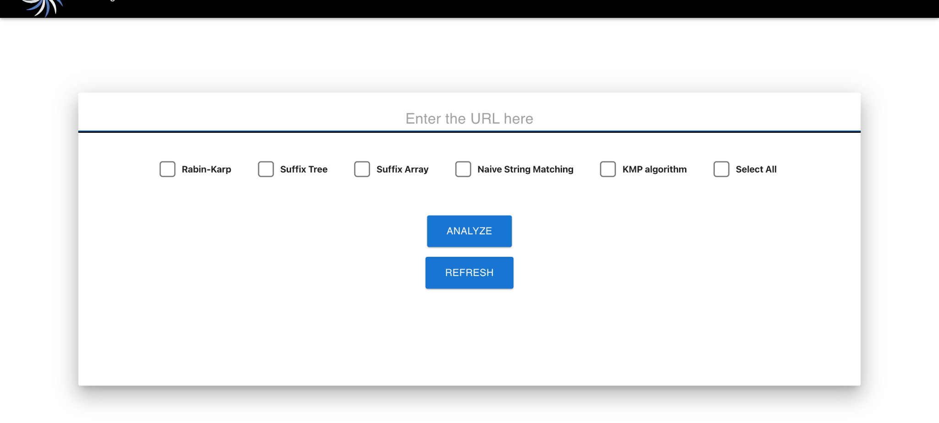
DEMO

Slide 7
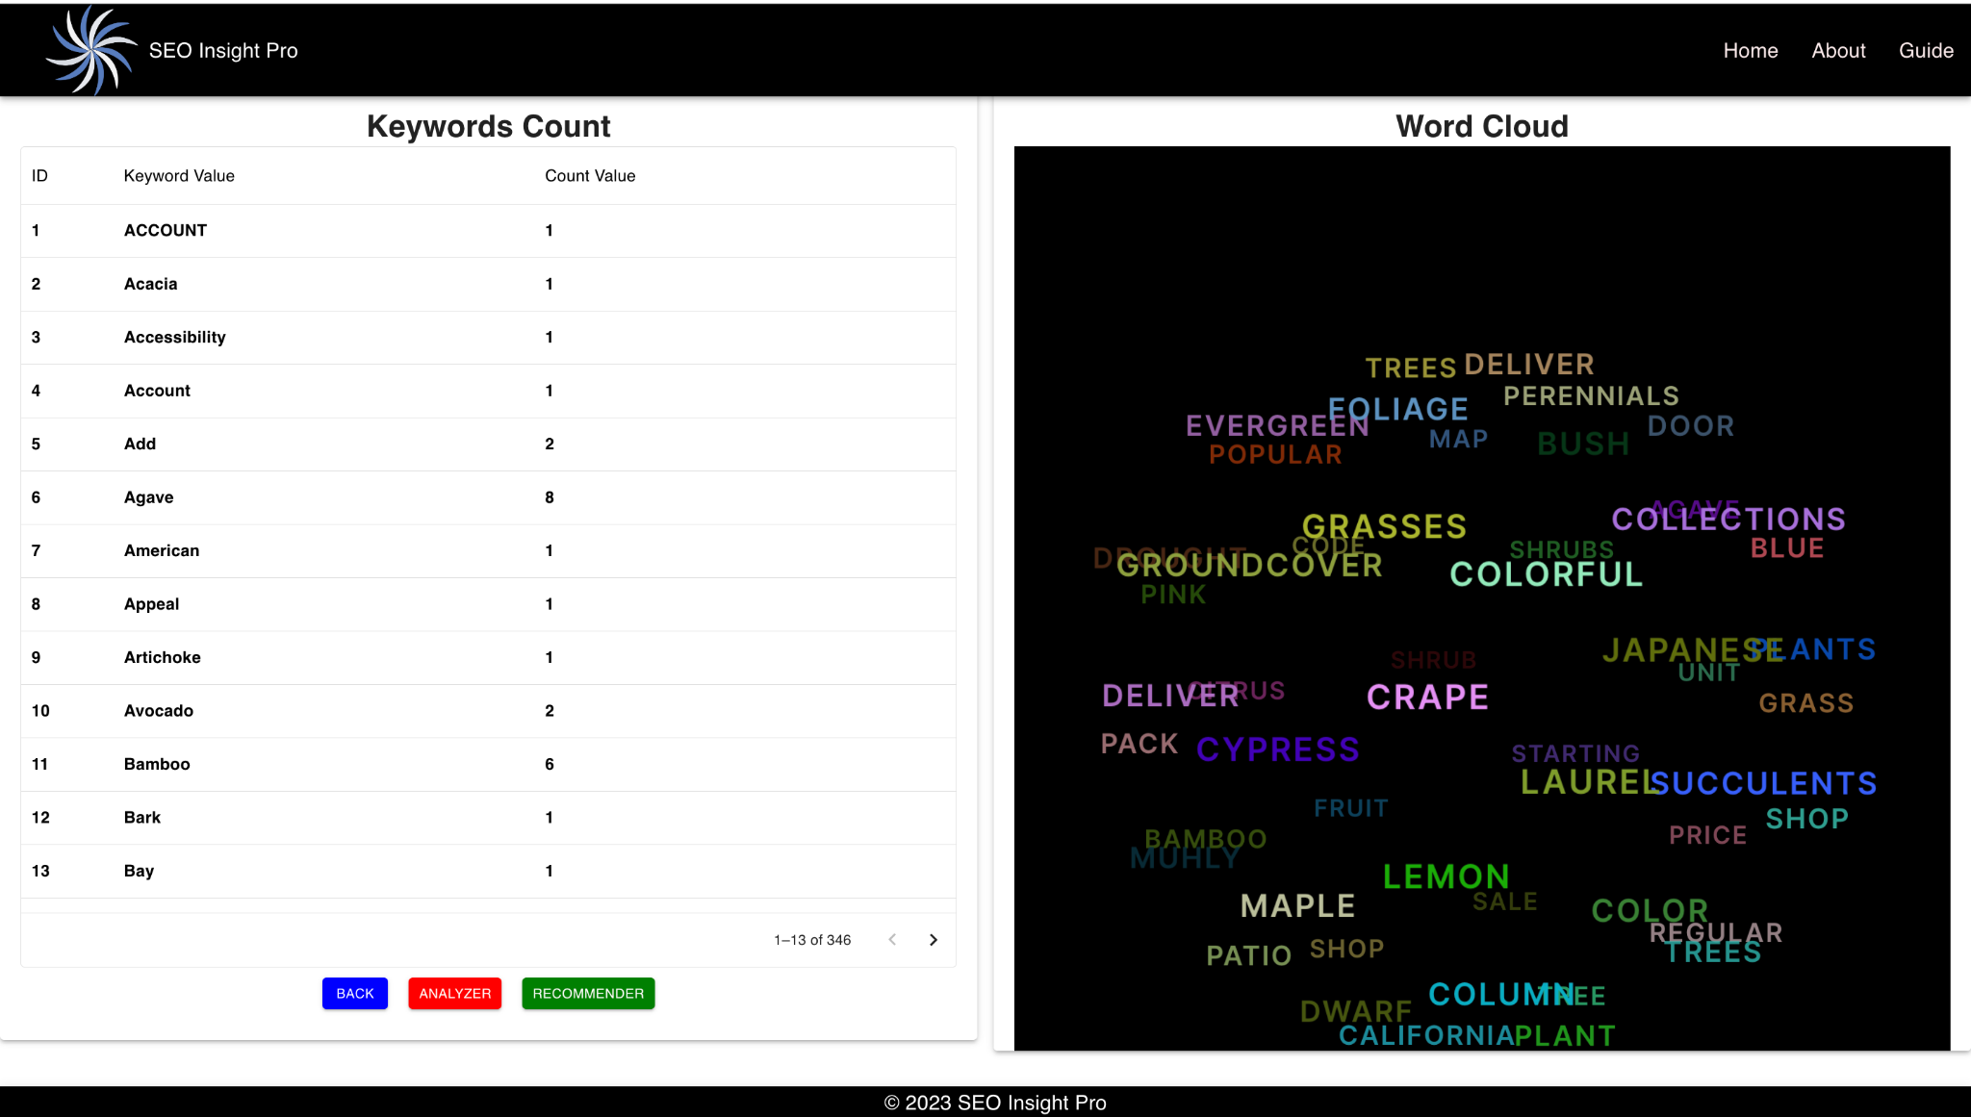

Slide 8

THANK YOU

