Slide 1
E-Commerce Analysis
Akash Avinash Butala
Abhishek Nagesh Shinde

Slide 2
Outline
Why E-commerce Analysis?
Benefits of E-commerce Analysis
The Dataset
Approach
Implementation till now
Foresight

Slide 3
Why E-commerce Analysis?
Technology is evolving rapidly and shopping trends shift on a daily basis, e-commerce is in a constant state of adaptation that can leave businesses blundering in the dark. To keep up with ecommerce trends, businesses must anticipate changes in the market using reliable data insights. In short, they need effective ecommerce analysis.
Ecommerce analysis simply refers to a strategy designed to analyze large amounts of data in order to produce meaningful insights. It helps to measure user behavior, performance trends, and ROI.
According to survey done by the Salesforce, more data was created in 2017 than was created during the previous 5,000 years combined.
With so much of data to measure, parse, and analyse. Performing premier analysis, however, can offer your brand an immeasurable advantage over the competition.

Slide 4

Benefits of E-commerce Analysis?
helps to get to know your customers better.
helps to optimize pricing of the products
helps to forecast inventory for the next season.
helps to provide recommendations based on customer likings.
helps businesses to boost the sales.

Slide 5

The Dataset
eCommerce behavior data from multi category store (kaggle)
The file contains behaviour data from a large multi-category online store(from October 2019 to April 2020)
Size of Data is 5gb (this is only one month of the dataset that we have used).

Slide 6




Approach
Processing Tool - “Apache Spark”.
Why PySpark Library?
Apache Spark vs Hadoop Map-Reduce.
Data Storage - “AWS S3 (Simple Storage Service)”
What is AWS S3?
Clustering - AWS EMR (equivalent to HDFS)
What is AWS EMR(Elastic Map-Reduce)?
Data Visualisation - “Tableau”

Slide 7

Architecture

Slide 8
Things done till now
Procedure 1:
Analyzed the dataset.
Cleaned the data.
Extracted small amount of data and tried processing on local machine to get an idea about the analysis.
Further tried processing large data.(Got an error).

Slide 9
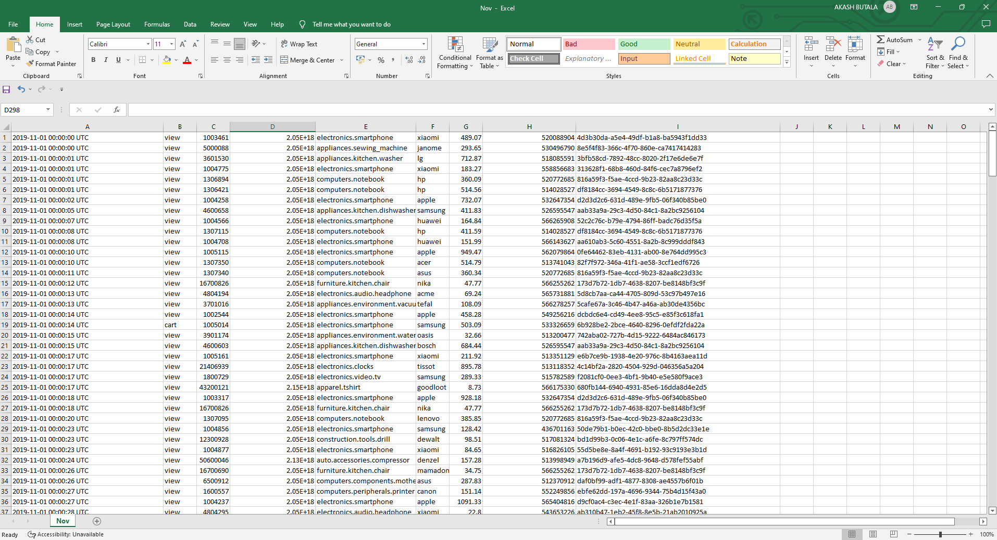

Slide 10
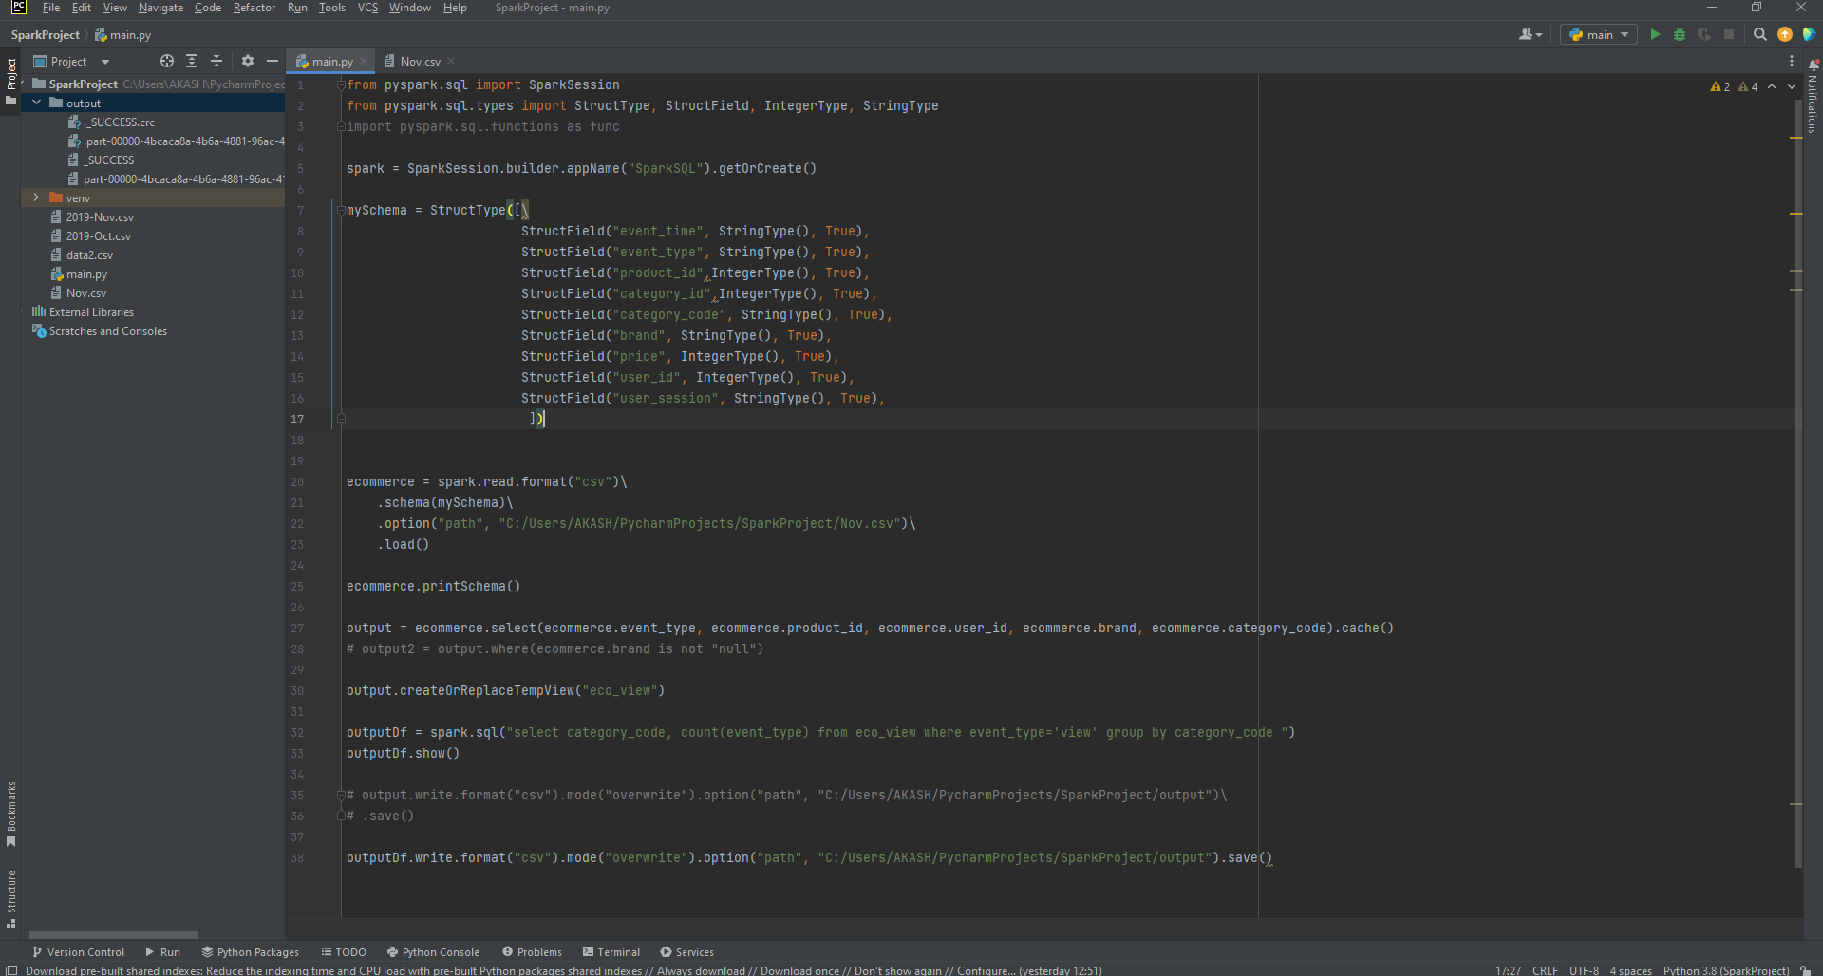

Slide 11
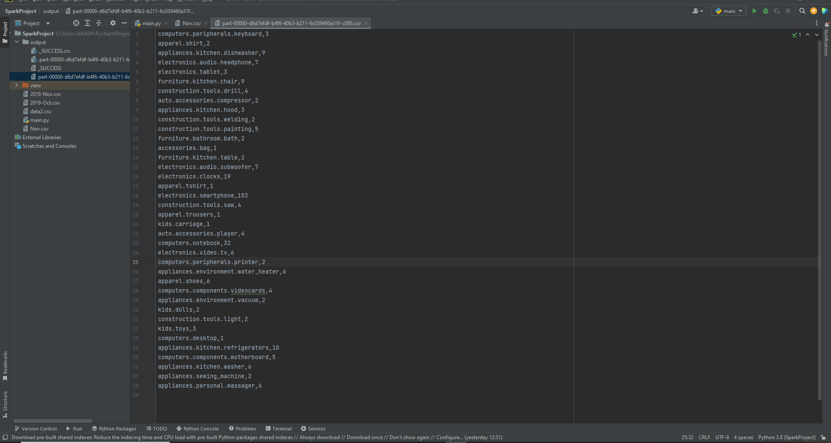

Slide 12
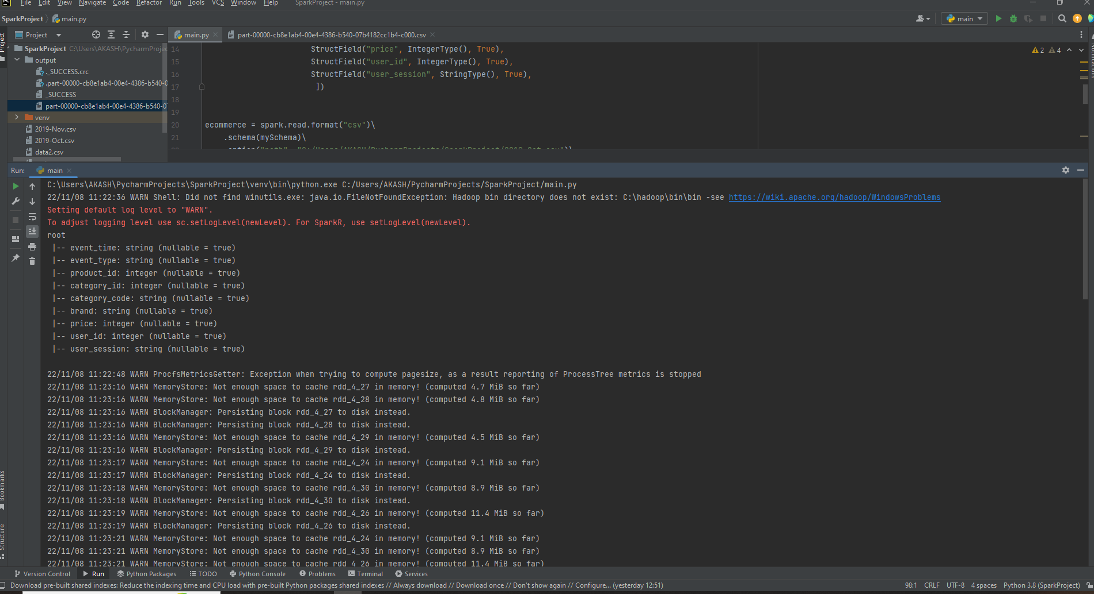

Slide 13
Procedure 2:
Moved the data on AWS S3 storage.
Configured EMR(Elastic Map-Reduce) with (1 Master 2 Cores)
Connected to master server with the help of putty.
Used Spark for processing the data.
Got the output which was then used for data analysis and visualisation.

Slide 14
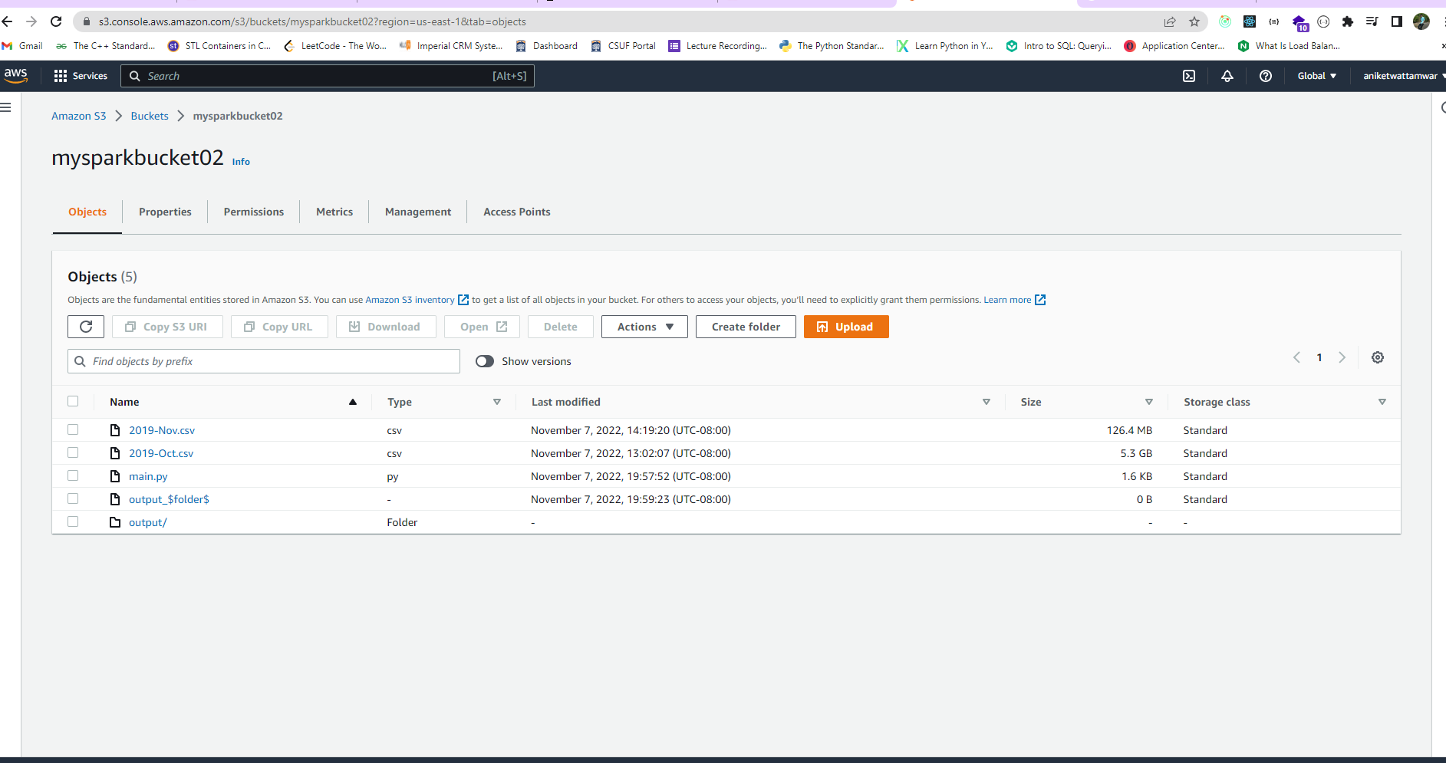

Slide 15
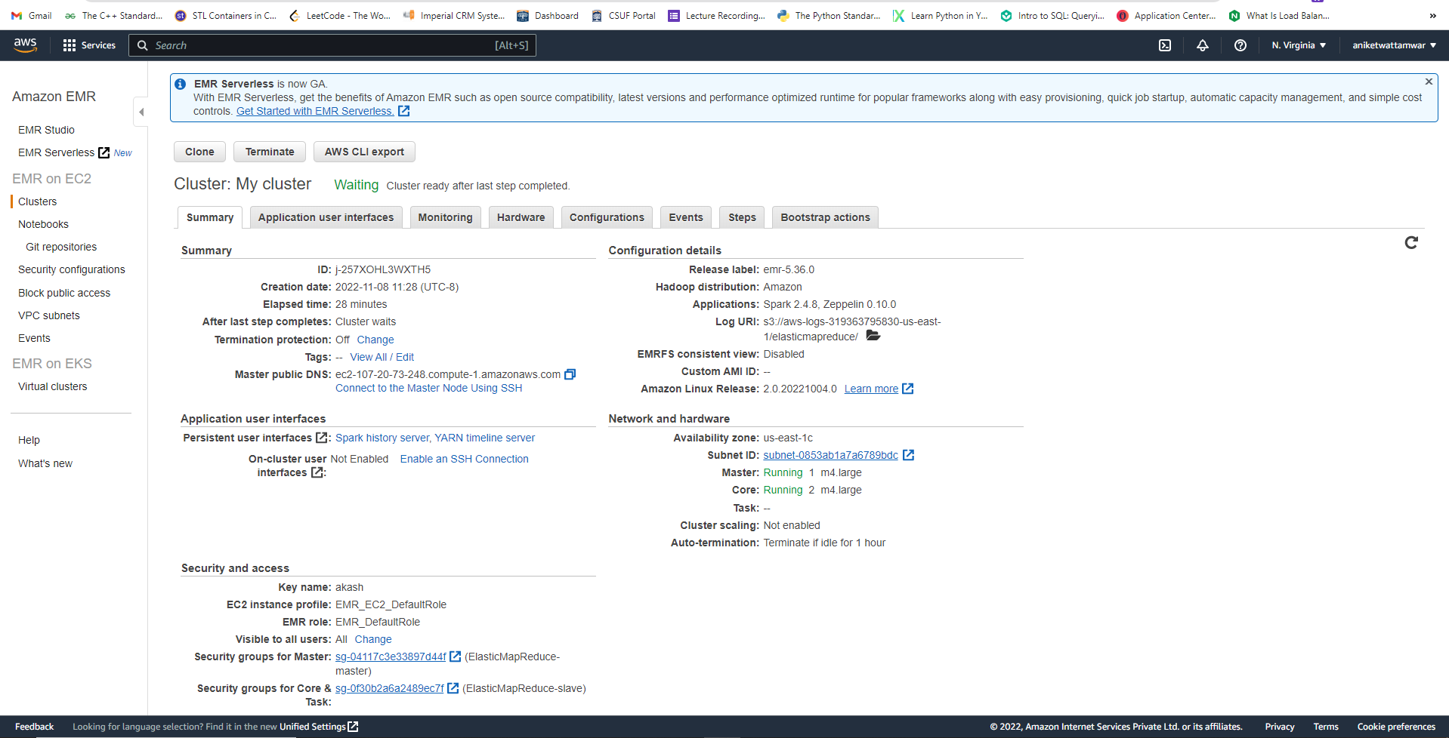

Slide 16
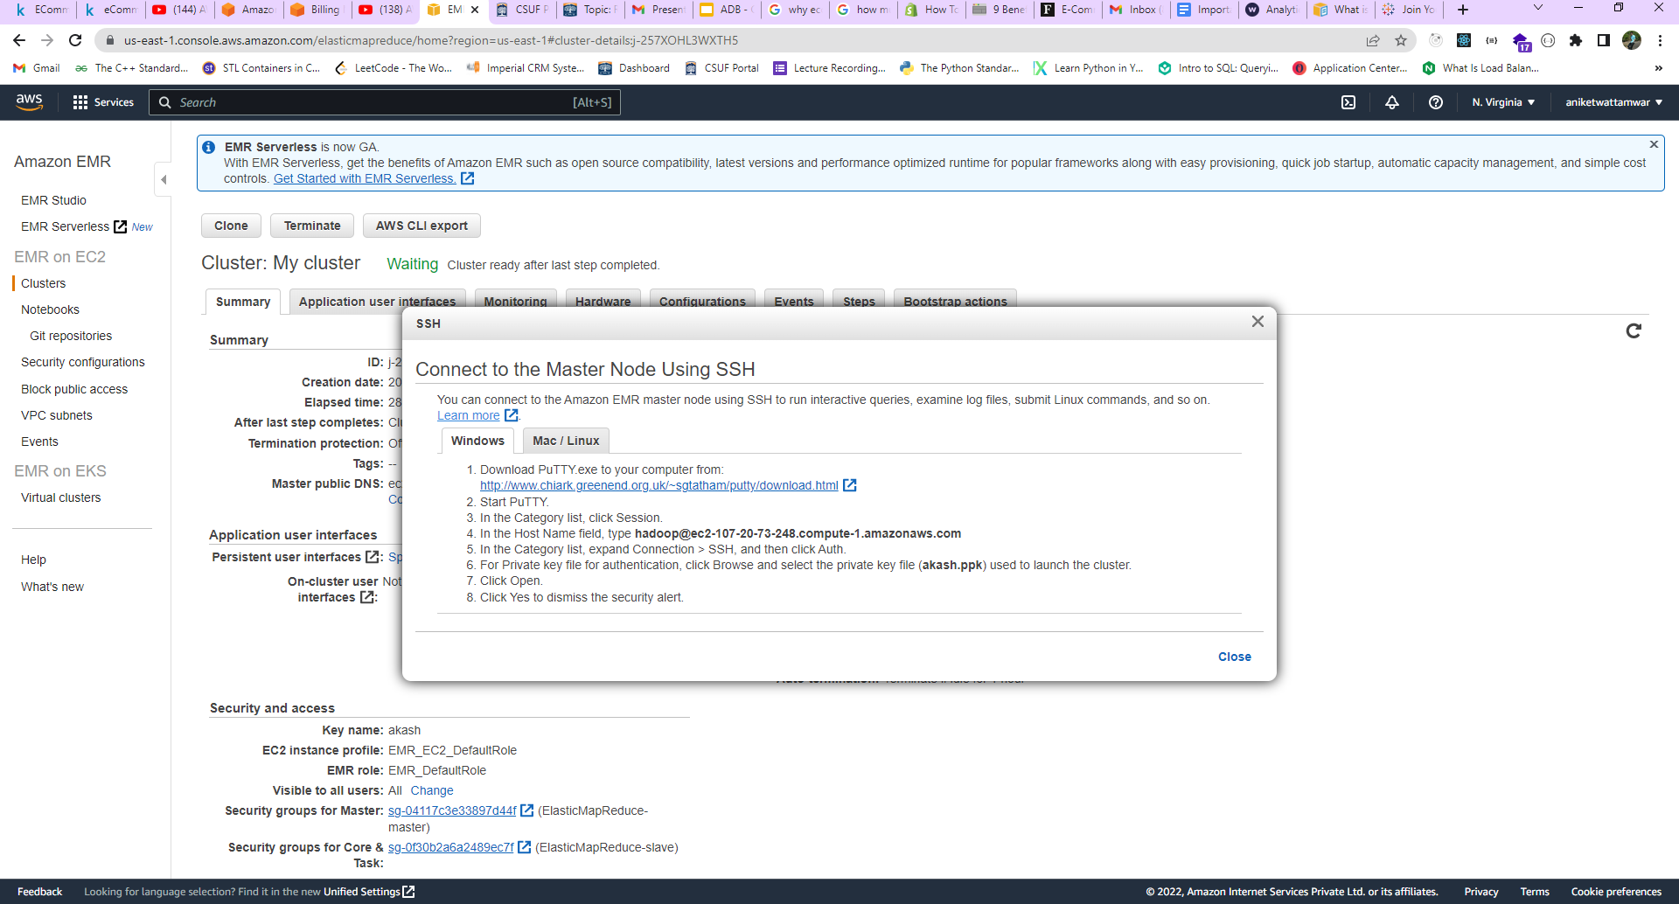

Slide 17
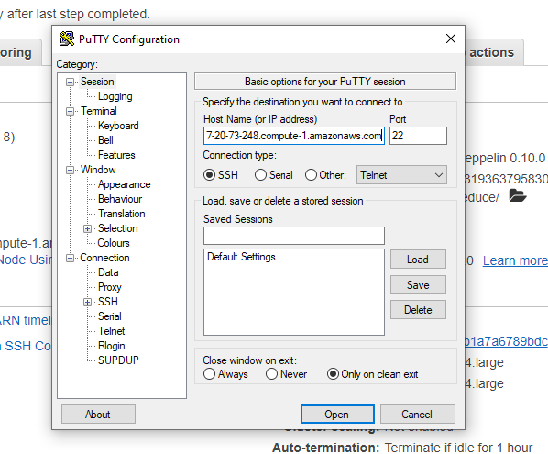

Slide 18
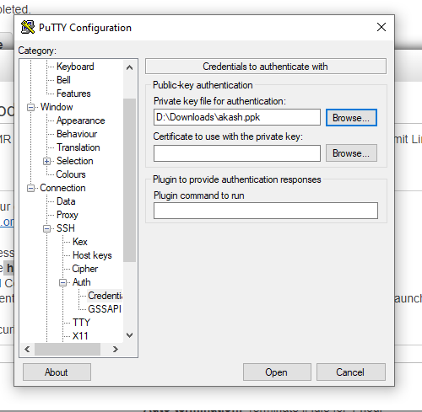

Slide 19
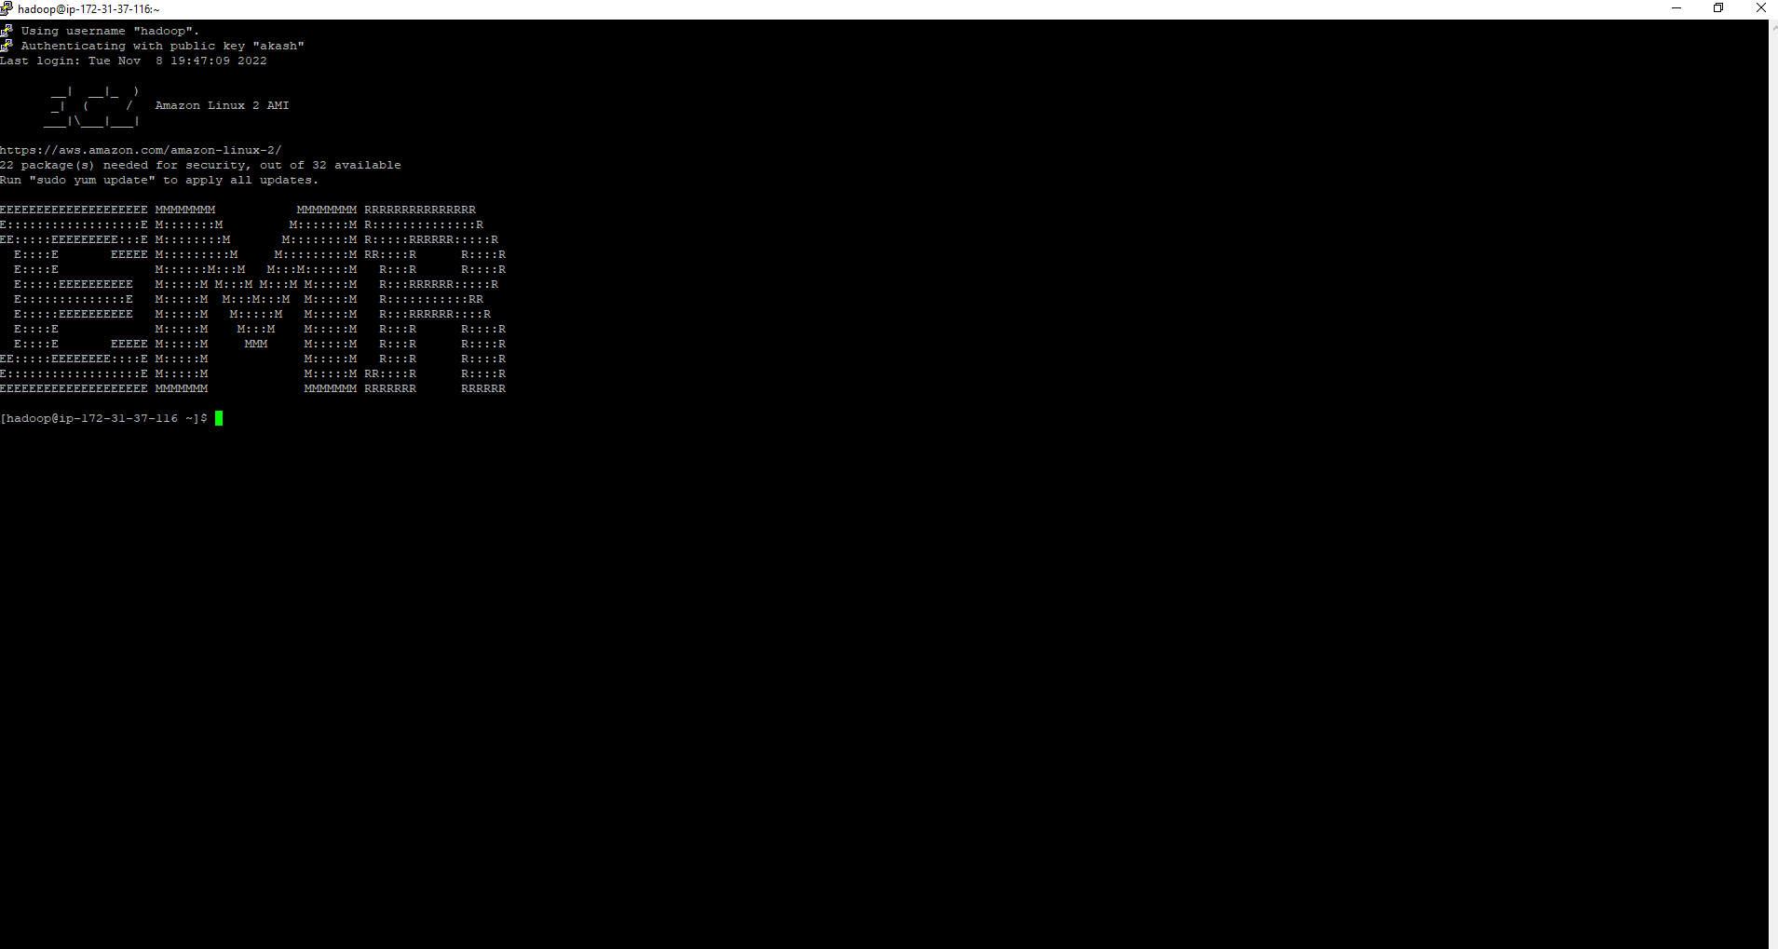

Slide 20
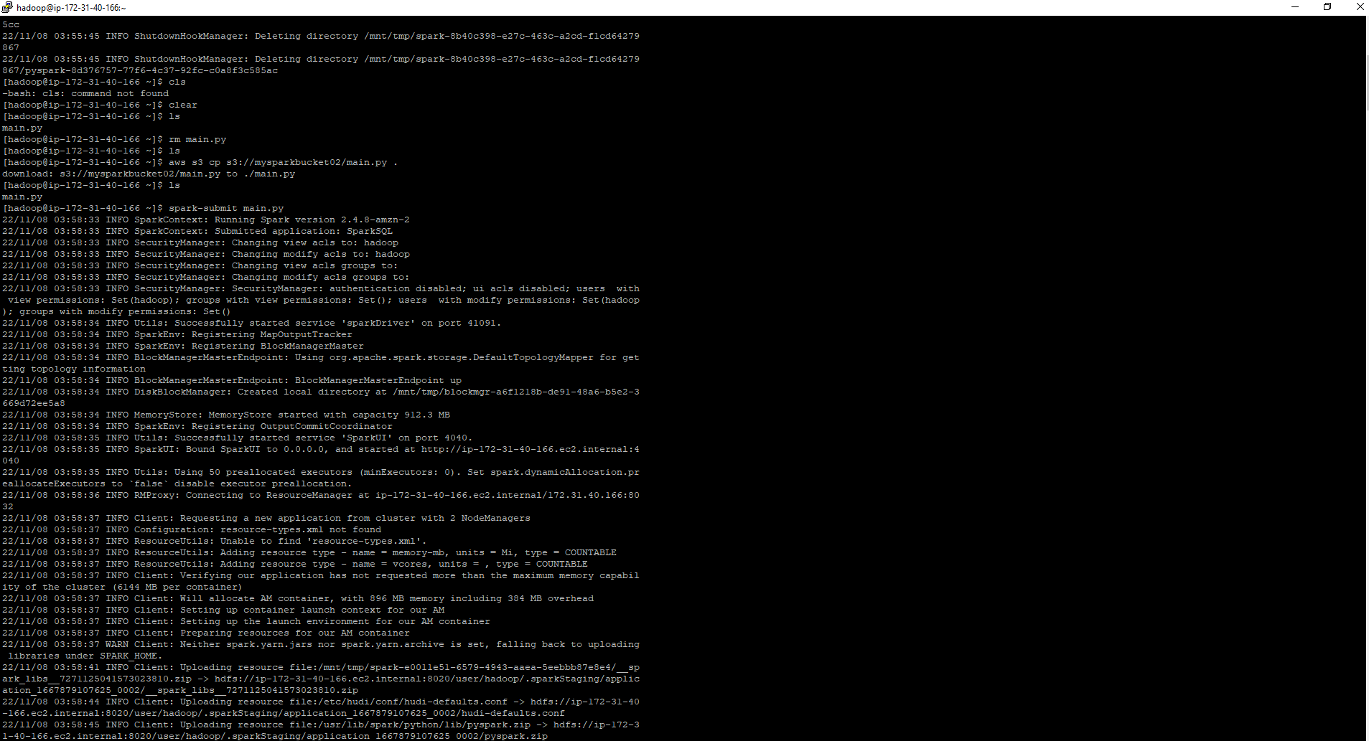

Slide 21
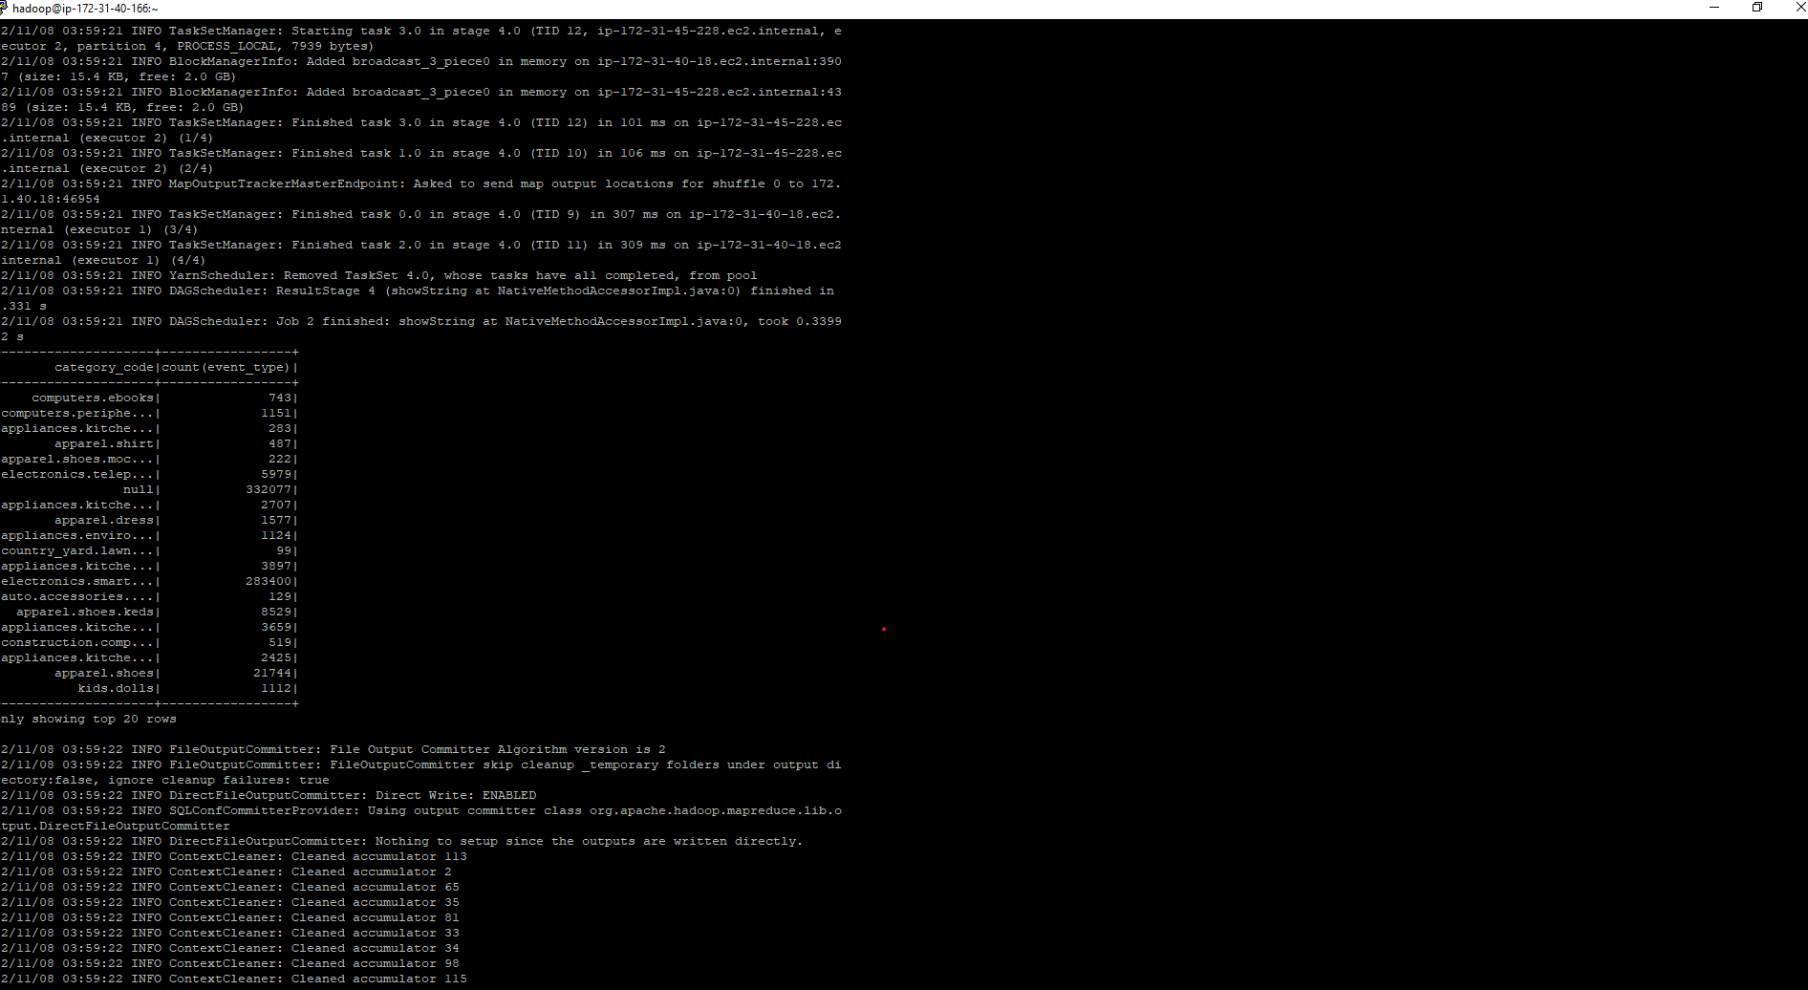

Slide 22
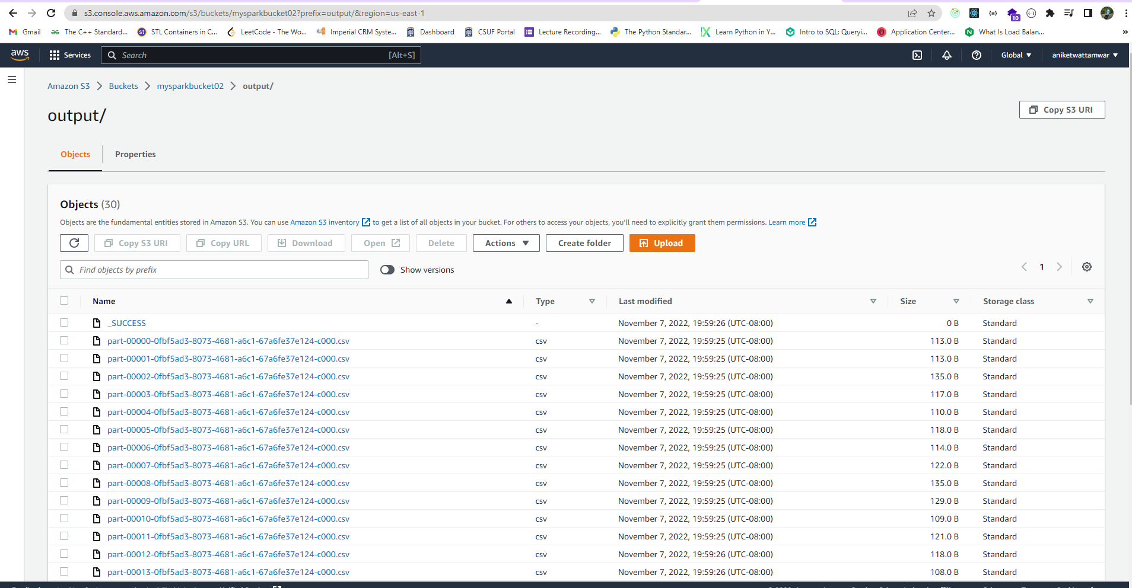

Slide 23
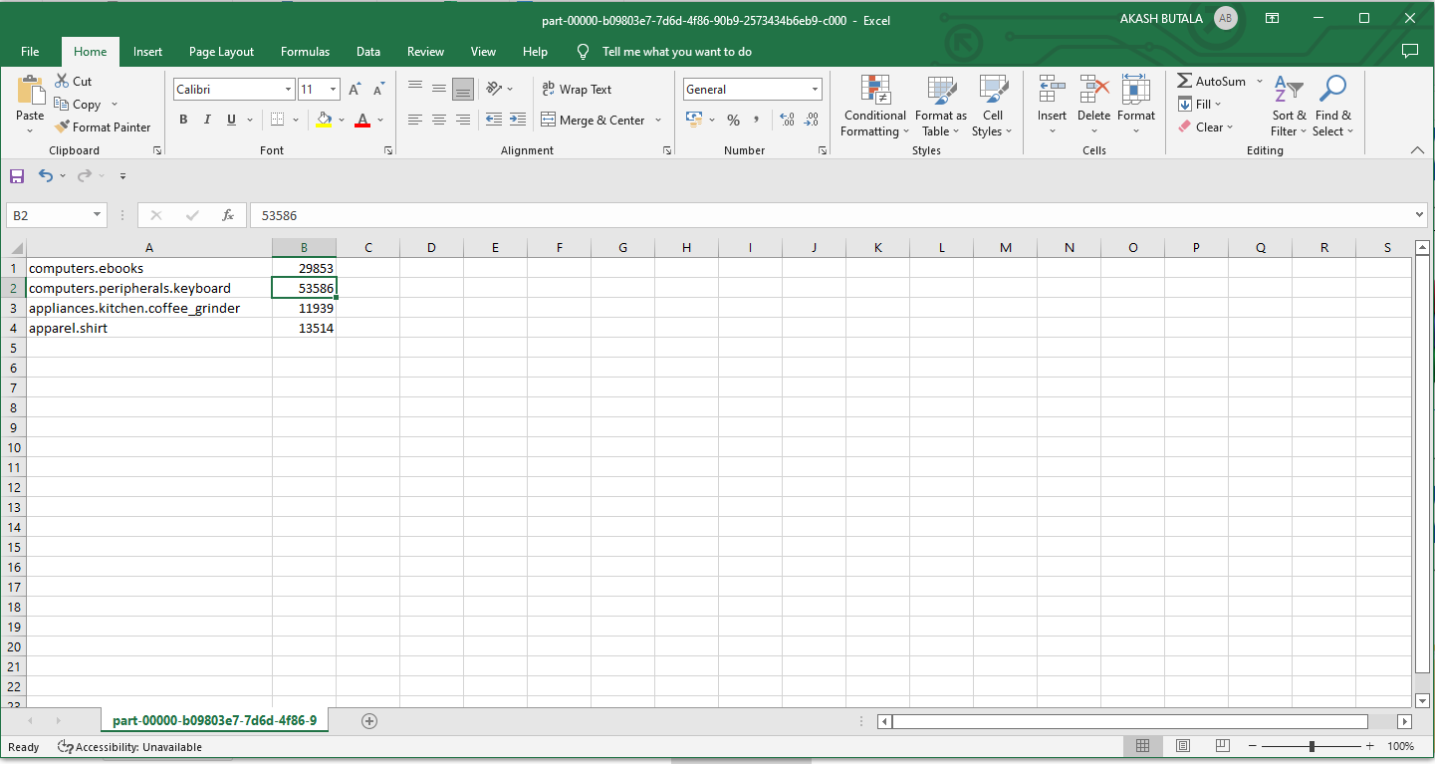

Slide 24
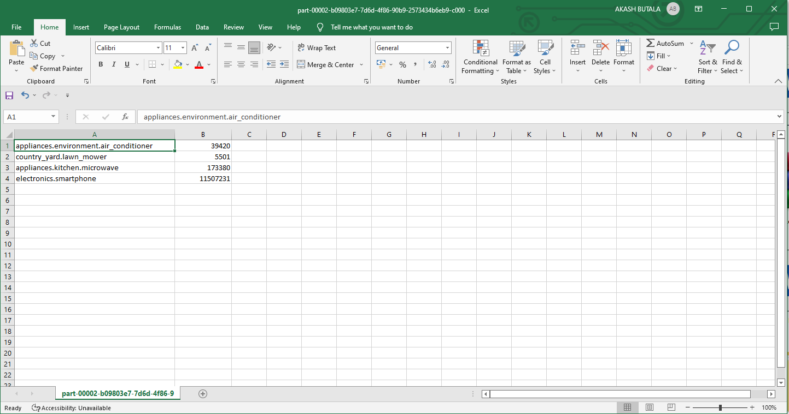

Slide 25
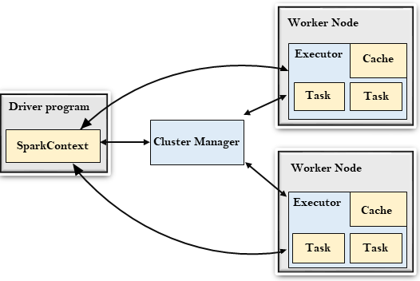
Spark Architecture

Slide 26
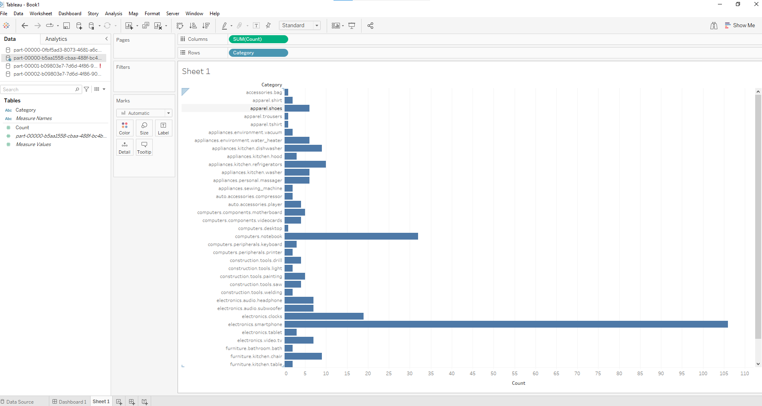

Slide 27
Foresight
We need to see how can we manage the number of partition being done.
Try out different data analysis and see how can we extract best insights.
Also, need to think about how we can join different part files in one to do the visualization and analysis.
Currently we have used only one month of data, we will see how we can better manage the data when working with 6 months of data.
If possible we are also thinking of expanding the scope of project by doing predictive analysis using Machine Learning models.

Slide 28
Thankyou

