Slide 1
GP Surrogate + Decision Loop
for COMSOL-Driven Stent Optimization
Current Goal: Defensible methods + efficient simulation allocation

Slide 2
What's Already Solid (Engineering Side)
Design params
CAD gen
COMSOL CFD
Metric extraction
✓ This part is working. Benchtop testing (6 commercial stents) + sim pipeline complete.
Decisions begin after metrics → GP fit → acquisition loop
This is where I want your expertise.

Slide 3
Full Pipeline Overview
14 params
design vec
Validity filter
3× oversample
COMSOL
CFD sim
Metrics y
ΔP, flow
GP fit
mean + σ
Acquire
EI/UCB
← Iterate until budget exhausted →
COMSOL Outputs (y):
• ΔP (pressure drop)
• Q_out (total flow)
• Q_SH (side-hole fluxes)
• WSS (future)
Sampling Strategy:
• 11 direct + 3 fractions = 14 params
• Derive: OD, ID, wall, hole_dia
• oversample_factor = 3
• Initial LHS: 60 pts (5×dim)

Slide 4
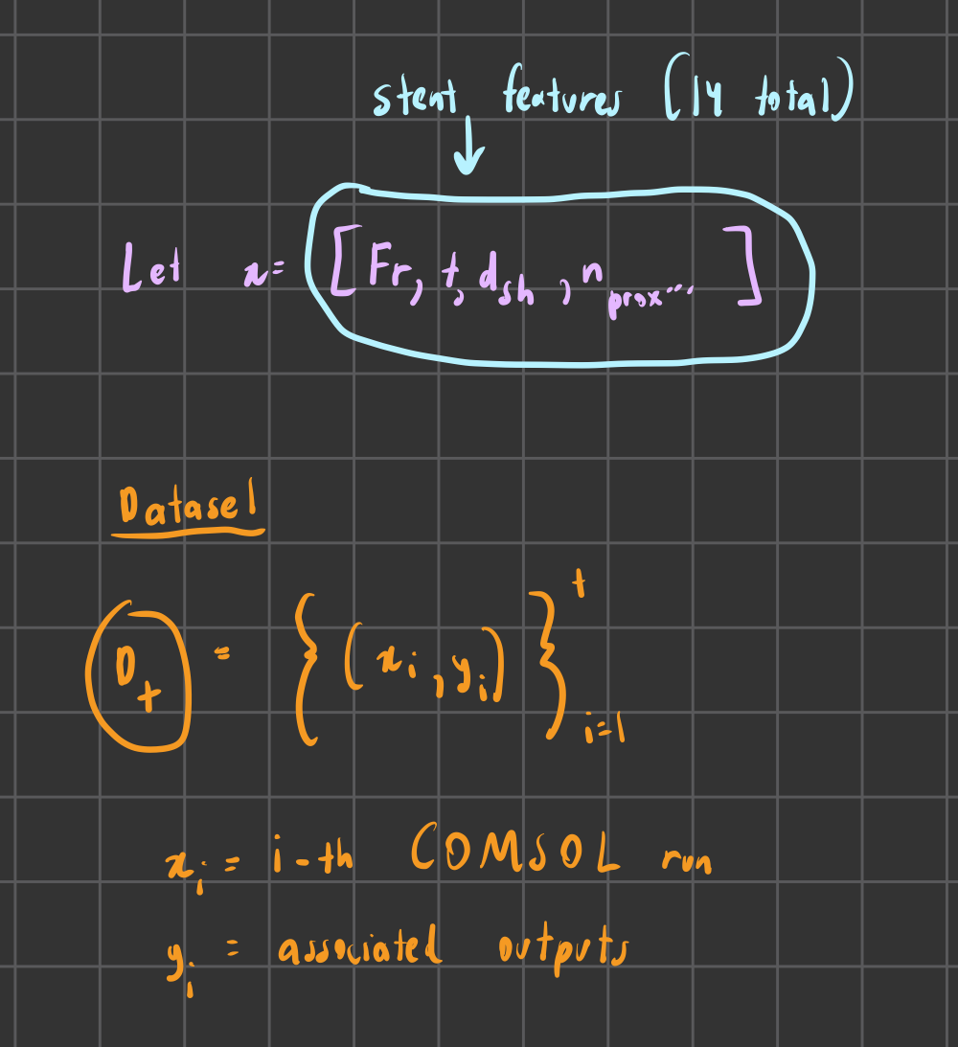
Design Variables (14 sampled → ~12 effective dimensions)
Parameter | Unit | Range | Type
stent_french | Fr | 4 – 8 | Direct
stent_length | mm | 100 – 300 | Direct
coil_radius | mm | 5 – 15 | Direct
coil_length | mm | 10 – 50 | Direct
pigtail_angle | ° | 270 – 360 | Direct
section_proximal | mm | 20 – 60 | Direct
section_distal | mm | 20 – 60 | Direct
n_proximal | ct | 0 – 10 | Direct
n_middle | ct | 0 – 15 | Direct
n_distal | ct | 0 – 10 | Direct
unroofed_length | mm | 0 – 30 | Direct
r_t | ratio | 0.10 – 0.22 | Fraction
r_sh | ratio | 0.20 – 0.70 | Fraction
r_end | ratio | 0.30 – 0.95 | Fraction
Derived Parameters:
• OD = 0.333 × stent_french
• wall_thickness = r_t × OD
• ID = OD − 2 × wall_thickness
• side_hole_diameter = min(r_sh × ID, ID − 0.15)
• end_hole_diameter = min(r_end × ID, ID − 0.15)
• section_middle = length − 2×coil − prox − dist

Slide 5
Feasibility Constraints
Constraint | Value | Rejection Rule
ID_min | 0.6 mm | Reject if ID < 0.6
d_sh_min | 0.3 mm | Reject if d_sh < 0.3
gap_min | 0.3 mm | pitch_min = d_sh + gap_min
buffer | max(1.0, d_sh) | L_use = L_section − 2×buffer
section_middle_min | 10 mm | Reject if middle < 10
Current Approach:
• Sample fractions (r_t, r_sh, r_end) instead of absolute dimensions
• Derive wall_thickness, hole diameters from OD/ID
• Oversample ~3× and reject invalid rows before fitting GP
• Hole-packing check: n_holes × pitch_min ≤ usable section length

Slide 6
Decision 1: Defining what we are optimizing
OPTIONS
CURRENT CHOICE
WHY
A) Single objective
(e.g., minimize ΔP)
B) Scalarization
(weighted sum of objectives tbd)
C) True multi-objective Pareto
(ΔP vs Q_out vs side-hole flux)
Start single or scalarization
to validate loop;
graduate to Pareto once
calibration is trusted.
• Reduces failure modes early
• Avoids premature Pareto
before uncertainty is
calibrated
• Simpler debugging

Slide 7
Decision 2: Data Preprocessing & Transforms
OPTIONS
CURRENT CHOICE
WHY
Input normalization:
• [0,1] scaling
• z-score (mean=0, std=1)
Output transforms:
• None
• Log for ΔP/flux metrics
• Box-Cox
Normalize all inputs to [0,1]
Consider log transforms for
ΔP / flux if spanning
orders of magnitude.
• Kernel distance depends
on scaling
• Transforms stabilize GP
assumptions (homoscedastic
noise, stationarity)

Slide 8
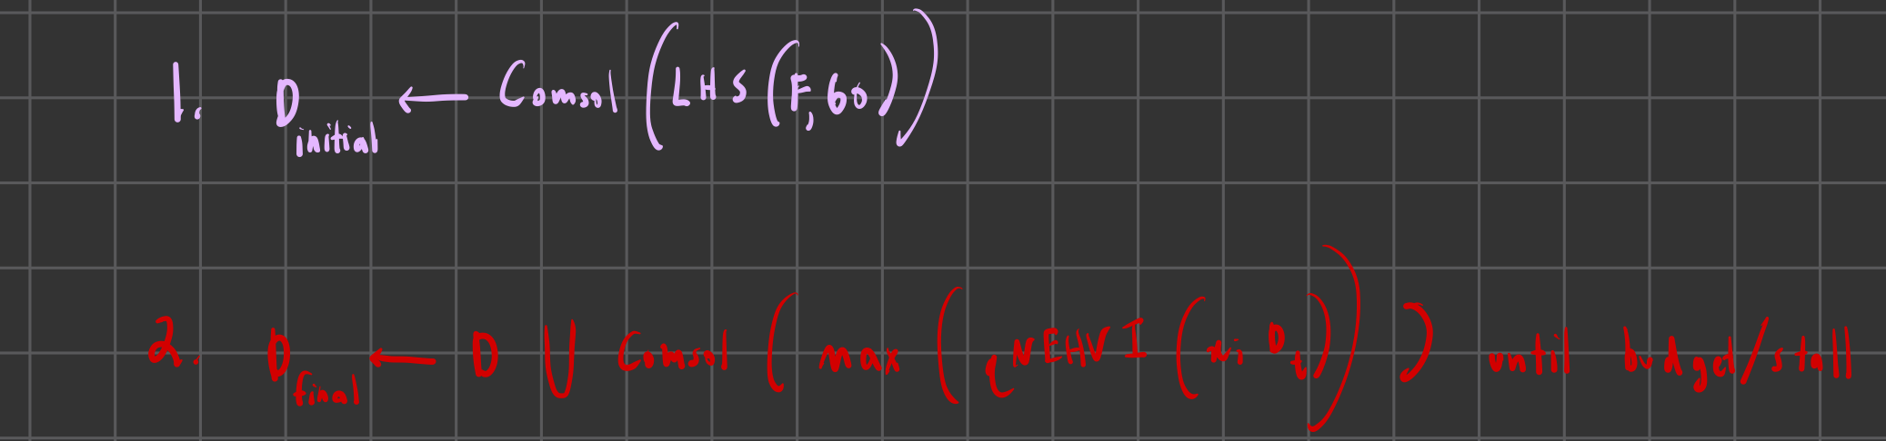
Decision 3: Sampling Plan 14 sampled → ~12 effective
OPTIONS
CURRENT CHOICE
WHY
A) Pure LHS (space-filling only)
B) LHS → adaptive BO
(our plan)
C) BO from the start
Config:
• default_samples: 60
• oversample_factor: 3 mayb 4
Initial LHS + feasibility
filtering (3× oversample) (all dimensions normalized ∈[0,1])
Then adaptive sampling
via EI/UCB.
• Space-filling baseline
• Reduces invalid designs
before GP sees data
• Supports stable GP
initialization

Slide 9
Decision 4: Surrogate Model y(x)=f(x)+ϵ
Model | Uncertainty | Scalability | Notes
GP / Kriging | ✓ Principled | ~1k pts but prob go for like 500? | Chosen
XGBoost + quantile or ensemble it | ≈ Heuristic | Large | Alt for big data
NN ensemble | ≈ Heuristic | Large | Alt
Polynomial RSM / just normal lin reg | ✓ (variance) | Any | Sanity baseline
CURRENT CHOICE
GP/Kriging as primary surrogate
And prob use polynomial RSM for sanity check
WHY
• Principled posterior uncertainty
• Standard for 'computer experiments'
• Supports acquisition decisions

Slide 10
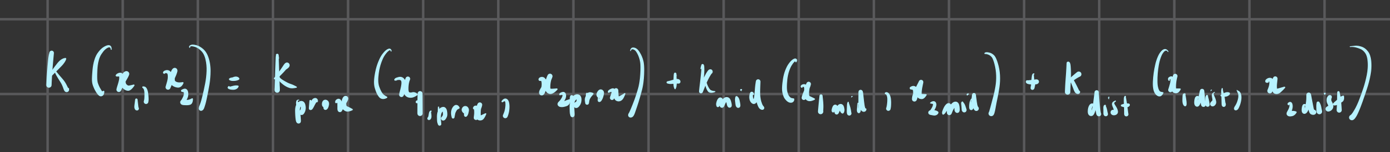
Decision 5: GP Specifics (Kernel + ARD + Noise)
OPTIONS
CURRENT CHOICE
WHY
Kernel:
• RBF / Squared Exp
• Matern 5/2
• Matern 3/2
Length-scales:
• ARD (Automatic Relevance Determination)
• Single shared
Noise:
• Interpolating (noise=0)
• Nonzero noise term
Matérn 5/2 first and hope that all the sections contribute under that smoothness definition but rotate thru stationary models if it is underfit/uncertain, and worst case, try additive kernel option (below)
ARD length-scales
small nonzero noise
• Smooth-but-not-too-smooth
(twice differentiable)
• Avoids overconfidence
(RBF can oversmooth)
• ARD → interpretability
• Noise handles solver/
mesh jitter
Additive kernel option could also be an option since prox/middle/distal sections might contribute semi-independetly

Slide 11
Decision 6: Training Procedure ('The Fit')
OPTIONS
CURRENT CHOICE
WHY
A) Maximize marginal
likelihood (MLE; if fits are unstable, try MAP priors)
— standard approach
B) Fully Bayesian inference
(MCMC over hyperparams)
— heavier, more robust
Marginal likelihood fitting
first;
Bayesian priors later
only if needed. But based on old results, doubt this is needed.
• Stable, fast iteration
• Defensible precedent
for engineering BO
• Can upgrade to full
Bayes if instability

Slide 12
Decision 7: Training Split (Very TBD)
OPTIONS
CURRENT CHOICE
WHY
A) Random split
(often too easy)
B) Blocked / region holdout
(chosen)
C) Hold out extremes / corners
(stress test; chosen)
Blocked holdout
+
Extremes / corner holdout
• Matches sequential design
reality
• Guards against over-
optimistic RMSE
• Tests extrapolation,
not just interpolation

Slide 13
Decision 7: (Very TBD)
OPTIONS
CURRENT CHOICE
WHY
A) Random split
(often too easy)
B) Blocked / region holdout
(chosen)
C) Hold out extremes / corners
(stress test; chosen)
Blocked holdout
+
Extremes / corner holdout
• Matches sequential design
reality
• Guards against over-
optimistic RMSE
• Tests extrapolation,
not just interpolation

Slide 14
Decision 8: Acquisition / Selecting Next COMSOL Runs
OPTIONS
CURRENT CHOICE
WHY
Single-objective:
• EI / qEI (Expected Improv.)
• UCB / LCB (exploration ctrl)
Multi-objective:
• EHVI (Expected HV Improv.)
• qNEHVI (batch Pareto)
EI / qEI early
EHVI / qNEHVI once multi-objective is enabled
and calibration is solid.
Figures to show (next slide): Incredibly TBD, haven’t done real research into how to display. Don’t expect any input till that pipeline is more hashed out.
• Stable early loop
• Scalable to batch
selection
• Natural transition to
Pareto later

Slide 15
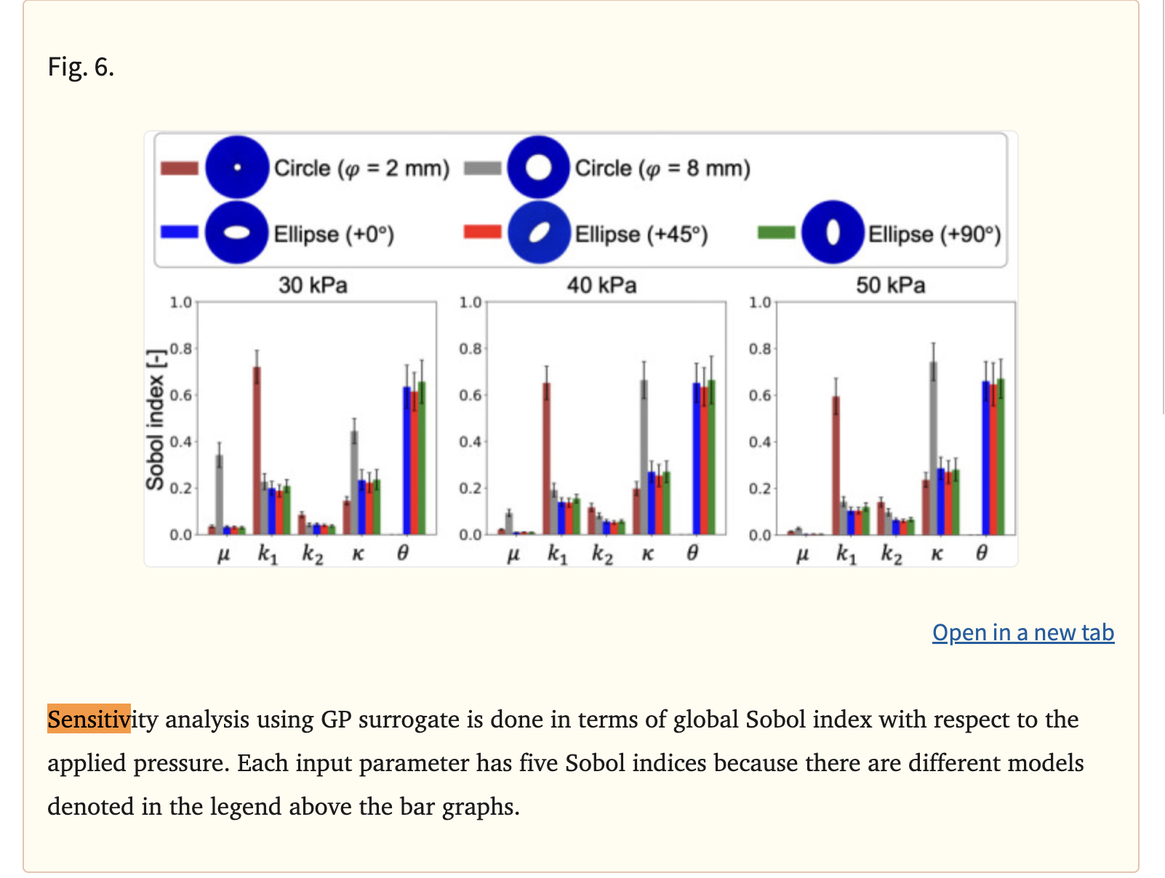
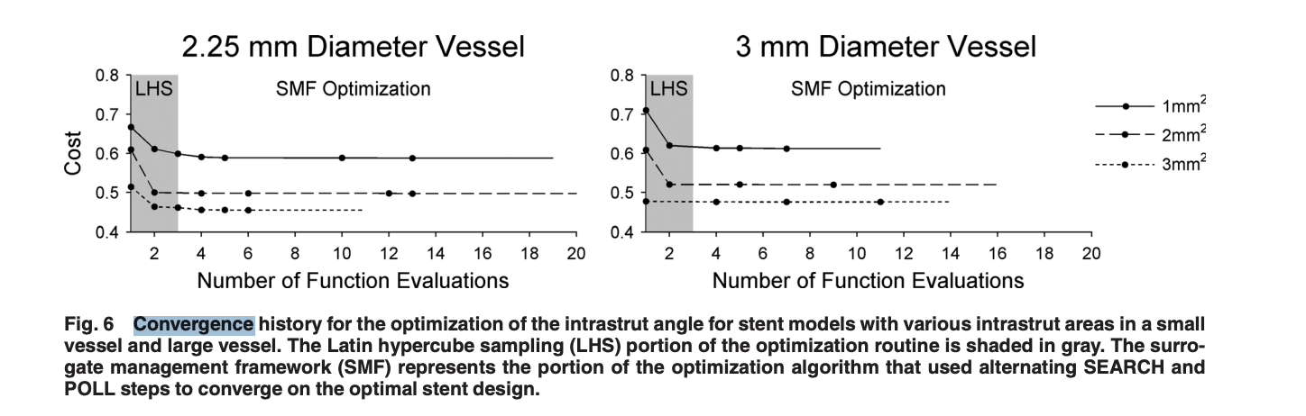
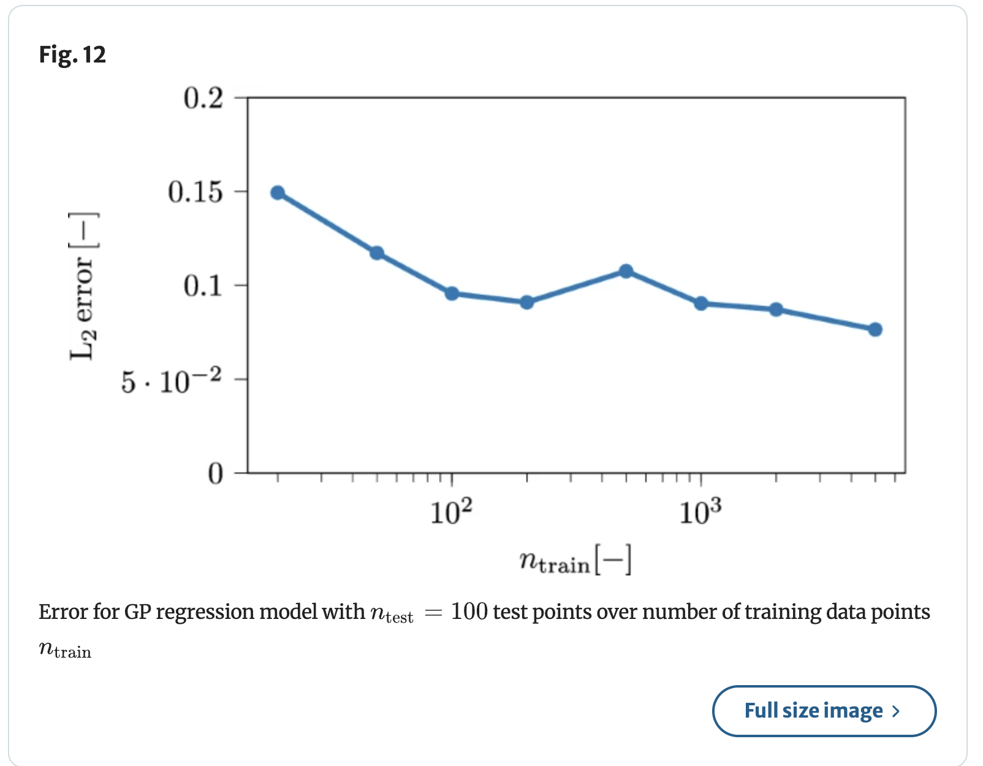
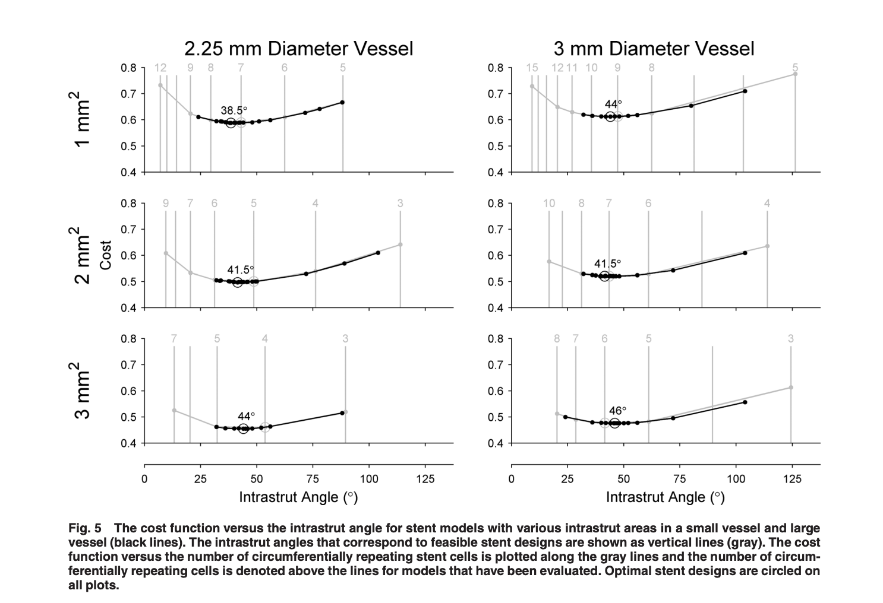
Decision 8: Acquisition / Selecting Next COMSOL Runs
Convergence History
Sensitivity Analysis
Plot for “Error stabilizes after n runs”
“Trade-off” cost function plot; ΔP vs (−Q) vs (−min side-hole flux) or similar

Slide 16
Questions leftt
1. What would you change first to make this GP-fit pipeline maximally defensible?
2. Kernel: Is Matérn 5/2 a good default here; when would you switch?
3. Noise: For deterministic-ish solvers, would you fit noise anyway? Replicate/mesh strategy?
4. Validation: What split strategy do you trust most for sequential design problems?
5. Multi-objective: When would you move from single/scalarization to true Pareto?

