Slide 1
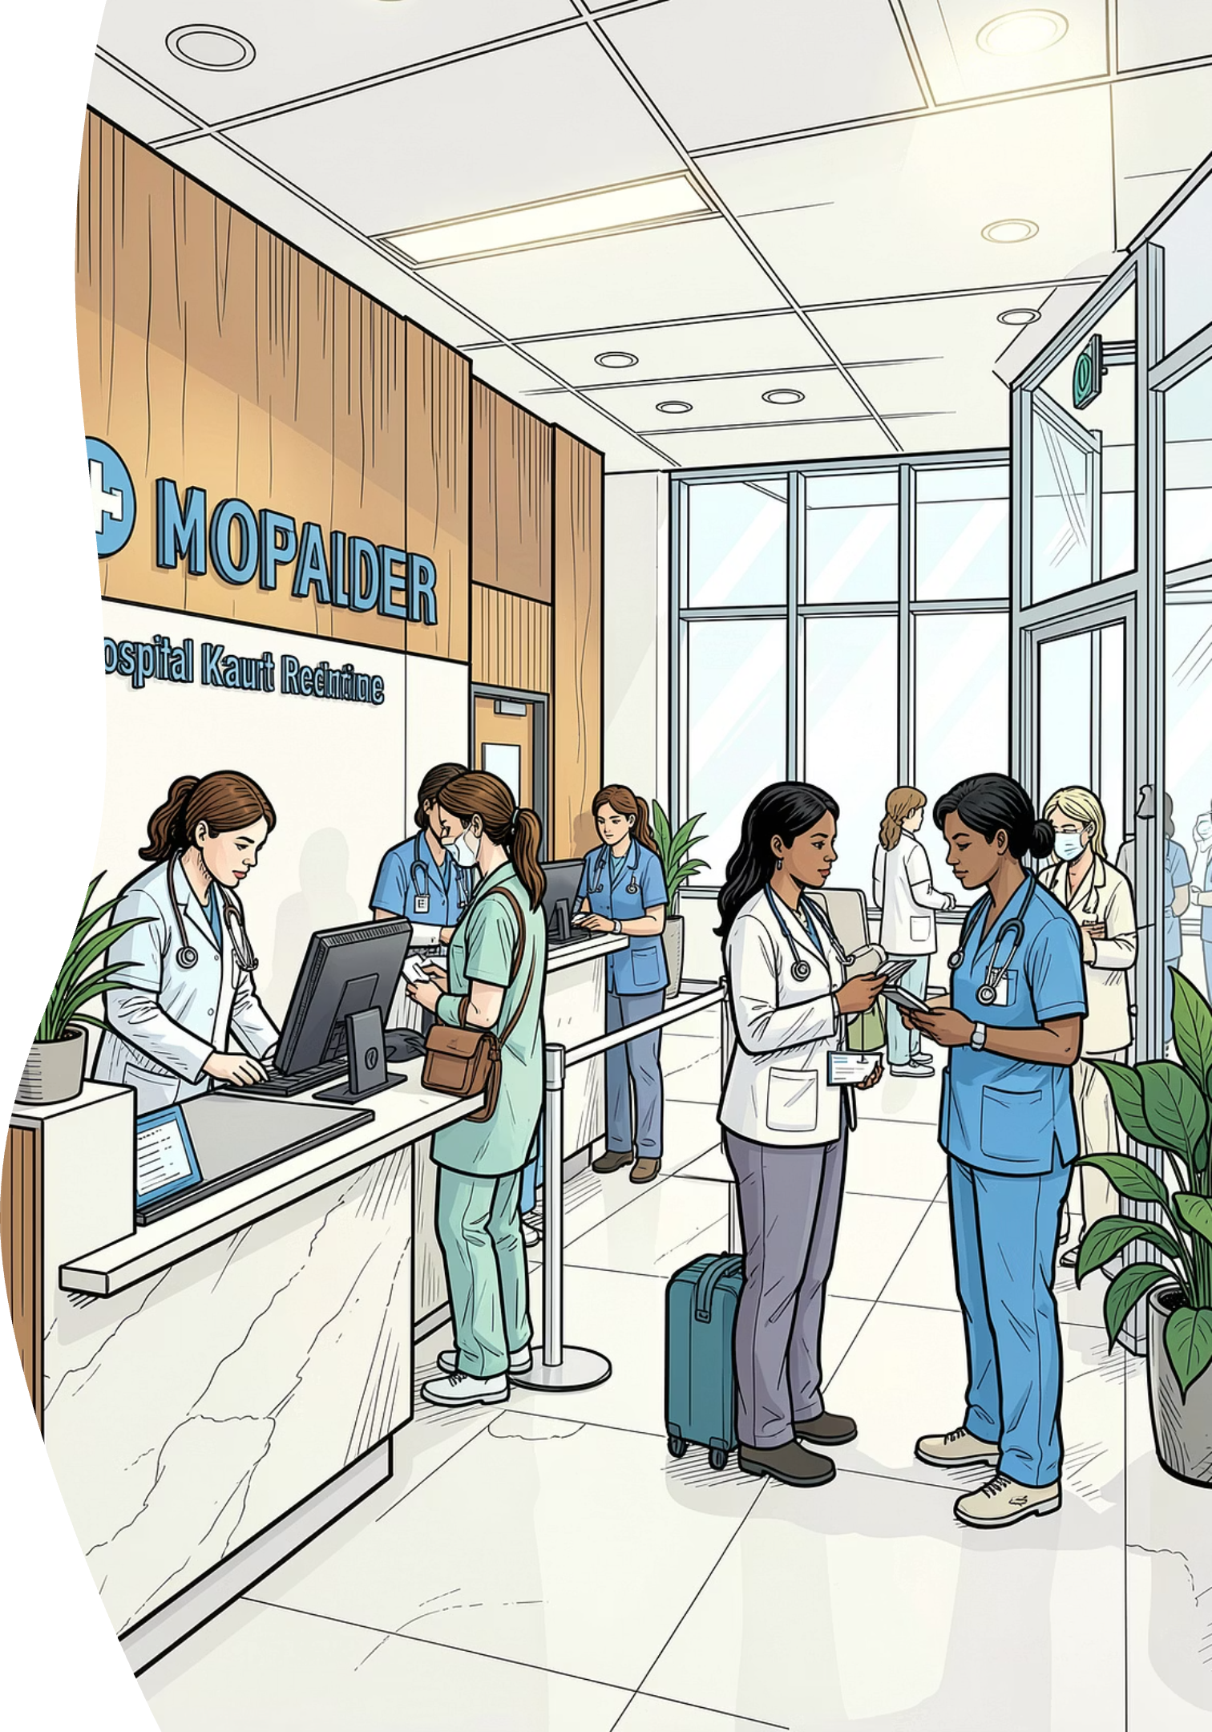
Health-Care No-Show Analysis
A data-driven investigation into the factors driving missed appointments — enabling healthcare administrators to reduce waste, improve scheduling, and strengthen patient engagement.
HEALTHCARE OPERATIONS
PREDICTIVE ANALYTICS

Slide 2
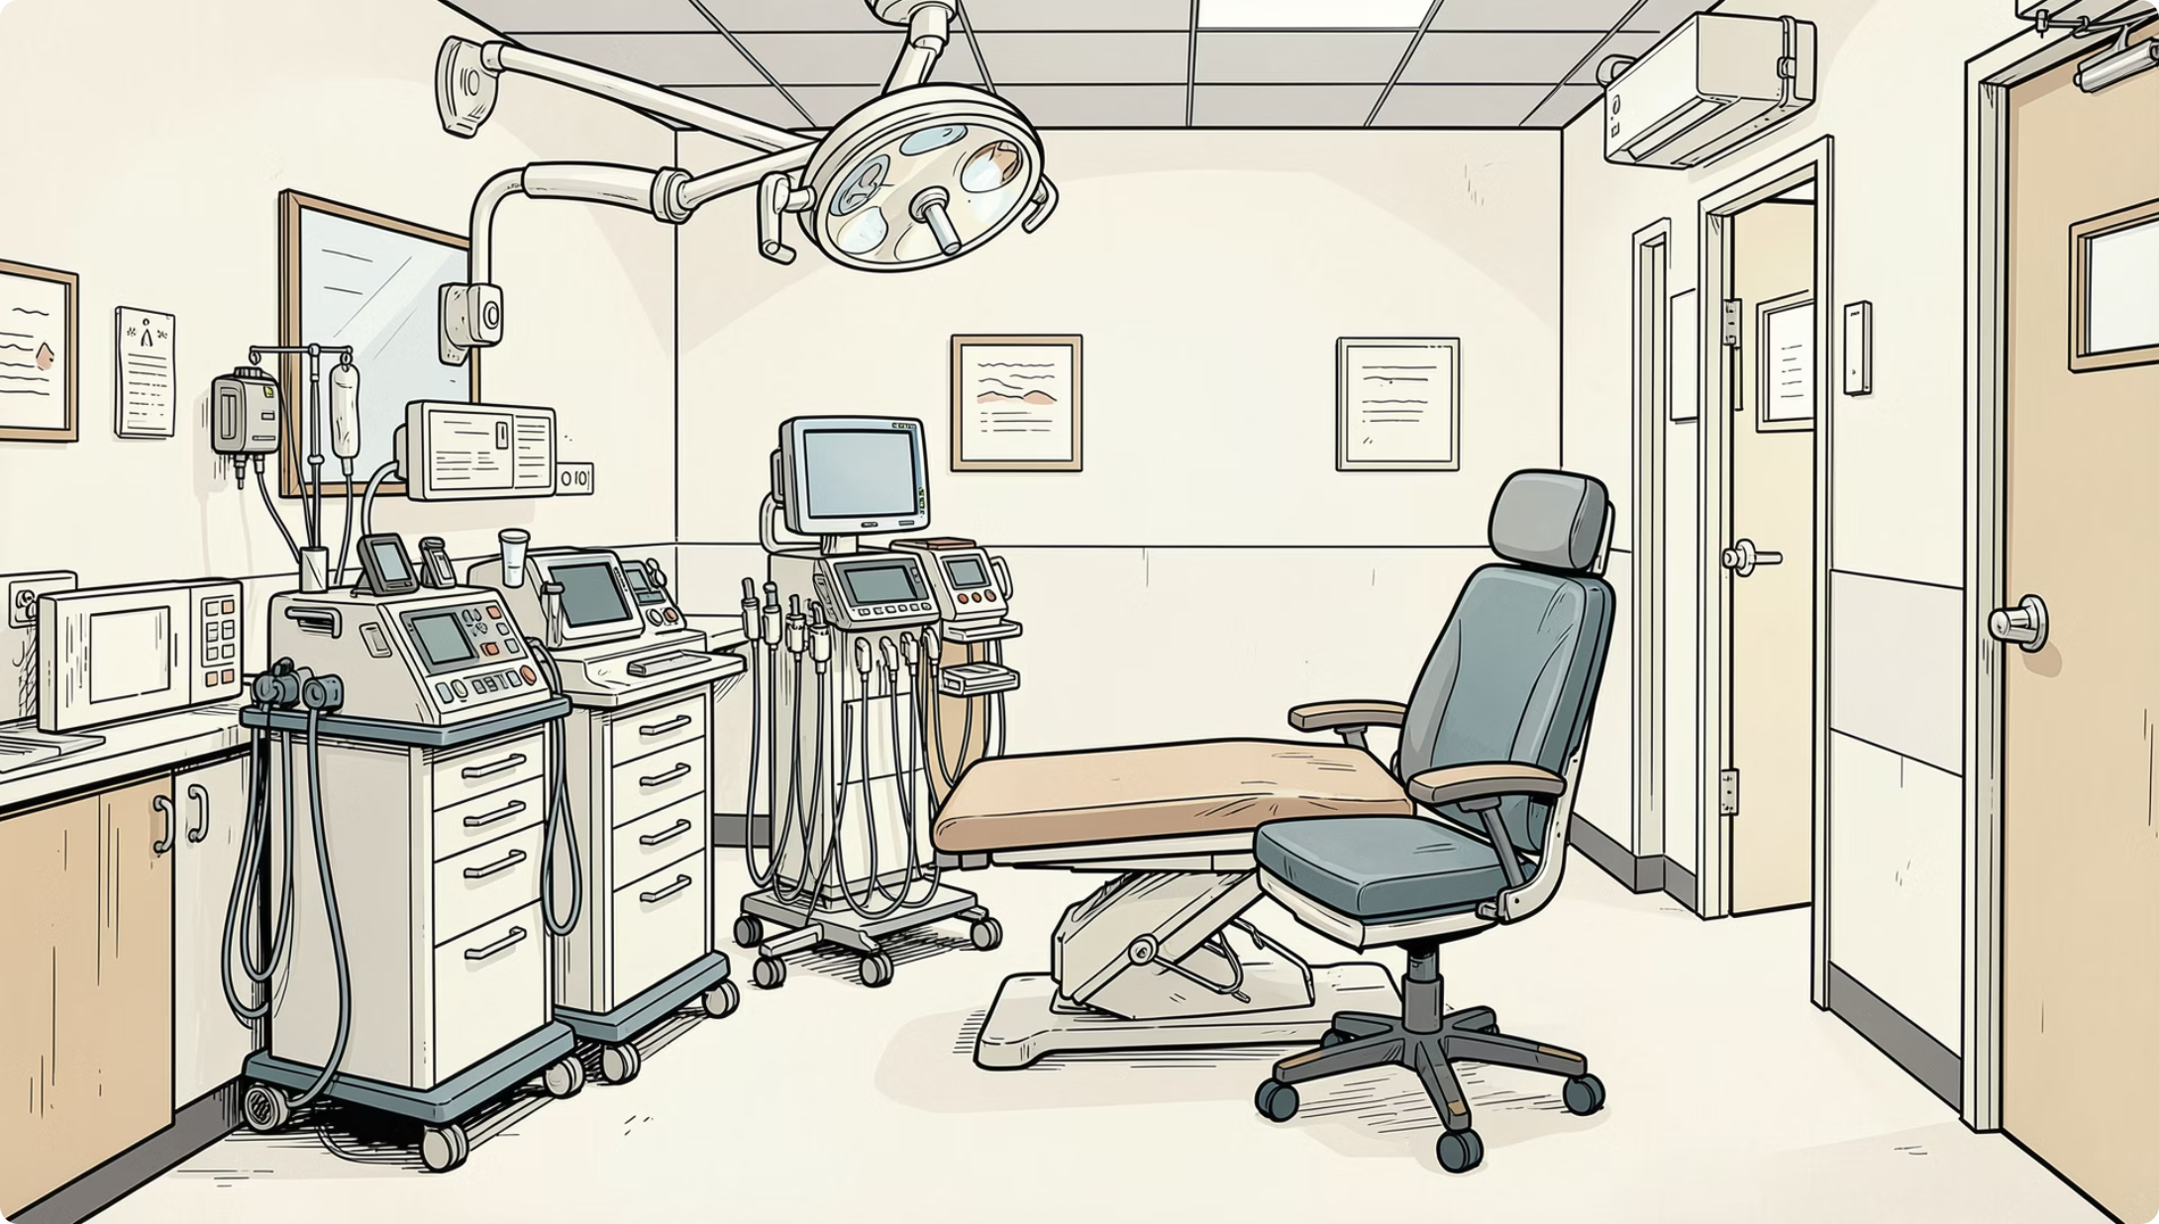
The Operational Cost of Missed Appointments
Why This Matters
When patients miss appointments without notice, clinics face wasted slots, idle staff, longer waits, and lost revenue. This analysis examines demographics, scheduling patterns, reminders, distance, weather, and satisfaction to identify drivers of no-show behavior.
Wasted Slots
Higher Costs
Longer Waits
Lost Revenue

Slide 3

Analysis Roadmap
Patient Profile
Data Prep
Scheduling & Comm
Clinic & Env
Each phase isolates a distinct dimension of no-show behavior, building toward actionable, evidence-based recommendations for clinic operations.

Slide 4

Overall No-Show Rate: ~8.3%
Key Insight
Overall No-Show Rate
Demographic Variation
The overall no-show rate is 8.3%. Demographic variables such as age, gender, city, and neighborhood show only minor differences in no-show rates, whereas operational, behavioral, and socioeconomic factors exhibit much stronger associations with patient attendance.
8.3%
Small
Age 8.04%–8.52%
City 8.01%–8.82%
Strongest Indicators
Waiting Days
Previous No-Shows
Sms Message
Reminder Calls
Patient Satisfaction
Income Level
Previous No-Shows
Travel Distance
Insurance Type
Weather Condition
Dataset Summary
Total Appointments: 50,000 Rows
Overall Attendance:
Show: 91.7%
No-Show: 8.3%
Variables Analyzed: 27 Columns
Strong / Very Strong Indicators: 8
Weak / Very Weak Indicators: 11
Executive overview of the analyzed dataset.

Slide 5
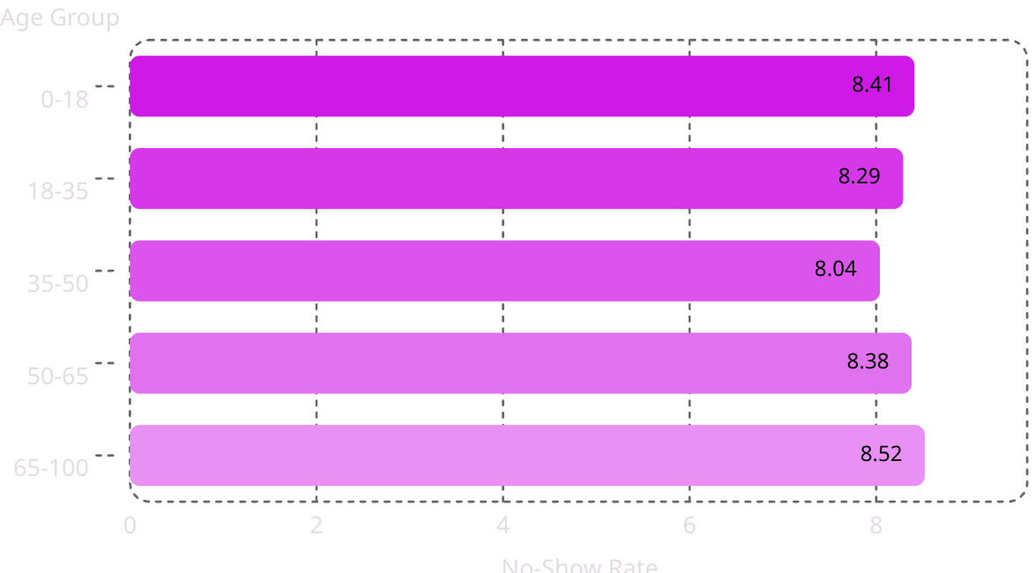
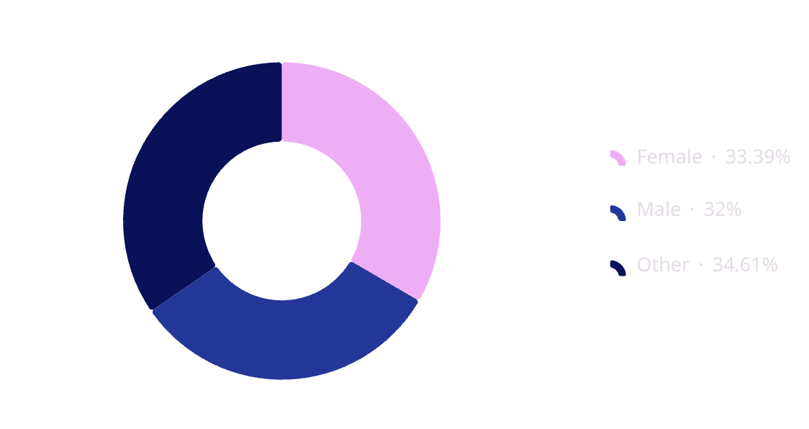
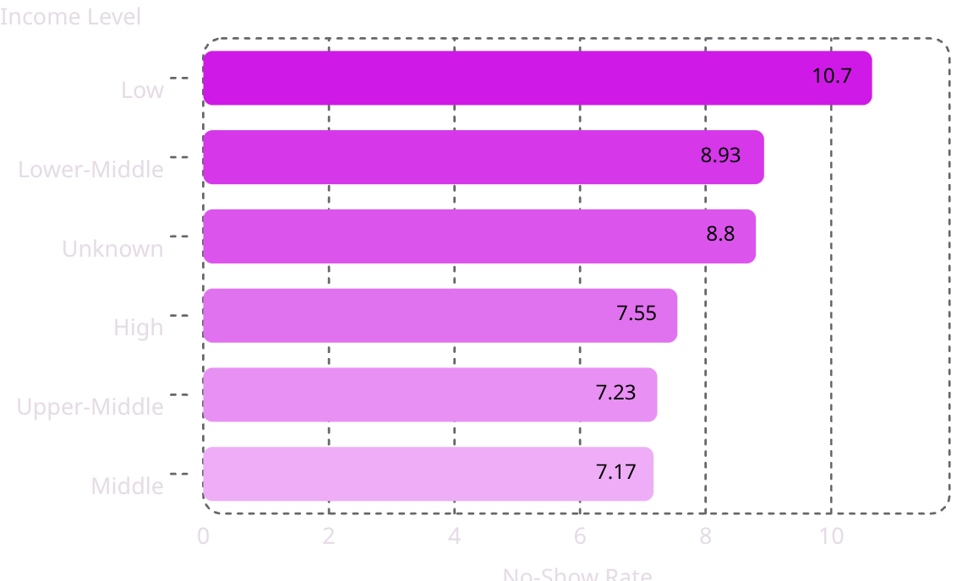
Patient Demographic Analysis
Age Group vs No-Show Rate
Gender vs No-Show Rate
Income Level vs No-Show Rate
Key Findings
Age: Very Weak (8.04%-8.52%)
Gender: Very Weak (8.08%-8.74%)
Income: Strong (7.17%-10.65%)
Income level shows the strongest demographic relationship with no-show behavior.

Slide 6
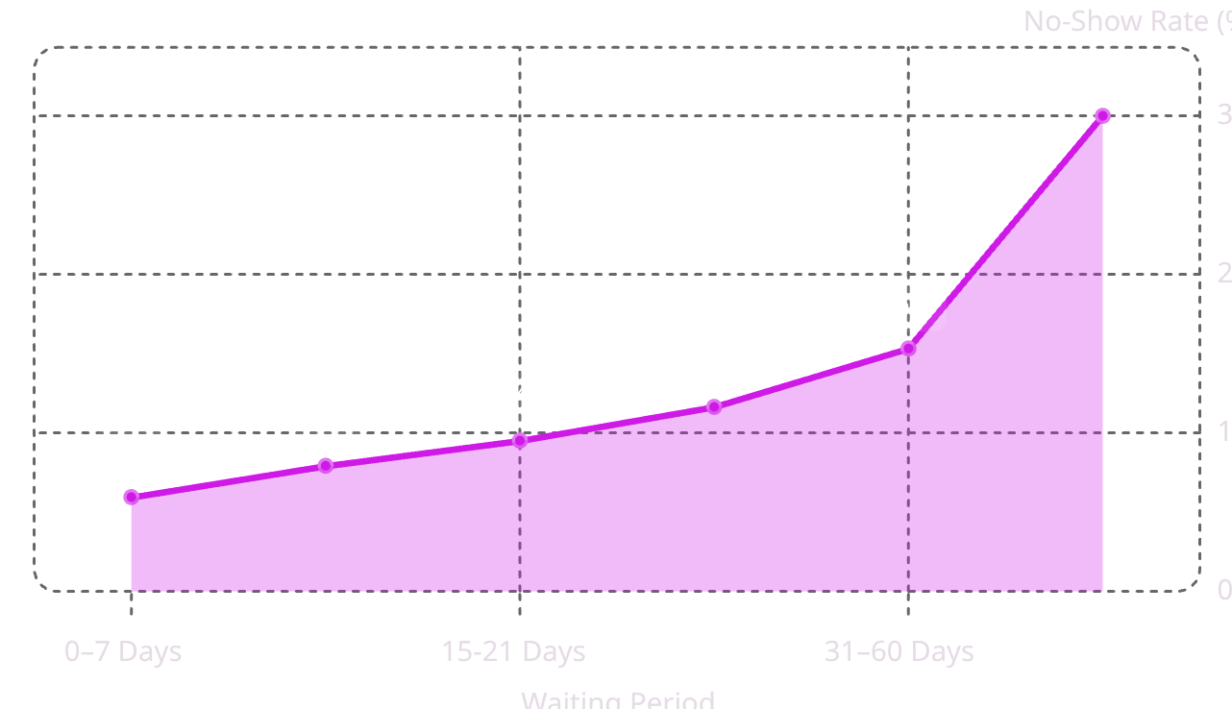
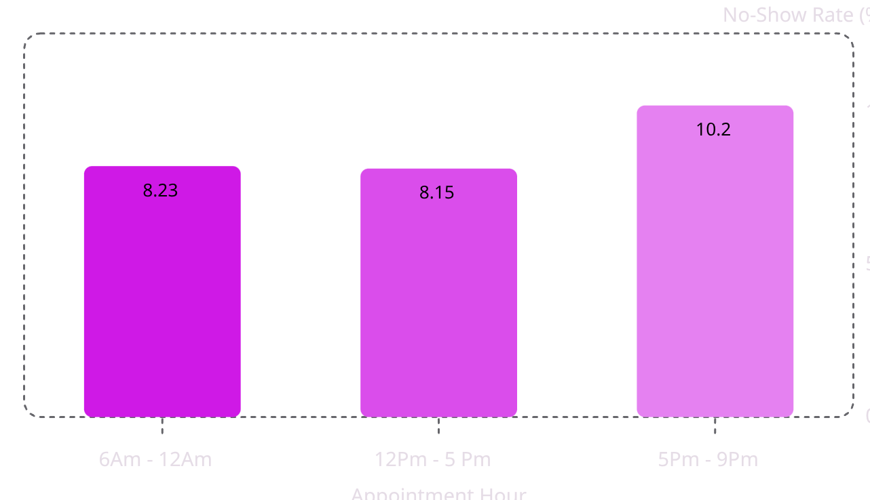
Waiting Time: The Strongest Scheduling Factor
A Clear Escalation Pattern
No-show rates climb from 5.9% for same-week appointments to 30% for bookings made over 60 days in advance — a 5× increase.
Long lead times erode patient commitment. Evening slots (5–9 PM) also show elevated rates at 10.22% vs. ~8.2% for morning and afternoon.

Slide 7
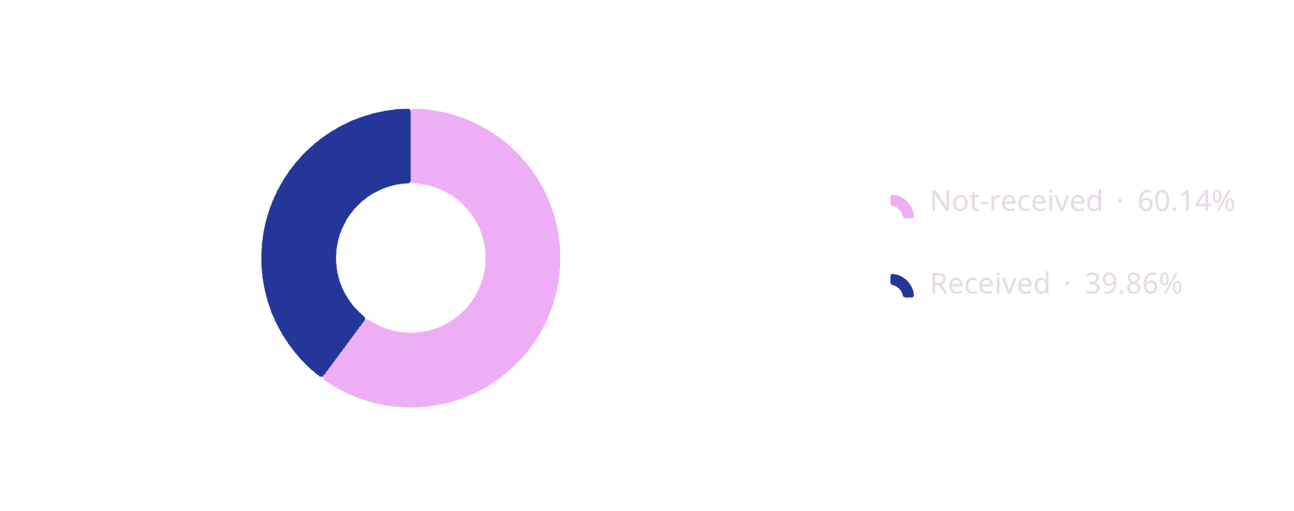
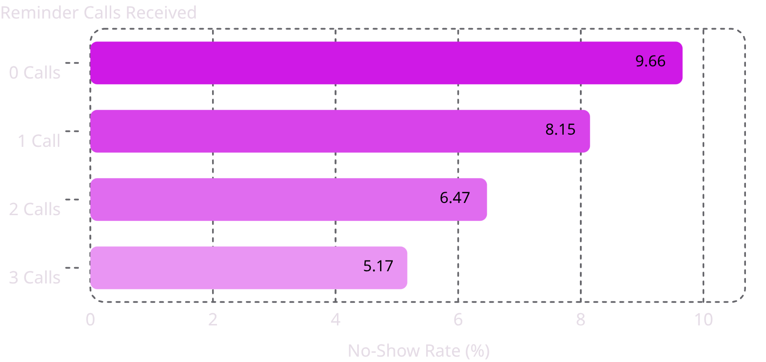
Reminders & Past Behavior: Powerful Predictors
Communication Is Highly Effective
Each additional reminder call reduces no-shows. SMS reminders cut rates from 10.94% (no SMS) to 7.25% (SMS sent).
Past Behavior Predicts the Future
Patients with no prior no-shows: 5.92%. Those with 8+ prior misses: 31.82% — a very strong signal for proactive outreach.

Slide 8
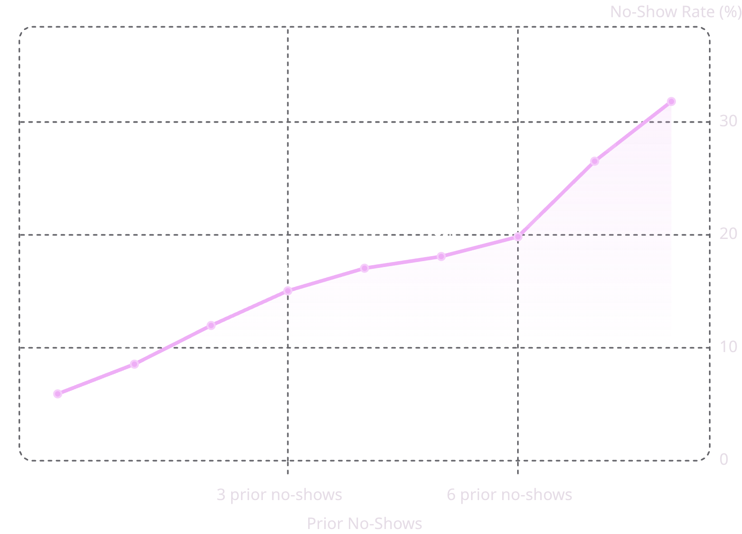
Previous No-Shows: A Very Strong Predictor
No-Show Rate by Prior No-Show History
Past Behavior Predicts Future Attendance
A very strong relationship exists between previous no-show history and future behavior. No-show rates escalate from 5.92% (no prior no-shows) to 31.82% (8+ prior no-shows).
This is one of the strongest predictors identified and suggests past no-show behavior is a critical signal for targeted intervention strategies.

Slide 9
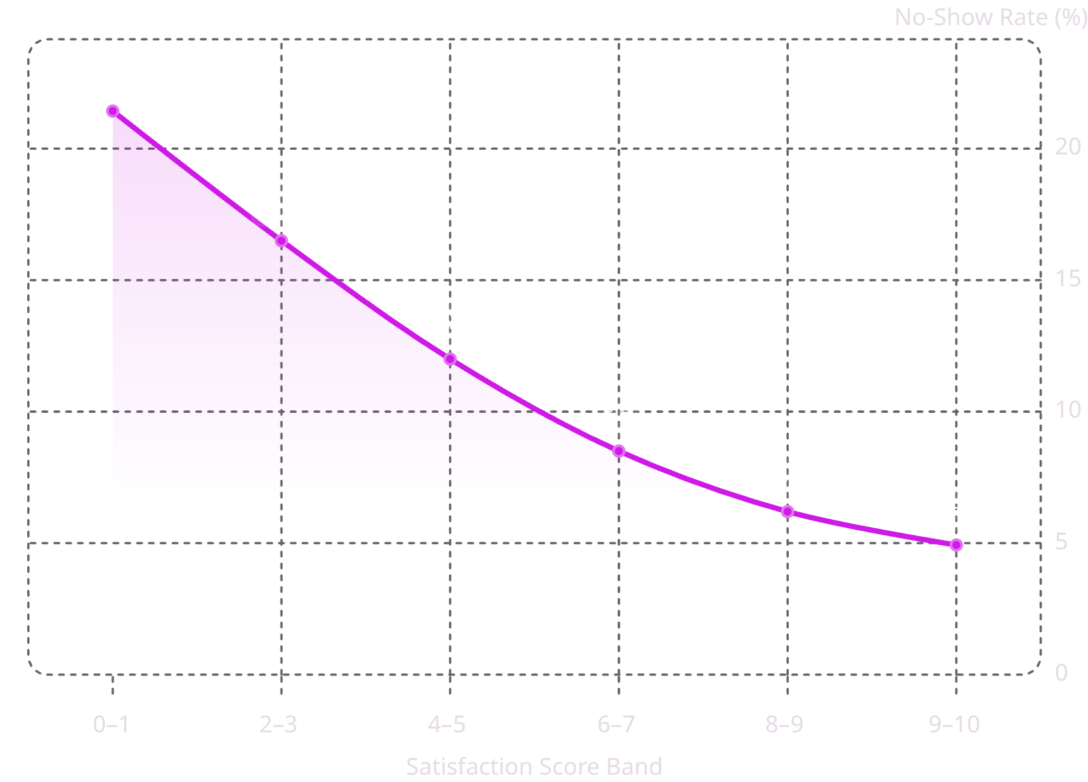
Patient Satisfaction: A Strong Inverse Relationship
The Satisfaction–Attendance Link
No-show rates fall from 21.43% (lowest satisfaction) to 4.93% (highest) — a 4× difference and one of the strongest associations in this analysis.
Improving patient experience is not just a quality metric — it is a direct lever for reducing missed visits and optimizing clinic throughput.

Slide 10
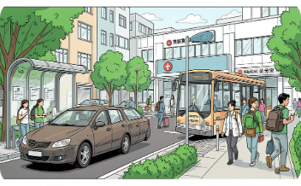
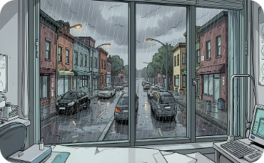
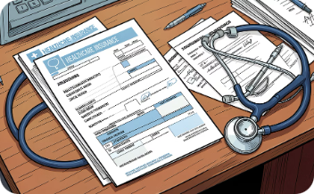
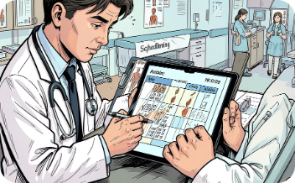
Clinic & Environmental Factors
Travel Distance
Weather Conditions
Insurance Type
Appointment Type
No-shows rise from 6.86% (<2 km) to 10.93% (>20 km). Car users show the lowest rate (7.27%); walkers the highest (9.68%).
Rain raises no-shows to 10.43%; sunny and cloudy days hold rates near 7.4%. Adverse weather is a meaningful external driver.
Uninsured patients: 11.04% no-show rate. Private insurance: 7.60%. Coverage status is a strong equity-related attendance factor.
Emergency visits: 4.87% (lowest). Therapy: 9.02% (highest). Perceived urgency directly shapes attendance.

Slide 11
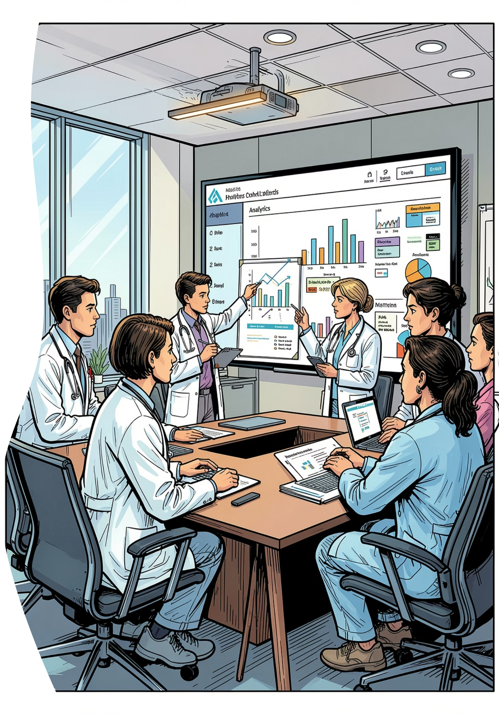
Key Takeaways & Recommendations
🔴 Act on Waiting Time
Review scheduling policies for long lead times. Consider additional reminders or follow-up for appointments booked more than 30 days in advance. Cap advance bookings at 30 days. Send automated reminders at 7 and 3 days before the visit.
📞 Scale Reminder Programs
3 calls reduce no-shows to 5.17%. Patients receiving more reminder calls exhibited lower no-show rates. Prioritize reminder programs, particularly for patients with a history of missed appointments
💡 Invest in Satisfaction
Patient satisfaction showed one of the strongest associations with attendance. Improving the patient experience may help support better attendance.
🤝 Address Access Barriers
Consider transportation support for patients traveling long distances or uninsured and proactive communication during adverse weather conditions.

