Slide 1
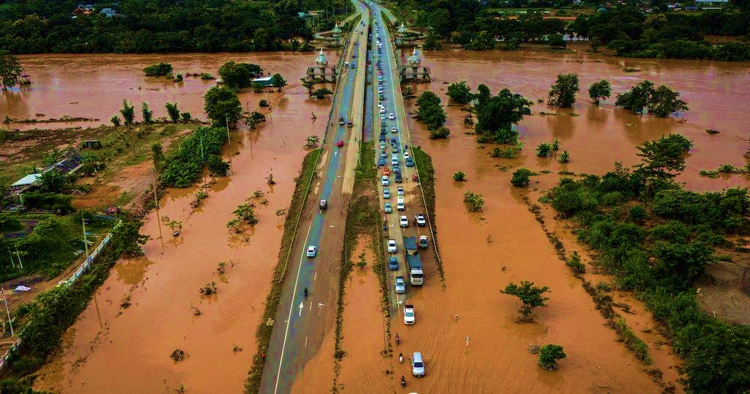
PCCOE Indradhanu – International Grand Challenge 2026
Theme: AI for Climate Change
Team:
Domain: Disaster Resilience, Public Health & Community Well-being
CASCADEBREAK AI
AI-powered counterfactual intervention optimization for climate disasters
Don’t just map the flood. Find the intervention that breaks the cascade

Slide 2
THE PROBLEM
When One Road Fails, The Impact Doesn’t Stop There
Climate disasters create cascading disruptions across interconnected urban systems.
🌊 Flooding
🚧 Road Disruption
The Challenge
Responders often know where flooding is, but not where intervention will create the greatest downstream benefit.
Restoring the most severely flooded road may not restore the most critical connectivity.
Multiple possible interventions compete for limited time and resources.
Decisions need to consider population, hospitals, relief centres and alternate routes together.
🔗 Network Disconnection
🏥 Critical Facility Inaccessibility
👥 Population Access Loss
Which intervention should responders prioritize to break the cascade with limited effort?
Current systems answer: “Where is the flood?”
CascadeBreak AI asks: “What should we intervene in first?”

Slide 3
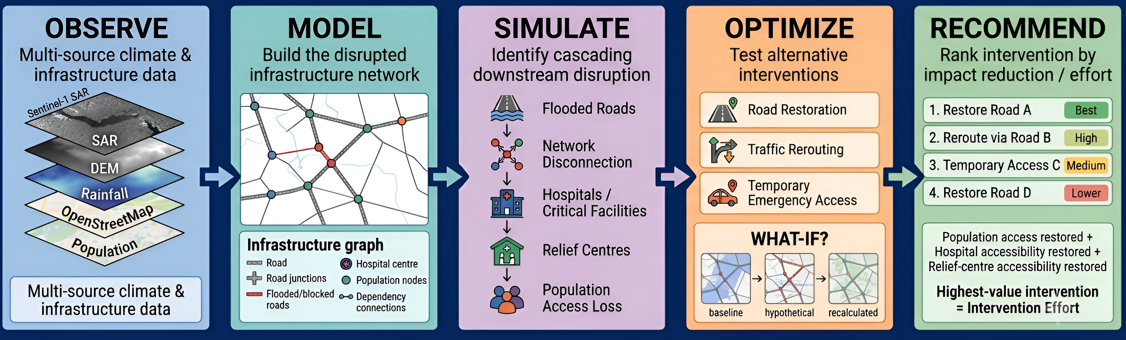
CASCADEBREAK AI: FROM FLOOD MAP TO ACTION
An explainable counterfactual engine for prioritizing disaster interventions
AI doesn't decide the response. It shows responders which intervention can break the cascade most effectively.

Slide 4
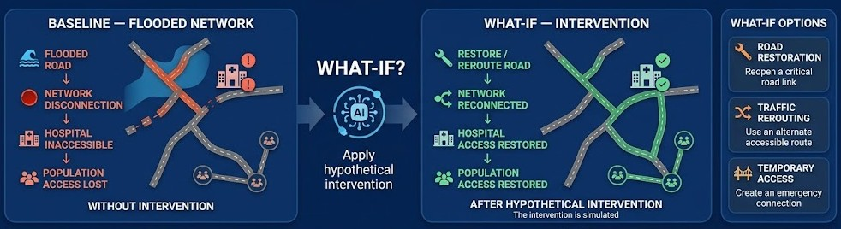
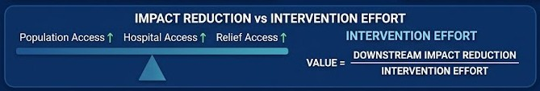
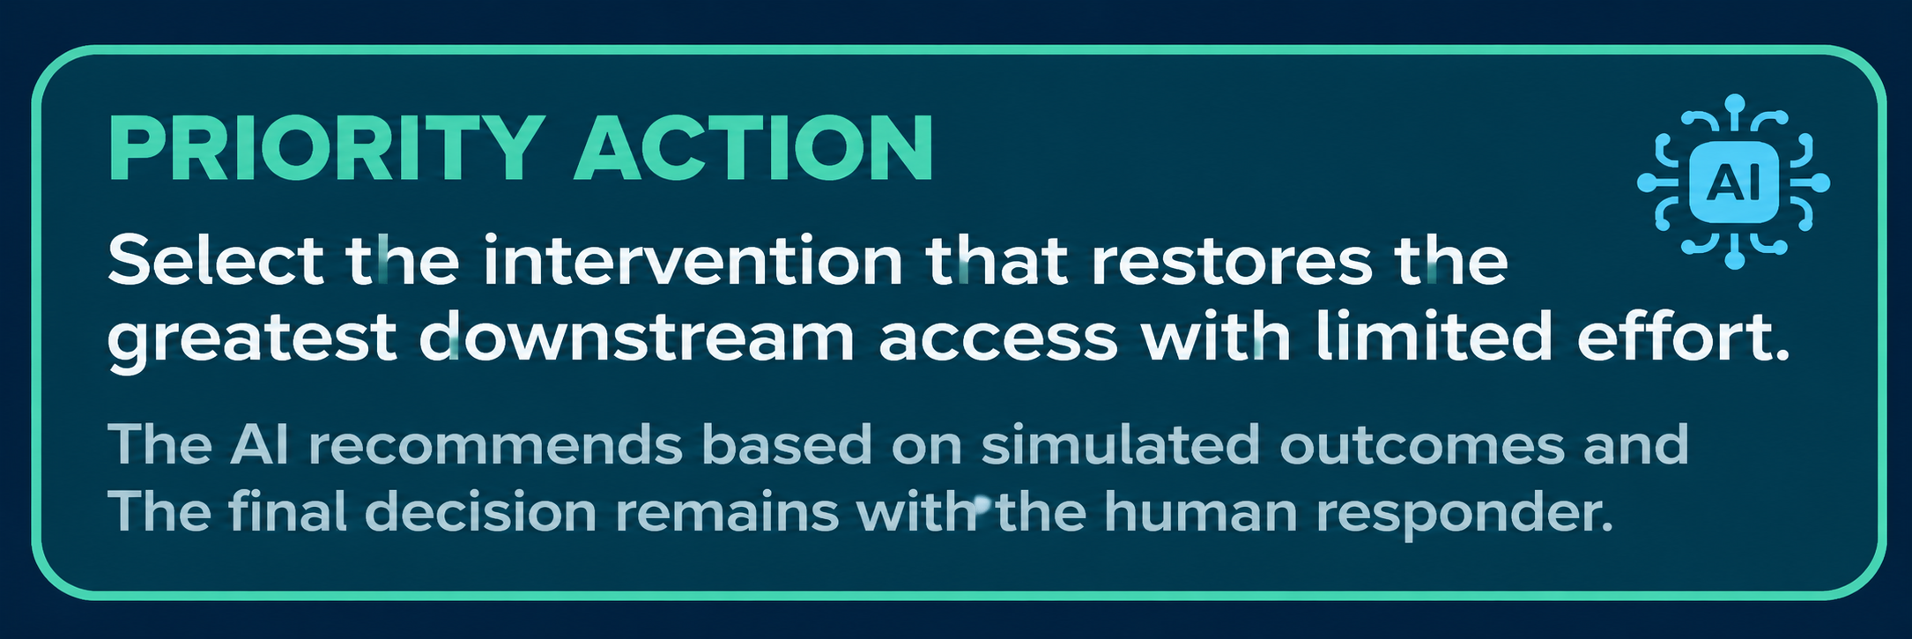
THE CORE INNOVATION
Counterfactual Intervention
Instead of asking “What is damaged?”, CascadeBreak AI asks “What happens if we intervene here?”
BEST≠MOST DAMAGED
Best=Maximum downstream access restored per unit effort

Slide 5
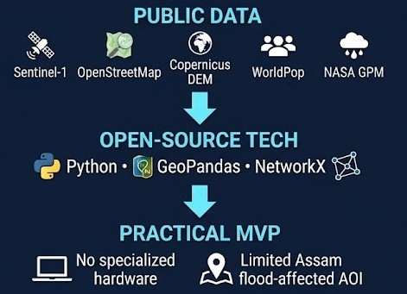
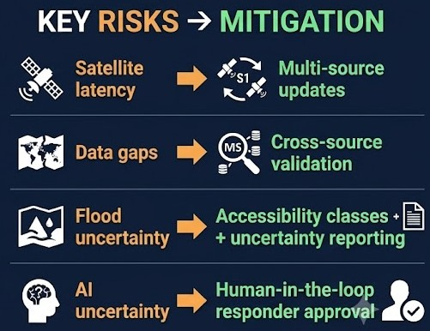
FEASIBILITY, CHALLENGES & RISK MITIGATION
A practical MVP using open geospatial data and explainable algorithms
Feasibility
Key risks & mitigation
MVP focuses on explainable road-accessibility cascades, not every real-world infrastructure failure

Slide 6
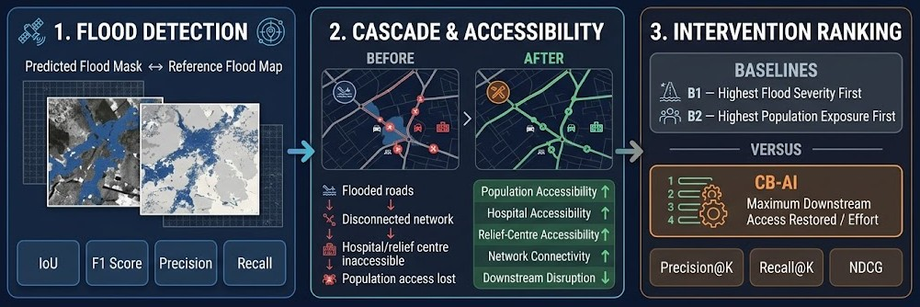
HOW WILL WE VALIDATE CASCADEBREAK AI
Measuring flood detection, accessibility recovery and intervention quality
We don’t validate only whether the flood was detected.
We validate whether the recommended intervention restores more critical access with less effort

Slide 7
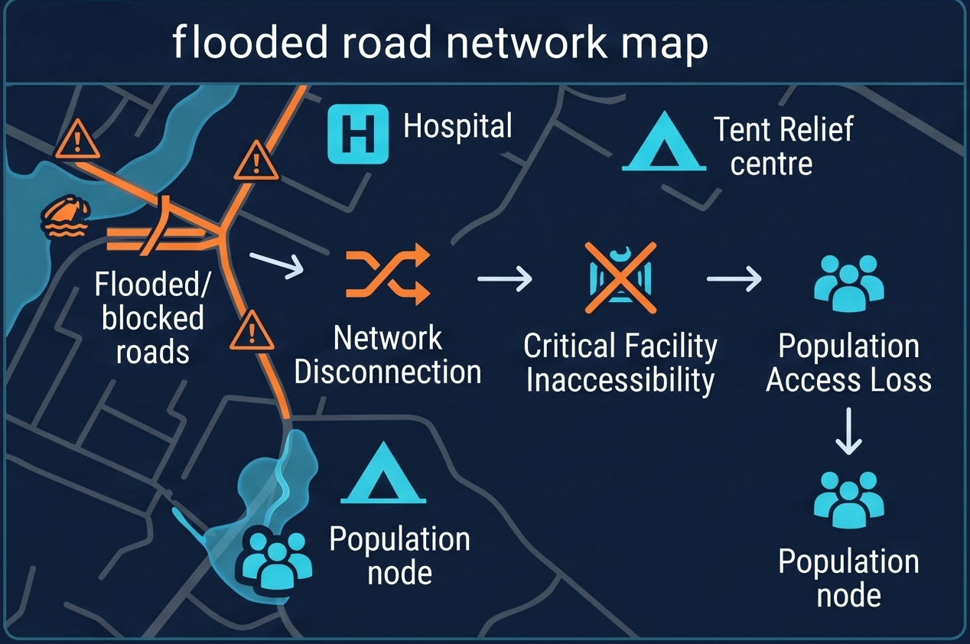
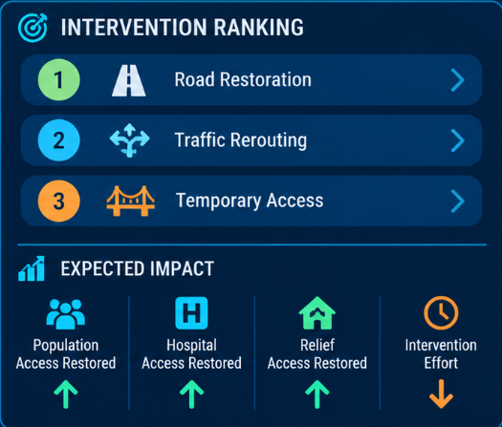
FROM CASCADE ANALYSIS TO PRIORITY ACTION
What CascadeBreak AI is designed to deliver to disaster responders
Conceptual system output — actual prototype implementation planned for Stage II.

Slide 8
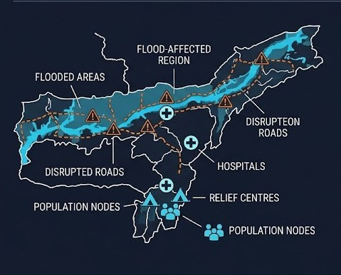
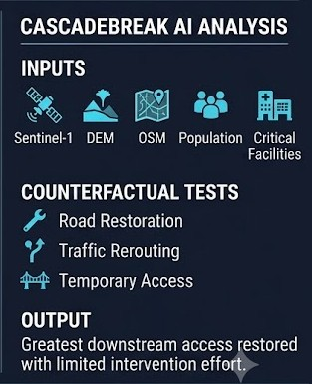
ASSAM 2026 FLOODS — RETROSPECTIVE CASE STUDY
Testing the CascadeBreak AI framework on a real climate-disaster scenario
🌊 Flooding
🚧 Road Disruption
🔗 Network Disconnection
🏥 Critical Facility Inaccessibility
👥 Population Access Loss
Retrospective case study — not a live operational deployment.

Slide 9
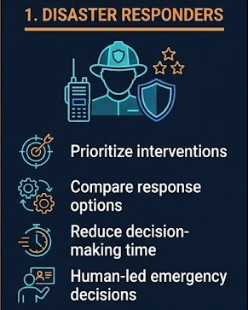
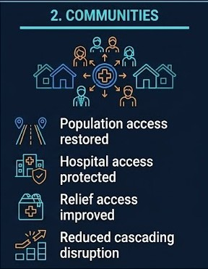
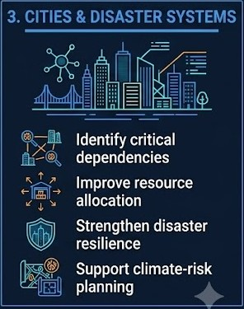
WHO BENEFITS FROM CASCADEBREAK AI?
Turning complex climate-disaster cascades into actionable priorities
From “What is affected?” → to “What should we fix first?”

Slide 10
LIMITATIONS & FUTURE SCOPE
Building from an explainable MVP toward operational climate-disaster intelligence
LIMITATIONS
Satellite latency → Sentinel-1 is not continuous real-time monitoring
Data completeness → OSM and population data may have gaps
Flood uncertainty → depth and accessibility may require local validation
Intervention effort → current index is not a direct repair cost
Human uncertainty → AI recommendations require responder review
FUTURE SCOPE
Multi-source real-time updates
IoT / water-level sensor integration
Crowdsourced & field reports
ML-based road failure prediction
More infrastructure dependencies
Dynamic intervention-cost estimation
Multi-hazard cascading risk
MVP: Explainable road-accessibility cascades → Future: Multi-hazard, multi-source disaster intelligence

Slide 11
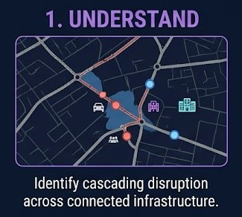
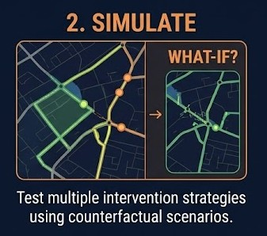
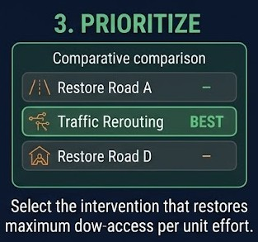
CASCADEBREAK AI
DON’T JUST MAP THE FLOOD.
FIND THE INTERVENTION THAT BREAKS THE CASCADE.
Explainable • Counterfactual • Human-in-the-loop
From flood intelligence → to actionable climate resilience

