Slide 1
Mechanical Turks

Slide 2
Coupon Recommendation Classification Problem
Understanding the Problem
Understanding the data
Data Preprocessing & Feature Selection
Feature engineering
EDA & Insights
Model
Results

Slide 3
Understanding Problem Statement
Problem Statement:
Ecom website- Mechanical Turk wants to create a coupon recommendation ML model to classify the users; whether the user will accept the coupon or not !!!
Understanding Data:
Data is collected via survey on Mechanical Turk’s website. The information collected describes various scenarios detailing Individual attributes, Demographic, Transit , Weather conditions, Contextual attributes
Supervised ML: Classification of Users on the basis of acceptance of Coupon

Slide 4
Understanding the data
Independent Features: 12684 data points & 25 features(includes 1 target column)
destination, passenger, weather, temperature, coupon, expiration, gender, age, maritalStatus, has_children, education, occupation, income, car, Bar, CoffeeHouse, CarryAway, RestaurantLessThan20, Restaurant20To50, toCoupon_GEQ5min, toCoupon_GEQ15min, toCoupon_GEQ25min, direction_same, direction_opp
Target Variable-
“Accept(Y/N)”? : Signifies if the user will accept the coupon or not
Datatypes-
17 object & 8 int type(all categorical variables)
Missing Values-
Car- 99.1% || Bar- 0.84% || CoffeeHouse-1.7% || CarryAway-1.2%
RestaurantLessThan20 - 1.02% || Restaurant20To50- 1.49%
Balanced/Imbalance Data-
Balanced dataset(Class 1: 7210 & Class 0: 5474 instances)

Slide 5
Data pre-processing
Renaming of 1 variable : (passanger → passenger)
Missing values : Dropped the data points with missing values as the number of total missing value is low compared to dataset(6.25%)
Duplicate values : Dropped the data points having duplicate values, while retaining the first occurrence of duplicates
Feature Selection: Using Chi_square
Checking whether Predictor variables are related or unrelated with Target variable
Hypothesis : The predictor variables do not have any effect on target variable
Confidence Interval : 95%
Not dependent variables(p>0.05) : toCoupon_GEQ5min, direction_same & direction_opp
Action : dropping the variables with p > 0.05

Slide 6
Feature Engineering Objective: To reduce model complexity
destination
No Urgent Place 5970
Home 3085
Work 3024
------------------------------------------
# OnSomeWork
# LiesureDay
passanger
Alone 6969
Friend(s) 3148
Partner 1024
Kid(s) 938
------------------------------------------
# Alone
# WithCoPassenger
weather
Sunny 9601
Snowy 1331
Rainy 1147
----------------------------------------------
# Sunny
# NotSunny
temperature
80 6222
55 3662
30 2195
----------------------------------------------
# 80F
# Not80F
age
Below21 547
21 2653
26 2559
31 2039
36 1319
41 1093
46 686
50pl 1788
------------------------------------------
# <=21
# 22~31
# 32~41
# >=42

Slide 7
Feature Engineering contd.
expiration
# 2h : 0
# 1d : 1
---------------------------------------------------
Education
# Undergrad :
Some college-no degree/ High School Graduate / Some High School
# Graduate :
Bachelors degree / Associates degree
# PostGraduate :
Graduate degree (Masters or Doctorate)
maritalStatus
Married partner 5100
Single 4752
Unmarried partner 2186
Divorced 516
Widowed 130 ===========================
# with_partner 7286
# without_partner 5398
income
Less than $12500 1042
$12500 - $24999 1831
$25000 - $37499 2013
$37500 - $49999 1805
$50000 - $62499 1659
$62500 - $74999 846
$75000 - $87499 857
$87500 - $99999 895
$100000 or More 1736
---------------------------------------------
# <= $12500($)
# 12500 ~ 37499 ($)
# 37500 ~ 62499 ($)
# 62500 ~ 87499 ($)
# 87500 ~ 99999 ($)
# >=$100000 ($)

Slide 8
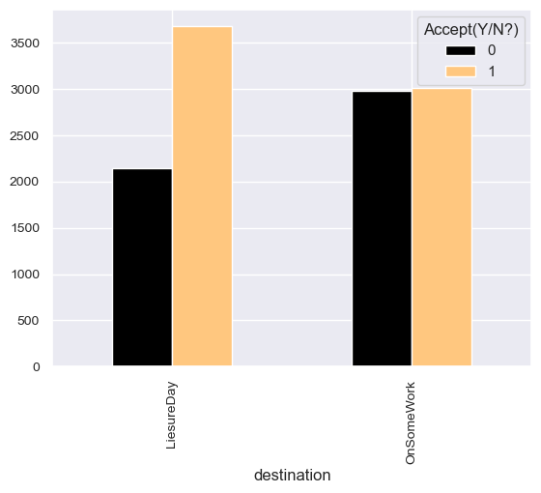
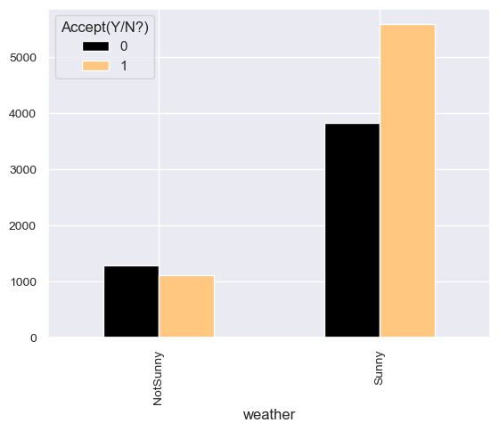
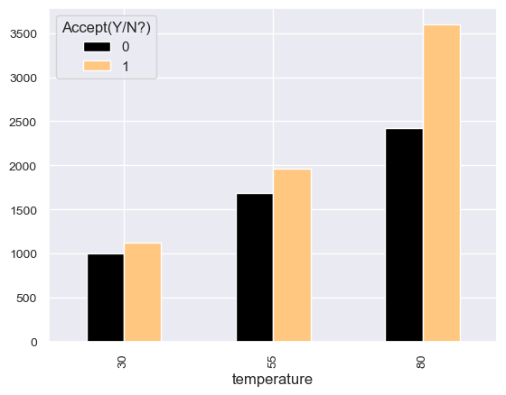
EDA
Key Insights
More people likely to accept coupon when out on a leisure day, compared to while shuttling between work and home
More people likely to accept coupon when “weather” is sunny, compared to Snowy or Rainy
Same can also be verified from temperature column; most coupon accepted when temperature is ~80F

Slide 9
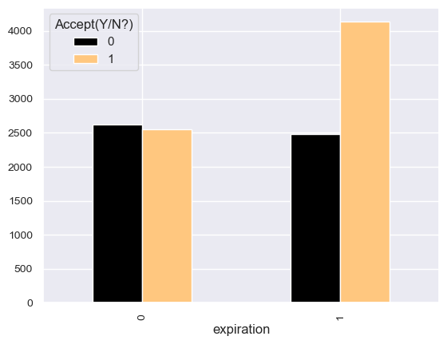
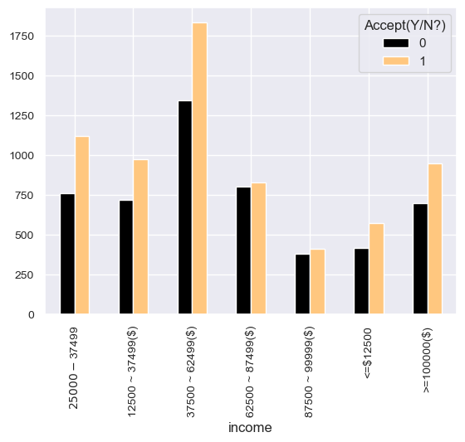
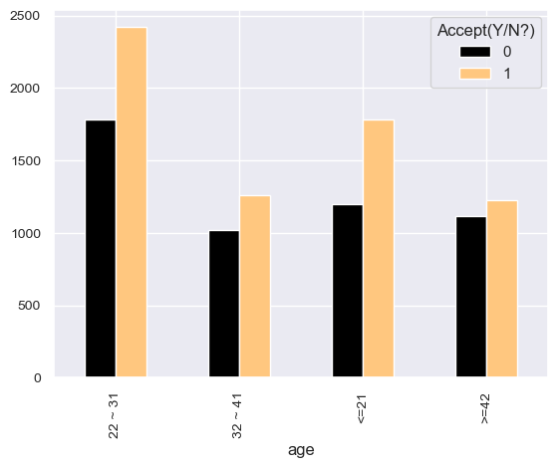
Key Insights
More people likely to accept coupon when the expiry date is 1 day, compared to 2 hour limit
On income distribution ranging from $12500 to $100,000: most coupon accepted by user in range $12500 to $ 62500
Age group 22 ~ 31 most likely to accept the coupon, which can also be verified as the number of users in Undergraduate & Graduate is significantly more compared to postgraduates

Slide 10
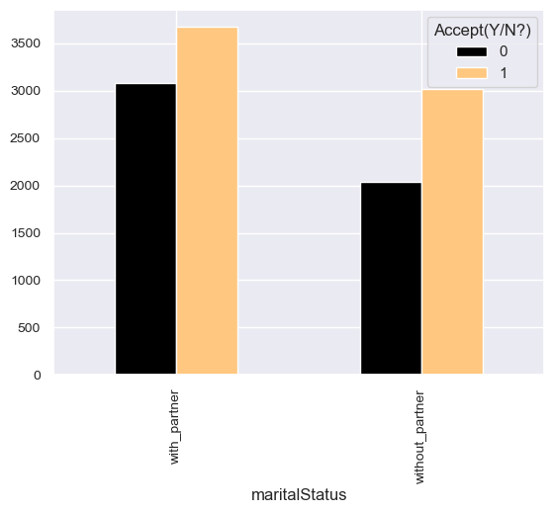
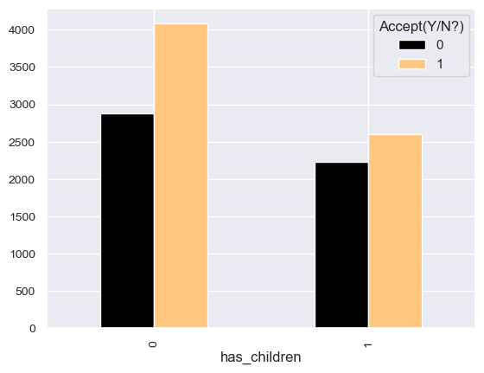
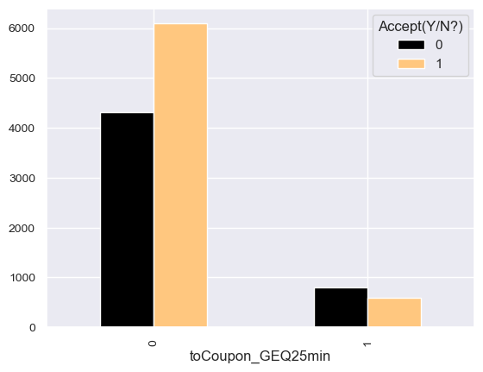
Key Insights
While there is not much difference between the marital status on acceptance of coupon, but the users with child/ren more likely to accept the coupon
User is unlikely to accept coupon when driving distance to the restaurant/cafe/bar for using the coupon is > 25 minutes

Slide 11
Model
Steps in model creation:
1. Hyper-parameter tuning | 2. Model Implementation | 3. Cross Validation | 4. Evaluation Metrices
Models/ Algorithms
1. LogisticRegression | 2.DecisionTree | 3.RandomForest | 4.ExtraTrees | 5.KNearestNeighbors |
6. SupportVectorMachine | 7.GradientBoosting | 8.AdaBoost | 9.XGBclassifer | 10.RidgeClassifier|
Evaluation metrics
1. Accuracy | 2. Confusion Metrics | 3. Classification Report | 4. AUC-ROC Score

Slide 12
Approach
Best model is selected primarily based on :
ROC-AUC Score
Accuracy on test data
Cross validation scores

Slide 13
Best Models
For classification of users on basis of accepting coupons by Mechanical Turks

Slide 14
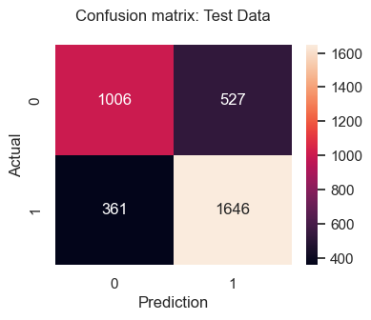
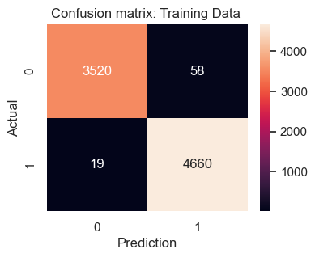
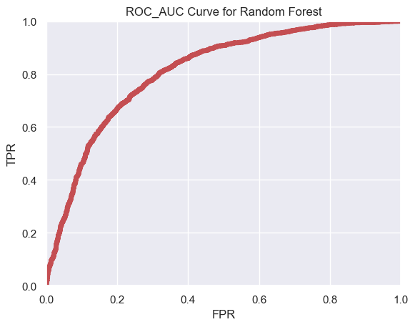
Random Forest Classifier
Accuracy:
Training Data: 0.98
Test Data: 0.74
Cross Validation:
The min accuracy of the model is: 0.64
The mean accuracy of the model is: 0.66
The max accuracy of the model is: 0.67
roc_auc_score – 0.73

Slide 15
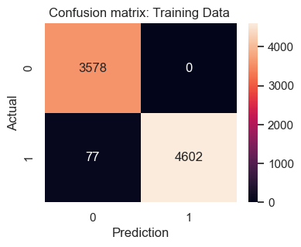


2. ExtraTrees Classifier
Accuracy:
Training Data: 0.98
Test Data: 0.73
Cross Validation:
The min accuracy of the model is: 0.63
The mean accuracy of the model is: 0.65
The max accuracy of the model is: 0.67
roc_auc_score – 0.72

Slide 16
2. AdaBoost Classifier
Accuracy:
Training Data: 0.98
Test Data: 0.73
Cross Validation:
The min accuracy of the model is: 0.65
The mean accuracy of the model is: 0.66
The max accuracy of the model is: 0.67
roc_auc_score – 0.72

Slide 17
Recommendations
Provide coupons mostly on Weekends : More people likely to accept coupon when out on a leisure day, compared to while shuttling between work and home
Summer season can be used to roll out offers and discounts to maximize the acceptance and utilization of coupons: More people likely to accept coupon when “weather” is sunny, compared to Snowy or Rainy. Same can also be verified from temperature column; most coupon accepted when temperature is ~80F
High expiry time of coupon may lead to more conversions: More people likely to accept coupon when the expiry date is 1 day, compared to 2 hour limit
Promotional activities at Schools/Colleges/TechParks/Social Circuits where gathering of Young masses may lead to more number of conversions: On income distribution ranging from $12500 to $100,000: most coupon accepted by user in range $12500 to $ 62500.
Age group 22 ~ 31 most likely to accept the coupon, which can also be verified as the number of users in Undergraduate & Graduate is significantly more compared to postgraduates
Coupons should be provided for Bar/CoffeeHouse/Restaurants which are less than 25mins travel: User is unlikely to accept coupon when driving distance to the restaurant/cafe/bar for using the coupon is > 25 minutes

Slide 18
Thank You !

