Slide 1
IBM University Engagement Project Submission
“Exploring the Power of Agentic AI with IBM Granite and IBM Bob”

Slide 2

Project Tile – AI Agent for Smart Farming Advice
Domain of Project – Agriculture
Student Name | Recent Passport Photo | Email ID | Mobile number [WhatsApp]
Akash Debbarma |  | akashdebbarma.cse@gmail.com | +91 6009636806

Slide 3
Problem Statement -
Problem Statement :AI Agent for Smart Farming Advice
The Challenge – An AI Agent for Smart Farming Advice, powered by RAG (Retrieval-Augmented Generation), supports small-scale farmers by delivering real-time, localized agricultural guidance. It retrieves trusted data on weather forecasts, soil conditions, crop recommendations, pest control measures, and current market prices from agricultural departments, meteorological sources, and agritech platforms. Farmers can interact in their local language and ask questions like “What crop is best for this season?” or “What is today’s mandi rate for tomatoes?” The agent ensures timely, data-driven decisions that reduce risk, increase yield, and boost income. This AI-driven assistant bridges the knowledge gap and brings smart farming to the grassroots.
Technology – Use of IBM Cloud Lite services / IBM Granite is mandatory.

Slide 4
Proposed Solution -
KrishiMitra AI — AI-Powered Smart Farming Assistant
KrishiMitra AI is a RAG-based Agentic AI solution designed to provide small-scale farmers with reliable, localized, and actionable agricultural guidance.
Core Solution
1. Intelligent Farmer Interaction The farmer enters a question related to crop selection, weather, soil, pest management, or market prices using natural language.
2. Retrieval-Augmented Generation (RAG) The system retrieves relevant information from trusted agricultural knowledge sources before generating an answer. This improves the relevance and reliability of the response.
3. IBM Granite for AI Reasoning IBM Granite processes the retrieved information, understands the farmer's question, and generates a clear, context-aware recommendation.
4. IBM Bob Agent Orchestration IBM Bob is used to design and orchestrate the agent workflow, connecting the different stages of retrieval, processing, and response generation.
5. Actionable Farming Advice The final response helps farmers make informed decisions regarding:
Crop selection and seasonal planning
Weather-based farming decisions
Soil and crop requirements
Pest and disease management
Agricultural market and mandi information
Expected Impact
Trusted Agricultural Data → RAG Retrieval → IBM Granite → Agentic Processing → Smart Farming Recommendation
Goal: Reduce decision-making risks, improve productivity, and help farmers make better data-driven farming decisions.

Slide 5
Technology Used
IBM Bob Used to visually design and orchestrate the Agentic AI workflow, connecting the different components of the smart farming solution.
IBM Granite Used as the core generative AI model for understanding farmer queries, reasoning over retrieved information, and generating relevant farming recommendations.
IBM Cloud Provides the cloud environment and infrastructure required to build, run, and deploy the AI-powered farming solution.
Retrieval-Augmented Generation (RAG) Retrieves relevant agricultural information from the knowledge base before generating an answer, helping the agent provide more reliable and context-aware responses.
Vector Database Stores embedded agricultural knowledge and enables semantic retrieval of information relevant to a farmer's query.
Agentic AI Enables the system to perform multiple intelligent steps such as understanding the query, retrieving information, processing the context, and generating a final recommendation.

Slide 6
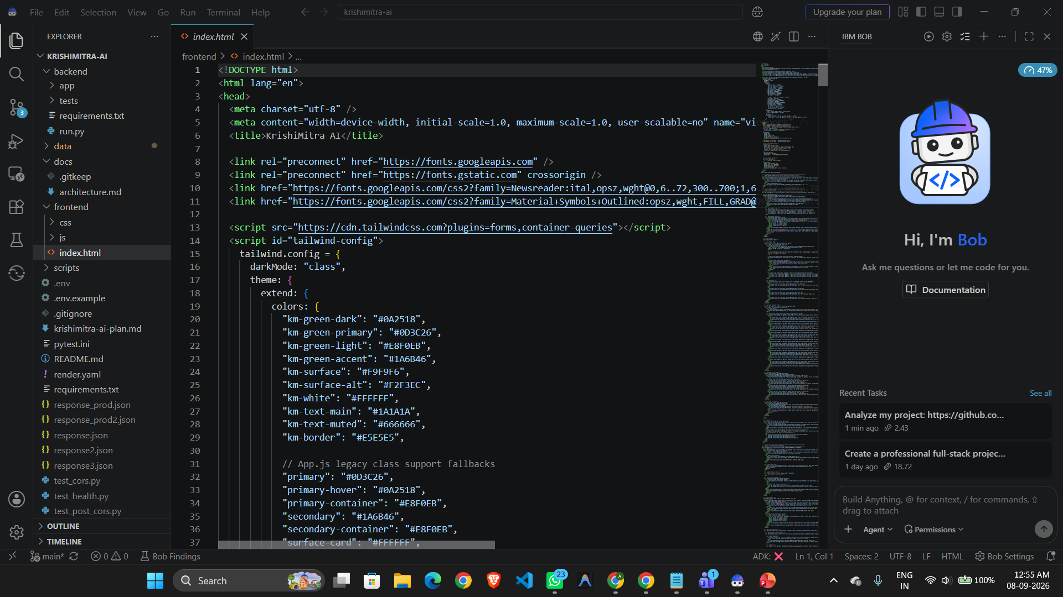
Required Files created using IBM bob -

Slide 7
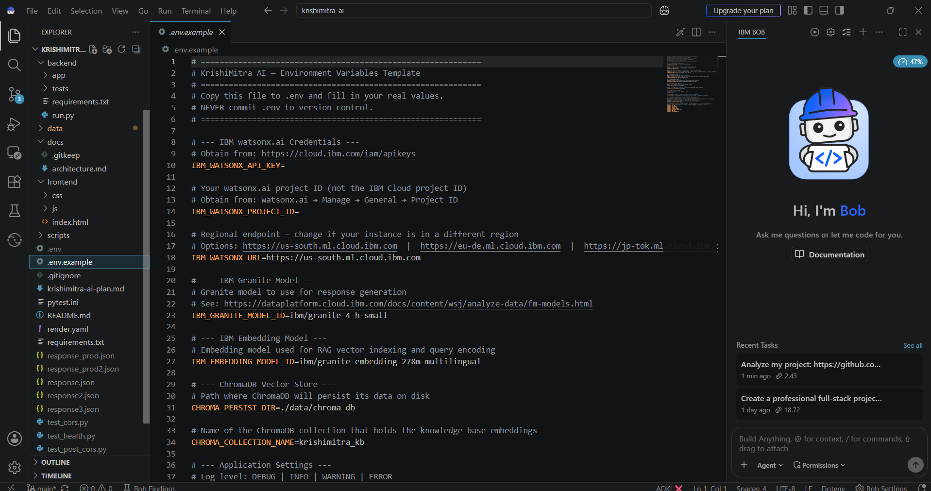
IBM Bob Screenshots:

Slide 8
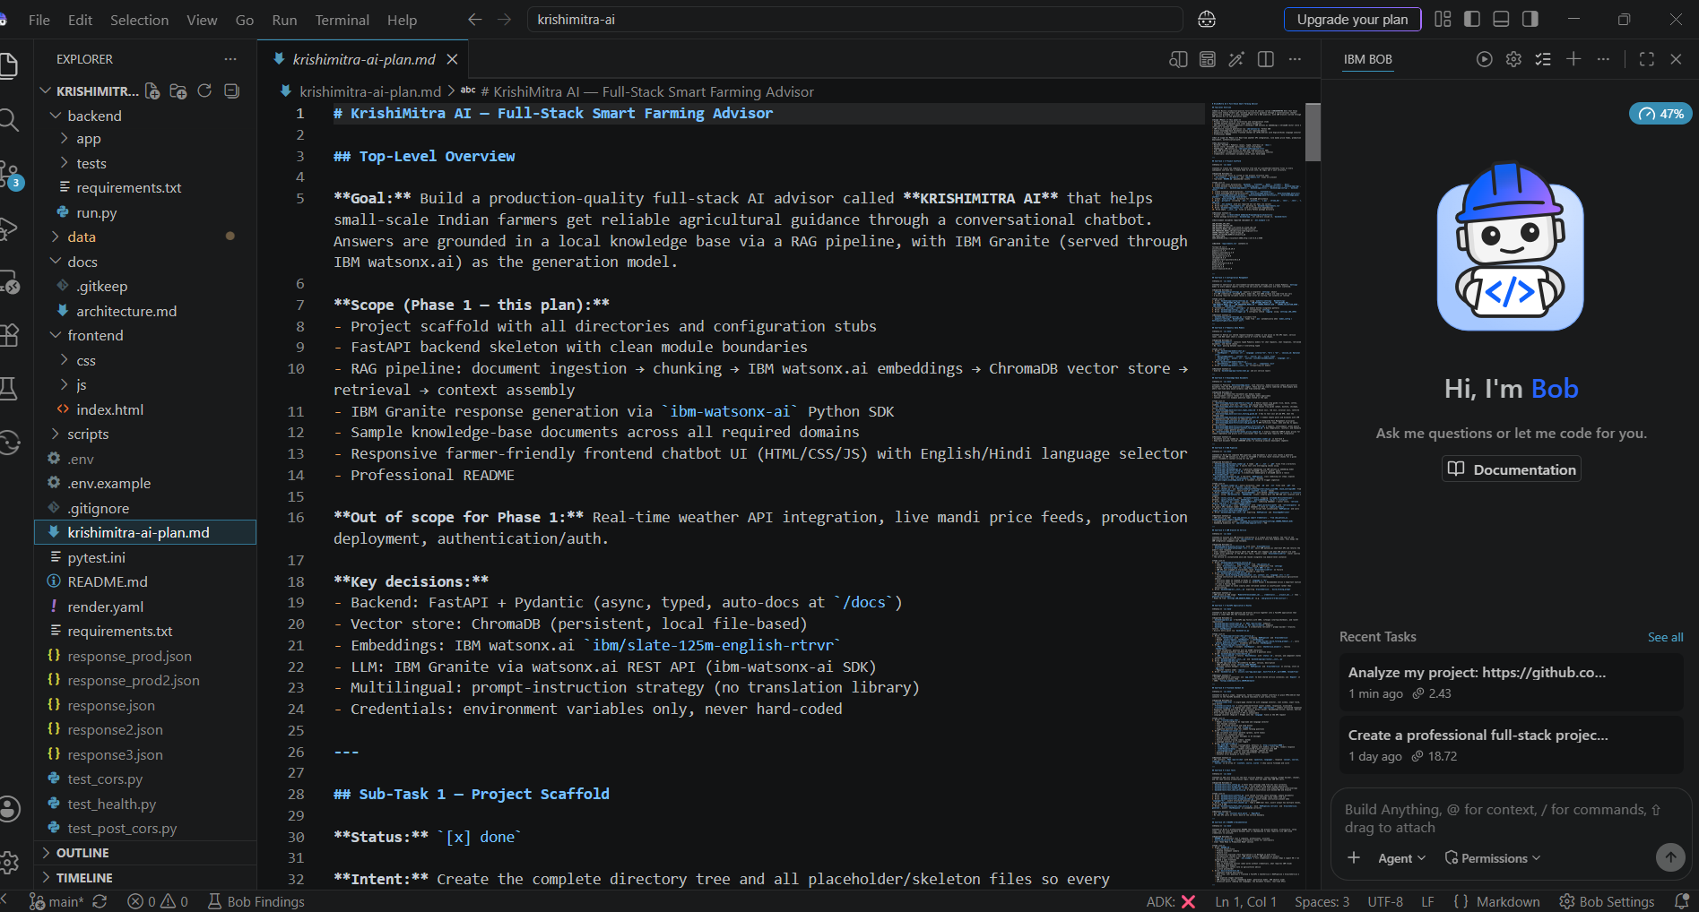

Slide 9
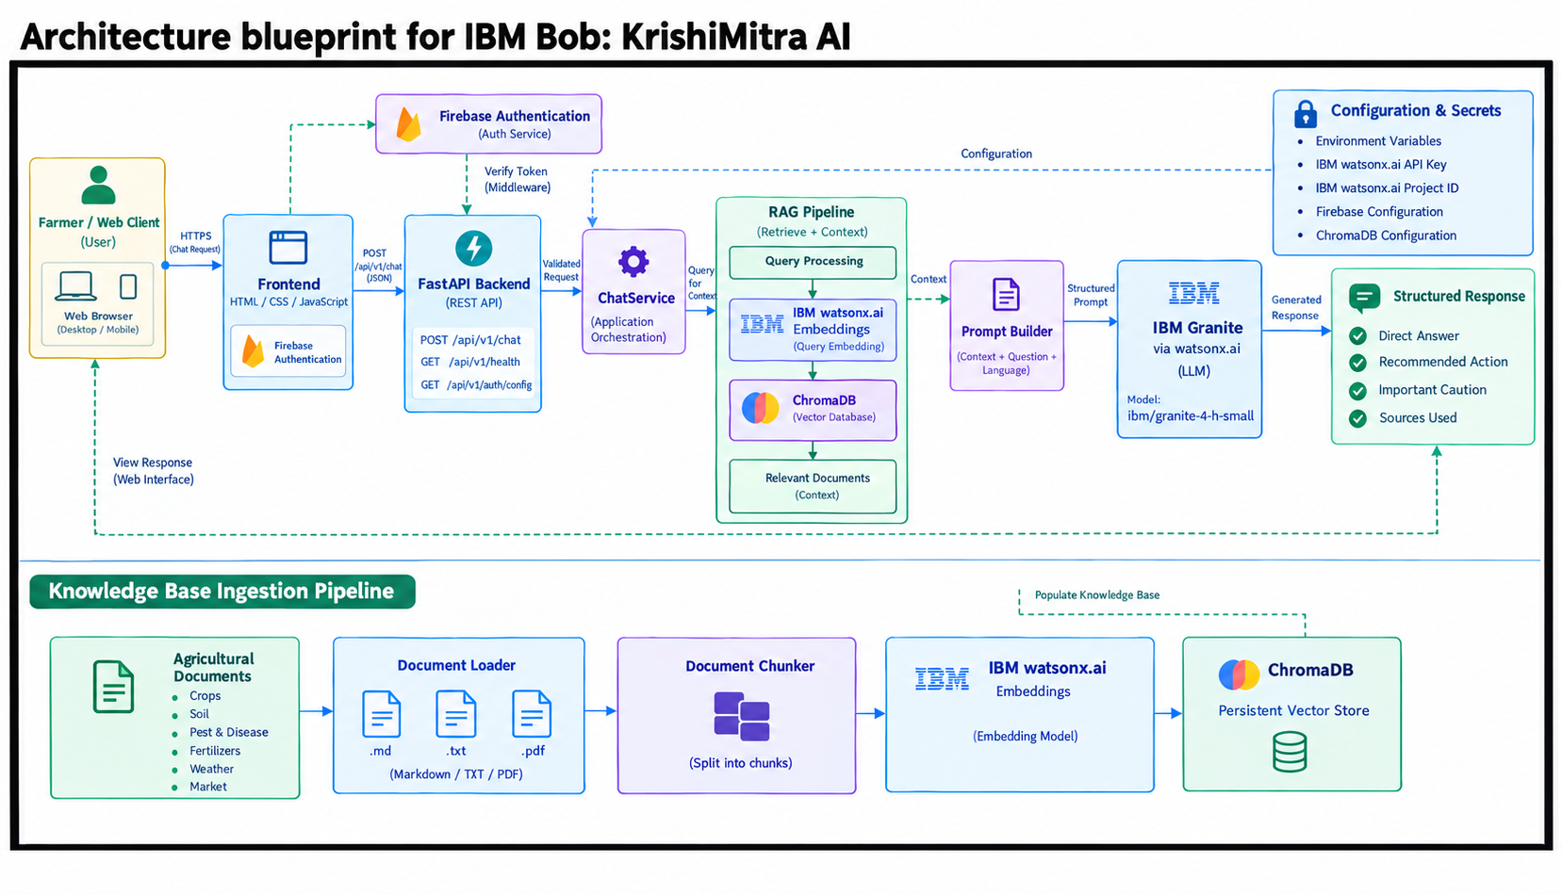
Architecture blueprint for IBM bob:

Slide 10
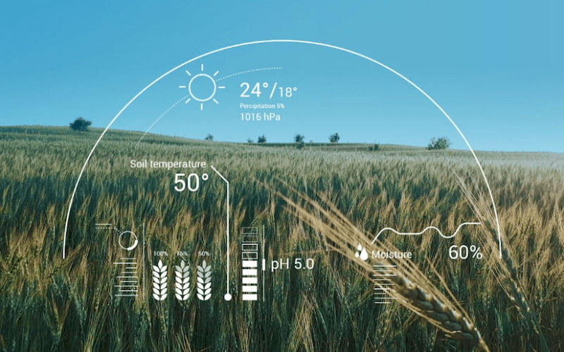
Role of Agentic AI in the solution
Agentic AI enables KrishiMitra AI to work as an intelligent, goal-oriented farming assistant rather than a simple question-and-answer chatbot.
Key Roles
1. Query Understanding The agent understands the farmer's question and identifies the type of agricultural information required.
2. Intelligent Information Retrieval The agent retrieves relevant information from the available agricultural knowledge base using the RAG approach.
3. Context-Aware Reasoning IBM Granite analyzes the farmer's query together with the retrieved information to generate a relevant response.
4. Multi-Step Decision Making The agent can coordinate multiple steps such as understanding the query, retrieving information, processing context, and generating advice.
5. Personalized Recommendations Based on the available context, the system can provide more relevant recommendations for crop selection, weather-related decisions, pest management, and other farming needs.
6. Autonomous Workflow Orchestration IBM Bob helps orchestrate the agent workflow so that different components work together efficiently.

Slide 11
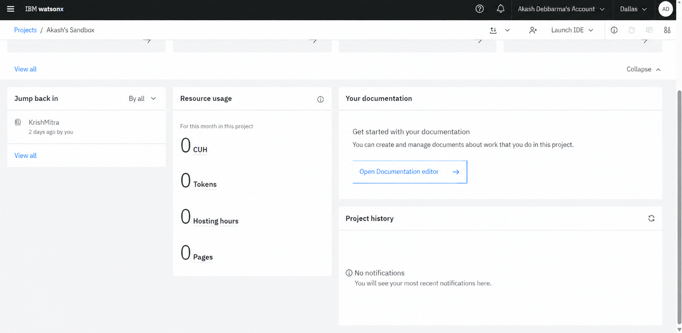
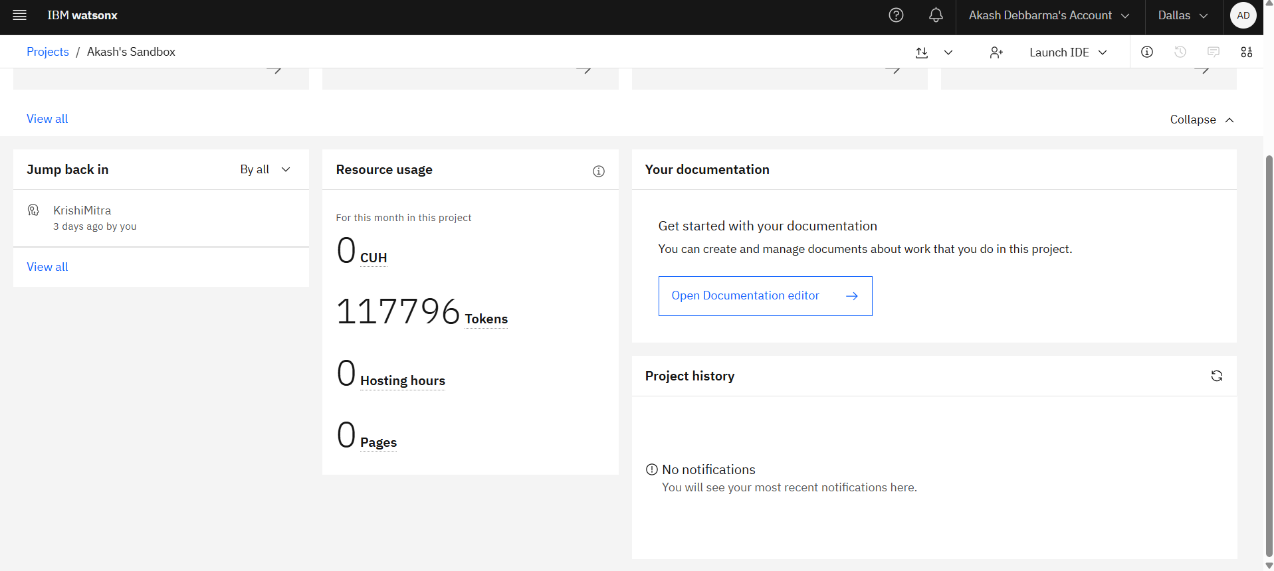
Token Usage
Before Prompt
After the Prompt
·
·
·

Slide 12
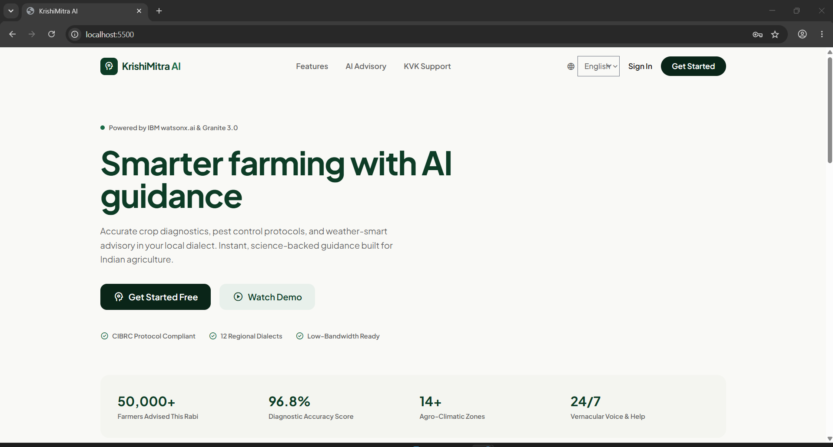
Project Output Screenshot
·
·
·

Slide 13
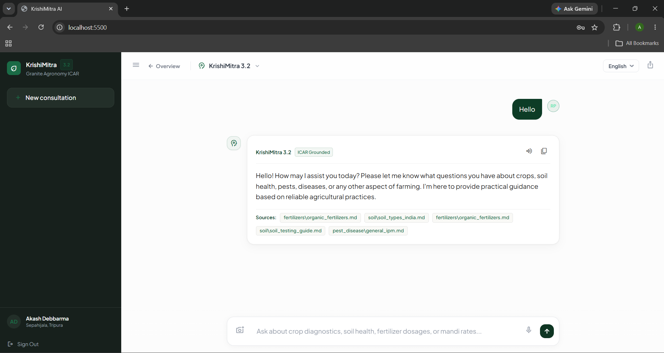
Project Output Screenshot
Please put IBM Bob output screenshots with 2-3 prompts.
You can take 2-3 more slides for each screenshot
·
·
·

Slide 14
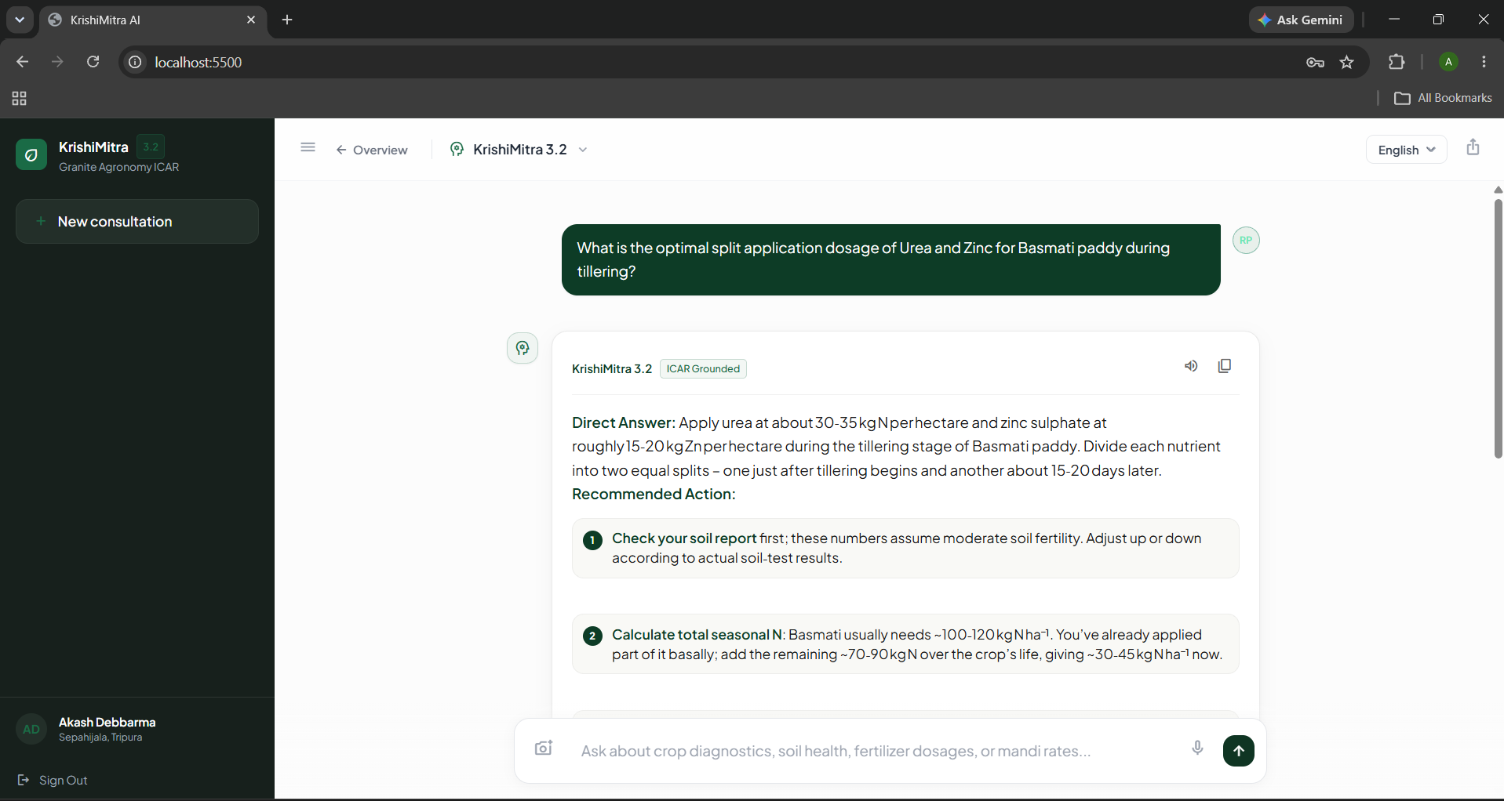
Project Output Screenshot
·
·
·

Slide 15
Novelty and Uniqueness
What Makes KrishiMitra AI Different:
1. RAG-Based Agricultural Intelligence Uses Retrieval-Augmented Generation to retrieve relevant agricultural information before generating responses, improving the reliability of farming advice.
2. Agentic AI Workflow Goes beyond a basic chatbot by using an intelligent workflow to understand queries, retrieve information, process context, and generate recommendations.
3. IBM Granite-Powered Reasoning Uses IBM Granite to understand natural-language farmer queries and generate context-aware agricultural guidance.
4. Localized Farming Support Designed to provide practical guidance relevant to the farmer's season, crop, location, and farming requirements.
5. Multi-Domain Agricultural Guidance
Brings multiple farming needs into one assistant, including:
Crop and seasonal recommendations
Weather-related guidance
Soil and crop information
Pest and disease management
Market and mandi information
6. Trusted Information Retrieval The RAG approach helps ground AI responses in retrieved agricultural knowledge instead of relying only on the model's internal knowledge.

Slide 16
Git Hub Link
Please create public github repository (Enable Add README button while creating repository) with format –
Please test and Paste the working Github URL – https://github.com/akashdebbarma06/AI-Agent-for-Smart-Farming
Make sure you have Uploaded following three files into your github repository 1) All Agent relevant files of IBM Cloud , 2) yourproblemstatement.pdf file 3) your projectpresntation.pptx file 4)any other files
·
·
·

Slide 17
Future Scope
Future Enhancements of KrishiMitra AI
1. Real-Time Weather Integration Integrate live weather APIs to provide location-based forecasts, rainfall alerts, temperature updates, and weather-based farming recommendations.
2. Live Mandi Price Integration Connect with agricultural market data sources to provide updated crop prices and help farmers make better selling decisions.
3. Multilingual Voice Assistant Add regional language and voice support so farmers can interact with the system naturally without depending on English or text-based input.
4. Soil and Crop Monitoring Integrate soil sensors and IoT devices to collect real-time information such as soil moisture, temperature, and nutrient conditions.
5. Image-Based Crop Disease Detection Enable farmers to upload crop images and use AI-based computer vision to identify possible diseases, pests, and crop damage.
6. Personalized Farm Recommendations Improve personalization using information such as location, crop type, soil condition, season, and previous farming activities.
7. Mobile Application Develop an Android/mobile application to make KrishiMitra AI accessible to farmers in rural and low-connectivity areas.
·
·
·

Slide 18
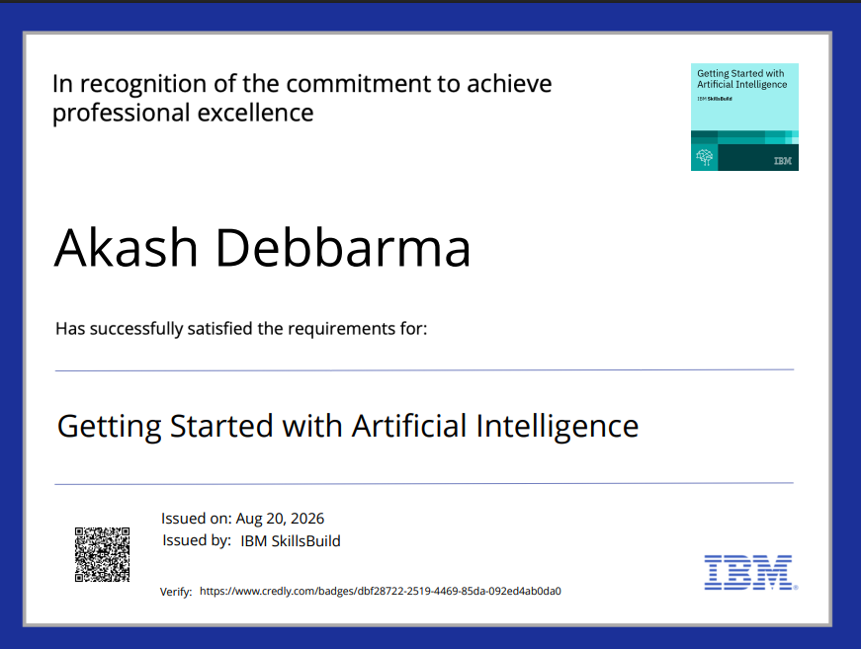
Certificates Earned:
Please add your credly certificate(Getting Started with Artificial Intelligence)

Slide 19
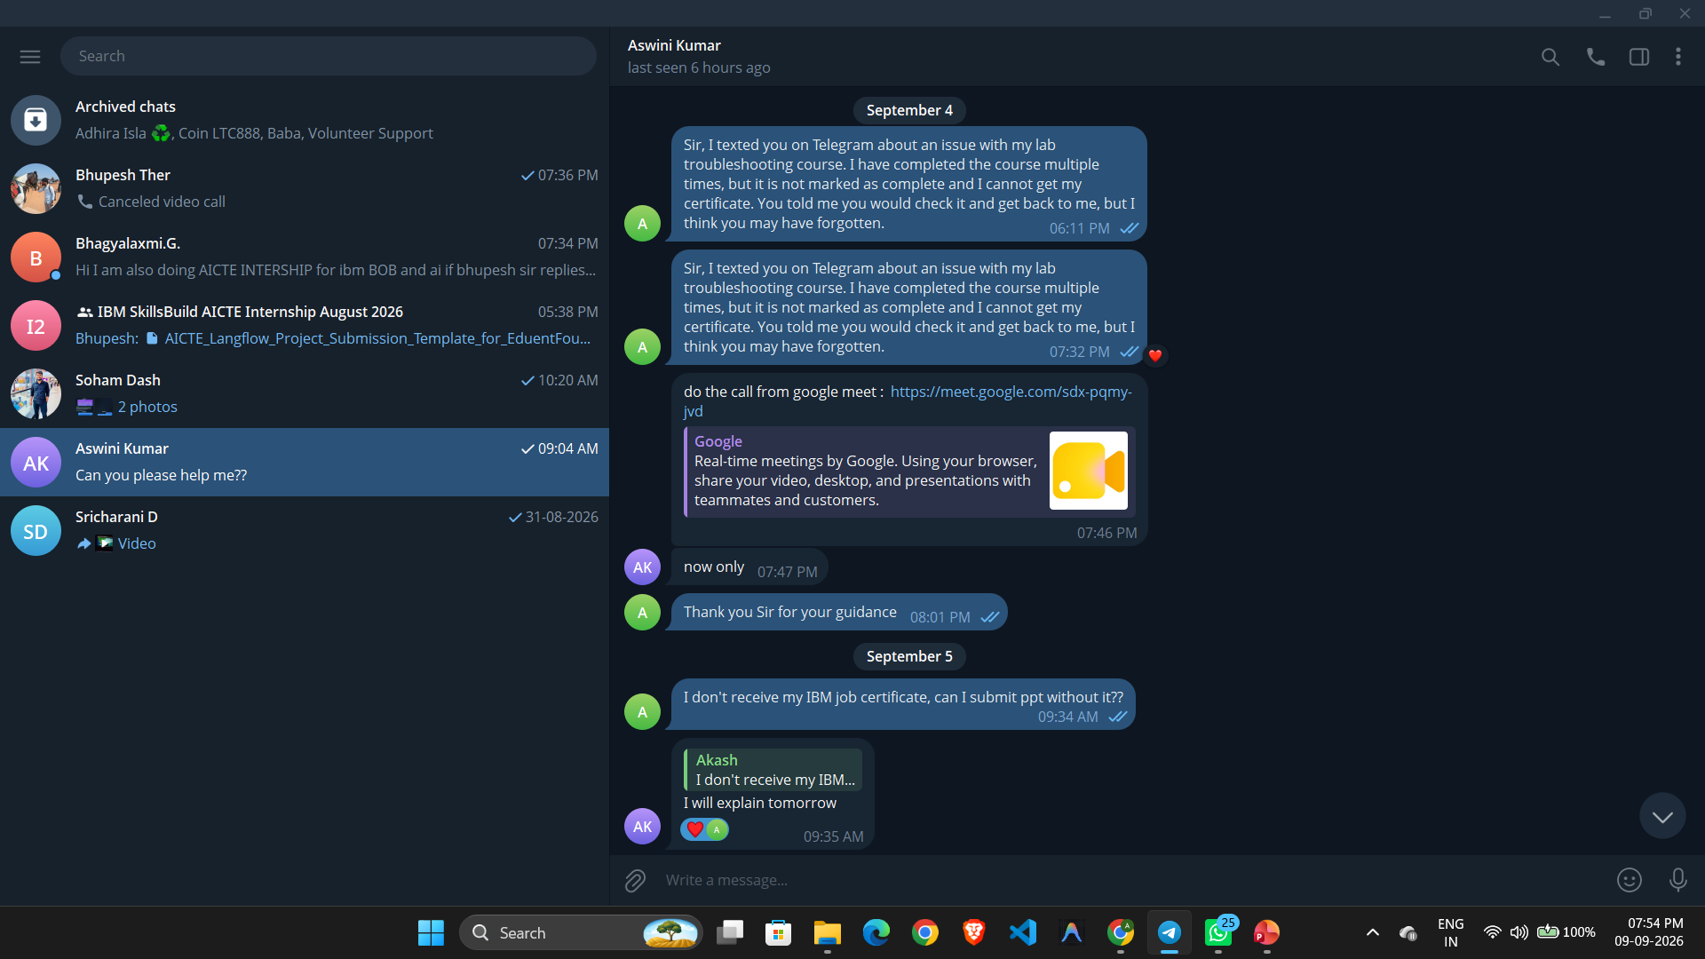
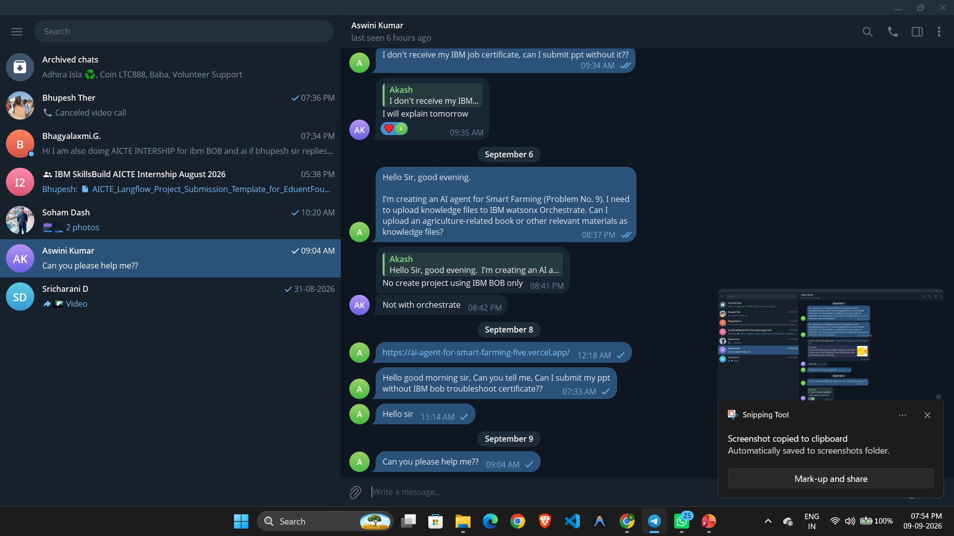
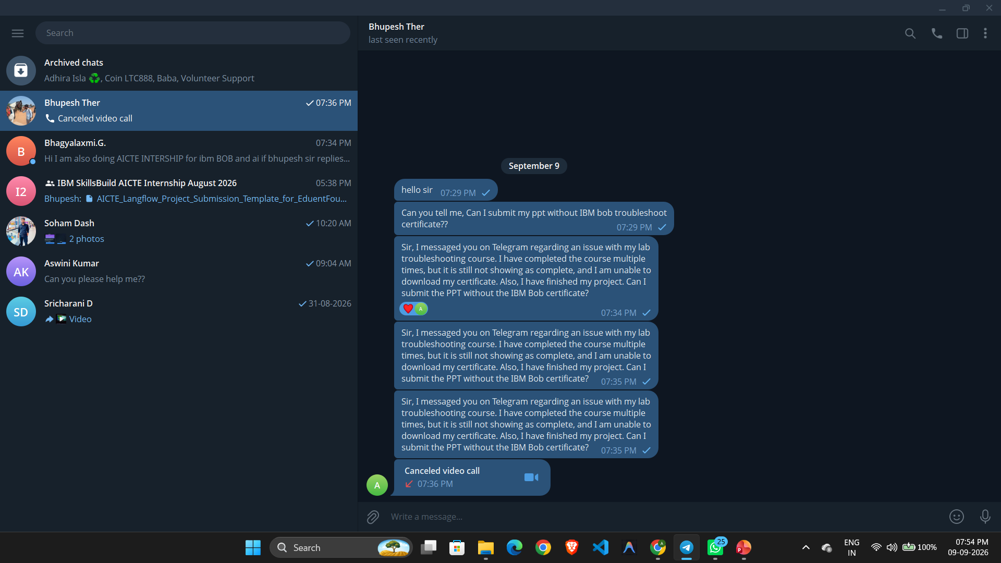
Certificates Earned:​
Add your IBM BOB Certificate

Slide 20


